Slide 1
Kernels: Part I
CS 61: Lecture 9 10/11/2023

Slide 2
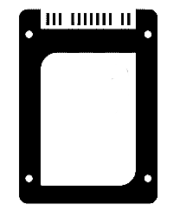
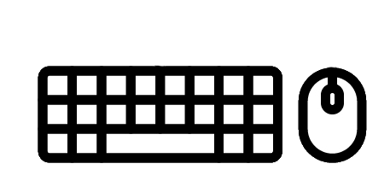
System Calls
OSes enforce process isolation: a process is restricted to performing computation that reads and writes the process’s own registers and memory
However, a process will often want to interact with the outside world
Ex: Read or write file data
Ex: Send or receive network messages
Ex: Receive user input
Ex: Send or receive a message involving another process
Ex: Create a new process
To interact with the external world, a user-level process invokes a system call
User-level process X
User-level process Y
User-level process Z
Operating system
(Kernel-level code)
MMU
MMU
MMU
MMU
Hardware
RAM
SSD
UX devices
Network

Slide 3
System Calls
A system call requests the OS to perform an action on behalf of the process
From the perspective of a user-mode process, a system call looks similar to a normal function call
The process saves caller-saved registers
The process hands arguments to the OS via registers and invokes syscall (not call)
The OS hands a return value back to the process
However, unlike a normal function, the caller’s code and the callee’s code live in a different protection domain!
The OS has full control over all hardware resources on a machine and, e.g., can access all memory
A user-mode process can only access its own registers and memory
User-level process X
User-level process Y
User-level process Z
Operating system
(Kernel-level code)
MMU
MMU
MMU
MMU
Hardware
RAM
SSD
UX devices
Network

Slide 4
System Calls
At any given time, only one thing (the kernel or a user-level process) executes on a CPU!
A system call requests the OS to perform an action on behalf of the process
From the perspective of a user-mode process, a system call looks similar to a normal function call
The process saves caller-saved registers
The process hands arguments to the OS via registers and invokes syscall (not call)
The OS hands a return value back to the process
However, unlike a normal function, the caller’s code and the callee’s code live in a different protection domain!
The OS has full control over all hardware resources on a machine and, e.g., can access all memory
A user-mode process can only access its own registers and memory
(2) The kernel does some work to handle the system call, and decides to run a different user-level process on the CPU.
(4) The kernel makes a scheduling decision to run another user-level process.
(3) The user-level process has an infinite loop! The hardware timer eventually fires and puts the kernel on the CPU.
(1) A user-level process executes and then invokes a system call, giving up the CPU so that the kernel can run.
(1)
timer interrupt
(2)
(3)
(4)
syscall
schedule
schedule
Flow of time from the perspective of the leftmost CPU
MMU
MMU
MMU
MMU
Hardware
RAM
SSD
UX devices
Network

Slide 5
CPU Modes
In privileged mode, the CPU can execute any kind of instruction, including privileged instructions that manipulate CPU configuration registers or other otherwise control low-level CPU behavior
In unprivileged mode, the CPU cannot execute privileged instructions
User-level processes run in unprivileged mode
The kernel runs in privileged mode
A system call flips the CPU mode to “privileged” before the kernel code starts executing!
When the kernel does a context switch back to user-level code, the CPU mode flips to “unprivileged”
Unprivileged
Privileged
Unprivileged
Privileged
Unprivileged
(1)
timer interrupt
(2)
(3)
(4)
syscall
schedule
schedule
Flow of time from the perspective of the leftmost CPU
MMU
MMU
MMU
MMU
Hardware
RAM
SSD
UX devices
Network
Notes:
[As we’ll see later, x86 CPUs really have four privilege levels (or “rings” in x86 parlance: 0—3, with ring 0 being the highest privilege and ring 3 being the lowest privilege). However, popular OSes only use rings 0 and 3 for kernel code and user code, respectively, with rings 1 and 2 being unused.]

Slide 6
Handling A System Call
Part I: Invoking the Kernel’s System Call Handler
Part II: Completing the Context Switch
Part III: Executing Kernel Code
Part IV: Returning to User-mode

Slide 7
Part I: Invoking the Kernel’s System Call Handler
The syscall instruction (invoked by user code) does several things
It saves the address of the instruction after syscall in %rcx
Then, it sets %rip to the value stored in the model-specific-register %IA32_LSTAR
Next, syscall stores the old %rflags value in %r11
x86 chips use MSRs to configure low-level hardware behavior
MSRs are accessed via the privileged instructions rdmsr and wrmsr
void init_cpu_hardware() { //In k-hardware.cc
//...Some stuff, then...
wrmsr(MSR_IA32_LSTAR, reinterpret_cast<uint64_t>(syscall_entry));
//syscall_entry refers to assembly code in weensyos64lab/k-exception.S
//that eventually calls syscall(regstate* reg).
wrmsr(MSR_IA32_FMASK, EFLAGS_IF | /*other flags*/); //Has the effect
//of forcing the syscall instruction to disable interrupts!
Notes:
[`reinterpret_cast` is used in C++ to cast between integers and pointers, different kinds of integers, or different kinds of pointers. See https://learn.microsoft.com/en-us/cpp/cpp/reinterpret-cast-operator?view=msvc-170 for a gentle introduction, or https://en.cppreference.com/w/cpp/language/reinterpret_cast for the gory details.]
[Ref: https://www.felixcloutier.com/x86/syscall
https://wiki.osdev.org/Model_Specific_Registers
https://lwn.net/Articles/604287/
Section 3.4.3 of “Intel 64 and IA-32 Architectures Software Developer’s Manual (Volume 1)”: https://www.intel.com/content/dam/www/public/us/en/documents/manuals/64-ia-32-architectures-software-developer-vol-1-manual.pdf]

Slide 8
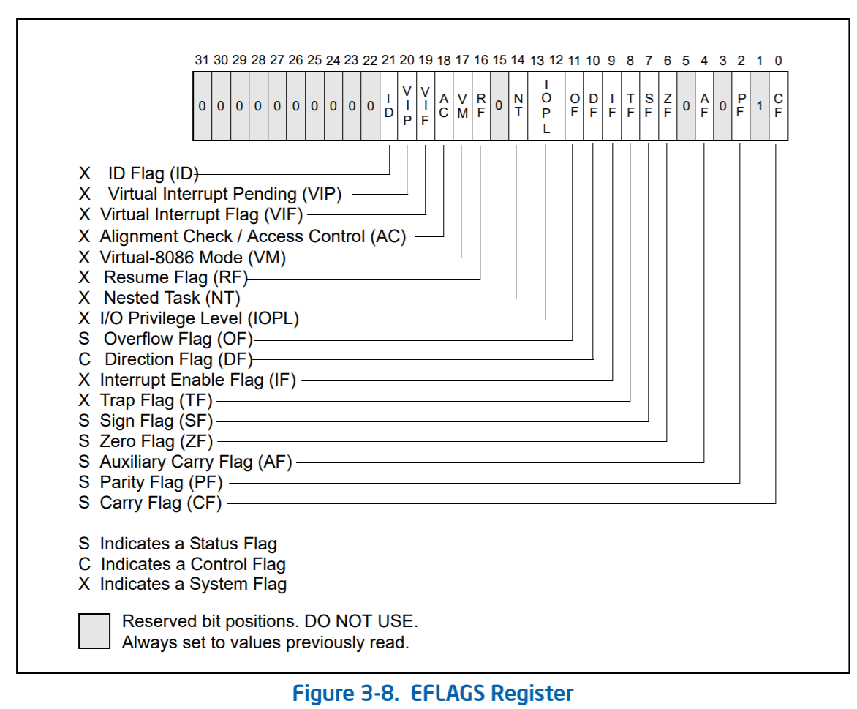
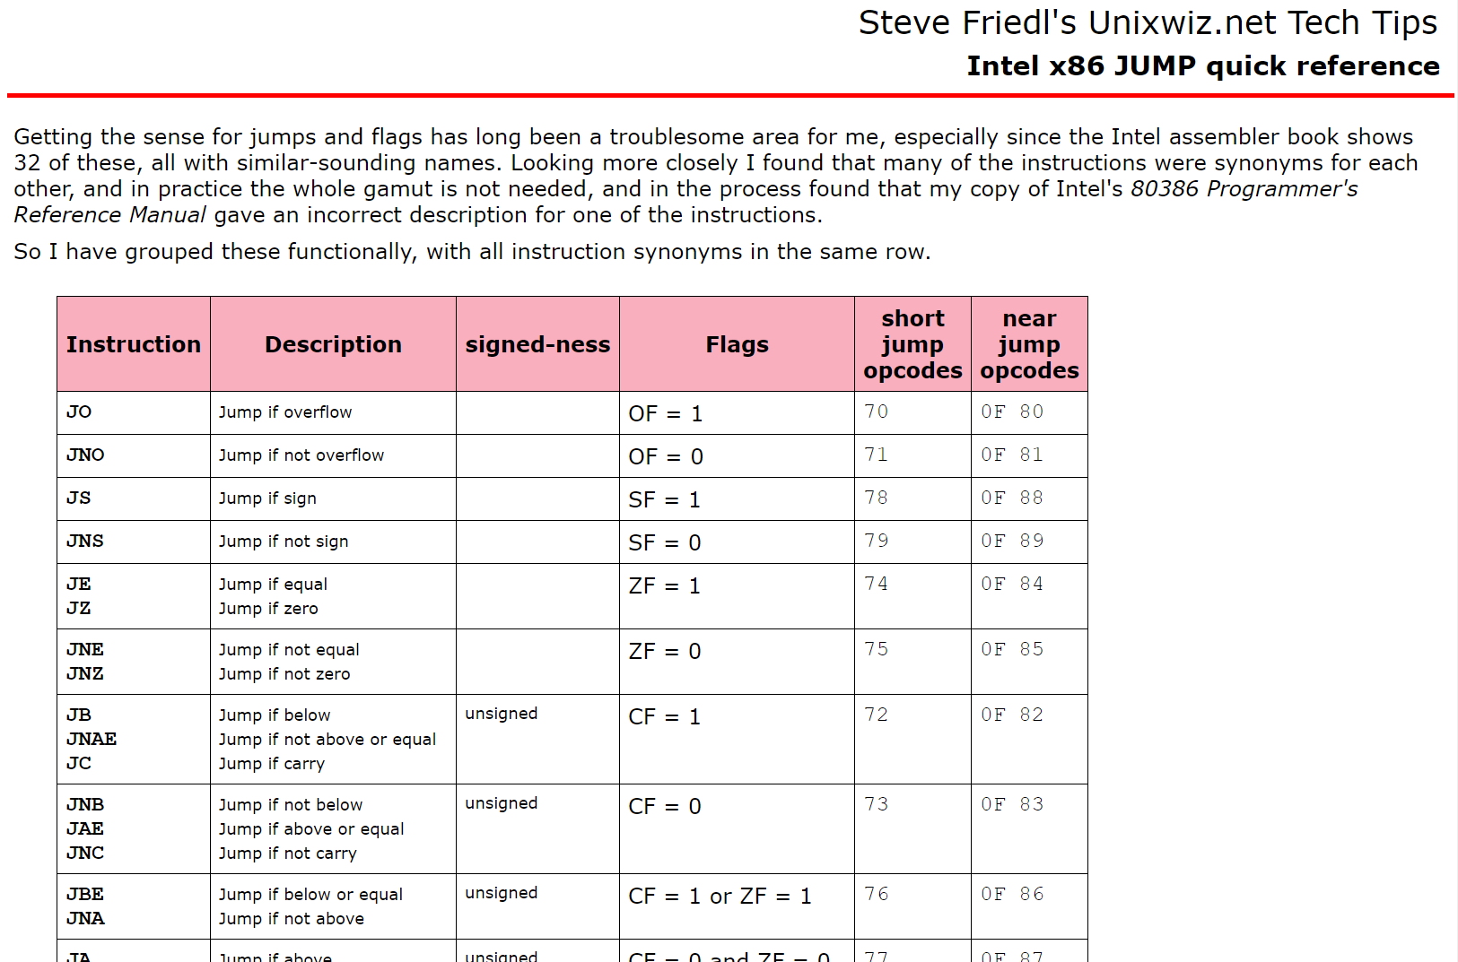
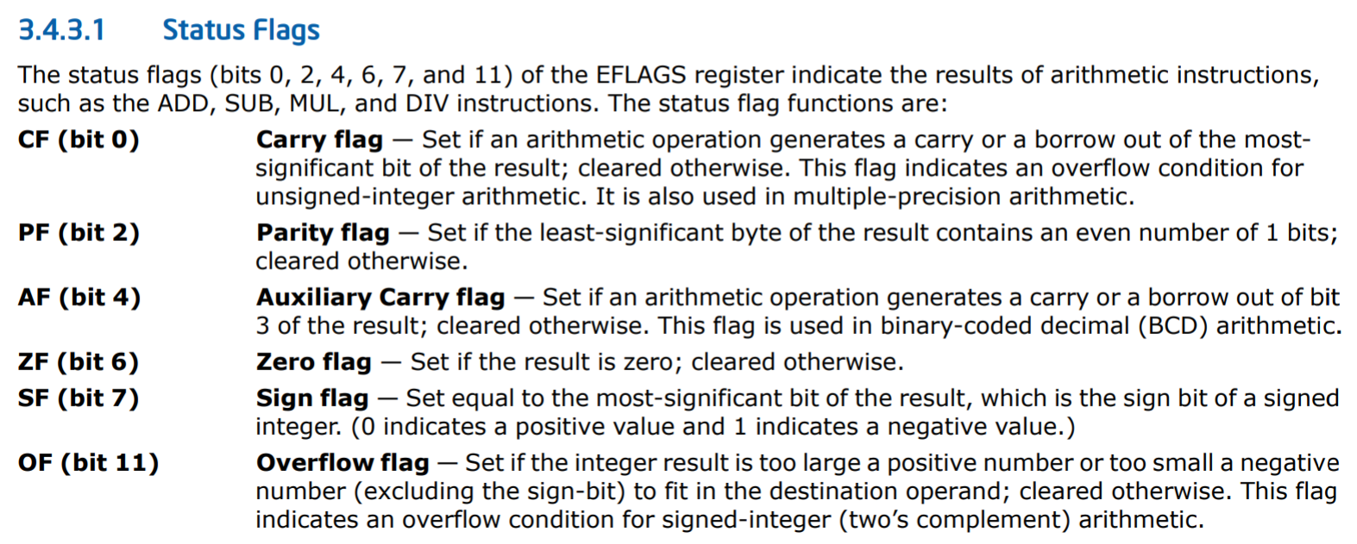
Notes:
[Note that %rflags is just the x86-64 version of the x86-32 %eflags register--%rflags has equivalent bit offsets as %eflags. As Intel’s manual states, “the upper 32 bits of RFLAGS register is reserved. The lower 32 bits of RFLAGS is the same as EFLAGS.”]
[The TF (trap flag) bit is what debuggers like gdb use to single-step through a program. If the TF bit is set, then the CPU will raise a debugging interrupt after executing a single instruction. The OS can then inform the debugger, who can examine the suspended program whose instruction caused the debugging interrupt.]
[Ref: https://www.intel.com/content/dam/www/public/us/en/documents/manuals/64-ia-32-architectures-software-developer-vol-1-manual.pdf
http://www.unixwiz.net/techtips/x86-jumps.html]

Slide 9
Part I: Invoking the Kernel’s System Call Handler
The syscall instruction (invoked by user code) does several things
It saves the address of the instruction after syscall in %rcx
Then, it sets %rip to the value stored in the model-specific-register %IA32_LSTAR
Next, syscall stores the old %rflags value in %r11
syscall then clears the bits in %rflags that are set to 1 in the %IA32_FMASK MSR
The CPU’s privilege level is set to 0 (i.e., supervisor-mode)
The kernel’s syscall handler assumes that user code:
Put the system call number in %rax
Passed arguments via %rdi, %rsi, %rdx, %r10, %r8, and %r9
Saved caller-saved registers if necessary
void init_cpu_hardware() { //In k-hardware.cc
//...Some stuff, then...
wrmsr(MSR_IA32_LSTAR, reinterpret_cast<uint64_t>(syscall_entry));
//syscall_entry refers to assembly code in weensyos64lab/k-exception.S
//that eventually calls syscall(regstate* reg).
wrmsr(MSR_IA32_FMASK, EFLAGS_IF | /*other flags*/); //Has the effect
//of forcing the syscall instruction to disable interrupts!
The current privilege level is stored in the lower two bits of the special-purpose %cs register
Notes:
[Note that the System V ABI passes function arguments via these registers:
%rdi, %rsi, %rdx, %rcx, %r8, %r9
However, the syscall instruction clobbers %rcx (to store the address of the instruction after the syscall instruction) and %rll (to save the old %rflags value)! So, user code passes system call arguments using these registers:
%rdi, %rsi, %rdx, %r10, %r8, %r9
In other words, relative to the standard System V calling convention, a syscall invoker passes arguments via %r10 instead of the clobbered %rcx.]
[Ref: https://www.felixcloutier.com/x86/syscall
https://wiki.osdev.org/Model_Specific_Registers
https://lwn.net/Articles/604287/
https://blog.packagecloud.io/eng/2016/04/05/the-definitive-guide-to-linux-system-calls/#64-bit-fast-system-calls //Although note that, in the latest version of the kernel, the location of the entry point has been moved—it’s now in arch/x86/entry/entry_64.S, not arch/x86/kernel/entry_64.S as it was at the time of the blog post. To look at the entry point assembly in the Linux v5.5 kernel (which is the most recent version at the time that these slides were created), see here: https://github.com/torvalds/linux/blob/c79f46a282390e0f5b306007bf7b11a46d529538/arch/x86/entry/entry_64.S#L107
Section 3.4.3 of “Intel 64 and IA-32 Architectures Software Developer’s Manual (Volume 1)”: https://software.intel.com/sites/default/files/managed/a4/60/253665-sdm-vol-1.pdf]

Slide 10
Handling A System Call
Part I: Invoking the Kernel’s System Call Handler
Part II: Completing the Context Switch
Part III: Executing Kernel Code
Part IV: Returning to User-mode

Slide 11
After the syscall instruction finishes . . .
The privilege bit is set to “supervisor mode”
Interrupts are off
The first instruction of the kernel’s syscall handler is about to execute
OH GOD, THE ADDRESS SPACE HASN’T CHANGED TO THE KERNEL’S ADDRESS SPACE
This is ok! The kernel is mapped into the address space of every process.

Slide 12
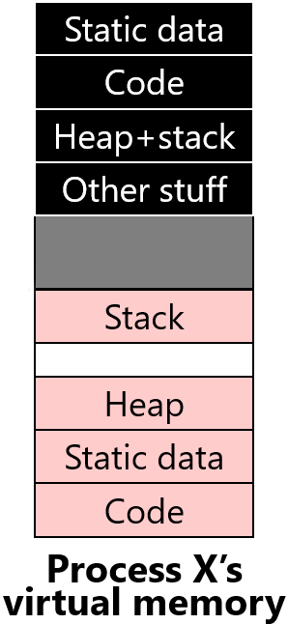
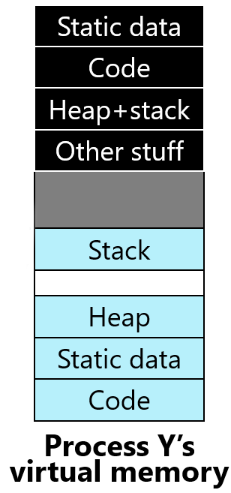
Kernel Memory
Static data
Static data
In modern OSes, the kernel resides in the address space of every process!
Ignoring some details, each address space has:
A series of unique memory regions that belong to a specific user-level process
A series of kernel memory regions that are mapped into each user-level process
Using virtual memory (to be discussed in more detail in the next lectures!):
The memory locations visible to assembly instructions (e.g., mov $0x42, -0x8(%rbp)) are virtual addresses
The MMU (configured via an OS-controlled page table) decides how to translate a virtual address to a physical address
Code
Code
Heap+stack
Heap+stack
Other stuff
Other stuff
Kernel memory
Kernel memory
User memory
Stack
User memory
Stack
Heap
Heap
Static data
Static data
Code
Code
Process X’s
virtual memory
Process Y’s
virtual memory
Physical RAM
Notes:
Commercial OSes like Linux, Windows, and macOS place the kernel at the top of the address space. As you’ll see in pset3, WeensyOS (the CS 61 teaching OS) places itself at the *bottom* of the address space.
[Aside: As described by CS 161 course notes (https://read.seas.harvard.edu/cs161/2022/doc/memory-layout/), “Some kernel code and data, including the code used to initialize secondary cores and data structures used to initialize processor descriptor tables, must live in the low portion of physical memory (below physical address 0x10000). This is because of hardware constraints. Chickadee [which is the CS 161 teaching OS] links this data starting at physical address 0x4000 (above the boot loader’s memory), but only addresses 0x4000–0x4FFF are loaded by the boot loader; the rest of it is initialized by the kernel itself. Most kernel instructions and data is loaded into higher memory, starting at physical address 0x40000 (kernel text address 0xFFFF'FFFF'8004'0000).”]
[In WeensyOS, the kernel lives at the bottom of the virtual address space. As described by https://cs61.seas.harvard.edu/site/2023/Kernel/#gsc.tab=0, “The kernel (designated as K [in the memviewer]) lives in addresses that start with 0x40000, while processes live in the upper addresses of virtual memory, starting at 0x10000.” Also see kernel.hh:
// Kernel start address
#define KERNEL_START_ADDR 0x40000
// Top of the kernel stack
#define KERNEL_STACK_TOP 0x80000
// First application-accessible address
#define PROC_START_ADDR 0x100000
All of this can also be verified in memviewer; for example, see the screenshots in https://cs61.seas.harvard.edu/site/2023/WeensyOS/#gsc.tab=0, which indicate that inside each user-level process’s address space, the `K` pages are at the bottom of the address space.]

Slide 13
Kernel Memory
Static data
Static data
The physical memory that a CPU can access is determined by the CPU’s current privilege mode!
Roughly speaking:
In privileged mode, all physical memory is accessible
In unprivileged mode, the CPU can only access the physical RAM belonging to the currently running user-mode process
Recall that the syscall instruction changes the CPU mode from unprivileged to privileged!
We’ll discuss the details of memory protections in the next two lectures and in pset3!
Code
Code
Heap+stack
Heap+stack
Other stuff
Other stuff
Kernel memory
Kernel memory
User memory
Stack
User memory
Stack
Heap
Heap
Static data
Static data
Code
Code
Process X’s
virtual memory
Process Y’s
virtual memory
Physical RAM

Slide 14
After the syscall instruction finishes . . .
The privilege bit is set to “supervisor mode”
Interrupts are off
The first instruction of the kernel’s syscall handler is about to execute
WHAT STACK
IS THE KERNEL
GOING TO USE?
%rsp still points to the user-level stack! Placing kernel stack data in user memory seems distasteful.

Slide 15
Part II: Completing the Context Switch
WeensyOS’s kernel.hh
WeensyOS (unlike Windows, Linux, and macOS) lives at the bottom of the address space
WeensyOS has a single kernel stack that is used when the CPU executes in privileged mode
The kernel stack is empty when the CPU is executing user-level code
The kernel stack contains stack frames for kernel functions when the CPU is executing in privileged mode
Meanwhile, the user mode stack still contains user-mode stack frames!
// Kernel start address
#define KERNEL_START_ADDR 0x40000
// Top of the kernel stack
#define KERNEL_STACK_TOP 0x80000
// First application-accessible address
#define PROC_START_ADDR 0x100000
Stack
Heap
Static data
Code
PROC_START_ADDR
KERNEL_STACK_TOP
Stack
In pset3, you’ll write a kernel heap allocator which manages this memory!
Static data
Code
KERNEL_START_ADDR
Process X’s virtual memory in WeensyOS
Notes:
[Note that KERNEL_STACK_TOP refers to the base of the stack: the stack grows downwards, towards lower addresses, away from the base. This is the same way that stacks grow in user-mode processes.]

Slide 16
Diagram from WeensyOS’s kernel.cc
// INITIAL PHYSICAL MEMORY LAYOUT
//
// +-------------- Base Memory --------------+
// v v
// +-----+--------------------+----------------+--------------------+---------/
// | | Kernel Kernel | : I/O | App 1 App 1 | App 2
// | | Code + Data Stack | ... : Memory | Code + Data Stack | Code ...
// +-----+--------------------+----------------+--------------------+---------/
// 0 0x40000 0x80000 0xA0000 0x100000 0x140000
// ^
// | \___ PROC_SIZE ___/
// PROC_START_ADDR
#define PROC_SIZE 0x40000 // initial state only

Slide 17
Part II: Completing the Context Switch
Using assembly code, WeensyOS:
Saves the user-mode %rsp value
Switches %rsp to point to the kernel stack
Saves the register state of the user-mode process so that the kernel’s system call code is able to inspect the register state of the user-level code
Recall that, before the syscall, user-level code saved the caller-saved registers
Kernel code is responsible for saving callee-saved registers and restoring them before transferring control back to the user-level process!
_Z13syscall_entryv:
//Save the user-level %rsp.
movq %rsp, KERNEL_STACK_TOP - 16
//Switch to the kernel stack.
movq $KERNEL_STACK_TOP, %rsp
//Push the state that the `iret`
//instruction (which returns to
//user mode) will expect.
pushq $(SEGSEL_APP_DATA + 3) //%ss
subq $8, %rsp //Skip
//the already-saved %rsp
pushq %r11 //%rflags
pushq $(SEGSEL_APP_CODE + 3) //%cs
pushq %rcx //%rip
//Push other registers, e.g.,
pushq %r10
pushq %r9
pushq %rdi
pushq %rsi
pushq %rbp
pushq %rbx
pushq %rdx
// Etc., then . . .
//Load the kernel page table.
movq $kernel_pagetable, %rax
movq %rax, %cr3
//Invoke syscall()!
movq %rsp, %rdi
call _Z7syscallP8regstate
Notes:
With respect to the stuff pushed onto the stack for the `iret` instruction, the most important stuff in the context of this lecture is the saved user-mode %rsp and the saved %rip value. When `iret` executes, it will restore the user-mode stack (switching away from the kernel stack) and then jump to user-mode %rip (i.e., the instruction *after* the syscall instruction), ensuring that the privilege mode is set to 3 (i.e., unprivileged) before doing the jump.

Slide 18
Part II: Completing the Context Switch
Using assembly code, WeensyOS:
Saves the user-mode %rsp value
Switches %rsp to point to the kernel stack
Saves the register state of the user-mode process so that the kernel’s system call code is able to inspect the register state of the user-level code
Recall that, before the syscall, user-level code saved the caller-saved registers
Kernel code is responsible for saving callee-saved registers and restoring them before transferring control back to the user-level process!
Configures the MMU so that the kernel can access all physical memory
Invokes kernel’s C++ function syscall( regstate* regs) with the compiler saving callee-saved regs as needed
_Z13syscall_entryv:
//Save the user-level %rsp.
movq %rsp, KERNEL_STACK_TOP - 16
//Switch to the kernel stack.
movq $KERNEL_STACK_TOP, %rsp
//Push the state that the `iret`
//instruction (which returns to
//user mode) will expect.
pushq $(SEGSEL_APP_DATA + 3) //%ss
subq $8, %rsp //Skip
//the already-saved %rsp
pushq %r11 //%rflags
pushq $(SEGSEL_APP_CODE + 3) //%cs
pushq %rcx //%rip
//Push other registers, e.g.,
pushq %r10
pushq %r9
pushq %rdi
pushq %rsi
pushq %rbp
pushq %rbx
pushq %rdx
// Etc., then . . .
//Load the kernel page table.
movq $kernel_pagetable, %rax
movq %rax, %cr3
//Invoke syscall()!
movq %rsp, %rdi
call _Z7syscallP8regstate
Notes:
Note that, when the kernel code executes, it saves any callee-saved (from the perspective of user code) registers on the kernel stack, not the user mode stack! Before the kernel returns, it will pop those saved values from the kernel stack into the relevant registers.

Slide 19
%ss
iretq expects this stuff to be on the stack
%rsp
%rflags
%cs
The struct regstate passed to syscall()!
%rip
Other registers
(%r8-%r15,
%rax--%rdi)
%rsp

Slide 20
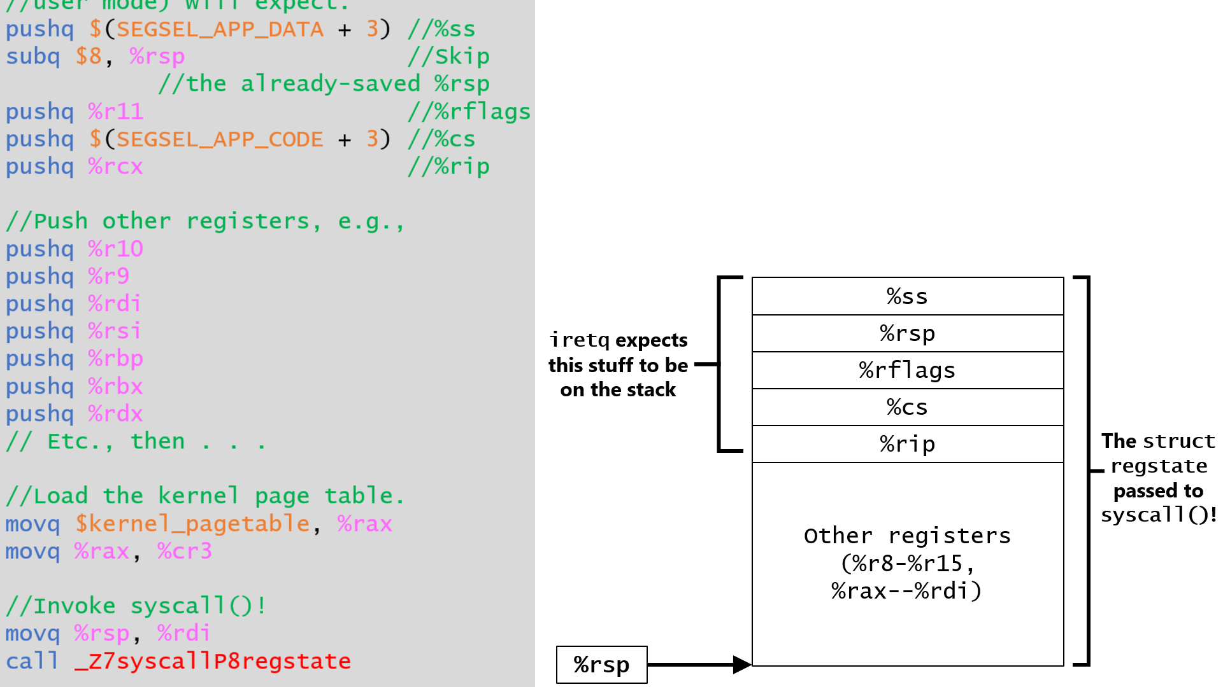
typedef struct regstate {
//General-purpose registers
uint64_t reg_rax;
uint64_t reg_rcx;
uint64_t reg_rdx;
uint64_t reg_rbx;
uint64_t reg_rbp;
uint64_t reg_rsi;
uint64_t reg_rdi;
uint64_t reg_r8;
uint64_t reg_r9;
uint64_t reg_r10;
uint64_t reg_r11;
uint64_t reg_r12;
uint64_t reg_r13;
uint64_t reg_r14;
uint64_t reg_r15;
uint64_t reg_fs;
uint64_t reg_gs;
//Interrupt number, -1 for syscall
uint32_t reg_intno;
//Whether to `swapgs` on resume
uint32_t reg_swapgs;
//Hardware-supplied exception errcode
uint64_t reg_errcode;
//Task state (pushed by hardware during
//exception, read by `iret`)
uint64_t reg_rip;
uint64_t reg_cs;
uint64_t reg_rflags;
uint64_t reg_rsp;
uint64_t reg_ss;
} regstate;

Slide 21
Handling A System Call
Part I: Invoking the Kernel’s System Call Handler
Part II: Completing the Context Switch
Part III: Executing Kernel Code
Part IV: Returning to User-mode

Slide 22
//Simplified version of WeensyOS’s system call handler.
uintptr_t syscall(regstate* regs) {
switch (regs->reg_rax) {
case SYSCALL_GETPID: //Return the pid
//of the user-mode process.
return current->pid;
case SYSCALL_PAGE_ALLOC: //Add a new
//page of memory at the user-
//specified address.
return alloc(current->regs.reg_rdi);
case SYSCALL_PANIC: //Give up on life!
//Print error message then exit
//upon receiving Control-C.
user_panic(current);
break; //Will not be reached!
default:
proc_panic(current, "Unhandled system call %ld (pid=%d, rip=%p)!\n",
regs->reg_rax, current->pid, regs->reg_rip);
}
panic("Should not get here!\n");
}
//Process state constants
#define P_RUNNABLE 1 //Runnable process
#define P_BLOCKED 2 //Blocked process
#define P_FAULTED 3 //Faulted process
struct proc {
x86_64_pagetable* pagetable; //Page table
pid_t pid; //Process ID
int state; //State (see above)
regstate regs; //User-mode registers
};
Notes:
[The `current` variable is set by `kernel.cc::run(proc* p)`, via code that does `current = p`. In turn, `run()` is called by `kernel.cc::kernel_start()` (to launch the first process), by `kernel.cc::schedule()` (i.e., the OS scheduler), and a few other places in the kernel.]
[P_FAULTED means that the process has suffered a “page fault,” i.e., the process has tried to access a virtual memory address that isn’t mapped to physical memory, or is mapped but in a way that is incompatible with how the process tried to access the page (e.g., writing a read-only page). P_BLOCKED isn’t actually used anywhere in the WeensyOS codebase, but it represents a possible extension to WeensyOS---the ability for a process to block (i.e., wait) on an external event like the reception of input from the user, or the completion of a data fetch from a file stored on an SSD. In the follow-up class to CS 61 (the mighty CS 161), you’ll see how to implement support for blocked processes :-D.]

Slide 23
Handling A System Call
Part I: Invoking the Kernel’s System Call Handler
Part II: Completing the Context Switch
Part III: Executing Kernel Code
Part IV: Returning to User-mode

Slide 24
_Z13syscall_entryv:
//Elided code: Save registers
//on the stack, enable access to
//kernel memory, then . . .
//Call syscall().
movq %rsp, %rdi
call _Z7syscallP8regstate
//C++ kernel code already restored
//callee-saved user-mode registers.
//Disable access to kernel memory.
movq current, %rcx
movq (%rcx), %rcx //proc::pagetable
movq %rcx, %cr3 //Update the page
//table pointer.
//Discard user-mode register state
//on the stack.
addq $(8 * 19), %rsp
//Return to the user-mode process!
iretq
struct proc {
x86_64_pagetable* pagetable; //Page table
pid_t pid; //Process ID
int state; //State (see above)
regstate regs; //User-mode registers
};
KERNEL_STACK_TOP
%ss
iretq pops these saved values into the relevant registers, jumping to the user-mode %rip and restoring the user-mode %rsp before flipping the privilege mode!
%rsp
%rflags
%cs
%rip
Other registers
(%r8-%r15,
%rax--%rdi)
%rsp
Notes:
Why is it ok to pop all 19 of those registers without restoring them? The reason is that, on the user-mode side, the caller-saved registers were already saved by the syscall wrapper, and callee-saved registers will have been restored already by C++ code in the syscall() C++call chain. [As described by https://read.seas.harvard.edu/cs161/2018/lectures/lecture6/, there are some subtleties:
“The syscall entry point saves most registers to a struct regstate. But is that really necessary? For instance, the callee-saved registers, such as %rbx and %r12, will be saved and restored by kernel C++ code automatically, since the C++ compiler uses the normal x86-64 calling convention. (For this reason, syscall_entry doesn’t bother to restore those registers when it resumes the user process!)
Which registers must syscall_entry save to struct regstate for Chickadee [which is the CS 161 OS] to work correctly? A: First, syscall_entry must save all the registers used for system call arguments. This is because [the `syscall` function] reads the system call arguments out of its regstate* argument. In current Chickadee, there are only two such registers, %rax (used for the system call number) and %rdi (the address argument for SYSCALL_PAGE_ALLOC), but obviously for more complex system calls there will be more.
Second, syscall_entry must save the callee-saved registers, even though in the normal case the C++ compiler will save and restore them too (making the initial save seem redundant). The reason is fork. The SYSCALL_FORK implementation initializes the child process’s registers with a copy of the parent’s registers, which are obtained through the regstate* regs argument. Although the calling convention says most of those registers are garbage, the callee-saved registers in the child must have the values from the parent, or the child will go wrong. So the regs must save those registers.”]

