Slide 1
Assembly: Part II
CS 61: Lecture 8 10/2/2023

Slide 2
The Function Lifecycle: Overview
Step 1: Caller preparation
Caller sets up the arguments for the callee
If the caller has values in caller-saved registers, the caller saves their values on the stack (so that the callee can use those registers without fear of overwriting the caller’s values!)
Caller tells the callee where to return to (i.e., which caller instruction the callee should jump to upon returning)
Caller invokes the callee
Step 2: Callee preparation
Callee creates the callee’s new stack frame
If the callee wants to manipulate values in callee-saved registers, the callee must save those registers in the stack
Step 3: Callee execution
Step 4: Callee termination
Callee sets up the return value
Callee deallocates the stack frame
Callee returns to the appropriate instruction in the caller
Calling convention
call instruction
Function prologue
Calling convention
Calling convention
Function epilogue
ret instruction

Slide 3
x86-64: System V Calling Convention
Simplest case: callee arguments+retval are integers or pointers
Caller stores first six arguments in %rdi, %rsi, %rdx, %rcx, %r8, and %r9
Remaining arguments are passed via the stack
Callee places return value in %rax
int64_t foo(int64_t a, int64_t b,
int64_t c, int64_t d,
int64_t e, int64_t f,
int64_t g, int64_t h){
int64_t local0 = a*b*c*d;
int64_t local1 = e*f*g*h;
return local0 - local1;
}
Caller info
h
g
return addr
saved %rbp
%rbp
local0
local1
%rsp
a
b
c
d
e
f
%rdi
%rsi
%rdx
%rcx
%r8
%r9
Compiler may store locals in registers if there are enough spare ones!
Notes:
System V was one of the first commercial versions of the Unix operating system. The design of Unix was extremely influential on subsequent operating systems like Linux. [Reference: https://en.wikipedia.org/wiki/UNIX_System_V]
[Note that, if a stack-passed integer argument is smaller than 64 bits, the argument is rounded up to 64-bits in size before being placed on the stack.]
[Reference: Section 3.2.3 of “System V Application Binary Interface: AMD64 Architecture Processor Supplement”:
https://raw.githubusercontent.com/wiki/hjl-tools/x86-psABI/x86-64-psABI-1.0.pdf]

Slide 5
main:
#...initial code...
#Call foo()!
movq %rbx, (%rsp)
movq %rax, 8(%rsp)
callq foo(long, long,
long, long,
long, long,
long, long)
#main resumes here...
post_call_instrs
foo(long, long, long, long,
long, long, long, long):
movq %rdx, %rax
imulq %rsi, %rdi
imulq %rcx, %rax
imulq %rdi, %rax
imulq %r9, %r8
imulq 8(%rsp), %r8
imulq 16(%rsp), %r8
subq %r8, %rax
retq
Other stuff in main()’s stack frame
%rbp
h
g
%rsp
return addr

Slide 6
main:
#...initial code...
#Call foo()!
movq %rbx, (%rsp)
movq %rax, 8(%rsp)
callq foo(long, long,
long, long,
long, long,
long, long)
#main resumes here...
post_call_instrs
foo(long, long, long, long,
long, long, long, long):
movq %rdx, %rax
imulq %rsi, %rdi
imulq %rcx, %rax
imulq %rdi, %rax
imulq %r9, %r8
imulq 8(%rsp), %r8
imulq 16(%rsp), %r8
subq %r8, %rax
retq
Other stuff in main()’s stack frame
Math: %rax is local0 and %r8 is local1; no need to store locals on the stack!
%rbp
Put foo()’s return value in %rax, as required by the calling convention!
h
g
%rsp
return addr

Slide 7
Functions: Red Zones
Call graph
main()
A leaf function is a function that does not invoke other functions
For such a function, the compiler may emit code that:
Does not decrement %rsp to make space for local variables, but instead . . .
Just assumes that the memory in the 128 bytes below %rsp can be used by the function to store local variables
The 128 byte region beneath %rsp is called the red zone
Red zones allow a function to avoid the overheads incurred by:
Decrementing %rsp on function entry
Incrementing %rsp on function exit
f()
q()
g()
r()
s()
Leaf function
Caller’s stack frame
Callee’s red zone
%rsp

Slide 8
Callee-saved vs. Caller-saved Registers
A calling convention distinguishes between two kinds of registers:
Caller-saved registers can be overwritten by the callee, so if the caller wants to preserve their value, the caller must push the register values on the stack before invoking the callee
Callee-saved registers are assumed by the caller to not be modified by callee, so the callee must push the register values on the stack before updating these registers
The distinction is useful because it prevents the unnecessary saving and restoring of registers
If the caller doesn’t use a caller-saved register, the caller doesn’t have to save it before invoking another function
If the callee doesn’t use a callee-saved register, the callee doesn’t have to save it before executing callee code
Notes:
[Q: Why not have the caller be responsible for saving and restoring all registers? A: The caller doesn’t know which registers the callee would trample, so the caller would have to be conservative and save all registers and restore them after the callee returned; some or all of that saving and restoring might be unnecessary (depending on how many registers the callee actually uses.
Q: Why not have the callee be responsible for saving and restoring all registers? A: The callee doesn’t know which registers the caller actually cares about, so the callee would have to be conservative in saving and restoring all registers, possibly leading to wasted work.]

Slide 9
Callee-saved vs. Caller-saved Registers
//Code at start of callee! Save
//the old breakpointer.
push %rbp
mov %rsp, %rbp
//Assume that callee will later
//need to overwrite callee-saved
//registers %rbx and %r12.
push %rbx
push %r12
//Allocate space for local vars.
subq $0x10, %rsp
//[Main body: use %rbx and %r12]
//Deallocate stack frame, restore
//callee-saved registers.
add $0x10, %rsp
pop %r12
pop %rbx
pop %rbp
ret
Callee-saved: %rbp, %rbx, %r12, %r13, %r14, %r15
%rbp (the breakpointer) is callee-saved!
This is why the callee is responsible for saving the caller’s old breakpointer before making %rbp point to the callee’s stack frame
Caller-saved: %rdi%, %rsi, %rdx, %rcx, %r8, %r9, %r10, %r11, %rax
Note that the first six caller-saved registers are the same ones used to pass the first six arguments to a function!
This is why those registers are caller-saved: the callee needs to be free to overwrite those registers
Notes:
Note that we pop %r12, %rbx, and %rbp in the reverse order that they were pushed! This is because a stack is a last-in, first-out (LIFO) data structure.

Slide 10
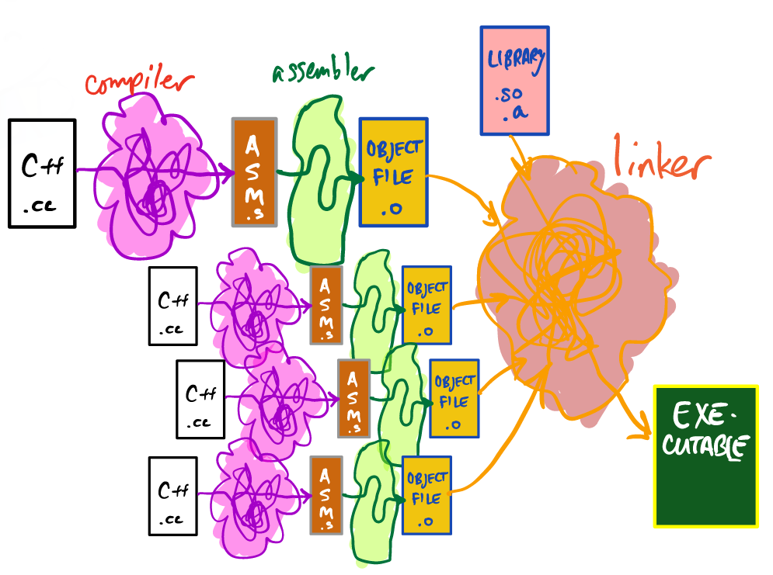
Compilation Lifecycle
Up to this point in the class, we’ve treated a compiler like gcc or clang as a monolithic program that takes source code as input and generates an executable file
However, compilation is actually a multi-step process!
The compiler converts source code to assembly
The assembler converts assembly to an object file
The linker combines object files into a final executable file
What developers colloquially call a “compiler” is actually a compiler driver which orchestrates communication between the real compiler, the assembler, and the linker
Notes:
[Ref: Section 7 of the textbook.]

Slide 11
Assembly Files
An assembly file contains:
Human-readable machine instructions (as represented by compiler mnemonics like jmp and %rsp)
Labels that represent jump targets (e.g., the beginning of a function, the start of a loop body)
Directives that convey helpful information to the assembler (i.e., the next actor in the compiler toolchain)
g++ -S file.cc tells the compiler to stop after compiling a file, with the generated assembly going into file.s
//Return the sum of the entries
//in an array.
int sum (int* a, int n) {
int s = 0;
for (int i = 0; i < n; i++) {
s += a[i];
}
return s;
}

Slide 12
.file "sum.cc"
.text
.globl _Z3sumPii
.type _Z3sumPii, @function
_Z3sumPii:
.LFB0:
.cfi_startproc
pushq %rbp
.cfi_def_cfa_offset 16
.cfi_offset 6, -16
movq %rsp, %rbp
.cfi_def_cfa_register 6
movq %rdi, -24(%rbp)
movl %esi, -28(%rbp)
movl $0, -4(%rbp)
movl $0, -8(%rbp)
jmp .L2
.L3:
movl -8(%rbp), %eax
cltq
leaq 0(,%rax,4), %rdx
movq -24(%rbp), %rax
addq %rdx, %rax
movl (%rax), %eax
addl %eax, -4(%rbp)
addl $1, -8(%rbp)
.L2:
movl -8(%rbp), %eax
cmpl -28(%rbp), %eax
jl .L3
movl -4(%rbp), %eax
popq %rbp
.cfi_def_cfa 7, 8
ret
.cfi_endproc

Slide 13
Name of source code file
The kind of file data (code for the “text” segment)
The symbol sum() is a global one (i.e., visible to other object files)
The symbol represents a function
Loop body
The assembly code for the sum() function
Loop test
Note that labels like .L3 aren’t associated with addresses because we don’t know where this code will live in the address space!
Notes:
[Aside: The .cfi directives are helpful to debuggers or other code that needs to know low-level information about the layout of stack frames. The documentation for the .cfi directives is very dense; for a higher-level overview, see https://stackoverflow.com/a/33732119.]

Slide 14
.file "main.cc"
.text
.globl array
.data
.align 8
.type array, @object
.size array, 8
array:
.long 1
.long 2
.text
.globl main
.type main, @function
main:
.LFB0:
.cfi_startproc
pushq %rbp
.cfi_def_cfa_offset 16
.cfi_offset 6, -16
movq %rsp, %rbp
.cfi_def_cfa_register 6
subq $16, %rsp
movl $2, %esi
movl $array, %edi
call _Z3sumPii
movl %eax, -4(%rbp)
movl -4(%rbp), %eax
leave
.cfi_def_cfa 7, 8
ret
.cfi_endproc
The globally-visible symbol is data (not code) of type array, has an alignment of 8 bytes, and has two elements having values 1 and 2 (note that the assembler directive “long” corresponds to a 32-bit (i.e., 4 byte) number
//A driver program that
//contains a reference to
//an external function
//called sum().
int sum (int* a, int n);
//^^^^^^^
//This declaration should
//really be in a header
//file :-D.
int array[2] = {1, 2};
int main () {
int val = sum(array, 2);
return val;
}
Note that this symbol isn’t locally-defined in this file!
Notes:
[The `leave` instruction is semantically equivalent to these instructions:
mov %rbp, %rsp
pop %rbp
In other words, `leave` resets the stack pointer to point to where the breakpointer points (which is the stack location of the saved breakpointer); `leave` then pops the top of the stack, making the breakpointer point to the saved breakpointer (i.e., the breakpointer of the caller).
]
[Recall that, in x86 instruction semantics, a “long” value corresponds to a 4-byte one, whereas a “quad” value refers to an 8-byte one. In x86-64 Linux, an “int” corresponds to a 4-byte value and a “long” corresponds to an 8-byte one.]
[It’s not clear why the compiler wants the alignment of the array to be 8 instead of 4 (i.e., the natural alignment of an int array on a Linux x86-64 machine). That being said, an alignment of 8 will also guarantee an alignment of 4.]
[For more details on assembler directives, see https://docs.oracle.com/cd/E26502_01/html/E28388/eoiyg.html.]

Slide 15
Object Files
The compiler consumes a source code file and generates a human-readable assembly file
The assembly file contains assembler mnemonics, but with some parts missing
The assembly file doesn’t associate locally-defined code or static data with memory addresses (because we don’t know where code or data will live yet!)
The assembly file also doesn’t know the addresses for externally-defined symbols
The assembler consumes an assembly file and generates an object file
An object file is a binary file, not a human-readable text file
An object file contains binary-level representations of machine instructions and static data like strings and numbers
An object file also contains other stuff (e.g., a symbol table and debugging information)
g++ -c file.cc –o file.o: Generate an assembly file and then generate an object file, placing the result in file.o

Slide 16
//Return the sum of the entries
//in an array.
int sum (int* a, int n) {
int s = 0;
for (int i = 0; i < n; i++) {
s += a[i];
}
return s;
}
g++ -c sum.cc -o sum.o
objdump –d –C –t sum.o
sum.o: file format elf64-x86-64
SYMBOL TABLE:
0000000000000000 l df *ABS* 0000000000000000 sum.cc
0000000000000000 l d .text 0000000000000000 .text
0000000000000000 l d .data 0000000000000000 .data
0000000000000000 l d .bss 0000000000000000 .bss
0000000000000000 l d .note.GNU-stack 0000000000000000 .note.GNU-stack
0000000000000000 l d .eh_frame 0000000000000000 .eh_frame
0000000000000000 l d .comment 0000000000000000 .comment
0000000000000000 g F .text 0000000000000045 sum(int*, int)
Disassembly of section .text:
0000000000000000 <sum(int*, int)>:
0: 55 push %rbp
1: 48 89 e5 mov %rsp,%rbp
4: 48 89 7d e8 mov %rdi,-0x18(%rbp)
8: 89 75 e4 mov %esi,-0x1c(%rbp)
b: c7 45 fc 00 00 00 00 movl $0x0,-0x4(%rbp)
The sum() symbol is a globally-visible (“g”) function (“F”)
The assembler can calculate address offsets because the assembler knows how big each instruction is . . . but to be useful, sum.o must be linked with another object file which invokes sum()!
Notes:
[In the symbol table, we see a bunch of local (“l”) symbols in addition to the global (“g”) symbol `sum`. Note that the local symbols are debugging (“d”) symbols which you can ignore for the purposes of this lecture.]

Slide 17
int sum (int* a, int n);
int array[2] = {1, 2};
int main () {
int val = sum(array, 2);
return val;
}
g++ -c main.cc -o main.o
objdump –d –C –t main.o
main.o: file format elf64-x86-64
SYMBOL TABLE:
0000000000000000 l df *ABS* 0000000000000000 main.cc
0000000000000000 l d .text 0000000000000000 .text
0000000000000000 l d .data 0000000000000000 .data
0000000000000000 l d .bss 0000000000000000 .bss
0000000000000000 l d .note.GNU-stack 0000000000000000 .note.GNU-stack
0000000000000000 l d .eh_frame 0000000000000000 .eh_frame
0000000000000000 l d .comment 0000000000000000 .comment
0000000000000000 g O .data 0000000000000008 array
0000000000000000 g F .text 000000000000001f main
0000000000000000 *UND* 0000000000000000 sum(int*, int)
Disassembly of section .text:
0000000000000000 <main>:
0: 55 push %rbp
1: 48 89 e5 mov %rsp,%rbp
4: 48 83 ec 10 sub $0x10,%rsp
The array symbol is the name of an object (“O”), i.e., a program variable that is globally (“g”) visible to other objects
The main symbol is a globally-visible function
OH NO
IT’S UNDEFINED LOCALLY
DOES SOMEONE ELSE DEFINE IT?

Slide 18
Linking
The compiler consumes a source code file and generates a human-readable assembly file
The assembly file contains assembler mnemonics, but with some parts missing
The assembly file doesn’t associate locally-defined code or static data with virtual addresses (because we don’t know where code or data will live yet!)
The assembly file also doesn’t know the addresses for externally-defined symbols
The assembler consumes an assembly file and generates a binary-formatted object file that contains:
Machine instructions and their relative offsets (i.e., addresses)
A symbol table which indicates:
The global symbols that are defined by the object and visible to other objects
The global symbols defined by the object but only visible within the object: C++ variables defined with the static attribute (e.g., static int bar(){. . .})
The external symbols that the object wants to import from other objects
The linker combines object files to produce an executable file!
The linker creates a new object that merges all of the code and data from the individual objects
The linker then patches unresolved symbol references, using the symbol table from each individual object file to locate everything

Slide 19
sum.cc
main.cc
int sum (int* a, int n) {
int s = 0;
for (int i = 0; i < n; i++) {
s += a[i];
}
return s;
}
int sum (int* a, int n);
int array[2] = {1, 2};
int main () {
int val = sum(array, 2);
return val;
}
COMPILATION
g++ -S sum.cc
g++ -S main.cc
ASSEMBLY
g++ -c sum.s –o sum.o
g++ -c main.s –o main.o
LINKING
g++ sum.o main.o –o prog
FINAL EXECUTABLE

Slide 20
In the final executable, the symbols are all resolved (i.e., they all have concrete locations)!
(Abridged) output of objdump -d -C -t prog
prog: file format elf64-x86-64
SYMBOL TABLE:
00000000004004eb g F .text 000000000000001f main
00000000004004a6 g F .text 0000000000000045 sum(int*, int)
00000000004004eb <main>:
4004eb: 55 push %rbp
4004ec: 48 89 e5 mov %rsp,%rbp
4004ef: 48 83 ec 10 sub $0x10,%rsp
4004f3: be 02 00 00 00 mov $0x2,%esi
4004f8: bf 28 10 60 00 mov $0x601028,%edi
4004fd: e8 a4 ff ff ff callq 4004a6 <sum(int*, int)>
400502: 89 45 fc mov %eax,-0x4(%rbp)
400505: 8b 45 fc mov -0x4(%rbp),%eax
400508: c9 leaveq
400509: c3 retq
40050a: 66 0f 1f 44 00 00 nopw 0x0(%rax,%rax,1)

Slide 21
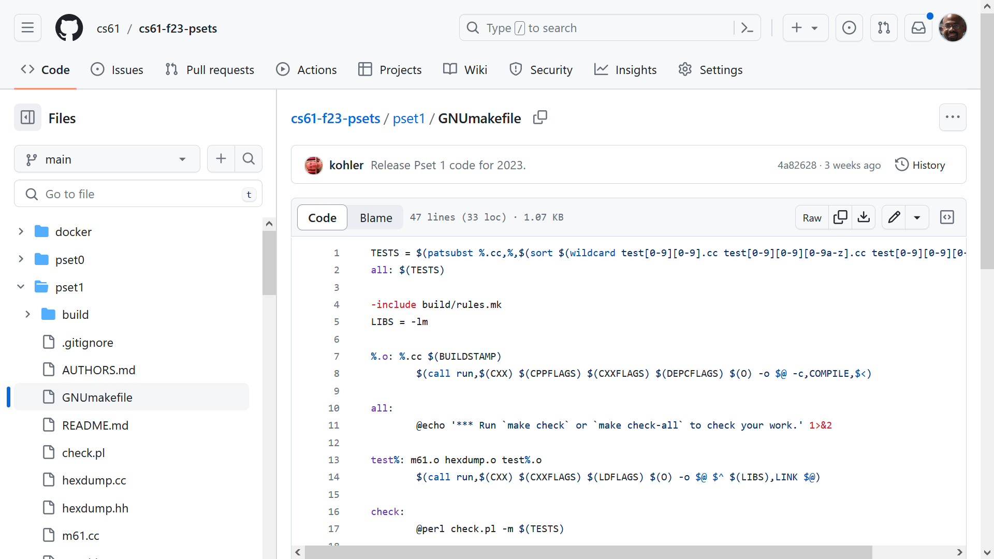
Notes:
Makefiles allow you to put all of your compiler toolchain incantations in one place; you can then use high-level commands like “make all” to trigger a bunch of individual incantations.

Slide 22
Dynamic Linking
The previous example showed static linking (i.e., linking at compilation time)
Dynamic linking (i.e., bringing in new object files while a program is executing) is also possible!
We already saw a cheaty example of this in Lecture 6
The less morally corrupt approach is to use dlopen(const char *filename,…) and friends, but they essentially do the same cheaty things
Map an object file into memory as readable and executable
Parse the symbol table of the object file to find the locations of exported symbols
Allow the process to query the table and get pointers to symbols (e.g., exported functions)!
int add(int a, int b) {
// Open the image file
const char* file = "cs61hello.jpg";
int fd = open(file, O_RDONLY);
assert(fd >= 0);
// Look up the file’s size
struct stat s;
int r = fstat(fd, &s);
assert(r >= 0 && S_ISREG(s.st_mode) &&
s.st_size > 0);
// Load it into memory starting at
// address `data`; treat it as executable!
void* data = mmap(nullptr, s.st_size,
PROT_READ | PROT_EXEC,
MAP_SHARED, fd, 0);
assert(data != MAP_FAILED);
// Obtain address of bytes in the image
// that represent 8d 04 37 c3 . . .
uintptr_t function_address =
(uintptr_t) data + 0x9efc;
// Add a and b using that code!
int (*function_pointer)(int, int) =
(int (*)(int, int)) function_address;
// Call add function!
return function_pointer(a, b);
}
Notes:
[Ref: https://man7.org/linux/man-pages/man3/dlopen.3.html]

