Slide 1
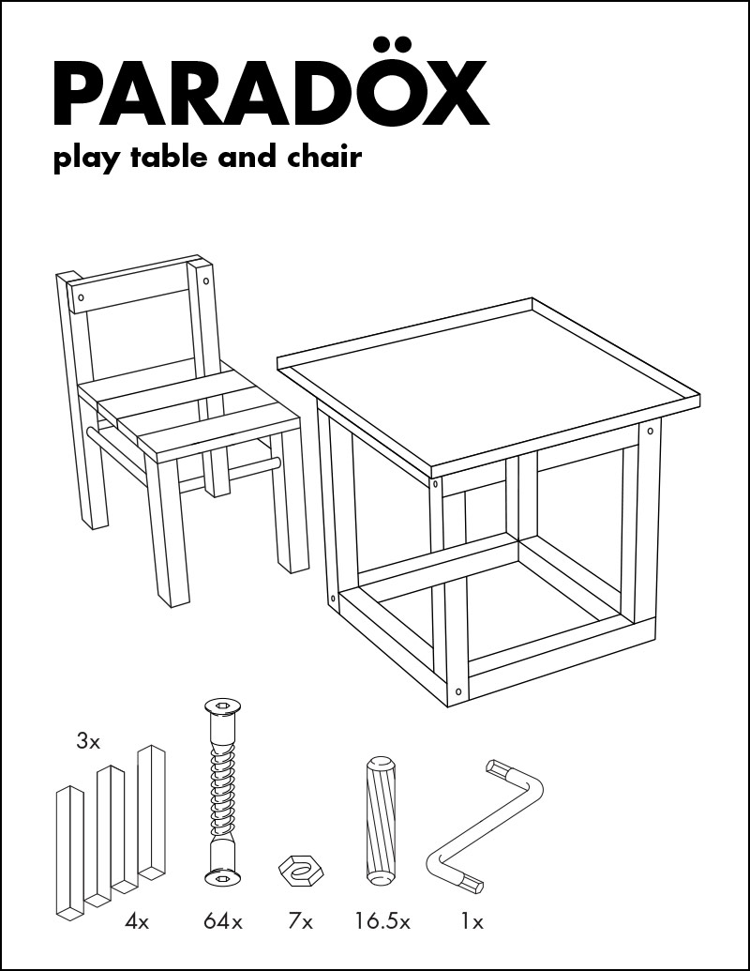
Assembly: Part I
CS 61: Lecture 7 9/27/2023

Slide 2
Overview of CPU Operation
The CPU iteratively:
Fetches an instruction
Decodes the instruction
Performs the desired operation
Given the currently executing instruction instr_{i}, the next instruction to fetch is:
The sequentially adjacent instr_{i+1} by default . . .
. . . unless instr_{i} is a control flow instruction that redirects the program elsewhere
A (simplified!) view of an x86 CPU and RAM
RAM
Byte N-1
Registers
%rax
%rbx
. . .
%rcx
%rdx
CPU
RAM controller
ALU
Instruction
decode
ALU op
ALU output
Byte 0
RAM controller command
There are three basic types of instructions
Arithmetic instructions perform math on values in registers or memory
Data movement instructions copy values between registers and memory
Control flow instructions implement if-else statements, for loops, function call/return, etc.

Slide 3
void f() {
int i = 0;
while (i < 10) {
i += 2;
}
}
int main() {...}
> g++ test.cc
> objdump –d –C a.out
Memory addresses
Byte encodings of instructions
Assembler mnemonics
00000000004004a6 <f()>:
4004a6: 55 push %rbp
4004a7: 48 89 e5 mov %rsp, %rbp
4004aa: c7 45 fc 00 00 00 00 movl $0x0,-0x4(%rbp)
4004b1: eb 04 jmp 4004b7 <f()+0x11>
4004b3: 83 45 fc 02 addl $0x2,-0x4(%rbp)
4004b7: 83 7d fc 09 cmpl $0x9,-0x4(%rbp)
4004bb: 7e f6 jle 4004b3 <f()+0xd>
4004bd: 90 nop
4004be: 90 nop
4004bf: 5d pop %rbp
4004c0: c3 retq
x86 has variable-length instructions!
Notes:
[A “mnemonic” is a representation that is designed to make information easier to understand.]
[The –d option for objdump asks the tool to disassemble the target file. The –C option option “demangles” C++ function names, such that objdump displays the function names used by the C++ source code instead of the modified function names that are internally created by the compiler. For more information about the arguments to objdump, see https://linux.die.net/man/1/objdump.]
[Aside: The reason why the code lives around address 0x400000 is because, according to the System V ABI for 64-bit systems, the text segment (i.e., the code segment) should start at 0x400000. See page 27 of https://refspecs.linuxbase.org/elf/x86_64-abi-0.99.pdf. Also see https://gist.github.com/CMCDragonkai/10ab53654b2aa6ce55c11cfc5b2432a4 and https://stackoverflow.com/questions/14314021/why-linux-gnu-linker-chose-address-0x400000.]
[Aside: “The base RISC-V ISA has fixed-length 32-bit instructions that must be naturally aligned on 32-bit boundaries. However, the standard RISC-V encoding scheme is designed to support ISA extensions with variable-length instructions, where each instruction can be any number of 16-bit instruction parcels in length and parcels are naturally aligned on 16-bit boundaries.” Ref: https://five-embeddev.com/riscv-isa-manual/latest/intro.html]

Slide 4
void f() {
int i = 0;
while (i < 10) {
i += 2;
}
}
int main() {...}
> g++ test.cc
> objdump –d –C a.out
Memory addresses
Byte encodings of instructions
Assembler mnemonics
00000000004004a6 <f()>:
4004a6: 55 push %rbp
4004a7: 48 89 e5 mov %rsp, %rbp
4004aa: c7 45 fc 00 00 00 00 movl $0x0,-0x4(%rbp)
4004b1: eb 04 jmp 4004b7 <f()+0x11>
4004b3: 83 45 fc 02 addl $0x2,-0x4(%rbp)
4004b7: 83 7d fc 09 cmpl $0x9,-0x4(%rbp)
4004bb: 7e f6 jle 4004b3 <f()+0xd>
4004bd: 90 nop
4004be: 90 nop
4004bf: 5d pop %rbp
4004c0: c3 retq
Current instruction
The local variable i lives in the stack, and is accessed via a memory offset from the breakpointer. Assign 0 to i.
Save the old breakpointer (i.e., main()’s breakpointer) on the stack.
Redirect control flow to the instruction at address 4004b7—this is the instruction which performs the loop test!
Update the breakpointer to point to f()’s stack frame!

Slide 5
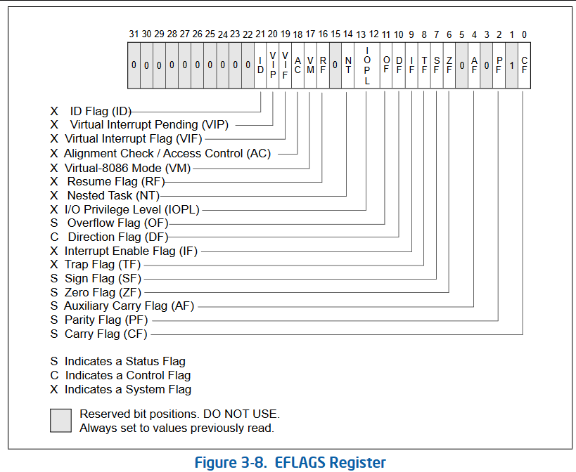
Arithmetic instructions: add, cmp
Data movement instructions: push, mov, pop
Branching instructions:
Unconditional (i.e., always jump): jmp, ret
Conditional (i.e., only jump in certain circumstances): jle
void f() {
int i = 0;
while (i < 10) {
i += 2;
}
}
int main() {...}
> g++ test.cc
> objdump –d –C a.out
Like sub $0x9, -0x4(%rbp) (i.e., i=i–9), but no arguments are modified. However, status flags in the special %rflags register are set.
ZF: Zero flag—was the result of the subtraction zero, i.e, were the two arguments equal?
CF: Carry flag—set to 1 if the dst was less than src, otherwise set to 0.
Memory addresses
Byte encodings of instructions
Assembler mnemonics
The jle (“jump less than or equal”) instruction diverts control flow only if dst <= src (as determined by ZF and CF).
00000000004004a6 <f()>:
4004a6: 55 push %rbp
4004a7: 48 89 e5 mov %rsp, %rbp
4004aa: c7 45 fc 00 00 00 00 movl $0x0,-0x4(%rbp)
4004b1: eb 04 jmp 4004b7 <f()+0x11>
4004b3: 83 45 fc 02 addl $0x2,-0x4(%rbp)
4004b7: 83 7d fc 09 cmpl $0x9,-0x4(%rbp)
4004bb: 7e f6 jle 4004b3 <f()+0xd>
4004bd: 90 nop
4004be: 90 nop
4004bf: 5d pop %rbp
4004c0: c3 retq
It’s unclear why the compiler generated the nop (“no operation”) instructions: they literally don’t do anything! The compiler doesn’t emit these when optimizations are enabled LOL.
Current instruction
Jump to the start of the loop body
Fall-through to the next instruction
Notes:
[Given the ZF and CF semantics described in the flag, we get the following behavior for `cmp src, dst`:
dst = src: ZF->1, CF->0
dst < src: ZF->0, CF->1
dst > src: ZF->0, CF->0
]
[Source for the rflags figure: the Intel® 64 and IA-32 Architectures Software Developer’s Manual.]

Slide 6
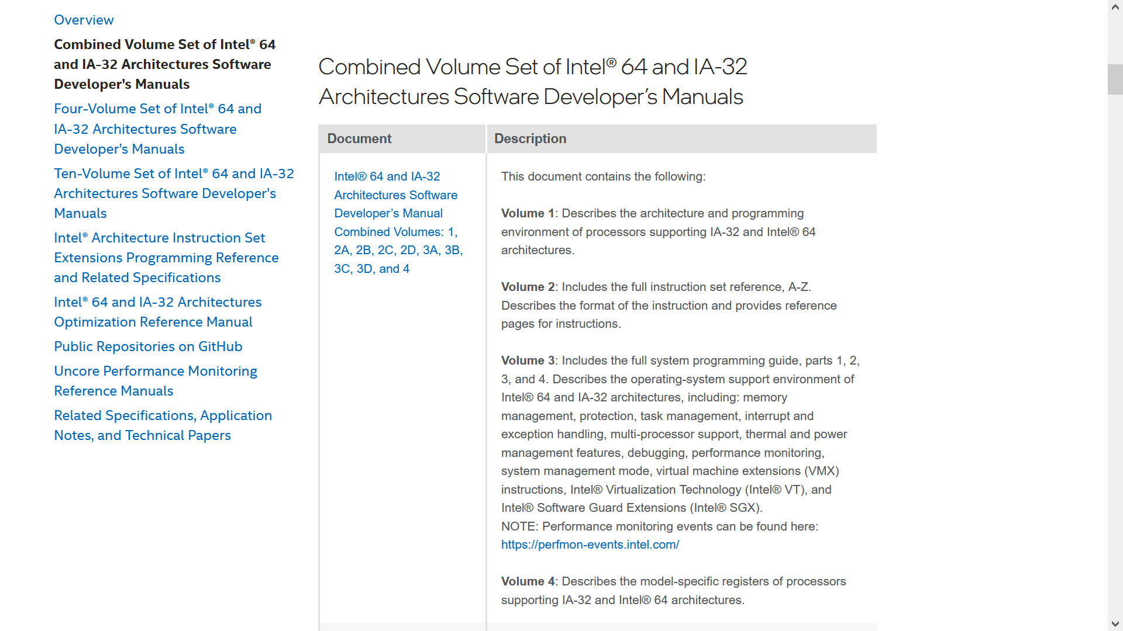
The Intel manuals get easier to read with practice
The Intel manuals are also the definitive source on how x86 chips work!
Random Internet sources are not always correct
Being able to search the Intel manuals for ground truth is a very useful skill😅
Notes:
[Ref: You can download the Intel manuals at https://www.intel.com/content/www/us/en/developer/articles/technical/intel-sdm.html.]

Slide 7
Register Slices
Recall that an b-bit processor has registers that are b bits wide
The bit-width of x86 processors has evolved over time
The first x86 processor was 16-bit
Eventually, x86 processors transitioned to 32-bits and then 64-bits
However, on a modern x86-64 processor, some general-purpose registers can be accessed via slices that expose only a contiguous subset of the bits in the register!
%rax: the entire register (bits 0—63)
%eax: the lowest 32 bits (bits 0—31)
%ax: the lowest 16 bits (bits 0—15)
%ah: bits 8—15
For instructions that manipulate registers, the suffix of the instruction indicates which register slices are being manipulated
movl $100, %eax: Move the 32-bit number 100 into %eax, setting bits 32—63 to zero
movq $100, %rax: Move the 64-bit number 100 into %rax
movl $100, %rax: Syntax error!
Instruction suffix table
b: 8-bit operands (“bytes”)
w: 16-bit operands (“words”)
l: 32-bit operands (“long words”)
q: 64-bit operands (“quad words”)
Notes:
On x86-64, a “word” is 16 bits (i.e., two bytes) long because the original x86 CPUs were 16-bit!
[Aside: As mentioned in the slide, manipulating a 32-bit slice sets the higher-order 32 bits to 0. However, manipulating a 16-bit slice or 8-bit slice does not modify the other bits in the register. Strange! But true!]
[Ref: https://en.wikibooks.org/wiki/X86_Assembly/GNU_assembly_syntax#Operation_Suffixes]

Slide 8
Register Slices
Compilers use register slices to naturally map source-code numeric types to the appropriately-sized registers
Supporting 16-bit and 32-bit instructions also allows an x86-64 CPU to provide backwards compatibility with old software that was compiled for 16-bit or 32-bit x86 CPUs!
Such software will automatically benefit from the faster clock speeds of a modern chip
However, Intel engineers experience continual sadness in having to always add compatibility circuitry to otherwise state-of-the-art chips
//C++ code
int f(int x, int y) {
return x + y;
}
//C++ code
long f(long x, long y) {
return x + y;
}
//x86 assembly
leal (%rdi,%rsi), %eax
retq
//x86 assembly
leaq (%rdi,%rsi), %rax
retq
Notes:
Recall that:
-The “l” suffix indicates an instruction which deals with 4 byte operands, whereas the “q” suffix indicates an instruction that deals with 8 byte operands.
-On x86-64 Linux, sizeof(int) is 4 bytes and sizeof(long) is 8 bytes.

Slide 9
An Internet Person installed Windows 98 (which has 16-bit and 32-bit code) on a modern x86-64 machine!
Notes:
Installing Windows 98 on a modern x86-64 machine isn’t trivial, despite the fact that an x86-64 chip can run 16-bit and 32-bit code. For example, many difficulties are generated not by the CPU, but by the machine’s devices. Any OS (Windows 98 included) contains device driver code which allows the OS to interact with keyboards, monitors, mice, network cards, and so on. A Windows 98 machine is unlikely to have a drivers for devices in a modern machine. Without such drivers, the mere fact that the OS can generally run instructions on a machine isn’t as helpful as it might seem---the OS also needs to know the specific instruction sequences (as contained in a device driver) which enable the OS to talk to non-CPU devices.
[Ref: https://www.youtube.com/watch?v=IO2BSLkQLDA
https://superuser.com/questions/1519671/can-a-64-bit-computer-x86-run-a-16-bit-os-natively-without-emulation]

Slide 10
Intel is floating trial balloons about dropping 16-bit and 32-bit support from x86-64
Notes:
As Figure 1 from the Intel whitepaper shows, when you initially turn on an x86-64 CPU, it automatically starts in 16-bit mode! The OS has to explicitly reconfigure the processor to enable 32-bit mode or 64-bit mode.
[Ref: https://www.intel.com/content/www/us/en/developer/articles/technical/envisioning-future-simplified-architecture.html]

Slide 11
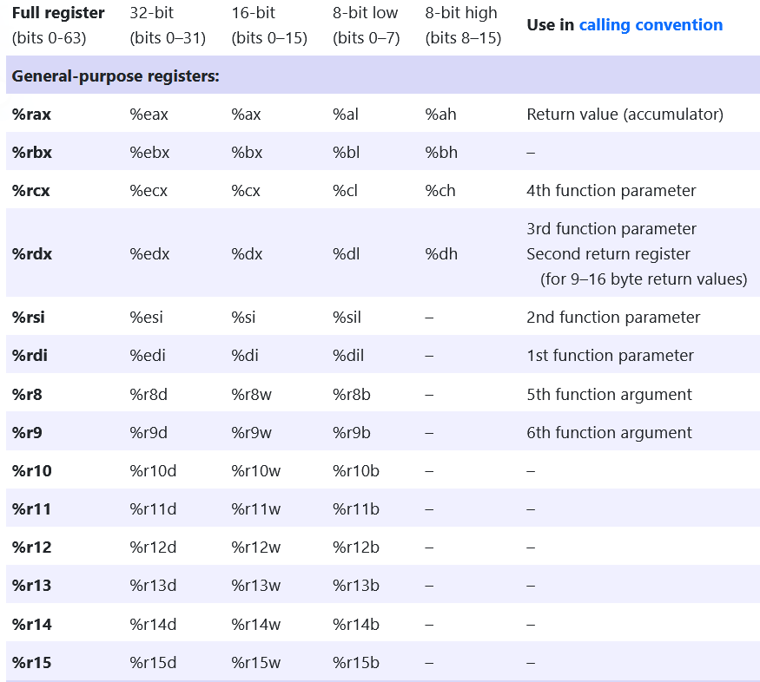
General-purpose Registers on the x86-64
Notes:
[Ref: https://cs61.seas.harvard.edu/site/2023/Asm/#Registers&gsc.tab=0]

Slide 12
Special-purpose Registers on the x86-64
Local variables often live in the stack and are accessed using an %rbp-relative address
%rip holds the address of the next instruction to execute
By default, the CPU automatically sets %rip to be the next instruction after the current one
Control flow instructions may introduce non-sequential jumps!
%rflags contains various flags that, e.g.,
Are set by arithmetic and comparison instructions
Are checked by control flow instructions like jle
00000000004004a6 <f()>:
4004a6: 55 push %rbp
4004a7: 48 89 e5 mov %rsp, %rbp
4004aa: c7 45 fc 00 00 00 00 movl $0x0,-0x4(%rbp)
4004b1: eb 04 jmp 4004b7 <f()+0x11>
4004b3: 83 45 fc 02 addl $0x2,-0x4(%rbp)
4004b7: 83 7d fc 09 cmpl $0x9,-0x4(%rbp)
4004bb: 7e f6 jle 4004b3 <f()+0xd>
4004bd: 90 nop
4004be: 90 nop
4004bf: 5d pop %rbp
4004c0: c3 retq
Notes:
[Ref: https://cs61.seas.harvard.edu/site/2023/Asm/#Registers&gsc.tab=0]

Slide 13
Data Operands and Address Modes
$i: An immediate value (i.e., a constant)
%r: A register value
(%r): an indirect reference (i.e., dereferencing the pointer in %r)
o(%r): more generally, a base+offset indirect reference (i.e., accessing the memory value at location %r + o)
00000000004004a6 <f()>:
4004a6: 55 push %rbp
4004a7: 48 89 e5 mov %rsp, %rbp
4004aa: c7 45 fc 00 00 00 00 movl $0x0,-0x4(%rbp)
4004b1: eb 04 jmp 4004b7 <f()+0x11>
4004b3: 83 45 fc 02 addl $0x2,-0x4(%rbp)
4004b7: 83 7d fc 09 cmpl $0x9,-0x4(%rbp)
4004bb: 7e f6 jle 4004b3 <f()+0xd>
4004bd: 90 nop
4004be: 90 nop
4004bf: 5d pop %rbp
4004c0: c3 retq

Slide 14
Data Operands and Address Modes
Address space
Stack
R+W
$i: An immediate value (i.e., a constant)
%r: A register value
(%r): an indirect reference (i.e., dereferencing the pointer in %r)
o(%r): more generally, a base+offset indirect reference (i.e., accessing the memory value at location %r + o)
g(%rip): a global symbol that lives at an offset g from the current %rip
int global = 2;
int main() {
return global;
}
Heap
R+W
00000000004004a6 <main>:
4004a6: 55 push %rbp
4004a7: 48 89 e5 mov %rsp,%rbp
4004aa: 8b 05 78 0b 20 00 mov 0x200b78(%rip),%eax
#<global>
4004b0: 5d pop %rbp
4004b1: c3 retq
%rip + 0x200b78
Static data
R(+W for some data)
Code
R+X
%rip

Slide 15
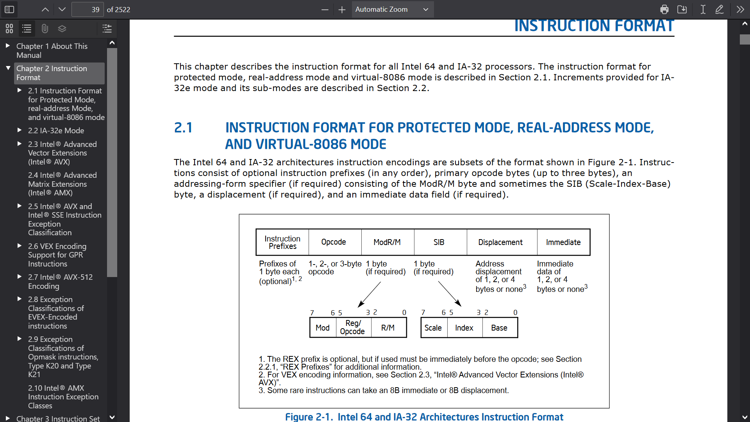
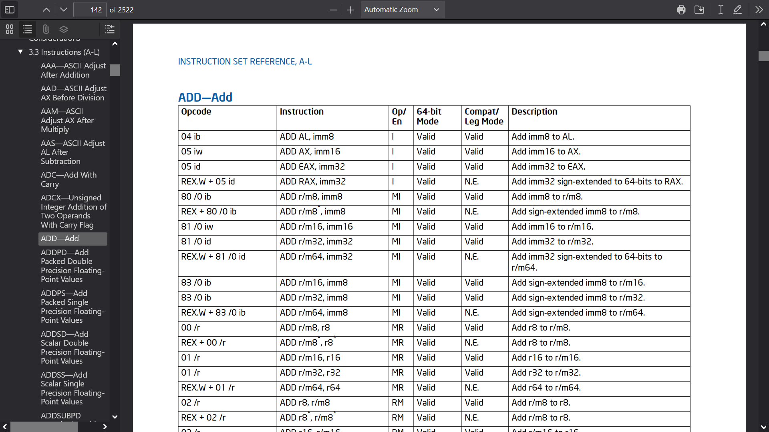
Arithmetic Instructions
The general format is op src, dst which means dst = dst op src
Ex: addl %eax, %ebx means %ebx = %ebx + %eax
Ex: subq %rdi, %r9 means %r9 = %r9 - %rdi
The Intel manuals describe the byte-level format of arithmetic instructions (and all others!)
Notes:
For the purposes of this class, the high-level takehome point is that the opcode field specifies the type of instruction (e.g., add or sub or mov or ret etc.), and the ModR/M + SIB + Displacement + Immediate fields represent the arguments to the instruction. Just like a high-level language has a grammar, an assembly language has a grammar!

Slide 16
More Complicated Memory References
x86 supports an offset(base, index, scale) mode
The referenced value is at offset + base + (index * scale)
offset must be a constant
scale must be 1, 2, 4, or 8
The default offset, base, and index are 0, whereas the default scale is 1
This strategery is helpful for various kinds of array accesses
int arr[4] = {99, 88, 77, 66};
int f(unsigned int i) {
return arr[i];
}
Move the argument i into %eax
Load the address of global variable arr into %rcx
0000000000400470 <f(unsigned int)>:
400470: 89 f8 mov %edi,%eax
400472: 48 8d 0d b7 0b 20 00 lea 0x200bb7(%rip),%rcx
#<arr>
400479: 8b 04 81 mov (%rcx,%rax,4),%eax
40047c: c3 retq
Read the value at this memory location:
arr + (i*4)
Recall that the
sizeof(int) is 4, and that arr contains ints!
Notes:
Recall that, according to the System V calling convention, a function’s return value goes in %eax. The `mov (%rcx,%rax,4),%eax` stores the referenced memory value in %eax!
[To reproduce the example objdump output above, try compiling this code . . .
int arr[4] = {99, 88, 77, 66};
int f(unsigned int i) {
return arr[i];
} int main() {
return f(2);
}
. . . with clang -O1 -fPIC test.cc.]

Slide 17
More Complicated Memory References
The lea (“load effective address”) instruction performs an address calculation but does not actually read or write the memory at that location
Ex: lea (%rdi,%rsi,8), %eax, with the offset implicitly being 0
Ex: The lea 0x200bb7(%rip), %rax from the example below, with the offset being 0x200bb7, and the index implicitly being 0 and the scale implicitly being 1
int arr[4] = {99, 88, 77, 66};
int f(unsigned int i) {
return arr[i];
}
Move the argument i into %eax
Load the address of global variable arr into %rcx
0000000000400470 <f(unsigned int)>:
400470: 89 f8 mov %edi,%eax
400472: 48 8d 0d b7 0b 20 00 lea 0x200bb7(%rip),%rcx
#<arr>
400479: 8b 04 81 mov (%rcx,%rax,4),%eax
40047c: c3 retq
Read the value at this memory location:
arr + (i*4)
Recall that the
sizeof(int) is 4, and that arr contains ints!

Slide 18
Bitwise Operations
Computers represent numbers using a binary representation, so bitwise operations are useful in a variety of settings
Left shifting and right shifting move the bits in a value to the left or to the right
a << i: Move the bits in a to the left by i positions, filling the vacated bits on the right with 0s
Left-shifting is equivalent to setting a = a*2^{i}, similar to how, in decimal arithmetic, left-shifting by i digits is equivalent to multiplying by 10^{i}
a >> i: Move the bits in a to the right by i positions, filling the vacated bits with:
0 if a is unsigned
The high-order sign bit (0 for a positive number, 1 for a negative number) if a is signed
Right-shifting is equivalent to setting a = a/2^{i} (rounded down)
On most CPUs, shift instructions are much faster than generic multiplication/division instructions, so compilers prefer to use shifting when multiplying or dividing by powers of two
Left-shift by 2
Decimal: 52
Decimal: 208(=52*2²)
Binary: 00110100
Binary: 11010000
Notes:
[Note that, when bit-shifting `a` by `i` bits, `i` must be positive and less than or equal to `8*sizeof(a)`.]
[For more information about sign bits in signed integers, see https://cs61.seas.harvard.edu/site/2023/Datarep/#Signed-integers and, in the textbook, §2.1–2.2.]

Slide 19
Bitwise Not, And, Or, Exclusive Or
(x & 1) == 0 tests whether x is even
x & 15 evaluates the decimal arithmetic test x % 16
System calls often accept “flag” arguments that can be combined via bitwise-or
There are a bunch of additional bitwise hacks—see the “Notes” section of this slide to learn more!
//Recall this example from the last lecture: PROT_READ is
//binary 001, PROT_WRITE is 010, and PROT_EXEC is 100.
void* data = mmap(nullptr, s.st_size, PROT_READ | PROT_EXEC,
MAP_SHARED, fd, 0);
Notes:
Decimal 15 is binary 1111. So, `x & 15` pulls out the low-order 4 bits of a number---those bits represent the modulus of the number with respect to 16.
[If you’re interested in learning more bitwise hacks, see:
https://cs61.seas.harvard.edu/site/2022/Datarep6/#gsc.tab=0 //See “Fun with bits,” “Using bits,” and “Bitset example”
https://graphics.stanford.edu/~seander/bithacks.html
]

