Slide 1
Compilation and Interpreters
CS 61: Lecture 6 9/25/2023

Slide 2
Grammars
A human language has a grammar which describes the format of valid sentences
Ex: Roughly speaking, English grammar requires subject-verb-object
+: “Sally hit the baseball” (SVO)
-: “Baseball Sally did hit” (OSV)
Ex: Roughly speaking, Spanish grammar allows subject-verb-object and subject-object-verb, depending on the context
+: “Jorge llamó a Fernanda” (SVO: “Jorge called Fernanda”)
+ “Jorge te llamó” (SOV: Literally “Jorge you called,” or what English speakers would state as “Jorge called you”)
By mapping the syntax (i.e., structure) of a particular sentence to the appropriate grammatical structure, we understand the semantics (i.e., meaning) of the sentence
Notes:
[Aside: For a breezy introduction to the important topic of Yoda’s grammar, see https://www.quickanddirtytips.com/articles/yoda-grammar/.]

Slide 3
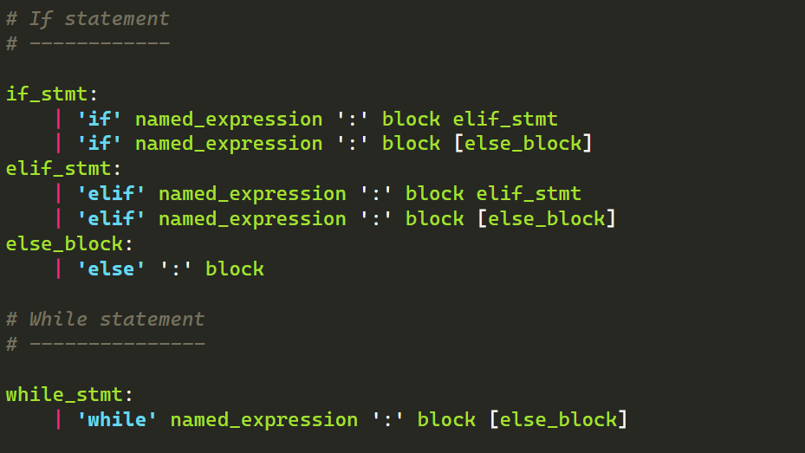
Grammars
Excerpt from the Python grammar
A human language has a grammar which describes the format of valid sentences
Ex: Roughly speaking, English grammar requires subject-verb-object
+: “Sally hit the baseball” (SVO)
-: “Baseball Sally did hit” (OSV)
Ex: Roughly speaking, Spanish grammar allows subject-verb-object and subject-object-verb, depending on the context
+: “Jorge llamó a Fernanda” (SVO: “Jorge called Fernanda”)
+ “Jorge te llamó” (SOV: Literally “Jorge you called,” or what English speakers would state as “Jorge called you”)
By mapping the syntax (i.e., structure) of a particular sentence to the appropriate grammatical structure, we understand the semantics (i.e., meaning) of the sentence
Notes:
[Ref: https://docs.python.org/3/reference/grammar.html]

Slide 4
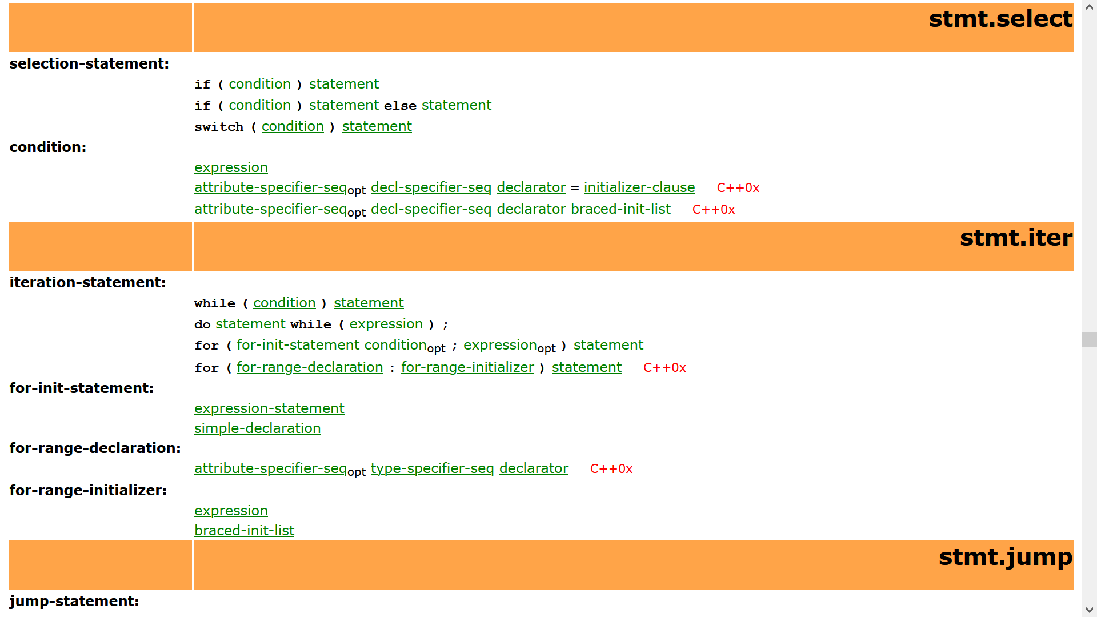
Excerpt from the C++ grammar
Notes:
[Ref: https://alx71hub.github.io/hcb/]

Slide 5
Step 1: Tokenization
Much like a sentence is composed of words, a source code file is composed of tokens
Each kind of token represents a specific kind of symbol that may legally exist in a program
Ex: Identifiers represent variable names and function names (e.g., num_puppies, foo)
Ex: Operators represent the examination or manipulation of data (e.g., =, <, ++)
The language grammar restricts the valid ways that a particular kind of token may be expressed
Ex: In C++, a variable name cannot start with a number
Ex: In Python, the whitespace used for beginning-of-line indentation must be consistent!
Compilation will fail if a program does not respect a language’s token syntax
Source code
int i = 41;
i++;
Token stream
Keyword: “int”
Identifier: “i”
Operator: “=”
Decimal literal: “41”
Punctuator: “;”
Identifier: “i”
Operator: “++”
Punctuator: “;”

Slide 6
Step 2: Parsing
Token stream
Keyword: “int”
The compiler iterates through the tokens and tries to apply the rules of the language grammar
As the compiler scans the tokens, it builds an abstract syntax tree (AST) which represents the grammatical structure of the source code
If the compiler finds a token sequence that cannot be mapped to a grammatical structure, the compilation as a whole fails (although the compiler may try to “look ahead” and find more grammatical errors)
Once the AST is built, the compiler will map the AST to actual machine instructions which implement the appropriate semantics!
Identifier: “i”
Operator: “=”
Decimal literal: “41”
Punctuator: “;”
Identifier: “i”
Operator: “++”
Punctuator: “;”
AST
stmt_seq
decl_assignment
postfix_expr
var: “i"
constant: 41
var: “i"
op: ++
Notes:
[An “abstract syntax tree” is “abstract” because it doesn’t necessarily capture every aspect of syntax that is represented in the higher-level source code. For instance, in the example above, the AST does not explicitly represent semicolon puctuators. As another example, programmers often use parentheses to force the compiler to evaluate operations in a certain order---this . . .
x+(y*z)
. . . is different than this:
(x+y)*z
However, in both cases, the AST doesn’t need to capture the parentheses; the first AST just needs to correctly indicate what the leftmost and rightmost arguments to the various mathematical operators are.]
[Note that the AST shown above is simpler than the one that would be generated by the C++ grammar from https://alx71hub.github.io/hcb/#unqualified-id. However, the basic idea is the same!]

Slide 7
Step 3: Code Generation
assignment
The compiler associates each kind of AST subtree with rules for generating the appropriate CPU instructions
To generate code for the entire program, the compiler makes one or more traversals through the AST, e.g.,
Phase 1: If the developer requested the compiler to perform optimizations, the initial passes will look for opportunities to “improve” the AST
Phase 2: Determine which locations (i.e., which registers and memory areas) will hold the values manipulated by the various parts of the AST
Phase 3: Translate the entire AST to CPU instructions
lhs
rhs
mov *location(rhs), location(lhs)
postfix_expr
lhs
op: ++
inc *location(lhs)
AST
stmt_seq
decl_assignment
postfix_expr
var: “i"
constant: 41
var: “i"
op: ++
Notes:
[The x86 inc instruction simply adds 1 to the operand (either a register or memory location) and stores the result in the operand. Ref: https://www.felixcloutier.com/x86/inc]

Slide 8
Step 3: Code Generation
assignment
The compiler associates each kind of AST subtree with rules for generating the appropriate CPU instructions
To generate code for the entire program, the compiler makes one or more traversals through the AST, e.g.,
Phase 1: If the developer requested the compiler to perform optimizations, the initial passes will look for opportunities to “improve” the AST
Phase 2: Determine which locations (i.e., which registers and memory areas) will hold the values manipulated by the various parts of the AST
Phase 3: Translate the entire AST to CPU instructions
lhs
rhs
mov *location(rhs), location(lhs)
postfix_expr
lhs
op: ++
inc *location(lhs)
AST
Location table
[Empty]
stmt_seq
i
%rax
Let’s store variable i in a register!
This variable has already been declared and lives in %rax!
decl_assignment
postfix_expr
var: “i"
constant: 41
var: “i"
op: ++
Notes:
In this example, let’s imagine that the developer didn’t ask the compiler to perform optimizations.

Slide 9
Step 3: Code Generation
assignment
The compiler associates each kind of AST subtree with rules for generating the appropriate CPU instructions
To generate code for the entire program, the compiler makes one or more traversals through the AST, e.g.,
Phase 1: If the developer requested the compiler to perform optimizations, the initial passes will look for opportunities to “improve” the AST
Phase 2: Determine which locations (i.e., which registers and memory areas) will hold the values manipulated by the various parts of the AST
Phase 3: Translate the entire AST to CPU instructions
lhs
rhs
mov *location(rhs), location(lhs)
postfix_expr
lhs
op: ++
inc *location(lhs)
Apply the code generation rule for assignments, using the relevant information in the location table!
Apply the code generation rule for postfix increment, using the relevant information in the location table!
AST
Location table
stmt_seq
i
%rax
decl_assignment
postfix_expr
var: “i"
constant: 41
var: “i"
op: ++
Generated code:
mov 41, %rax
inc %rax

Slide 10
AND NOW . . .

Slide 11
Simple Examples of Optimization
In general, given two sequences of instructions with equivalent semantics, the sequence with fewer instructions will execute faster!
Original source code
Unoptimized instructions
Optimized instructions
int i = 41;
i++;
mov 41, %rax
inc %rax
mov 42, %rax
Notes:
This optimization is an example of constant folding: the compiler can just look at the source code, without even executing it, and know that i will be set to the value 41+1. [See https://en.wikipedia.org/wiki/Constant_folding.]

Slide 12
Simple Examples of Optimization
Unoptimized instructions
f(int, int):
pushq %rbp
movq %rsp, %rbp
movl %edi, -4(%rbp)
movl %esi, -8(%rbp)
movl -4(%rbp), %eax
addl -8(%rbp), %eax
popq %rbp
retq
main:
pushq %rbp
movq %rsp, %rbp
subq $16, %rsp
movl $0, -4(%rbp)
movl $30, %edi
xorl %esi, %esi
callq f(int, int)
xorl %eax, %eax
addq $16, %rsp
popq %rbp
retq
Set up f()’s stack frame
Copy the function arguments x and y (which are in %edi and %esi) to locations in f()’s stack frame
Original source code
Copy x’s value in the stack to %eax, then add y’s value in the stack to %eax
int f(int x, int y) {
return x + y;
}
int main() {
f(30, 0);
return 0;
}
The return value is in %eax; return from the function!
[Addr]
%rbp
main()’s stack frame
[Addr]
%rbp for main()
%rsp
x
f()’s stack frame
x’s value
%edi
x+y
y’s value
y
%eax
%esi
Notes:
Recall that, in the System V ABI, the first argument is passed via %rdi and the second one is passed via %rsi; see Lecture 4! [Note that %edi represents the first 32 bits of the 64-bit register %rdi, and %esi represents the first 32-bits of the 64-bit register %rsi; see https://cs61.seas.harvard.edu/site/2023/Asm/#Registers.]

Slide 13
Simple Examples of Optimization
Unoptimized instructions
f(int, int):
pushq %rbp
movq %rsp, %rbp
movl %edi, -4(%rbp)
movl %esi, -8(%rbp)
movl -4(%rbp), %eax
addl -8(%rbp), %eax
popq %rbp
retq
main:
pushq %rbp
movq %rsp, %rbp
subq $16, %rsp
movl $0, -4(%rbp)
movl $30, %edi
xorl %esi, %esi
callq f(int, int)
xorl %eax, %eax
addq $16, %rsp
popq %rbp
retq
Set up f()’s stack frame
Copy the function arguments x and y (which are in %edi and %esi) to locations in f()’s stack frame
Original source code
Copy x’s value in the stack to %eax, then add y’s value in the stack to %eax
int f(int x, int y) {
return x + y;
}
int main() {
f(30, 0);
return 0;
}
The return value is in %eax; return from the function!
Set up main()‘s stack frame
Set up the arguments to f() stack frame and then invoke f()
Place the return value of 0 in %eax (recall that XOR’ing a value with itself always results in 0!), deallocate the stack frame by incrementing %rsp, and return!

Slide 14
Simple Examples of Optimization
Unoptimized instructions
Optimized instructions
f(int, int):
pushq %rbp
movq %rsp, %rbp
movl %edi, -4(%rbp)
movl %esi, -8(%rbp)
movl -4(%rbp), %eax
addl -8(%rbp), %eax
popq %rbp
retq
main:
pushq %rbp
movq %rsp, %rbp
subq $16, %rsp
movl $0, -4(%rbp)
movl $30, %edi
xorl %esi, %esi
callq f(int, int)
xorl %eax, %eax
addq $16, %rsp
popq %rbp
retq
f(int, int):
leal (%rdi,%rsi), %eax
retq
main:
xorl %eax, %eax
retq
Original source code
int f(int x, int y) {
return x + y;
}
int main() {
f(30, 0);
return 0;
}
The compiler sees that:
f() can use a single leal instruction to add the function arguments and put the result in %eax
main() will always return 0, so there’s no need to even call f()—just place 0 in %eax and return!
Notes:
The lea instruction “loads an effective address,” and is often used by compilers to implement array indexing. The instruction . . .
lea (%src1, %src2, N), %dst
. . has these semantics:
%dst = %src1 + (N * %src2)
Such an instruction is useful if you want to calculate the memory address of the i-th element of an array where each element has a sizeof==N; just place the starting address of the array in %src1 and the index i in %src2! In the example above, the function f uses the instruction . . .
leal (%rdi, %rsi), %eax
. . . with the N value implicitly being 1.
[You can try this example yourself on Godbolt (https://godbolt.org/)! The compiler used in this example was x86-64 clang 16.0.0 with no optimizations or –O1 optimizations.]

Slide 15
Compilers May Generate Spooky Binaries!
With no/few optimizations enabled, the compiler may generate code that contains obvious inefficiencies
With optimizations enabled, the compiler may generate seemingly weird sequences
The semantics of the instruction sequences may not be obvious
The compiler may omit (i.e., “optimize away”) entire parts of your source code!
Use objdump –d <executableName> to display the instructions in a binary!
Notes:
An example of an obvious inefficiency was shown in the previous example of unoptimized code. The compiler could have just done arithmetic directly on the registers containing the arguments x and y. However, the compiler instead generated instructions to store the arguments in memory locations, and then perform math that read those values from memory and stored the result in a register.
The “-d” option for objdump instructs objdump to “disassemble” a binary, i.e., parse the binary and display the static data and executable instructions in that binary.

Slide 16
The Many-to-Many Mappings Between Source Code and CPU Instructions
The same piece of source code can be mapped to many different sequences of machine instructions
Ex: An optimizing compiler may generate shorter sequences than a non-optimizing compiler
Ex: A sanitizing compiler may add “extra” instructions to check for undefined behavior
Ex: A security-conscious compiler may add “extra” instructions to check for security problems
Similarly, the same sequence of machine instructions can be mapped to multiple kinds of source code
A set of bytes in a register or in memory can be interpreted in different ways by higher-level languages
Semantically-different pieces of source code might still perform the same instruction-level operations

Slide 17
//C++ code
int f(int x, int y) {
return x + y;
}
//C++ code
int f(int orange, int julius) {
return orange + julius;
}
Source code names aren’t reflected in the CPU instructions!
//C++ code
unsigned int f(unsigned int x,
unsigned int y) {
return x + y;
}
The same x86-64 instructions do math on 32-bit ints and unsigned ints!
//x86 assembly
leal (%rdi,%rsi), %eax
retq
64-bit math uses different instructions than 32-bit math!
//C++ code
long f(long x, long y) {
return x + y;
}
//C++ code
char* f(char* a, long b) {
return &a[b];
}
On a 64-bit CPU, pointers hold 64-bit addresses!
Returning a 64-bit value requires a 64-bit register!
//x86 assembly
leaq (%rdi,%rsi), %rax
retq
Notes:
The “l” at the end of an arithmetic instruction like “leal” means that the instruction represents an x86-64-level “double word” that is 4 bytes long. The “q” indicates an operation on an 8-byte “quad word.” [Trivia: On x86-64, a “word” is 16 bits (i.e., two bytes) long because the original x86 CPUs were 16-bit!]

Slide 18
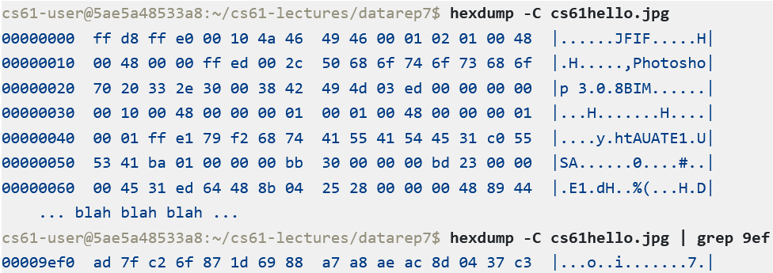
An Interesting Stunt
Address space
int add(int a, int b) {
// Open the image file
const char* file = "cs61hello.jpg";
int fd = open(file, O_RDONLY);
assert(fd >= 0);
// Look up the file’s size
struct stat s;
int r = fstat(fd, &s);
assert(r >= 0 && S_ISREG(s.st_mode) &&
s.st_size > 0);
// Load it into memory starting at
// address `data`; treat it as executable!
void* data = mmap(nullptr, s.st_size,
PROT_READ | PROT_EXEC,
MAP_SHARED, fd, 0);
assert(data != MAP_FAILED);
// Obtain address of bytes in the image
// that represent 8d 04 37 c3 . . .
uintptr_t function_address =
(uintptr_t) data + 0x9efc;
// Add a and b using that code!
int (*function_pointer)(int, int) =
(int (*)(int, int)) function_address;
// Call add function!
return function_pointer(a, b);
}
Stack
R+W
mmap’ed file data for cs61hello.jpg
//x86 assembly
leal (%rdi,%rsi), %eax
retq
//Byte representation
8d 04 37 c3
R+X
Heap
R+W
Static data
R(+W for some data)
cs61hello.jpg
Code
R+X
Notes:
[Note that the use of asserts in this function probably isn’t what you’d want to do in real code. System calls often fail in real life, so you often don’t want to treat them as fatal. For example, an open() may fail for a variety of reasons, e.g., the desired file has been deleted, or the file exists but the user doesn’t have the appropriate access permissions.]

Slide 19
An Interesting Stunt
int add(int a, int b) {
// Open the image file
const char* file = "cs61hello.jpg";
int fd = open(file, O_RDONLY);
assert(fd >= 0);
// Look up the file’s size
struct stat s;
int r = fstat(fd, &s);
assert(r >= 0 && S_ISREG(s.st_mode) &&
s.st_size > 0);
// Load it into memory starting at
// address `data`; treat it as executable!
void* data = mmap(nullptr, s.st_size,
PROT_READ | PROT_EXEC,
MAP_SHARED, fd, 0);
assert(data != MAP_FAILED);
// Obtain address of bytes in the image
// that represent 8d 04 37 c3 . . .
uintptr_t function_address =
(uintptr_t) data + 0x9efc;
// Add a and b using that code!
int (*function_pointer)(int, int) =
(int (*)(int, int)) function_address;
// Call add function!
return function_pointer(a, b);
}
This will work! The meaning of a byte sequence depends on how you interpret it 😅.
cs61hello.jpg

Slide 20
Interpreters
#Python code
def mult(i, j):
return i * j
Given an AST, a compiler generates CPU instructions that implement the semantics of the AST
Given an AST, an interpreter executes the program directly
The interpreter implements data structures that represent a software-level “virtual” CPU
The interpreter iterates through the AST (or more commonly, through bytecode derived from the AST), updating the virtual CPU as required by the AST/bytecode
If the AST/bytecode wants to interact with the outside world, the interpreter issues the appropriate system calls
#Python bytecode
#The interpreter associates each
#function has a co_varnames tuple
#that contains the locations of the
#function’s args and local vars.
#The LOAD_FAST i bytecode pushes
#co_varnames[i] onto the interpreter
#stack.
LOAD_FAST 0 #i
LOAD_FAST 1 #j
#Pop two items off the stack, perform
#an operation on them, and push the
#result.
BINARY_OP 5 #*
#Pop the top-of-stack and return it.
RETURN_VALUE
Notes:
You can think of a bytecode as being the CPU instructions for the virtual CPU that is defined by the interpreter!
[Ref: https://docs.python.org/3/library/dis.html
https://lerner.co.il/wp-content/uploads/2020/04/Function-dissection-lab.pdf]

Slide 21
Compilation vs. Interpretation
In the “edit-compile-run” loop, the “compile” phase is faster with an interpreter
The interpreter just has to translate source code to an intermediate form and can then execute that intermediate form
A compiler must translate the intermediate form to native CPU instructions before the program can run
However, once a program has been compiled, it will typically run faster than an interpreted version
An interpreter requires extra “bookkeeping” instructions to maintain the state of the virtual CPU
A compiled version of a program only runs the instructions necessary to implement the program’s semantics
For performance reasons, interpreters are often written in C/C++
Ex: The CPython Python interpreter is written in C and Python
Ex: The HotSpot Java virtual machine is written in C/C++ and Java

