Slide 1
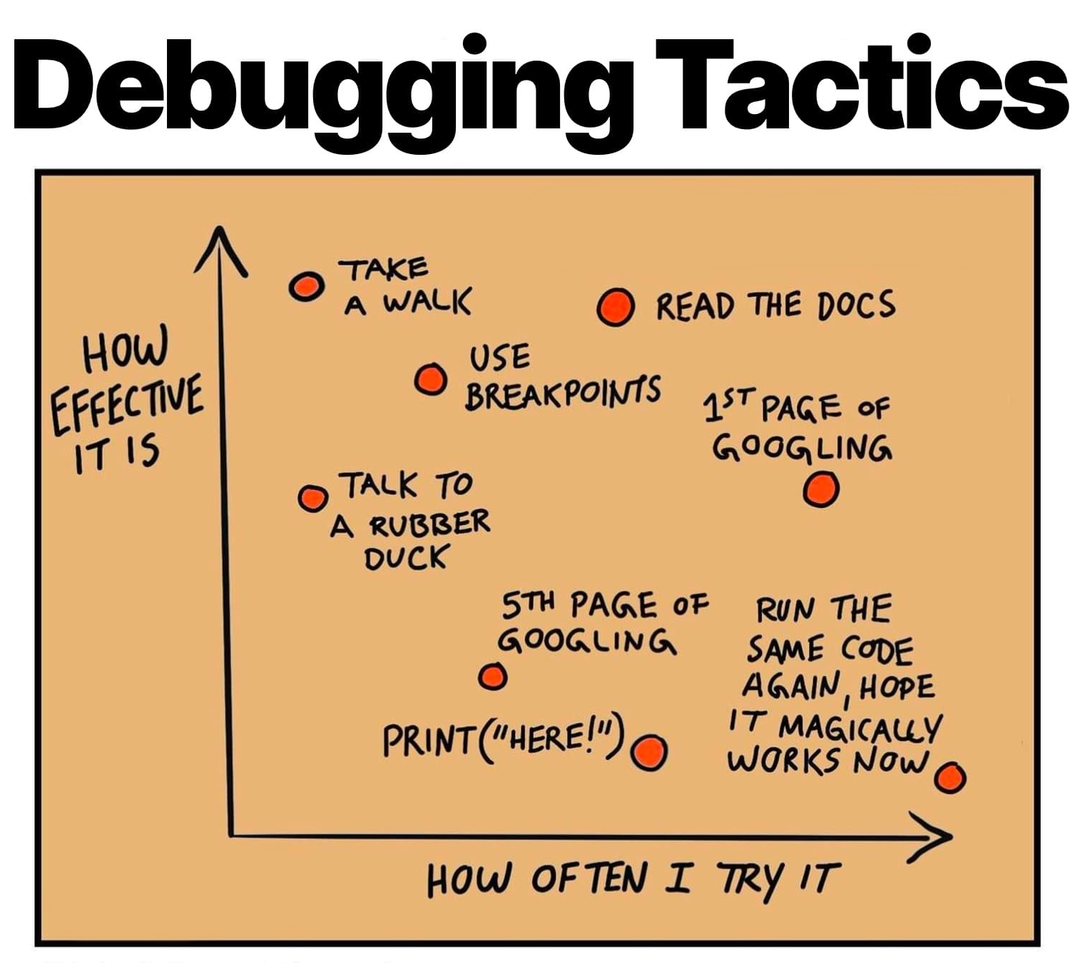
Debugging
CS 61: Lecture 5 9/20/2023

Slide 2
Notes:
On the CS 61 website, you can find links to the lecture slides and pointers to helpful reading!

Slide 3
BUGS ARE ALMOST ALWAYS YOUR FAULT
It is possible that your IDE, the compiler, the OS, Docker, or local weather conditions caused your program to misbehave
It is probable that the cause is an error in your code
This observation is true for programmers of all skill levels!

Slide 4
What Should You Do When Your Program Misbehaves?
The first thing is to realize that your program bug is trying to tell you something
At a high level, a bug is saying “the programmer thinks that X, Y, and Z are true, but the program thinks that X, Y, and S are true”
The mismatches in expectation are what cause the program to misbehave
Sometimes the programmer is correct about what should be happening
Sometimes the program is correct and the error messages/crashes/etc. are pointing out a flaw in your own thinking!
So, when a bug occurs, you should:
Think explicitly and concretely about what your expectations are
Figure out how they differ from the expectations of the program
Determine whether the code needs to be fixed and/or your expectations need to be fixed

Slide 5
Asserts: Codifying Expectations
Example of a binary search tree
40
An assert checks whether a condition is true, terminating the program if the condition is false
Use assertions to perform sanity checks, i.e., to ensure that logically impossible conditions are not actually happening
If a program encounters a logically impossible condition, the program has a serious bug
In this scenario, you should prefer to have your program exit immediately (“fail stop”) instead of continuing to execute and corrupting data or doing other bad stuff!
Avoid assertions when dealing with “reasonable” or ”routine” failure modes
30
50
35
25
45
60
/**
* The invariant for a binary search tree
* is that, for any parent node, the
* parent's key is greater than or equal to
* the left child's key, and less than the
* right child's key.
*/
void bst_insert (/* params */) {
//...code...
assert((parent->left == nullptr) ||
(parent->left.key <= parent->key));
assert((parent->right == nullptr) ||
(parent->right.key > parent->key));
//...code...
}

Slide 6
Asserts: Codifying Expectations
/**
* The new operator will fail if there
* is no free space in the heap . . .
* but this may not always be a fatal
* fatal error!
*/
std::map<int, char*> cache;
while (true) {
request req = get_req();
if (cache.find(req.key) !=
cache.end()) {
send_resp(cache[req.key]);
} else {
char* resp =
new (std::nothrow) char[SIZE];
if (resp == nullptr) {
//Free some memory!
cache.clear();
resp = new (std::nothrow)
char[SIZE];
assert(resp != nullptr);
}
fill_in_response(resp);
cache[req.key] = resp;
send_resp(resp);
}
}
An assert checks whether a condition is true, terminating the program if the condition is false
Use assertions to perform sanity checks, i.e., to ensure that logically impossible conditions are not actually happening
If a program encounters a logically impossible condition, the program has a serious bug
In this scenario, you should prefer to have your program exit immediately (“fail stop”) instead of continuing to execute and corrupting data or doing other bad stuff!
Avoid assertions when dealing with “reasonable” or ”routine” failure modes
Notes:
You might wonder why the calls to new are being adorned with “(std::nothrow)”. As it turns out, you can pass arguments to the new operator! One of the things that you can do is pass std::nothrow, which indicates that if new cannot allocate memory, then new should return nullptr instead of throwing an exception. [For more details on this, see https://cplusplus.com/doc/tutorial/exceptions/ and https://cplusplus.com/reference/new/nothrow/.]

Slide 7
Asserts: Codifying Expectations
/**
* You should always check the return
* values of system calls!
*
* Suppose that a process wants to
* examine the data in a file . . .
*/
int fd = open(“file.txt”, O_RDONLY);
if (fd == -1) {
perror(“open() failed:”);
exit(-1);
}
//Try to read 32 bytes of file data!
char buf[32];
ssize_t n;
while (true) {
n = read(fd, buf, sizeof(buf));
if (n == 0) {
printf(“End of file reached!\n”);
break;
} else if (n == -1) {
perror(“read() failed:”);
break;
} else {
analyze_file_data(buf, n);
}
}
An assert checks whether a condition is true, terminating the program if the condition is false
Use assertions to perform sanity checks, i.e., to ensure that logically impossible conditions are not actually happening
If a program encounters a logically impossible condition, the program has a serious bug
In this scenario, you should prefer to have your program exit immediately (“fail stop”) instead of continuing to execute and corrupting data or doing other bad stuff!
Avoid assertions when dealing with “reasonable” or ”routine” failure modes
Notes:
Checking the return values of system calls is an example of defensive programming---the explicit act of thinking about how your program might fail and including code to handle potential failure paths. Using asserts is another way to practice defensive programming.
[Note that, after you finish handling a file, you’ll want to close() the file descriptor :-D. See https://man7.org/linux/man-pages/man2/close.2.html.]

Slide 8
Good Programming Habits
To “desk check” code means to “read the code, simulate in your mind what it will do, and think about whether the simulated behavior is what you actually want”
You can discover many logic bugs and syntax errors this way!
You should prefer your compilation errors to only involve syntax errors, not semantic mistakes as well
Incrementally write a small amount of code, desk-check that code, compile the program, and then test the program
This approach leads to easier-to-understand compilation errors
This approach also makes it easier to localize the source of newly manifested bugs—the culprit will often reside in the small amount of new code

Slide 9
Reproducible Test Cases
Ideally, a buggy program will always act the same way when given the same input
You (or someone else) can deterministically trigger a bug simply by feeding a particular input to the program
The problematic input is thus a reproducible test case
The best reproducible test case is a minimal one—the smallest/least complex input which triggers a bug
When you’re trying to fix a bug (or asking someone else for debugging help!), always try to generate:
A minimal, reproducible test case
An explicit statement of what you think should have happened but did not happen

Slide 10
THE MERE STATEMENT “I AM NOT PASSING test49.cc” IS NOT A REPRODUCIBLE TEST CASE

Slide 11
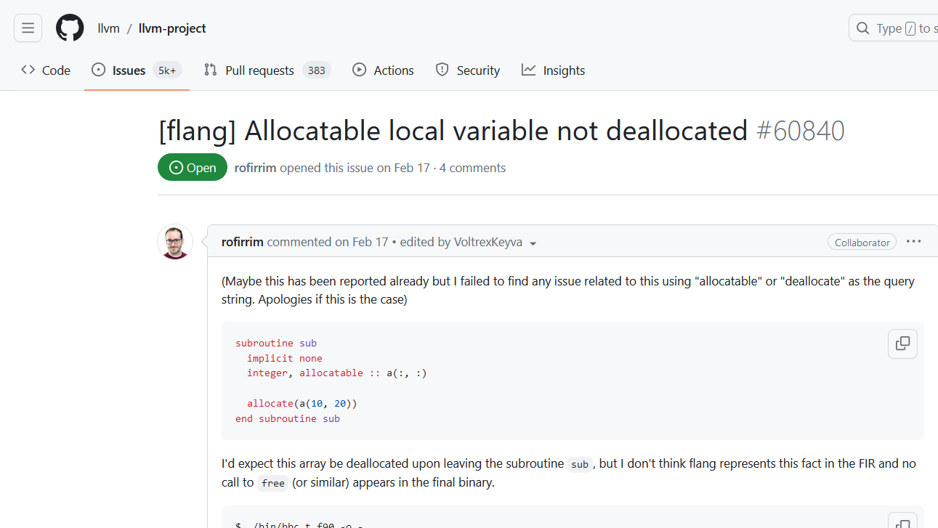
Notes:
[Ref: https://github.com/llvm/llvm-project/issues/60840]

Slide 12
Nondeterministic Bugs
Sometimes, a program may do different things even when provided with a fixed set of inputs!
Ex: A program’s behavior may be decided by random numbers
Ex: A program may trigger undefined behavior
Just trying to debug the problem may cause the bug to disappear!
Ex: Invoking a debug printf() will result in an additional stack frame being created and destroyed, possibly changing the bytes that populate an uninitialized local variable that is later (incorrectly) read
As a result, nondeterministic bugs are sometimes called “Heisenbugs”
Finding the source of nondeterminism is often the first step in creating a reproducible test case!
//A simple fortune-telling program
#include <cstdio>
#include <cstdlib>
int main() {
printf(“Your fortune:\t”);
long r = random() % 3;
switch (r) {
case 0:
printf(“Great success!\n”);
break;
case 1:
printf(“Slight joy.\n”);
break;
case 2:
long* ptr = &r;
ptr++; //OH NO
printf(“%ld\n”, *ptr);
break;
}
return 0;
}
Notes:
The sample program both suffers from undefined behavior and also has behavior that is intrinsically decided by random numbers!
Nondeterministic bugs are sometimes called “Heisenbugs,” a joke name inspired by the name of Werner Heisenberg, a famous physicist who studied quantum mechanics. A “heisenbug” is one that seems to disappear whenever you try to recreate it. The joke is that, in quantum mechanics, the behavior of a physical system can change due to the mere act of observing the system. See https://en.wikipedia.org/wiki/Heisenbug.

Slide 13
Recap of What We’ve Discussed So Far
You can get pretty far with desk checking, asserts, defensive programming, and debugging print statements!
Be tasteful with the use of these techniques
Don’t create unnecessary defensive checks (e.g., don’t check a pointer for nullptr multiple times in the same function unless you reassign to the pointer)
Make your debugging print statements easy to parse by people and/or scripts!
Good: printf(“x: %8lu y: %7lu z: %7lu\n”, x, y, z)
Less good: printf(“Variable values of x,y,z are: %lu %lu %lu\n”, x, y, z)
Think about what print statements will be easier to read when it’s 2am and you’re drinking your fifth Red Bull
Notes:
[The “less good” printf example is bad because data names aren’t immediately next to data values, and because the three columns of output numbers may not remain a tidy vertical alignment due to the lack of minimal character length specifiers!]

Slide 14
Advanced Debugging Tools

Slide 15
Address Sanitization
Address space
Goal: Detect out-of-bounds memory accesses and uses of deallocated memory
Strategy for the heap:
Divide heap memory into 8-byte-aligned chunks of 8 bytes each
For each chunk, maintain a byte of shadow memory which tracks how many of a chunk’s bytes are valid
0 means all 8 bytes are valid
k (for 1 <= k <= 7) means that the first k bytes are valid
Anything else means that the memory shouldn’t be accessed
Update shadow memory during new and delete
For each instruction which tries to access memory, have the compiler insert new instructions which check shadow memory to see if the access is valid!
Stack
Shadow memory
Only the first 4 bytes of the new allocation are valid!
. . .
255
255
255
4
Heap
0
0
0
Static data
. . .
Code
Program does int*p = new int, enlarging the heap by 16 bytes (with only sizeof(int)==4 bytes actually valid)
Shadow memory
Notes:
[Aside: In reality, the clang implementation of address sanitization places the shadow memory in the middle of the address space, not at the bottom; the basic idea is the same. For the technical details, see the academic paper about clang’s sanitizer: https://www.usenix.org/system/files/conference/atc12/atc12-final39.pdf]

Slide 16
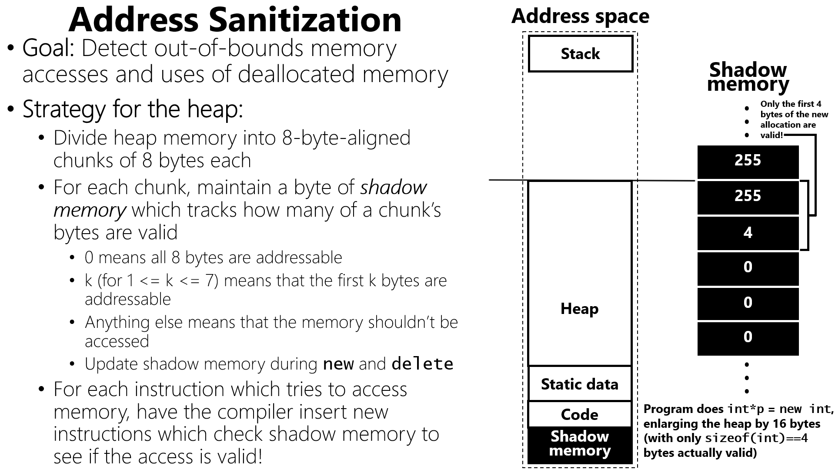
//Developer-written code
int* p = new int;
int* arr = p;
printf(“%d\n”, arr[1]);
//Instrumented code
int* p = new int;
int* arr = p;
//arr[1] lives in the last 4 bytes of an
//8 byte chunk. So, the relevant shadow
//byte needs to indicate that all 8 bytes
//of the chunk are valid.
char sb = _san_get_sb(&arr[1]); //sb is here:
if (sb != 0) {
report_and_crash(&arr[1]);
}
printf(“%d\n”, arr[1]);
Notes:
[Recall that, when allocating memory for an object, the object is placed at the *beginning* of the memory slot. So, if the memory at the end of a slot must be valid, that means that all preceding bytes in the slot must also be valid. This is why, in the sanitization code above, the sanitizer checks whether all 8 bytes of the chunk are valid—this ensures that the 4 bytes at the end of the chunk are valid.]

Slide 17
Address Sanitization
Address space
Address sanitizers are not guaranteed to catch all memory errors!
Suppose that a program generates the shadow memory on the right by doing:
The following buffer overread will not trigger a sanitization error!
Stack
Shadow memory
. . .
int* arr = new int[4]; //Allocates a 16 byte
//region, all of which
//is valid
int* p = new int; //Allocates a 16 byte
//region, but only the
//first 4 bytes are
//valid
255
255
Second allocation
255
4
Heap
0
0
First allocation
0
printf("%d\n", arr[4]);//A buffer overread of
//4 bytes . . . but the
//overread targets valid
//memory from the sanitizer’s
//perspective!
Static data
. . .
Code
Shadow memory

Slide 18
Address Sanitization
To catch those kinds of errors, a sanitizer can use redzones
The heap allocator will “overallocate,” placing an object in the middle of a heap region that is bigger than the object
The shadow memory for the redzones will be marked as invalid
This approach guarantees that invalid memory accesses “near” an object will be detected
There is a trade-off between:
The coverage of the memory errors that you can detect
The excess memory consumed by redzones (and excess CPU work incurred by checks)
The redzone approach can also be used to protect stack variables and global variables!
Heap allocation:
24 byte object with 16 byte redzones
Shadow memory
. . .
255
Redzone
Redzone
255
Heap object
0
0
Object
0
Redzone
255
Redzone
255
. . .
Notes:
[pset1 essentially asks you to create a redzone at the end of an allocation to detect overwrites of a heap object!]

Slide 19
More Sanitizer Goodness
Sanitizers can detect various problems involving undefined (or otherwise undesired) behavior
Ex: Overflow on integers (both signed and unsigned)
int main() {
unsigned int k = 0xffffffff;
printf("%u\n", k);
k += 1; //Oh no---overflow!
printf("%u\n", k);
return 0;
}
At the binary level, the addition looks like this . . .
Compiled with no sanitizers
11111111’11111111’11111111’11111111
+ 1
------------------------------------
1’00000000’00000000’00000000’00000000
4294967295
0
Console
. . . but an unsigned int can only hold 4 bytes, so the high-order bit is dropped and only the zeroes remain 😭
Notes:
The unsigned int value 0xffff’ffff corresponds to the largest representable value for the type---4294967295. At the binary level, such a value consists of all 1s. When we try to add 1 to that value, we trigger a series of carries, similar to what would happen in decimal arithmetic if you added 1 to 999. In decimal arithmetic, 999+1 equals 1000; in other words, we’d require an additional decimal digit to hold the result of cascading carries. However, on a computer with a fixed size integer type, there is no way to add another binary digit to hold the cascading carry. So, the result is that the final carry is lost, and the value “wraps around” to the all-zeroes value! For more information about binary arithmetic, see https://cs61.seas.harvard.edu/site/2023/Datarep/#Unsigned-integers, https://cs61.seas.harvard.edu/site/2023/Datarep/#Signed-integers, and https://cs61.seas.harvard.edu/site/2023/Datarep/#Computer-arithmetic; also, in the textbook, see §2.2 and §2.3.
[As described by the CS 61 webpage mentioned above, “Arithmetic on unsigned integers is much safer [than arithmetic on signed integers] with respect to undefined behavior. Unsigned integers are defined to perform arithmetic modulo their size. This means that if you add 1 to the maximum positive unsigned integer, the result will always be zero.” However, even though this behavior is defined, it is often surprising to developers nonetheless :-D.]
[For more information about what kinds of undefined/undesireable behavior can be detected by the clang compiler, see https://clang.llvm.org/docs/UndefinedBehaviorSanitizer.html. As that documentation notes, “Unlike signed integer overflow, [unsigned integer overflow] is not undefined behavior, but it is often unintentional.”]

Slide 20
More Sanitizer Goodness
Sanitizers can detect various problems involving undefined (or otherwise undesired) behavior
Ex: Overflow on integers (both signed and unsigned)
int main() {
unsigned int k = 0xffffffff;
printf("%u\n", k);
k += 1; //Oh no---overflow!
printf("%u\n", k);
return 0;
}
At the binary level, the addition looks like this . . .
With the sanitizer enabled, the compiler inserts extra code to check whether an arithmetic operation causes overflow!
Compiled with -fsanitize=unsigned-integer-overflow
11111111’11111111’11111111’11111111
+ 1
------------------------------------
1’00000000’00000000’00000000’00000000
runtime error: unsigned integer overflow: 4294967295 + 1 cannot be represented in type 'unsigned int'
SUMMARY: UndefinedBehaviorSanitizer: undefined-behavior /app/example.cpp:6:7
4294967295
0
Console
. . . but an unsigned int can only hold 4 bytes, so the high-order bit is dropped and only the zeroes remain 😭

Slide 21
More Sanitizer Goodness
int main() {
int i = 42;
char* c_ptr = (char*) &i;
c_ptr++;
int* ptr = (int*) c_ptr; //Oh no!
//Misalignment!
printf("&i:\t%p\n", &i);
printf("ptr:\t%p\n", ptr);
hexdump_object(i);
printf("%d\n", *ptr);
return 0;
}
Sanitizers can detect various problems involving undefined (or otherwise undesired) behavior
Ex: Overflow on integers (both signed and unsigned)
Ex: Use of an unaligned pointer
Compiled with no sanitizers
&i: 0x7ffe3f25aff8
ptr: 0x7ffe3f25aff9
7ffe3f25aff8 2a 00 00 00 |*...|
0
Console
Notes:
[Here’s the full source code if you want to run this example on godbolt.org with x86-64 clang---be sure to try it with and without the “-fsanitize=alignment” compiler argument!
#include <cstdio>
#include <cstdlib>
static void fhexdump_ascii(FILE* f, const unsigned char* p, size_t pos) {
// Print an ASCII report that ends with byte p[pos].
// The first byte printed is p[first], where first is the max multiple
// of 16 having `first < pos`. The report starts at column 51.
size_t first = pos - (pos % 16); // first char to print
int n = pos + 1 - first; // # chars to print
char buf[17];
for (size_t i = first; i != first + n; ++i) {
buf[i - first] = (p[i] >= 32 && p[i] < 127 ? p[i] : '.');
}
fprintf(f, "%*s|%.*s|\n", 51 - (3 * n + (n > 8)), "", n, buf);
}
void fhexdump_at(FILE* f, size_t first_offset, const void* ptr, size_t size) {
const unsigned char* p = (const unsigned char*) ptr;
for (size_t i = 0; i != size; ++i) {
if (i % 16 == 0) {
fprintf(f, "%08zx", first_offset + i);
}
fprintf(f, "%s%02x", (i % 8 == 0 ? " " : " "), (unsigned) p[i]);
if (i % 16 == 15 || i == size - 1) {
fhexdump_ascii(f, p, i);
}
}
}
void hexdump(const void* ptr, size_t size) {
fhexdump_at(stdout, (size_t) ptr, ptr, size);
}
#define hexdump_object(object) hexdump(&(object), sizeof((object)))
int main() {
int i = 42;
char* c_ptr = (char*) &i;
c_ptr++;
int* ptr = (int*) c_ptr; //Oh no!
//Misalignment!
printf("&i:\t%p\n", &i);
printf("ptr:\t%p\n", ptr);
hexdump_object(i);
printf("%d\n", *ptr);
return 0;
}
]

Slide 22
More Sanitizer Goodness
int main() {
int i = 42;
char* c_ptr = (char*) &i;
c_ptr++;
int* ptr = (int*) c_ptr; //Oh no!
//Misalignment!
printf("&i:\t%p\n", &i);
printf("ptr:\t%p\n", ptr);
hexdump_object(i);
printf("%d\n", *ptr);
return 0;
}
Sanitizers can detect various problems involving undefined (or otherwise undesired) behavior
Ex: Overflow on integers (both signed and unsigned)
Ex: Use of an unaligned pointer
Ex: Division by zero
Ex: Loading of a bool value which is neither true nor false
Ex: Casting from a larger integer type to a smaller one such that data loss occurs
Sanitization checks slow down your program!
Compiled with -fsanitize=alignment
runtime error: load of misaligned address 0x7ffe3f25aff9 for type 'int', which requires 4 byte alignment
SUMMARY: UndefinedBehaviorSanitizer: undefined-behavior /app/example.cpp:10
&i: 0x7ffe3f25aff8
ptr: 0x7ffe3f25aff9
7ffe3f25aff8 2a 00 00 00 |*...|
0
Console
Notes:
Casting from a larger integer type to a small one will cause data loss if the smaller type cannot hold the original value. For example, consider an unsigned int value of 1024. Such a value is too large to hold in an unsigned char!

Slide 23
Notes:
[To use this online gdb sandbox, see https://www.onlinegdb.com/.]

Slide 24
Debugging via gdb
gdb is a debugger, i.e., a program that is used to analyze and debug the behavior of other programs
gdb lives in a separate process than the one to debug
gdb uses system calls to read and write the memory and registers of the debuggee
Helpful gdb commands:
b <func_name>: Place a breakpoint at the beginning of <func_name>
c: Continues to run the program until hitting a breakpoint, error, or program termination
s: Step through (i.e., run) the next line in the program
bt: Print a “backtrace” (i.e., a stack trace)
info reg: Print the values of the registers
Debugging using gdb is often less tedious than debugging via print statements 😅
Notes:
[For a cheatsheet of handy gdb commands, see https://users.ece.utexas.edu/~adnan/gdb-refcard.pdf.]

