Slide 1
Functions
CS 61: Lecture 4 9/18/2023

Slide 2
C++: Pointer Arithmetic
Address space
A pointer holds the location (i.e., memory address) of an object
Ex: An int* holds the address of an int
Ex: A float* holds the address of a float
C++ allows some kinds of pointer arithmetic
IT IS VERY IMPORTANT FOR YOU TO BECOME COMFORTABLE WITH POINTERS AND POINTER ARITHMETIC
Stack
Byte N-1
Typically a bad idea to create pointers to unallocated space—we’ll return to this topic when we discuss virtual memory!
A pointer value represents a location in this space
Heap
Static data
Code
Byte 0

Slide 3
Index:
0
1
2
3
4
char a[5] = {‘C’,‘S’,‘6’,‘1’,‘!’};
char* p1 = &a[1];
char* p2 = &a[4];
C
S
6
1
!
a
p1
p2
Notes:
You can think of the entire address space as one big array. This allows you to understand pointer arithmetic involving arbitrary pointers, not just ones derived from a specific C++ array (as in the example above).
[Ref: https://cs61.seas.harvard.edu/site/2023/Datarep/#Pointer-arithmetic]

Slide 4
Let’s play around with functions!

Slide 5
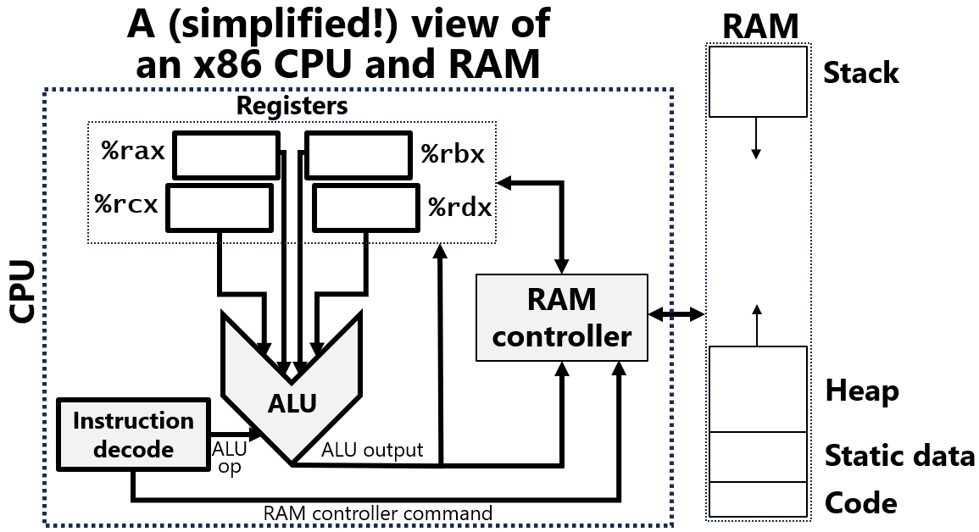
We’ll practice on the toy x86-64 CPU before seeing what happens on a real x86-64 CPU!

Slide 6
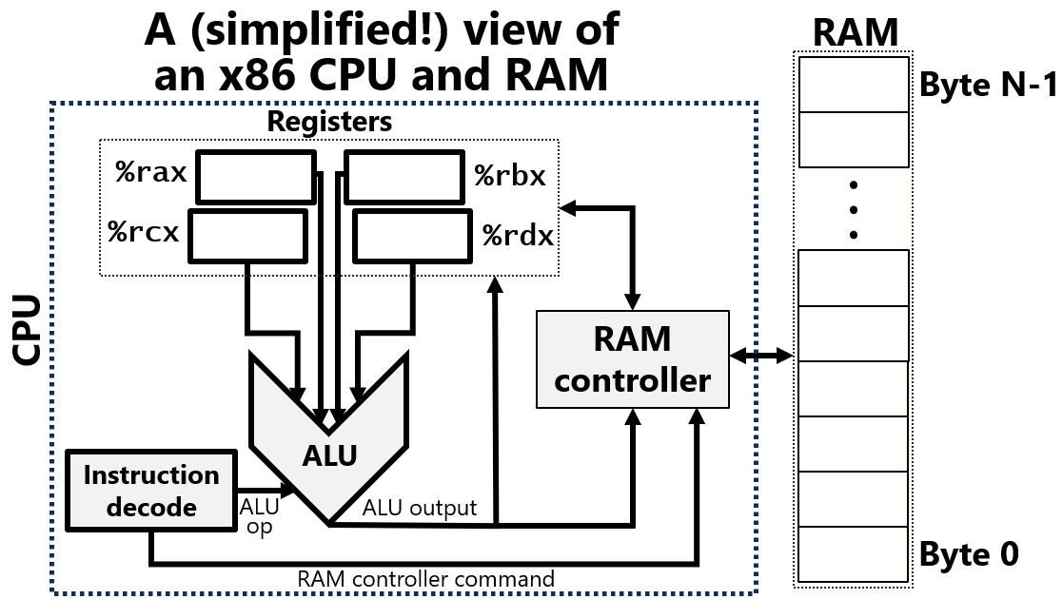
Function Arguments: Pass-by-value in Python
def f(arg):
arg = 0
x = 2
f(x)
print(“x is {}”.format(x))
The program passes an integer variable x to a function
The function modifies its parameter . . .
. . . but the change does not modify the caller’s value!
The reason is that the function parameter is a copy of the caller’s value—changes to the function’s copy do not affect the caller’s value
How is this implemented?
The two values might live in different registers
Or maybe one value lives in memory and the other lives in a register
Or maybe the two values live in different memory locations
The compiler/interpreter decide!
Console output: x is 2
Notes:
We will talk more about compilers vs. interpreters in a few lectures!

Slide 7
Function Arguments: Pass-by-reference in Python
def f(arg):
arg = [“P”]
x = [“C”, “S”, “6”, “1”]
f(x)
print(“x is {}”.format(x))
In Python (and other languages like Java and C#), non-primitive values use pass-by-reference
The callee’s argument is a pointer to the caller’s value
The callee’s pointer can be changed to point to something else—this does not affect what the caller’s pointer is pointing to!
However, if the callee changes the referenced value, that change is seen by the caller
Pass-by-reference avoids copying the value, which can result in big savings if the value is big!
Console output: x is ["C", "S", "6", "1"]
def f(arg):
arg[0] = “P”
x = [“C”, “S”, “6”, “1”]
f(x)
print(“x is {}”.format(x))
Console output: x is [“P", "S", "6", "1"]
Notes:
[Examples of a “big value” would be an array containing millions of integers.]

Slide 8
Pass-by-reference in Python: One Implementation
The array is created and the reference x is stored in %rbx
The function f(x) is invoked, such that a copy of the reference (not a copy of the array) is placed in %rax as a function argument
The function does mov 0x50, 0x0(%rax), where 0x50 is the ASCII value for the character ‘P’!
def f(arg):
arg[0] = “P”
x = [“C”, “S”, “6”, “1”]
f(x)
print(“x is {}”.format(x))
#Step 3
1
#Step 1
6
S
#Step 2
C
P
Start address of array
Console output: x is [“P", "S", "6", "1"]
Notes:
[Aside: The way that pass-by-reference actually happens in Python is more subtle than what happens here, e.g., because in CPython, an interpreter is involved. We’ll discuss this more in the lectures about compilation and assembly programming! For now, suffice it to say that the slide above is giving a feel for what happens, but the use of registers and memory by a real version of the program might differ.]
[Aside: Another subtlety is that Python employs Unicode, not ASCII, to represent strings. However, the byte-level Unicode representation of an ASCII character is equal to the byte-level ASCII representation of that character. In other words, the character ‘A’ has the same byte-encoding in Unicode as in ASCII. See here for more details: https://docs.python.org/3/howto/unicode.html. We’ll talk more about Unicode later in the semester!]
[Aside: Yet another subtlety is that a Python array contains not just the memory for storing the array elements, but an integer representing the length of the array. That integer allows the Python runtime to determine whether a particular attempt to index into the array is a valid indexing attempt. So, you can think of the internal representation for a Python array as being similar to the internal representation of the C++ vectors that we’ll discuss in a few slides.]

Slide 9
Pass-by-value in Python: One Implementation
The register %rbx is used to hold x’s value of 2
The function f(x) is invoked, such that a copy of x’s value (which is 2) is placed in %rax as a function argument
The function does mov 0x0, %rax, to implement the Python code arg = 0!
def f(arg):
arg = 0
x = 2
f(x)
print(“x is {}”.format(x))
#Step 3
0
2
2
#Step 1
#Step 2
Console output: x is 2

Slide 10
Python References vs. C++ Pointers
Both a Python reference and a C++ pointer contain the address of an object in memory
However, the C++ abstract machine allows a program to inspect that address and perform pointer arithmetic
In contrast, the Python abstract machine disallows inspection of that address or pointer arithmetic involving that address
Prohibiting address manipulation eliminates many kinds of programming bugs (or at least detects them synchronously)!
int main() {
float f_arr[2] = {4.99, 5.00};
float* fp = f_arr;
printf("f_arr:\t%p\n", f_arr);
printf("fp:\t%p\n", fp++);
printf("fp:\t%p\n", fp++);//After the
//increment, fp is now OOB!
printf("*fp: %f\n", *fp); //OH NO
return 0;
}
Console output:
f_arr: 0x7ffdde27bb20
fp: 0x7ffdde27bb20
fp: 0x7ffdde27bb24
*fp: -302192256.000000
a = ["CS","61"]
b = a
b = b + 1 #OH NO
Console output:
Traceback (most recent call last):
b = b + 1
~~^~~
TypeError: can only concatenate
list (not "int") to list
Notes:
[Aside: The slide says that the Python abstract machine disallows direct inspection of virtual addresses. This isn’t *quite* true. For example, in the Cpython implementation of the Python runtime, the id(obj) function returns the address of obj; see https://docs.python.org/3/library/functions.html#id for details. As another example, in the OpenJDK implementation of Java (a language which also uses references instead of pointers), the VirtualMachine::addressOf(obj) function returns the address of obj. However, these kinds of interfaces are only used by specialized, low-level progams like debuggers. In the very common case, Python programmers and Java programmers do not need to think about where objects live! So, for practical purposes, it’s common to say that languages like Python and Java do not expose raw addresses to developers.]

Slide 11
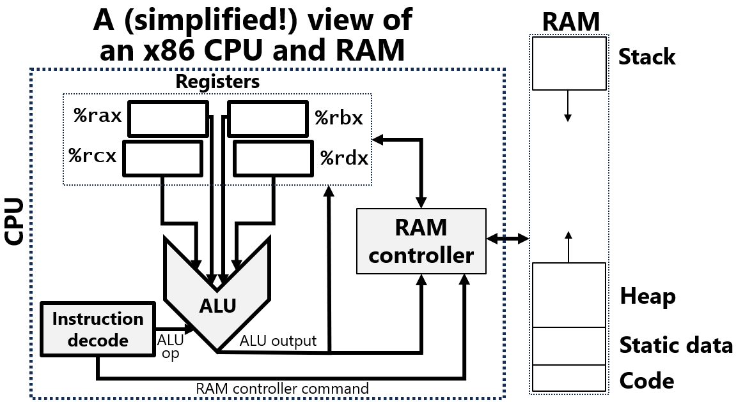
Function Parameters in C++ on x86-64
void f(int arg) {
arg = 0;
}
int main() {
int x = 2;
f(x);
printf(“x is %d\n”, x);
return 0;
}
The default approach is pass-by-value
If an argument can fit in a register (e.g., an int or a T*), the compiler will place the copy of the caller’s value in a register
If an argument cannot fit in a register (e.g., a large struct), the compiler will place the copy of the caller’s value in memory
Compilers often store local variables in the stack (but may keep them in registers too)
//Step 3
//Step 1
//Step 2
Console output: x is 2
Stack frame for main()
Step 1: The local variable x, which lives in the stack region for main(), receives the value 2
Stack frame for f()
Step 2: main() invokes f(x), creating a new stack region for f(), and placing a copy of x’s value in %rax
Step 3: f() assigns to its argument, updating %rax; main()’s copy of x is unchanged!
Notes:
[When f() returns, it’s stack frame goes away (is “popped”). Execution resumes inside of main(), at the line which does the prinf(). We’ll talk more about how stack frames get “pushed” and popped” during the discussion of assembly!]
[The strategy for passing arguments on a Linux x86-64 is the System V strategy; for more details, see Section 3.2.3 of the System V ABI (https://raw.githubusercontent.com/wiki/hjl-tools/x86-psABI/x86-64-psABI-1.0.pdf). This strategy in this slide is similar to System V, although System V uses %rdi to pass the first function argument, not %rax as shown above. Other parameter passing strategies are possible. For example, a different strategy would be to pass all function arguments via the stack. This in fact is what the System V strategy does for 32-bit x86 processors (i.e., x86-32 CPUs)---see Section 2.2.3 of https://uclibc.org/docs/psABI-i386.pdf. Why does System V’s 32-bit strategy only use the stack to pass arguments? The reason is that x86-32 CPUs only define 8 general-purpose registers instead of the 16 provided by an x86-64 chip. With only 8 registers, you have to be very careful in how registers are used! In particular, you need to reserve some registers for holding temporary results; if a function has a lot of parameters, you can’t just use all of the registers for parameters because then there will be no registers left to hold intermediate results.]

Slide 12
Function Parameters in C++ on x86-64
struct _s {int x; int y;};
void f(struct _s* arg) {
arg->x = 0;
}
int main() {
struct _s s = {2,3};
f(&s);
printf(“s.x is %d\n”, s.x);
return 0;
}
The default approach is pass-by-value
If an argument can fit in a register (e.g., an int or a T*), the compiler will place the copy of the caller’s value in a register
If an argument cannot fit in a register (e.g., a large struct), the compiler will place the copy of the caller’s value in memory
Compilers often store local variables in the stack (but may keep them in registers too)
//Step 3
//Step 1
//Step 2
Console output: s.x is 0
main()’s s
Step 1: The local variable s, which lives in the stack frame for main(), has its members initialized to 2 and 3, respectively
Stack frame for main()
Stack frame for f()
Step 2: main() invokes f(&s), creating a new stack frame for f(), and placing the address of s in %rax
Step 3: f() updates the single copy of the struct via reference!

Slide 13
Function Parameters in C++ on x86-64
struct _s {int x; int y;};
void f(struct _s* arg) {
arg->x = 0;
}
int main() {
struct _s s = {2,3};
f(&s);
printf(“s.x is %d\n”, s.x);
return 0;
}
The default approach is pass-by-value
If an argument can fit in a register (e.g., an int or a T*), the compiler will place the copy of the caller’s value in a register
If an argument cannot fit in a register (e.g., a large struct), the compiler will place the copy of the caller’s value in memory
Compilers often store local variables in the stack (but may keep them in registers too)
A programmer can pass-by-reference using:
Explicit C++ pointers (first example)
Implicit C++ references (second example)
In Step 2, the compiler implicitly uses the address of s as the argument for f()
In Step 3, the compiler implicitly adds code to dereference a pointer
//Step 3
//Step 1
//Step 2
Console output: s.x is 0
struct _s {int x; int y;};
void f(struct _s& arg) {
arg.x = 0;
}
int main() {
struct _s s = {2,3};
f(s);
printf(“s.x is %d\n”, s.x);
return 0;
}
//Step 3
//Step 1
//Step 2
Console output: s.x is 0
Notes:
In CS 61, we recommend that you use explicit pointers whenever possible!
[An advantage of reference arguments is simplicity---developers don’t have to remember to use the “->” dereference operator to interact with the argument. Another advantage is safety---you can’t do pointer arithmetic on a reference, which avoids all of the tragedies that can arise from pointer arithmetic. The compiler also checks that, at reference creation time, the reference points to a valid object, so you don’t have to worry about a reference being a nullptr or pointing to some random place in memory. A disadvantage of references is that they partially hide the fact that code is manipulating an object via a pointer---if you forget the method signature of a function, and just look at the method code, you might mistakenly think that the code is manipulating a pass-by-value argument instead of a pass-by-reference argument that lives somewhere external to the function (e.g., the heap). As it turns out, not knowing whether you’re manipulating an object directly (via a reference alias) or a separate copy of the object can lead to a lot of confusion. So, as with many things C++, there are religious wars about the exact situations in which references should be used instead of pointers. For an example of the gore (and a demonstration of the complexities of C++, most of which we won’t discuss in this class), see https://herbsutter.com/2020/02/23/references-simply/; however, only read that essay if you want nightmares about C++ minutiae :-D.]

Slide 14
C++: Passing Complicated Values
//Note that f accepts the
//vector argument by value,
//not by reference.
void f(std::vector<int> v) {
printf("&v in f:\t%p\n",
&v);
v[0] = -1;
} //f()’s v is now destroyed!
int main() {
std::vector<int> v = {42,
41,
40};
printf("sizeof(v) is %d\n",
sizeof(v));
printf("&v in main:\t%p\n",
&v);
f(v);
printf("v[0] is %d\n",
v[0]);
return 0;
}
Address space
A vector<int> object contains:
arr: Pointer to the array which stores the elements of the vector
size: The number of elements added and removed via methods like .push_back(), .insert(), and .erase()
capacity: The actual size of the array (which maybe larger than the vector’s size!)
What happens if you try to pass a vector<int> by value to a function?
A copy of the vector will be placed in the callee’s stack frame, with a copy of the vector’s array placed in the heap
The callee will interact with this copy
The copy will be destroyed when the callee returns
Pass-by-value is expensive if the object to copy is large—use pass-by-reference instead!
Stack frame for main()
arr
size
capacity
Stack frame for f()
arr
size
capacity
Heap
Static data
sizeof(v) is 24
&v in main: 0x7ffd292e05f0
&v in f: 0x7ffd292e0620
v[0] is 42
Code
Console
Notes:
[You might wonder why creating a copy of a vector doesn’t result in the new copy’s array pointer pointing to the old vector’s array. The reason is that a vector is a C++ class, and C++ classes can define a function called a copy constructor. The copy constructor specifies what happens when the compiler needs to make a copy of a class object. In this case, C++ vectors have a copy constructor which requires that a vector copy receive a separate, newly-created array whose elements are copied from those of the source object. For more details, see https://stackoverflow.com/questions/73492380/how-do-vectors-pass-by-value and Slides 18--23 of https://www.ecb.torontomu.ca/~courses/coe808/Truman/Lecture24.pdf.]

Slide 15
C++ Arrays as Function Parameters and Return Values
void f(int arg[]) {
arg[0] = -1;
}
int main() {
int arr[2] = {99, 100};
f(arr);
printf("arr[0] is %d\n",
arr[0]);
return 0;
}
Passing an array as a function parameter (or returning one as a return value) is equivalent to passing/returning a pointer to the first array element
In other words, an array is passed/returned by reference
So, passing/returning an array does not create a new copy of the array!
We recommend passing/returning a pointer to an array’s first element instead of passing/returning the array itself, to make these semantics more explicit
Console output: x is -1

Slide 16
NEVER RETURN A POINTER TO A LOCAL VARIABLE
The lifetime of a local variable is the lifetime of the enclosing function
So, when the enclosing function goes away, the memory belonging to the object becomes invalid
Trying to access that object’s memory later will result in undefined behavior!

Slide 17
NEVER RETURN A POINTER TO A LOCAL VARIABLE
int* f(int arg) {
int local = arg + 42;
int* p = &local;
printf("f() &local:\t%p\n", p);
return p; //OH NO
}
void g(int* ptr) {
int local = 999;
int* p = ptr;
printf("g() &local:\t%p\n", &local);
printf("g() ptr:\t%p\n", ptr);
printf("g() *ptr:\t%d\n", *ptr);
}
int main() {
int* p = f(0);
g(p);
return 0;
}
main()’s stack frame
int* p
int local
42
f()’s stack frame
int* p
0x7fffcd443e94
f() &local: 0x7fffcd443e94
Console
output

Slide 18
NEVER RETURN A POINTER TO A LOCAL VARIABLE
int* f(int arg) {
int local = arg + 42;
int* p = &local;
printf("f() &local:\t%p\n", p);
return p; //OH NO
}
void g(int* ptr) {
int local = 999;
int* p = ptr;
printf("g() &local:\t%p\n", &local);
printf("g() ptr:\t%p\n", ptr);
printf("g() *ptr:\t%d\n", *ptr);
}
int main() {
int* p = f(0);
g(p);
return 0;
}
main()’s stack frame
int* p
0x7fffcd443e94
int local
42
g()’s stack frame
int* p
0x7fffcd443e94
The pointer points to an invalid object
f() &local: 0x7fffcd443e94
Console
output

Slide 19
NEVER RETURN A POINTER TO A LOCAL VARIABLE
int* f(int arg) {
int local = arg + 42;
int* p = &local;
printf("f() &local:\t%p\n", p);
return p; //OH NO
}
void g(int* ptr) {
int local = 999;
int* p = ptr;
printf("g() &local:\t%p\n", &local);
printf("g() ptr:\t%p\n", ptr);
printf("g() *ptr:\t%d\n", *ptr);
}
int main() {
int* p = f(0);
g(p);
return 0;
}
main()’s stack frame
int* p
0x7fffcd443e94
42
int local
999
g()’s stack frame
int* p
0x7fffcd443e94
g()’s stack frame reuses space that was previously occupied by f()’s stack frame!
f() &local: 0x7fffcd443e94
g() &local: 0x7fffcd443e94
g() ptr: 0x7fffcd443e94
g() *ptr: 999 //Not 42!
Console
output

Slide 20
NEVER RETURN A POINTER TO A LOCAL VARIABLE
int* f(int arg) {
int local = arg + 42;
int* p = &local;
printf("f() &local:\t%p\n", p);
return p; //OH NO
}
void g(int* ptr) {
int local = 999;
int* p = ptr;
printf("g() &local:\t%p\n", &local);
printf("g() ptr:\t%p\n", ptr);
printf("g() *ptr:\t%d\n", *ptr);
}
int main() {
int* p = f(0);
g(p);
return 0;
}
The lifetime of a local variable is the lifetime of the enclosing function
So, when the enclosing function goes away, the memory belonging to the object becomes invalid
Trying to access that object’s memory later will result in undefined behavior!
This kind of error can lead to subtle bugs that are difficult to fix
f() &local: 0x7fffcd443e94
g() &local: 0x7fffcd443e94
g() ptr: 0x7fffcd443e94
g() *ptr: 999 //Not 42!
Console
output

Slide 21
How do functions really work on x86-64?
Notes:
[Ref: Section 3.2.3 of the System V ABI (https://raw.githubusercontent.com/wiki/hjl-tools/x86-psABI/x86-64-psABI-1.0.pdf)]

Slide 22
x86-64: Registers
16 general-purpose integer registers
%rbp: break pointer
%rsp: stack pointer
%rax, %rbx, %rcx, %rdx, %rsi, %rdi, %r8, %r9, %r10, %r11, %r12, %r13, %r14, %r15: used for various purposes
%rip: instruction pointer (i.e., holds the address of the next instruction to execute)
Incremented or decremented by more than one instruction during jumps, function calls/returns
Various special-purpose registers like:
%cr3: the page table pointer
%xmm0—%xmm15: floating point registers

Slide 23
x86-64: System V Calling Convention
Simplest case: callee arguments+retval are integers or pointers
Caller stores first six arguments in %rdi, %rsi, %rdx, %rcx, %r8, and %r9
Remaining arguments are passed via the stack
Callee places return value in %rax
int64_t foo(int64_t a, int64_t b,
int64_t c, int64_t d,
int64_t e, int64_t f,
int64_t g, int64_t h){
int64_t local0 = a*b*c;
int64_t local1 = d*e*f;
return local0 - local1;
}
Caller info
h
g
return addr
Stack frame for foo()
%rbp
saved %rbp
local0
local1
%rsp
a
b
c
d
e
f
%rdi
%rsi
%rdx
%rcx
%r8
%r9
Notes:
System V was one of the first commercial versions of the Unix operating system. The design of Unix was extremely influential on subsequent operating systems like Linux. [Reference: https://en.wikipedia.org/wiki/UNIX_System_V]
[Note that, if a stack-passed integer argument is smaller than 64 bits, the argument is rounded up to 64-bits in size before being placed on the stack.]
[Reference: Section 3.2.3 of “System V Application Binary Interface: AMD64 Architecture Processor Supplement”:
https://raw.githubusercontent.com/wiki/hjl-tools/x86-psABI/x86-64-psABI-1.0.pdf]

Slide 24
//Code at start of function.
//Save old breakpointer.
pushq %rbp
movq %rsp, %rbp
//Allocate local vars.
subq $0x10, %rsp
//Rest of function . . .
int64_t foo(int64_t a, int64_t b,
int64_t c, int64_t d,
int64_t e, int64_t f,
int64_t g, int64_t h){
int64_t local0 = a*b*c;
int64_t local1 = d*e*f;
return local0 - local1;
}
Caller info
h
g
return addr
saved %rbp
%rbp
local0
local1
%rsp
a
b
c
d
e
f
%rdi
%rsi
%rdx
%rcx
%r8
%r9

Slide 25
int f3() {
int f3_local = 3;
printf("&f3_local:\t%p\n", &f3_local);
return f3_local;
}
int f2() {
int f2_local = 2;
printf("&f2_local:\t%p\n", &f2_local);
return f3();
}
int f1() {
int f1_local = 1;
printf("&f1_local:\t%p\n", &f1_local);
return f2();
}
int main() {
int main_local = 0;
printf("&main_local:\t%p\n", &main_local);
return f1();
}
Console output
&main_local: 0x7ffeaa7f27cc
&f1_local: 0x7ffeaa7f27ac
&f2_local: 0x7ffeaa7f278c
&f3_local: 0x7ffeaa7f276c
Recall that the stack on x86 grows downwards!

Slide 26
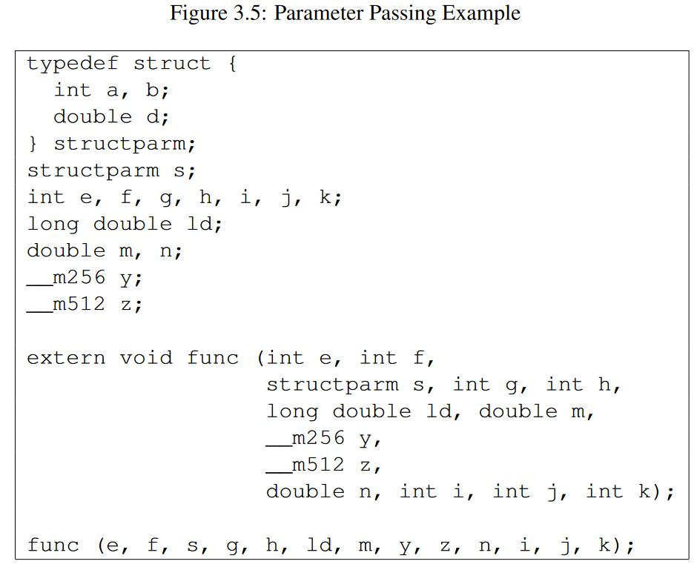
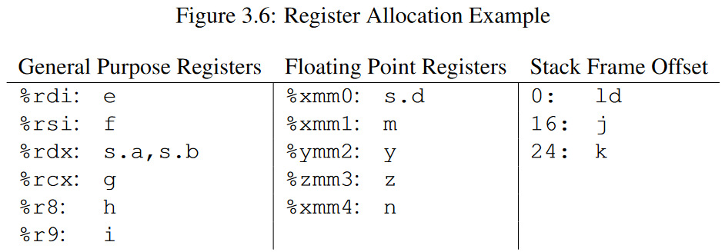
x86-64: System V Calling Convention
If a compound value is too big to fit inside a register, the compiler will pass it via memory, or via a combination of registers and memory
Recall that a CPU can read/write a register must faster than memory
Accessing a register takes ~0.5ns, whereas accessing memory takes ~60ns (i.e., ~100x slower!)
So, the compiler tries to place arguments in registers if possible
Notes:
[In a previous slide about passing vectors by memory, the slide said that “A copy of the vector will be placed in the callee’s stack frame, with a copy of the vector’s array placed in the heap.” However, as indicated in the current slide, it’s also possible that the compiler might alternatively place some portions of the copied vector in registers. The copied vector’s array will be put in the heap, though.]
[Ref: https://raw.githubusercontent.com/wiki/hjl-tools/x86-psABI/x86-64-psABI-1.0.pdf
https://www.intel.com/content/www/us/en/developer/articles/technical/memory-performance-in-a-nutshell.html
https://www.alibabacloud.com/blog/the-mechanism-behind-measuring-cache-access-latency_599384
]

