Slide 1
Types and Memory, Part II
CS 61: Lecture 3 9/13/2023
CPU
RAM
Values

Slide 2
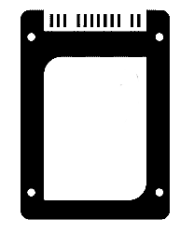
Recap: Memory
A program’s address space has four segments
The code segment stores the program’s CPU instructions
The static data segment contains global variables
The stack contains bookkeeping information (e.g., local variables) for active functions: More details in the next lecture!
The heap contains dynamically allocated data
The lifetime of a C++ object depends on which segment it lives in!
Code and static data is born at program start and only dies when the program dies
The compiler automatically ensures that a live function’s stack data is created when the function starts, and only lives as long as the function
A programmer has to manually allocate and deallocate heap memory via new and delete!
Address space
Stack
Byte N-1
Pulled from executable into RAM during (6)
Heap
Static data
Code
Byte 0
SSD
Notes:
[Ref: https://cs61.seas.harvard.edu/site/2023/Datarep/#Segments //See discussion about variable lifetimes: static vs. automatic vs. dynamic]

Slide 3
Heap Allocation and Deallocation (Slightly simplified)
The OS keeps track of the sizes and locations of the four segments (code, static data, heap, and stack)
The C++ runtime tracks the locations of free space in the heap
During a call to new <type> . . .
If the heap has sizeof(<type>) contiguous free bytes, the C++ runtime simply allocates those bytes
Otherwise, the C++ runtime must first invoke a system call like sbrk() to ask the OS to increase the size of the heap
During a call to delete <var_name> . . .
The C++ runtime deallocates the relevant heap bytes
The runtime may also use a system call to shrink the heap, although many runtimes don’t do this
A language runtime contains code that is:
Provided by the language implementation itself
Handles bookkeeping tasks on behalf of developer-written code
Examples of runtime code are:
C++ new/delete operators that directly handle low-level heap management
C++ code which initializes global variables to all-zero bytes
C++ IO functionality (e.g., printf(), cout) that provides simplified interfaces to IO-related system calls
C++ data structures like vector
Garbage collectors in languages like Python, Java, and OCaml

Slide 4
Heap Allocation and Deallocation (Slightly simplified)
//new operator
//calls sbrk(8)
//to increase
//heap size by
//8 bytes
The OS keeps track of the sizes and locations of the four segments (code, static data, heap, and stack)
The C++ runtime tracks the locations of free space in the heap
During a call to new <type> . . .
If the heap has sizeof(<type>) contiguous free bytes, the C++ runtime simply allocates those bytes
Otherwise, the C++ runtime must first invoke a system call like sbrk() to ask the OS to increase the size of the heap
During a call to delete <var_name> . . .
The C++ runtime deallocates the relevant heap bytes
The runtime may also use a system call to shrink the heap if there are free bytes at the end of the heap
//Suppose that
//heap has no
//free bytes
//and then we
//do . . .
int* p1 = new int;
int* p2 = new int;
*p1 = 389324381;
*p2 = 50600650;
delete p1;
delete p2;
0x03
0x04
p2
0x1A
0xCA
0x17
0x34
p1
0x9E
0x5D
brk pointer
Notes:
In this slide, allocated heap bytes are colored yellow, whereas unallocated bytes are colored white.
[The slide ignores several details about how C++ runtimes allocate memory in practice. For example, some large allocations are not satisfied from the heap, but rather from large allocations created by mmap() system calls (https://man7.org/linux/man-pages/man2/mmap.2.html). The mmap’d areas count of valid segments in the process’s address space, alongside the code, static data, heap, and stack.]
[For a handy decimal-to-hex/binary calculator, see https://www.rapidtables.com/convert/number/decimal-to-hex.html. Recall that x86 is little-endian!]

Slide 5
What happens if the program then does this . . .
printf(“%d\n”, *p1);
. . .?
According to the C++ standard, “When the end of the duration of a region of storage is reached, the values of all pointers representing the address of any part of that region of storage become invalid pointer values. Indirection through an invalid pointer value and passing an invalid pointer value to a deallocation function have undefined behavior.”
UNDEFINED BEHAVIOR
==
MONSTER PARTY
NOBODY KNOWS WHAT THESE FOUL THINGS WANT
DO NOT BRING THEM INTO YOUR LIFE
Undefined
behavior
Undefined
behavior
Notes:
[Ref: Section 6.7 of the C++ standard (https://www.open-std.org/jtc1/sc22/wg21/docs/papers/2017/n4659.pdf)]

Slide 6
When your program performs an undefined action, your program is not guaranteed to deterministically perform the same behavior (e.g., hang, crash, emit smoke) during each program run.
All you know is that something will happen.
SOMETHING UNDEFINED.

Slide 7
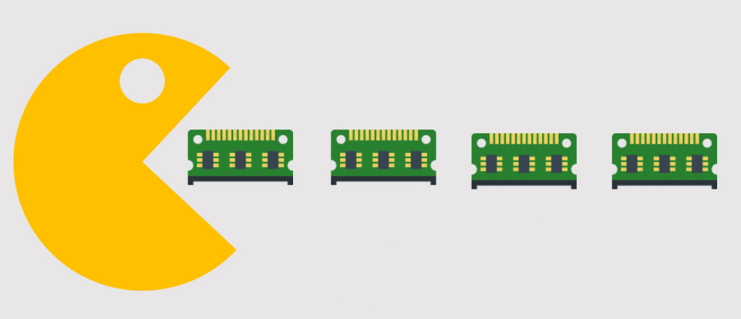
Q: What happens if you forget to deallocate
memory that you no longer need?
A: You get a memory leak!
THIS WILL HAPPEN TO YOU IN YOUR LIFE.
Notes:
In a memory leak, the memory consumption of your program gradually increases until there is no free areas in the address space! If this happens, you can’t dynamically allocate any more memory, and your function stack can’t grow any more.

Slide 8
C++: Primitive Types vs. Compound Types
A type describes two things
A set of possible values
A set of valid operations on those values
A primitive type is not composed of other types (e.g., char, float)
A compound type can aggregate one or more primitive types
An array represents a collection of values:
Having the same type
Accessed via indexing
A struct represents a collection of values:
Having potentially different types
Accessed via field names
#include <cstdio>
#include "hexdump.hh"
int main() {
int arr[2] = {61, 62};
hexdump_object(arr);
struct {
int a;
int b;
char c;
char d;
} s = {61, 62, 63, 64};
hexdump_object(s);
hexdump_object(s.a);
return 0;
}
Console output:
7ffc72c1cc08 3d 00 00 00 3e 00 00 00 |=...>...|
7ffc72c1cbfc 3d 00 00 00 3e 00 00 00 3f 40 00 00 |=...>...?@..|
7ffc72c1cbfc 3d 00 00 00 |=...|
^^^^^^^^^^^^ ^^^^^^^^ ^^^^^^
Address of starting value Hex representation ASCII representation
Notes:
Each line of output from hexdump-object() consists of three items: the address of the thing being printed, the hex values in the thing being printed, and the ASCII representation of the thing being printed. [For a list of ASCII characters, see https://www.ascii-code.com/. For example, the byte 61 is equal to ASCII character ‘=‘, and the byte 62 is equal to the ASCII character ‘>’.]

Slide 9
#include <cstdio>
#include <cstdlib>
static void fhexdump_ascii(FILE* f, const unsigned char* p, size_t pos) {
// Print an ASCII report that ends with byte p[pos].
// The first byte printed is p[first], where first is the max multiple
// of 16 having `first < pos`. The report starts at column 51.
size_t first = pos - (pos % 16); // first char to print
int n = pos + 1 - first; // # chars to print
char buf[17];
for (size_t i = first; i != first + n; ++i) {
buf[i - first] = (p[i] >= 32 && p[i] < 127 ? p[i] : '.');
}
fprintf(f, "%*s|%.*s|\n", 51 - (3 * n + (n > 8)), "", n, buf);
}
void fhexdump_at(FILE* f, size_t first_offset, const void* ptr, size_t size) {
const unsigned char* p = (const unsigned char*) ptr;
for (size_t i = 0; i != size; ++i) {
if (i % 16 == 0) {
fprintf(f, "%08zx", first_offset + i);
}
fprintf(f, "%s%02x", (i % 8 == 0 ? " " : " "), (unsigned) p[i]);
if (i % 16 == 15 || i == size - 1) {
fhexdump_ascii(f, p, i);
}
}
}
void hexdump(const void* ptr, size_t size) {
fhexdump_at(stdout, (size_t) ptr, ptr, size);
}
#define hexdump_object(object) hexdump(&(object), sizeof((object)))
Here is the hexdump code in case you’re curious about how it works!
Notes:
[If you want to play around with hexdump functionality in the Godbolt compiler explorer (https://godbolt.org/), you can cut-and-paste the code above and then add whatever code you want to test.]

Slide 10
C++: Object Layout
The C++ standard restricts how the compiler and runtime can position objects in memory
Two objects cannot overlap in memory: a particular byte in memory belongs to no object, or exactly one object
#include <cstdio>
#include "hexdump.hh"
int main() {
int arr[2] = {61, 62};
hexdump_object(arr);
struct {
int a;
int b;
char c;
char d;
} s = {61, 62, 63, 64};
hexdump_object(s);
hexdump_object(s.a);
return 0;
}
…
…
int p
int p
int q
int q
…
…
Console output:
7ffc72c1cc08 3d 00 00 00 3e 00 00 00 |=...>...|
7ffc72c1cbfc 3d 00 00 00 3e 00 00 00 3f 40 00 00 |=...>...?@..|
7ffc72c1cbfc 3d 00 00 00 |=...|

Slide 11
C++: Object Layout
The C++ standard restricts how the compiler and runtime can position objects in memory
Two objects cannot overlap in memory: a particular byte in memory belongs to no object, or exactly one object
For an array holding elements of type T:
Each value is arranged sequentially and back-to-back
Given an array with starting address a, the i-th element (i.e., the element a[i]) lives at memory location a + (i * sizeof(T))
The total amount of memory consumed by the array is N * sizeof(T)
#include <cstdio>
#include "hexdump.hh"
int main() {
int arr[2] = {61, 62};
hexdump_object(arr);
struct {
int a;
int b;
char c;
char d;
} s = {61, 62, 63, 64};
hexdump_object(s);
hexdump_object(s.a);
return 0;
}
Addrs
0x107
0x106
0x105
0x104
0x103
0x102
0x101
0x100
char* a = new char[8]; //new returns 0x100
Console output:
7ffc72c1cc08 3d 00 00 00 3e 00 00 00 |=...>...|
7ffc72c1cbfc 3d 00 00 00 3e 00 00 00 3f 40 00 00 |=...>...?@..|
7ffc72c1cbfc 3d 00 00 00 |=...|
Notes:
[Ref: https://cs61.seas.harvard.edu/site/2023/Datarep/#Array-representation
https://cs61.seas.harvard.edu/site/2023/Datarep/#Compiler-layout
https://cs61.seas.harvard.edu/site/2023/Datarep/#Collection-representation
]

Slide 12
C++: Object Layout
The C++ standard restricts how the compiler and runtime can position objects in memory
Two objects cannot overlap in memory: a particular byte in memory belongs to no object, or exactly one object
For an array holding elements of type T:
Each value is arranged sequentially and back-to-back
Given an array with starting address a, the i-th element (i.e., the element a[i]) lives at memory location a + (i * sizeof(T))
The total amount of memory consumed by the array is N * sizeof(T)
struct fields are laid out sequentially but maybe not adjacently—more on this later!
#include <cstdio>
#include "hexdump.hh"
int main() {
int arr[2] = {61, 62};
hexdump_object(arr);
struct {
int a;
int b;
char c;
char d;
} s = {61, 62, 63, 64};
hexdump_object(s);
hexdump_object(s.a);
return 0;
}
Console output:
7ffc72c1cc08 3d 00 00 00 3e 00 00 00 |=...>...|
7ffc72c1cbfc 3d 00 00 00 3e 00 00 00 3f 40 00 00 |=...>...?@..|
7ffc72c1cbfc 3d 00 00 00 |=...|

Slide 13
C++ Unions
#include <cstdio>
#include "hexdump.hh"
int main() {
struct {
union {
char c;
double d;
} u;
bool is_char; //The tag!
} s;
s.u.c = ‘J’;
s.is_char = true;
printf(“%zu\t”, sizeof(s.u));
printf("%zu\n", sizeof(s.is_char));
printf(“%zu\n”, sizeof(s));
hexdump_object(s);
return 0;
}
Like a struct, a union aggregates primitive types
Unlike a struct, a union only has enough space to store the largest of its contained types!
At any given moment, only one of the possible values in a union is valid
In practice, unions are often associated with a tag to indicate which union field is valid
Console output:
8 1
16
Notes:
[Ref: https://cs61.seas.harvard.edu/site/2023/Datarep/#Collection-representation]

Slide 14
Hmm . . . if sizeof(s.u) is 8 and sizeof(s.is_char) is 1, then why is sizeof(s) not 8+1=9?
The answer is alignment!
On modern computers, a CPU fetches data from RAM in units of cache lines (e.g., 64 bytes on a modern x86-64 processor)
If a primitive value spanned two adjacent cache lines, then reading or writing that value would require two RAM accesses (which would be slower than just one)
So, the C++ standard imposes alignment restrictions on the locations at which primitives and compound values may start
#include <cstdio>
#include "hexdump.hh"
int main() {
struct {
union {
char c;
double d;
} u;
bool is_char; //The tag!
} s;
s.u.c = ‘J’;
s.is_char = true;
printf(“%zu\t”, sizeof(s.u));
printf("%zu\n", sizeof(s.is_char));
printf(“%zu\n”, sizeof(s));
hexdump_object(s);
return 0;
}
Console output:
8 1
16

Slide 15
Hmm . . . if sizeof(s.u) is 8 and sizeof(s.is_char) is 1, then why is sizeof(s) not 8+1=9?
The answer is alignment!
On modern computers, a CPU fetches data from RAM in units of cache lines (e.g., 64 bytes on a modern x86-64 processor)
If a primitive value spanned two adjacent cache lines, then reading or writing that value would require two RAM accesses (which would be slower than just one)
So, the C++ standard imposes alignment restrictions on the locations at which primitives and compound values may start
#include <cstdio>
#include "hexdump.hh"
int main() {
struct {
union {
char c;
double d;
} u;
bool is_char; //The tag!
} s;
s.u.c = ‘J’;
s.is_char = true;
printf(“%zu\t”, sizeof(s.u));
printf("%zu\n", sizeof(s.is_char));
printf(“%zu\n”, sizeof(s));
hexdump_object(s);
return 0;
}
Console output:
8 1
16
7ffea59a86e0 4a 87 9a a5 fe 7f 00 00 01 00 00 00 00 00 00 00 \
|J...............|
Notes:
[Ref: Section 3.9.3 of the textbook
https://lemire.me/blog/2022/06/06/data-structure-size-and-cache-line-accesses/
https://en.cppreference.com/w/c/language/object
]

Slide 17
C++: Memory Alignment
A type T has an alignment requirement of A if any value of type T must start at a memory address that is evenly divisible by A
The C++ standard says that all alignments must be powers of two
So, a particular valid alignment is aligned with all smaller alignments
Ex: A type with an alignment of 16 bytes also satisfies an alignment of 8 bytes
Each primitive type T has an alignment of alignof(T)
Notes:
[Ref: https://cs61.seas.harvard.edu/site/2022/Datarep3/#gsc.tab=0
https://cs61.seas.harvard.edu/site/2023/Datarep/#Alignment]

Slide 18
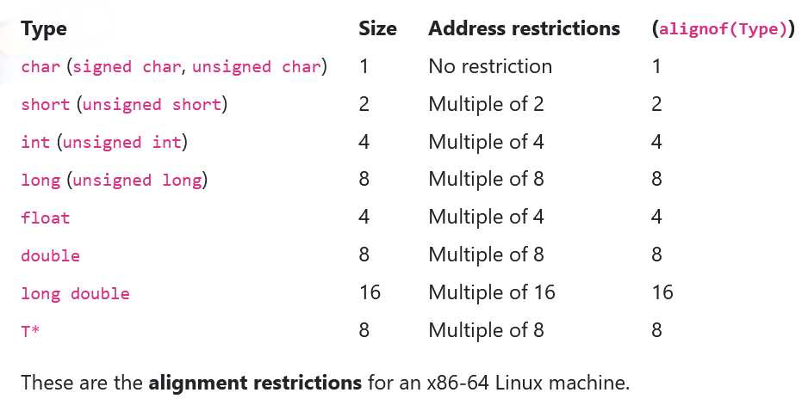
Notes:
So, the take-home point here is that, on x86-64 Linux, the alignment of a primitive value is equal to the size of that value. In other words, alignof(T) == sizeof(T). However, this relationship isn’t guaranteed to hold for all CPU+OS environments. For example, on x86-32 Linux, sizeof(double) is 8 but alignof(double) is 4.
[Ref: https://cs61.seas.harvard.edu/site/2023/Datarep/#Alignment]

Slide 19
C++: Memory Alignment
A type T has an alignment requirement of A if any value of type T must start at a memory address that is evenly divisible by A
The C++ standard says that all alignments must be powers of two
So, a particular valid alignment is aligned with all smaller alignments
Ex: A type with an alignment of 16 bytes also satisfies an alignment of 8 bytes
Each primitive type T has an alignment of alignof(T)
Each element of a compound object must satisfy alignment, so:
Array: alignof(T[N]) == alignof(T)
Struct: alignof(struct{T₀,T₁,…,T_{N}}) == max_{i}(alignof(T_{i}))
This rule ensures that the first member of the struct is aligned
However, aligning subsequent members may require padding between members
A funny side effect is that you can sometimes change a struct’s size by reordering its members!
Notes:
In the slide above, interpret alignof(T[N]) as meaning “the alignment of an array that hold elements of type T.”
Recall that the C++ standard requires all elements in an array to be laid out sequentially and back-to-back in memory. That requirement, along with the requirement that alignof(T[N]) == alignof(T), is sufficient to ensure that all of the individual elements of an array are aligned.
By ensuring that a struct is aligned with the largest alignment of any member, we ensure that the first member of the struct (which lives at the beginning of the struct’s memory) is aligned. However, the location immediately after the last byte of the first member may not be properly aligned for the second member! Thus, the compiler may insert padding betweenthe firs and second member. The padding is just dead space that doesn’t belong to any variable.
Note that the C++ `new T` operator is required by the C++ standard to return a memory address that satisfies alignof(T).
[Ref: https://cs61.seas.harvard.edu/site/2022/Datarep3/#gsc.tab=0
https://cs61.seas.harvard.edu/site/2023/Datarep/#Alignment
https://cs61.seas.harvard.edu/site/2023/Datarep/#Collection-representation
]

Slide 20
Padding Example
struct {
char a; //alignof(char): 1
int b; //alignof(int): 4
short c;//alignof(short):2
char d; //alignof(char): 1
} s;
struct {
char a; //alignof(char): 1
char _pad0[3]; //padding to
//make s.b start on
//4-byte boundary
int b; //alignof(int): 4
short c;//alignof(short):2
char d; //alignof(char): 1
char _pad1[1]; //padding to
//make sizeof(s) a
//multiple of the
//alignment (which
//is 4, because that
//is the largest
//alignment of any
//struct member
};
//sizeof(s): 12
//alignof(s): 4
Any starting location for s will satisfy the alignment properties for s.a and s.d
However, arbitrary starting locations for s are not guaranteed to ensure alignment for s.b and s.c!
So, the compiler pretends that s starts at address 0, and then . . .
adds padding between s’s members, and
possibly adds padding at the end
. . . such that:
aligned locations for s also result in alignment for all of s’s members, and
sizeof(s) is a multiple of the alignof(s)
Notes:
Note that the padding is not something that you can access explicitly via a member name in a struct! However, as we show explicitly in the next slide, padding bytes do exist in the real-life representations of compound types.
Why does sizeof(s) have to be a multiple of alignof(s)? Consider the way that an array of type s is laid out: each element must be sequential and back-to-back. With (say) an alignment of 4 but a sizeof 11, the first struct in the array would occupy bytes 0--10, and the second struct would start at address 11 . . . but the address 11 is not aligned with alignof of 4!
[Ref: This example is adapted from the one used by https://learn.microsoft.com/en-us/cpp/cpp/alignment-cpp-declarations?view=msvc-170.]

Slide 21
Notes:
[Ref: https://cs61.seas.harvard.edu/site/2022/Datarep3/#gsc.tab=0]

Slide 22
Alignment is the reason that sizeof(s) is 16!
The largest alignment of any element in s is alignof(double) == 8
So, s’s alignment is 8
The “natural” (i.e., unpadded) size of s is 8+1 = 9, but 9 is not evenly divisible by s’s alignment 8, so we must pad the object to be 16 bytes
#include <cstdio>
#include "hexdump.hh"
int main() {
struct {
union {
char c;
double d;
} u;
bool is_char; //The tag!
} s;
s.u.c = ‘J’;
s.is_char = true;
printf(“%zu\t”, sizeof(s.u));
printf("%zu\n", sizeof(s.is_char));
printf(“%zu\n”, sizeof(s));
hexdump_object(s);
return 0;
}
8 1
16
7ffea59a86e0 4a 87 9a a5 fe 7f 00 00 01 00 00 00 00 00 00 00 \
|J...............|
Console output:
.u.c (the ‘J’ char)
.is_char
Padding!
Notes:
[You might wonder what the seven remaining bytes in s.u are. Those are junk bytes: they weren’t explicitly set by the program, and C++ does not initialize local variables to preset values (as we see later in these lecture slides); so, the remaining seven bytes in s.u are just whatever random stuff happened to be in memory at the time that the program ran!]
[Ref: Section 3.9.3 of the textbook
https://lemire.me/blog/2022/06/06/data-structure-size-and-cache-line-accesses/
https://en.cppreference.com/w/c/language/object
]

Slide 23
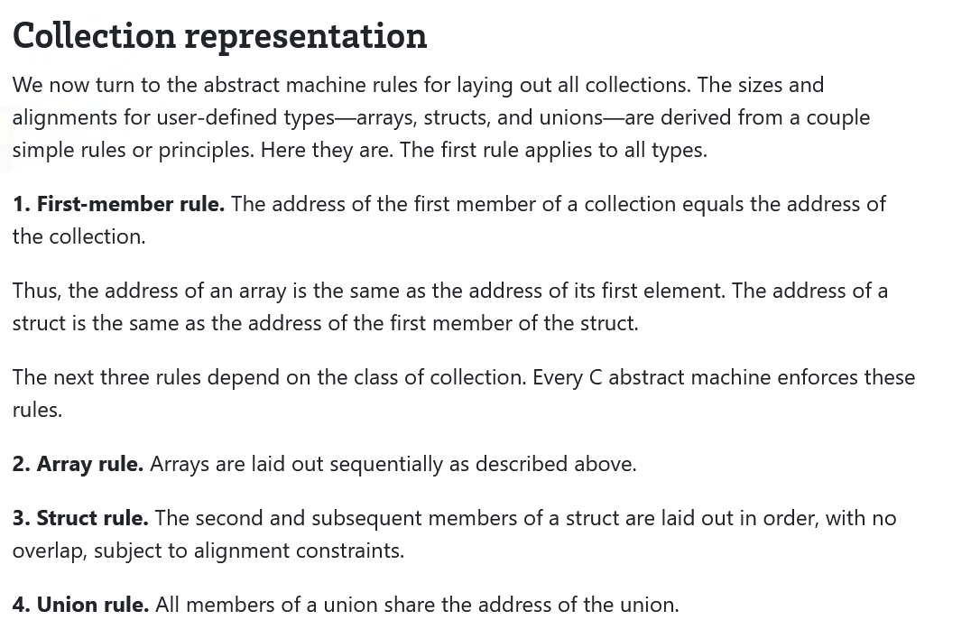
The C++ standard requires that the expression new T will return an address that satisfies alignof(T)!
malloc(size) must return memory that is aligned for any object! In practice, this means that the memory must satisfy alignof(std::max_align_t) == 16 on x86-64!
Notes:
The malloc() constraint is relevant to the code that you write for pset1!
[Ref: https://cs61.seas.harvard.edu/site/2023/Datarep/#Collection-representation]

