Slide 1
Synchronization, Part III
CS 61: Lecture 22 11/29/2023

Slide 2
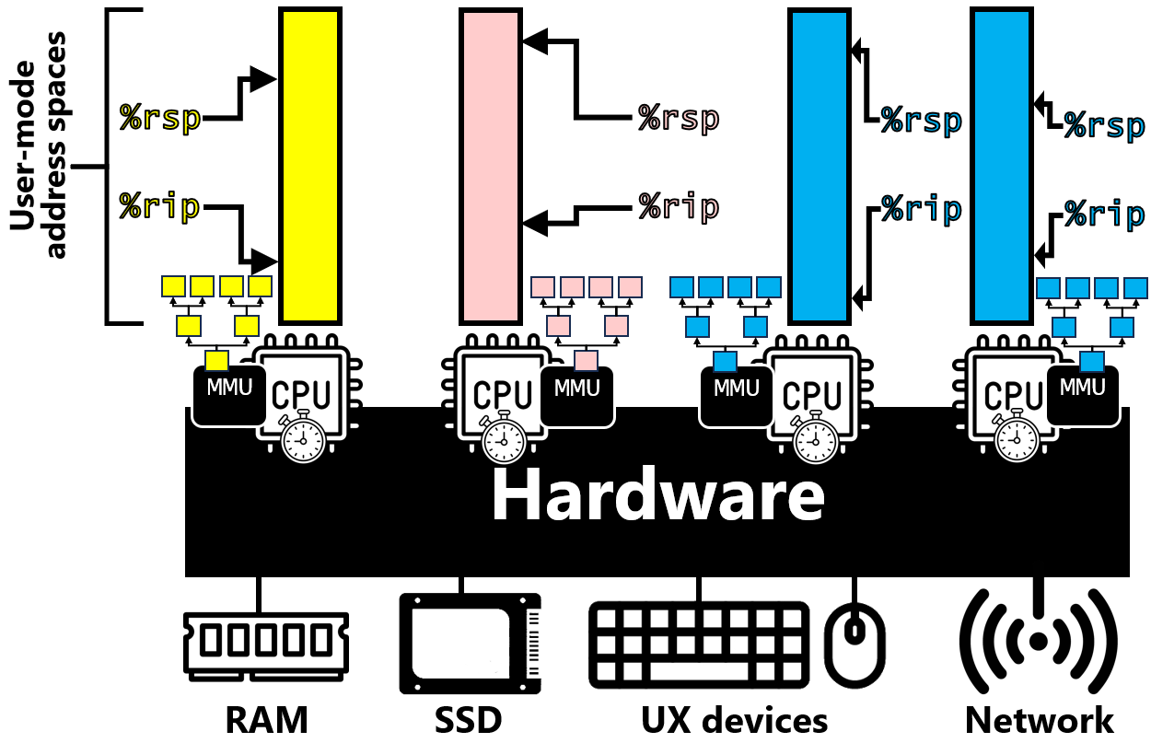
Recap of the Last Lecture
Virtual address space
(user-level)
Kernel
memory
A multithreaded process has multiple execution contexts called threads
The OS associates each thread with a struct thread that contains:
A pointer to the associated struct proc (whose address space is shared with other threads)
Register state (including %rsp and %rip) that is unique per thread and saved/restored during syscalls, interrupts, and exceptions
In an OS that supports threads, struct threads are what get scheduled, not struct procs
On a multicore machine, a single process can have multiple threads running in parallel!
Threads in the same process can talk via memory reads and writes which are much faster than cross-process IPC
However, the threads in a process have no memory isolation!
Thread X’s stack
struct
proc
%cr3
Thread Y’s stack
pid
Thread Z’s stack
struct
thread
Heap
struct
thread
Static data
struct
thread
Code

Slide 3
Recap of the Last Lecture
A data race in memory occurs when parallel computations . . .
try to access the same memory location concurrently (i.e., at the same time) . . .
without synchronization, and . . .
at least one of the accesses is a write
The result of a data race is undefined behavior: we can’t guarantee the order that the memory accesses will complete!
To avoid races, we must remember that:
Simple, aligned reads and writes are individually atomic
A read-modify-write instruction typically is not atomic because it consists of multiple micro-ops which are not collectively atomic
Using the lock prefix, an instruction grabs exclusive access to RAM and issues its micro-ops as an atomic unit
Compiler-generated instruction
add $1, (%rbp)
Micro-ops
mov (%rbp), %internal
add $1, %internal
mov %internal, (%rbp)
lock add $1, (%rbp)
ret
mov (%r9),%rcx
mov $1, 0x4(%rax)
Memory bus
RAM
Notes:
Note that, in the multicore example in the bottom right, all four instructions access memory . . . including the ret instruction! Recall that a ret instruction has to read a return value pointed to by %rsp and assign that value to %rip.

Slide 4
Implementing a Mutex
Implementing a Semaphore
typedef struct {
std::atomic<bool> lock_ = {false};
//Initialize the lock to “unheld.”
void lock() {
while (lock_.exchange(true)) {}
//The .exchange() compiles to an
//atomic instruction like x86’s
//atomic exchange instruction...
// xchg %rax, (%rbx)
//...where %rax initially stores
//1 (i.e., true) and %rbx points
//to the spinlock variable.
}
void unlock() {
lock_.store(false); //The store
//can just be a simple aligned
//write: recall that aligned
//writes are guaranteed to be
//atomic!
}
} spinlock;
typedef struct {
mutex m_; //Initially unlocked.
unsigned sem_;
void semaphore(unsigned init_val) {
sem_ = init_val;
}
void post() {
m_.lock();
++sem_;
m_.unlock();
}
void wait() {
bool keep_looping = true;
while (keep_looping) {
m_.lock();
if (sem_ > 0) {
--sem_;
keep_looping = false;
}
m_.unlock();
}
}
} semaphore;

Slide 5
Locking Rules
Rule 1: Every shared object that is mutable (i.e., can be written) must be guarded by a synchronization operation (e.g., locking or an atomic instruction)
Rule 2: If a program invariant (e.g., about pointers in a data structure) involves multiple shared mutable objects, then:
A) All of the objects must be protected by the same synchronization operation (e.g., the acquisition of the same lock)
B) Once a thread acquires ownership of the critical section, the invariant must be reestablished before releasing the critical section
Notes:
[Ref: This excellent advice is adapted from http://web.mit.edu/6.005/www/fa15/classes/23-locks]

Slide 6
Locking Granularity
Coarse-grained locking: Use a single lock to protect all of the shared memory objects
Good: It’s easy to implement this strategy and convince yourself that it’s correct
Bad: It restricts parallelism—even if (say) four threads are touching four different objects that are not involved in the same invariant, those threads will contend for the same lock, and only one thread will make forward progress while the single lock is held
Fine-grained locking: Use multiple locks, with each lock protecting a subset of the shared memory objects
Good: Parallelism improves!
Bad: It’s harder to design a correct locking approach

Slide 7
Locking Granularity
struct {
int val;
struct node* next;
} node;
struct node* head = nullptr;
void insert(struct node* new_node) {
if (head == nullptr) {
head = new_node;
new_node->next = nullptr;
return;
}
if (new_node->val <= head->val) {
new_node->next = head;
head = new_node;
return;
}
struct node* curr = head;
while (curr->next != nullptr) {
if (new_node->val <=
curr->next->val) {
new_node->next = curr->next;
curr->next = new_node;
return;
}
}
curr->next = new_node;
new_node->next = nullptr;
}
With coarse-grained locking:
We associate one lock with the entire data structure
Any function that accesses the list (not just insert(new_node), but contains(val) etc.) must grab that lock
Correctness is easy to guarantee: each interaction with the data structure happens atomically!
There is no concurrent access to the list, which is possibly bad from the performance perspective
However, if threads are often doing stuff other than accessing the list, our program will still have good parallelism!
std::mutex m; //Protects the entire
//list.
std::lock_guard<std::mutex> lg(m);
//Ensures that the mutex will
//be released regardless of
//how the function returns!
Notes:
[The difference between a std::lock_guard and the std::scoped_lock introduced in earlier lectures is that a std::lock_guard holds one mutex, whereas a std::scoped_lock can hold multiple mutexes. See https://en.cppreference.com/w/cpp/thread/lock_guard and https://en.cppreference.com/w/cpp/thread/scoped_lock.]

Slide 8
Locking Granularity
struct {
int val;
struct node* next;
std::mutex m;
} node;
Perhaps we can do fine-grained locking by just associating a lock with each node!
In this approach, a thread would iteratively:
Grab the lock on a node via curr->m.lock()
Examine the node (e.g., to find(), insert(), or remove())
Do curr->m.unlock() and, if not finished, move to the next node
Does this approach work?
Thread 1
Thread 2
Found node to delete! Let’s do
curr->next = curr->next->next.
Found node to delete! Let’s do
curr->next = curr->next->next.
Remove 3
Remove 5
1
3
5
10
head

Slide 9
Locking Granularity
struct {
int val;
struct node* next;
std::mutex m;
} node;
Perhaps we can do fine-grained locking by just associating a lock with each node!
In this approach, a thread would iteratively:
Grab the lock on a node via curr->m.lock()
Examine the node (e.g., to find(), insert(), or remove())
Do curr->m.unlock() and, if not finished, move to the next node
Does this approach work?
Thread 1
Thread 2
Found node to delete! Let’s do
curr->next = curr->next->next.
Found node to delete! Let’s do
curr->next = curr->next->next.
Remove 3
Remove 5
Deallocate the memory for the deleted node!
Deallocate the memory for the deleted node!
1
3
5
10
head

Slide 10
Locking Granularity
For a linked list, a correct way to do fine-grained locking is hand-over-hand locking
Each node receives its own lock, but in the steady state, a thread holds two locks for two adjacent nodes
When traversing a list, a thread iteratively:
Grabs the next node’s lock
Does a list operation if necessary, and then
Releases the previous node’s lock
Hand-over-hand locking works because it “freezes” the appropriate two nodes
A node insertion requires the predecessor and successor of the node-to-insert to not be concurrently deleted or have a new node concurrently inserted between them
A node removal requires the node-to-delete and its predecessor to not be concurrently deleted or have a new node concurrently inserted between them (or after the node-to-delete)
Thread 1
Thread 2
I have the lock for 1, but cannot get the lock for 3 until Thread 2 releases it!
Found node to delete! Let’s do
prev->next = curr->next.
Remove 3
Remove 5
1
3
5
10
head
Notes:
[If you’re looking for the an example of actual C++ code to do hand-over-hand locking for a list, see Slide 27 of https://gfxcourses.stanford.edu/cs149/winter19content/lectures/13_lockfree/13_lockfree_slides.pdf.]

Slide 11
Locking Granularity
For a linked list, a correct way to do fine-grained locking is hand-over-hand locking
Each node receives its own lock, but in the steady state, a thread holds two locks for two adjacent nodes
When traversing a list, a thread iteratively:
Grabs the next node’s lock
Does a list operation if necessary, and then
Releases the previous node’s lock
Hand-over-hand locking works because it “freezes” the appropriate two nodes
A node insertion requires the predecessor and successor of the node-to-insert to not be concurrently deleted or have a new node concurrently inserted between them
A node removal requires the node-to-delete and its predecessor to not be concurrently deleted or have a new node concurrently inserted between them
Thread 1
Thread 2
I have the lock for 1, but cannot get the lock for 3 until Thread 2 releases it!
Found node to delete! Let’s do
prev->next = curr->next.
Found node to delete! Let’s do
prev->next = curr->next.
Remove 3
Remove 5
Deallocate the memory for the deleted node!
Deallocate the memory for the deleted node!
1
3
5
10
head

Slide 12
Deadlock
void t1() {
x.lock();
y.lock();
}
void t2() {
y.lock();
x.lock();
}
Deadlock occurs in a multithreaded process when each thread is waiting forever on a lock that is held by another thread
Deadlock is caused by a cycle in the graph of resource ownership and resource waiting
Ex: Two threads deadlocked on two locks
Ex: One thread deadlocked on one lock
To avoid deadlocks:
Don’t try to acquire a lock that you already have, to avoid deadlocking yourself 😅
Establish a total order over all locks (e.g., x_lock -> y_lock -> z_lock) and ensure that each thread always acquires the lock subset of interest in order
Ex: If a thread only cares about x_lock and z_lock, the thread should acquire the locks in that order
This approach guarantees no cycles in the ownership/waiting graph
Waiting for
Owned by
x
t2
t1
Owned by
y
Waiting for
std::mutex m;
void f() {
std::scoped_lock guard(m);
g();
}
void g() {
std::scoped_lock guard(m);
//The code down here never runs!
}
Notes:
Why does acquiring locks in a global order ensure no deadlocks? For an intuition, consider two threads, both of which want to acquire lock x and lock z. The deadlock can only arise if the two threads pick different orders in acquiring the locks: the first thread gets x, while the second thread gets z, and then the two threads try to get the remaining unheld lock and deadlock. If the two threads had instead tried to acquire x and z in order, then one thread will win the race to acquire lock x, and then the other thread will block as the winner acquires z and then executes the necessary critical section. Once the winner unlocks the locks, the loser can grab them and execute its own critical section.

Slide 13
What If I Can’t Order My Locks?
In some multithreaded applications, it may be difficult for a programmer to create a global order of locks ahead of time
For example, suppose that a program uses fine-grained locking for multiple data structures
Further suppose that, to handle a particular request, a thread may need to traverse several of the data structures in unpredictable ways, taking locks on individual nodes in those data structures
In these cases, a program can avoid deadlock using timed waits on locks
A thread will only wait for a finite period of time to grab a lock
If the timeout expires, the thread aborts
The thread releases all of its held locks
The thread also undos any tentative work that it may have already done; this preserves atomicity semantics—a critical section either totally completes or doesn’t complete at all
The thread then restarts the lock acquisition dance
typedef struct {
std::atomic<bool> lock_ = {false};
//Initialize the lock to “unheld.”
void lock() {
while (lock_.exchange(true)) {}
}
bool try_lock() {
for (int i = 0; i < 1000; ++i) {
if (!lock_.exchange(true)) {
return true;
}
}
return false;
}
void unlock() {
lock_.store(false);
}
} spinlock;

Slide 14
The Producer/Consumer Pattern
The producer/consumer design pattern is very common in multithreaded programming
One or more producer threads iteratively create work items and put them in a queue
One or more consumer threads iteratively dequeue work items and compute on them
The simplest way to implement this pattern is to busy-wait for new work items to arrive
Ideally, a worker could go to sleep until a work item is ready!
std::mutex m;
std::queue<work_item*> q;
void producer() {
while (true) {
work_item* wi = get_work();
m.lock()
q.push(wi);
m.unlock()
}
}
void consumer() {
while (true) {
work_item* wi = nullptr;
m.lock()
if (!q.empty()) {
wi = q.front();
q.pop();
}
m.unlock()
if (wi != nullptr) {
do_work(wi);
}
}
}

Slide 15
The Producer/Consumer Pattern
A condition variable (e.g., in C++, a std::condition_variable_any) allows the consumer to avoid busy-waiting
cv.wait(std::mutex& m)
m must be locked by the calling thread before calling this method!
In a single atomic step, the method unlocks m and blocks the calling thread until cv.notify_all() is called by a different thread
Before waking a thread up, cv.wait() reacquires the lock on m
cv.notify_all()
Wake up (i.e., unblock) all threads blocked in cv.wait()
cv.wait() must atomically unlock the mutex and block the calling thread to avoid a lost wakeup in which
The waiting thread unlocks m
The waker thread calls notify_all() but the waiting thread isn’t blocked yet!
The waiting thread blocks and never gets unblocked by the lost wake-up!
std::mutex m;
std::condition_variable_any cv;
std::queue<work_item*> q;
std::mutex m;
std::queue<work_item*> q;
void producer() {
while (true) {
work_item* wi = get_work();
m.lock()
q.push(wi);
m.unlock()
}
}
void producer() {
while (true) {
work_item* wi = get_work();
m.lock()
q.push(wi);
cv.notify_all();
m.unlock()
}
}
void consumer() {
while (true) {
work_item* wi = nullptr;
m.lock()
if (!q.empty()) {
wi = q.front();
q.pop();
}
m.unlock()
if (wi != nullptr) {
do_work(wi);
}
}
}
void consumer() {
while (true) {
m.lock()
while (q.empty()) {
cv.wait(m);
}
work_item* wi = q.front();
q.pop();
m.unlock()
do_work(wi);
}
}
Notes:
[For another take on condition variables, you might enjoy https://pages.cs.wisc.edu/~remzi/OSTEP/threads-cv.pdf.]
[Aside: You might be wondering how exactly it is that cv.wait() can atomically unlock the mutex and block the calling thread. The implementation is actually pretty subtle and we won’t talk about it in this class, but if you’re interested in knowing how this works, take CS 161 :-D.]

Slide 16
The Producer/Consumer Pattern
At first glance, it might seem like the consumer does not need to do cv.wait(m) in a loop—wouldn’t an if-statement suffice?
The answer is no!
If the program has . . .
multiple consumers and
multiple work items that can be enqueued before a notification is raised
. . . it’s possible that, after the call to cv.notify_all(), the consumers that run first will remove all of the work items, such that the queue is empty when a laggard consumer finally checks the queue
Also note that, if the process catches a signal while a thread is doing a conditional wait, the wait may return early, causing a spurious wakeup!
std::mutex m;
std::condition_variable_any cv;
std::queue<work_item*> q;
void producer() {
while (true) {
work_item* wi = get_work();
m.lock()
q.push(wi);
cv.notify_all();
m.unlock()
}
}
void consumer() {
while (true) {
m.lock()
while (q.empty()) {
cv.wait(m);
}
work_item* wi = q.front();
q.pop();
m.unlock()
do_work(wi);
}
}
Notes:
[As the man page for pthread_cond_wait() (which underlies the C++-level conditional wait) says, “If a signal is delivered to a thread waiting for a condition variable, upon return from the signal handler the thread resumes waiting for the condition variable as if it was not interrupted, or it shall return zero due to spurious wakeup.” Ref: https://linux.die.net/man/3/pthread_cond_wait]

Slide 17
Four Strategies for Designing Correct Multithreaded Programs
Confinement: Don’t share any data between threads
This is a perfectly fine approach if each thread can work independently
Total confinement would mean that a thread only uses local variables (and doesn’t use global variables, or only uses global variables that are assigned to that thread)
Immutability: Only share read-only data between threads
Recall that a memory object is only subject to data races if the concurrent accesses include one or more writes!
Thus, only sharing immutable data with multiple threads cannot generate race conditions, even if the shared data is a complex data structure
Use preexisting thread-safe data structures: Leverage preexisting concurrent data structures from your language’s standard library or elsewhere
Ex: In Java, the built-in ConcurrentHashMap is a thread-safe version of Hashtable
Ex: In Go, the built-in map is not thread-safe, but the third-party sync.Map is
Ex: In C++, the STL data structures like std::queue are not thread-safe, so you need to protect such a structure with a lock (or use a third-party library that does provide thread-safe data structures)
Roll your own thread-safe datatype: See the insights from the past three lectures LOL
Notes:
[Aside: For a deeper dive on these four strategies, see https://web.mit.edu/6.005/www/fa15/classes/20-thread-safety/.]

Slide 18
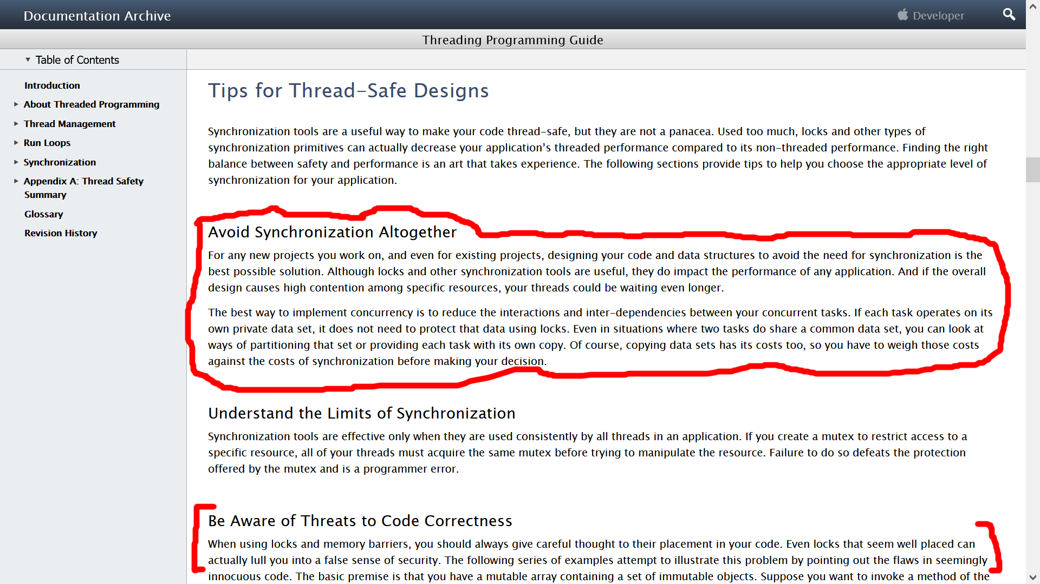
Notes:
[Ref for Apple design strategies: https://developer.apple.com/library/archive/documentation/Cocoa/Conceptual/Multithreading/ThreadSafety/ThreadSafety.html]

