Slide 1
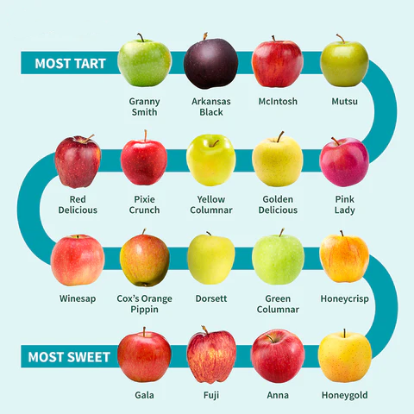
Types and Memory, Part I
CS 61: Lecture 2 9/11/2023

Slide 2
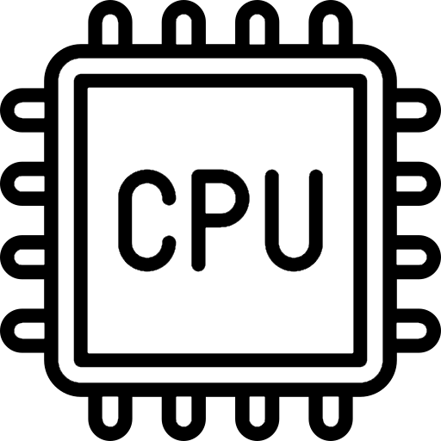
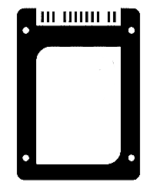
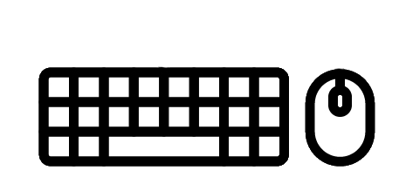
Recap of Lecture 1
User-level processes interact with each other and the hardware via the operating system—in particular, via system calls
User-level process X
User-level process Y
User-level process Z
//Process X wants to read 32 bytes of data
//from a file that is stored on the SSD.
//First, get a file descriptor that allows
//the process to interact with the file.
int fd = open(“file.txt”, O_RDONLY);
Operating system
(Kernel-level code)
MMU
MMU
MMU
MMU
Hardware
RAM
SSD
UX devices
Network

Slide 3
Recap of Lecture 1
User-level processes interact with each other and the hardware via the operating system—in particular, via system calls
User-level process X
User-level process Y
User-level process Z
//Process X wants to read 32 bytes of data
//from a file that is stored on the SSD.
//First, get a file descriptor that allows
//the process to interact with the file.
int fd = open(“file.txt”, O_RDONLY);
//Declare an array to hold the file data.
char buf[32];
//Read the file data into the array!
ssize_t bytes_read = read(fd, buf, sizeof(buf));
Operating system
(Kernel-level code)
MMU
MMU
MMU
MMU
Hardware
RAM
SSD
UX devices
Network

Slide 4
Recap of Lecture 1
User-level processes interact with each other and the hardware via the operating system—in particular, via system calls
A process contains in-memory state like:
Program variables (e.g., global variables and local variables)
Function code
At any given moment, a particular CPU executes code from a single entity (either a user-level process or the OS)
The OS leverages various hardware features to maintain order on the computer
MMU (memory management unit): OS configures it so that, when a process executes, it can only touch the memory belonging to that process
Timer hardware: Ensures that the OS will eventually get to run even if a process loops forever
User-level process X
User-level process Y
User-level process Z
Operating system
(Kernel-level code)
MMU
MMU
MMU
MMU
Hardware
RAM
SSD
UX devices
Network

Slide 5
Recap of Lecture 1
User-level processes interact with each other and the hardware via the operating system—in particular, via system calls
A process contains in-memory state like:
Program variables (e.g., global variables and local variables)
Function code
At any given moment, a particular CPU executes code from a single entity (either a user-level process or the OS)
The OS leverages various hardware features to maintain order on the computer
MMU (memory management unit): OS configures it so that, when a process executes, it can only touch the memory belonging to that process
Timer hardware: Ensures that the OS will eventually get to run even if a process loops forever
User
Kernel
User
Kernel
User
(1)
timer interrupt
(2)
(3)
(4)
syscall
schedule
schedule
Flow of time from the perspective of the leftmost CPU
MMU
MMU
MMU
MMU
Hardware
RAM
SSD
UX devices
Network

Slide 6
Today’s Lecture: Data Types and Memory
In a C++ program:
What types of data values can be stored in memory?
For each type, what kinds of operations does C++ support?
How is the memory space of a process organized?
Where does code live?
Where does data live, and how long does it live?
User-level process X
User-level process Y
User-level process Z
Operating system
(Kernel-level code)
MMU
MMU
MMU
MMU
Hardware
RAM
SSD
UX devices
Network

Slide 7
Primitive Types in C++
A type describes two things
A set of possible values
A set of allowable operations on those values
A primitive type is one that is not composed of other types
Different programming languages define different primitive types!
In C++, there are primitive types for:
Integers (e.g., 57, -9123, 0, with arithmetic, comparison, and bitwise operations)
Floating-point numbers (e.g., 61.925, INFINITY, NAN, with arithmetic and comparison operations)
Booleans (i.e., true, false, with comparison operations (==, !=))
Pointers (i.e., the memory locations of other values, with limited arithmetic operations (addition, subtraction, comparison))
Arithmetic: +, -, *, /, %
Comparison: <, <=, ==, >=, >,!=
Bitwise: ~, &, |, ^, <<, >>
Notes:
Arithmetic operations perform the kind of math that you learned in algebra class: +, -, *, /, and %.
Comparison operations test an operand in relationship to another: <, <=, ==, >=, >, and !=.
Bitwise operations manipulate the binary representation of a value: ~ (invert), & (bitwise AND), | (bitwise OR), ^ (bitwise XOR), << (left shift), >> (right shift).
[To read about the low-level technical details of these operations, see https://en.cppreference.com/w/cpp/language/operator_arithmetic.]

Slide 8
Primitive Types in C++
A type describes two things
A set of possible values
A set of allowable operations on those values
A primitive type is one that is not composed of other types
Different programming languages define different primitive types!
In C++, there are primitive types for:
Integers (e.g., 57, -9123, 0, with arithmetic, comparison, and bitwise operations)
Floating-point numbers (e.g., 61.925, INFINITY, NAN, with arithmetic and comparison operations)
Booleans (i.e., true, false, with comparison operations (==, !=))
Pointers (i.e., the memory locations of other values, with limited arithmetic operations (addition, subtraction, comparison))
int id = 999;
int* ptr = &id; //ptr contains the
//memory address
//of the variable id
Notes:
[“NAN” stands for “not a number.” As the ever-infallible Wikipedia states at https://en.wikipedia.org/wiki/NaN, a NAN value represents a value for a numeric type where that value is “undefined or unrepresentable, such as the result of zero divided by zero.” Another example of a NAN value is the square root of a negative number; such a value is a complex number, but standard C++ floating point types can only contain real number values.]
[Ref: https://en.cppreference.com/w/cpp/header/cmath //Info on floating-point constants like INFINITY]

Slide 9
Values in C++
CPU instructions manipulate bits (zeroes and ones) that are stored in registers and memory
8 bits is called a byte
An “x-bit” CPU has registers that are x bits in size, e.g., a 64-bit Intel CPU has registers that are 64 bits (i.e., 8 bytes) large
A (simplified!) view of an x86 CPU and RAM
RAM
Byte N-1
Registers
%rax
%rbx
. . .
%rcx
%rdx
CPU
RAM controller
ALU
Instruction
decode
ALU op
ALU output
Byte 0
RAM controller command
Notes:
[If you need a refresher about how the bit-level pattern is interpreted as decimal, see the discussion “Unsigned integer representation” in https://cs61.seas.harvard.edu/site/2023/Datarep/#Unsigned-integers. For a more general discussion of what it means to use a particular base (e.g., 2 as in binary, 10 as in decimal, or 16 as in hex) in a number system, see https://condor.depaul.edu/sjost/lsp121/documents/binary-tutorial.htm.]

Slide 10
Values in C++
CPU instructions manipulate bits (zeroes and ones) that are stored in registers and memory
8 bits is called a byte
An “x-bit” CPU has registers that are x bits in size, e.g., a 64-bit Intel CPU has registers that are 64 bits (i.e., 8 bytes) large
A bit pattern can be represented in various ways
Consider this 16-bit (i.e., 2 byte) pattern . . .
Raw bits: 01100111’11000011
Hex: 67C3
Decimal: 26563
the apostrophe does not exist in the actual binary representation
do not waste time trying to find it

Slide 11
Values in C++
Recall that:
C++ programs execute on an abstract machine which defines stuff like:
A memory model
Valid data types
Control flow operations (e.g., if-else)
The compiler translates a program’s manipulation of the abstract machine to actual CPU instructions that can execute on real hardware
The C++ standard defines minimum sizes for integer data types, but allows a compiler to represent them using more bits (as appropriate for a particular CPU)

Slide 12
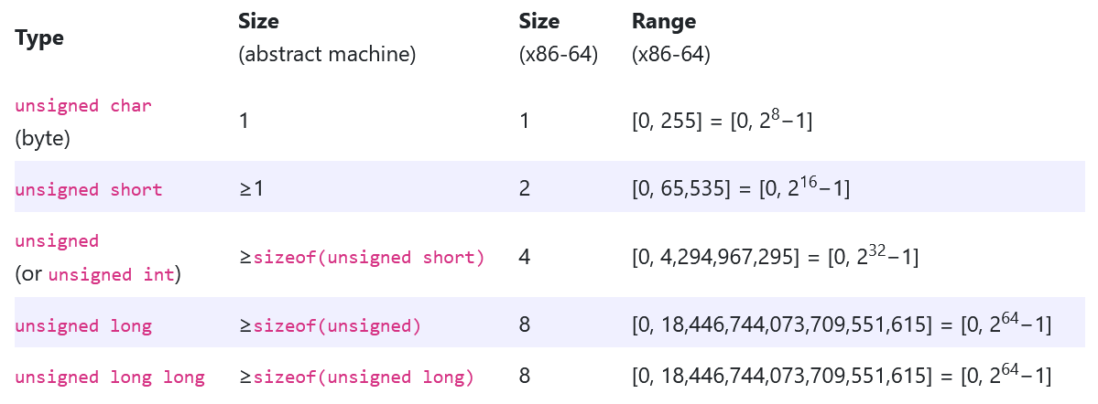
Values in C++
Notes:
C++ uses IEEE standards to define the sizes and bit-level representations of floating point numbers. For example, the two most common types of floating-point numbers in C++ (`float` and `double`) are 4 bytes and 8 bytes long, respectively, and follow IEEE semantics for bit-level representations of exponents etc.
[Ref: https://cs61.seas.harvard.edu/site/2023/Datarep/#gsc.tab=0
https://en.cppreference.com/w/cpp/language/types]

Slide 13
Values in C++
Different types have different rules for interpreting the bits in a value
So, the same set of bits mean different things when interpreted as different types!
This means that you cannot tell the type of a value just by looking at its bit values!
//On x86-64, all of these
//values have the same size
//and the same bit-level
//representation!
int a1 = 1;
unsigned char a2[] = {1,0,0,0};
unsigned short a3[] = {1,0};
unsigned a4 = 1;
float a5 = 1.4013e-45;
Notes:
[Ref: See the discussion of “Objects” in https://cs61.seas.harvard.edu/site/2023/Datarep/#Objects.]

Slide 14
The sizeof() operator in C++
The C++ operator sizeof(x) allows a program to retrieve the size in bytes of the value belonging to x (as defined by x’s type)
Ex: int x = 42; printf(“%d\n”, sizeof(x));
Ex: printf(“%d\n”, sizeof(int)); //i.e., you can also
//pass a type name to sizeof()
For example, on a Linux x86-64 machine:
sizeof(char): 1 sizeof(unsigned char): 1
sizeof(short): 2 sizeof(unsighed short): 2
sizeof(int): 4 sizeof(unsigned int): 4
sizeof(long): 8 sizeof(unsigned long): 8
sizeof(float): 4
sizeof(double): 8

Slide 15
Objects in C++
An object is a value stored in one or more adjacent memory locations
Values like 42 or false are Platonic: they exist in the spirit world and can never change
However, an object might contain different values over time
int x = 0; //x is an object living
//somewhere in memory;
//the object’s current
//value is 0.
x = 42; //The memory location
//belonging to object x
//now stores the value 42.
A computer uses RAM (“random access memory”) hardware to store objects
A modern laptop or desktop has ~8GB—32GB of RAM
An iPhone 14 has 6GB of RAM
A datacenter server has ~16GB—1TB of RAM
Logical view of memory
Actual physical RAM
Byte N-1
We’ll talk about the mapping in a few weeks!
. . .
Stores the binary representation of the value 0
42
Byte 0
Notes:
[We’ll discuss exactly how logical memory is mapped to physical RAM in a few lectures! For now, suffice it to say that the mapping is not 1-1. A process’s logical view of memory (called virtual memory) typically contains many more bytes than physical RAM; furthermore, physical RAM is typically shared by many processes. So, the mapping between a location in a process’s virtual memory and the “real” location in physical RAM couldn’t possibly be a straightforward 1-1 mapping like “virtual location 12 maps to physical location 12.”]

Slide 16
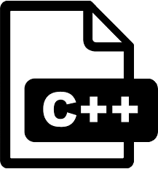
Lifecycle of a Process
(5) Via the terminal shell or a graphical interface, the user requests the launching of a new instance of the executable
> bsort in.txt
SSD
(6) The shell or GUI uses system calls to:
Create a new process
Read the code and static data from the on-disk executable; place that information into the memory region that belongs to the new process
Have the new process start running the loaded code!
//Pseudocode to sort an array
//of length n.
bubblesort(arr, n):
for(i=0; i<(n-1); i++):
for(j=0; j<(n-i-1); j++):
if(arr[j] > arr[j+1]):
tmp = arr[j];
arr[j] = arr[j+1];
arr[j+1] = tmp;
(4) The binary (“executable”) arrives on a user’s storage device (e.g., via an Internet download, a USB stick, or a local compilation)
(1) Design the program
.cc
(2) Translate design to code
.hh
(3) Compile the program

Slide 17
//C++ variables declared outside of
//a function are globals (i.e.,
//visible to any function). They
//have a static duration---they
//are created when the program
//launches and destroyed when the
//program exits.
int g = 42; //Initial value is 42.
void increment(bool do_print) {
bool is_even; //This variable is a
//local variable: it’s created
//when the enclosing function
//starts, is only visible to
//that function, and dies when
//the function returns.
g++;
is_even = ((g % 2)==0);
if (do_print) {
printf(“%d\t”, g);
printf(“even: %s\n”,
is_even ? “true”: “false”);
}
}
int main() {
increment(true); //Prints “43 false”
increment(true); //Prints “44 true”
return 0;
}
Address space
Stores info about active functions (e.g., the values of local variables)
Byte N-1
Stack
Pulled from executable into RAM during (6)
Static data
Code
Byte 0
SSD
Notes:
[The code and static data section of the address space are initialized using information contained by the on-storage executable. This means that a so-called “executable” file doesn’t just contain executable instructions—it also contains the initial values for global variables! [If you want to know more about the exact structure of an executable file on Linux, do some Internet searching about the ELF (“Executable and Linkable File”) format; for example, check out https://wiki.osdev.org/ELF.]]
[In practice, the compiler may choose to store a local variable in stack memory *or* in a CPU register. Placing the variable in a register allows the CPU to access the variable faster than if the variable were in memory. We’ll examine this topic in more detail in Lecture 4.]

Slide 18
OK . . . but what if you can’t predict how many variables your program will need?
Ex: Your audio mixing program cannot predict how long a new track will be
Ex: Your ML program reads training data from a live stream and you don’t know the stream length a priori

Slide 19
Dynamic memory allocation to the rescue!
Instead of determining how many variables you need at program development time . . .
void f() {
int x, y; //f always gets
//two ints
. . . allocate the needed amount of memory at program execution time:
void f() {
int n = read_int_from_user();
int* data = new int[n];
for (int i = 0; i < n; i++) {
do_stuff(data[i]);
But where does this data live in the address space?

Slide 20
The Heap
Dynamically-allocated memory lives in a program region known as the heap
A programmer must explicitly allocate and deallocate heap memory
int* ptr = new int; //Allocation;
//the new int
//lives here
do_stuff(ptr);
delete ptr; //Deallocation
In contrast:
The compiler and program loader automatically allocate memory space for static data
The compiler automatically emits machine instructions to allocate and deallocate memory space for stack variables—we’ll see this in a few lectures!
Address space
Stack
Byte N-1
Pulled from executable into RAM during (6)
Heap
Static data
Code
Byte 0
SSD
Notes:
[Ref: https://cs61.seas.harvard.edu/site/2023/Datarep/#Segments //See discussion about variable lifetimes: static vs. automatic vs. dynamic]

Slide 21
Real-life Example of an Address Space
Address space
#include <cstdio>
int main(){
int x = 42; //Local variable in function
int* ptr = new int[64]; //ptr is a local variable
//whose value is the address
//(i.e., starting memory
//location) of the array
//of ints in the heap
printf(“&x: %p\n”, &x); //0x0000’7ffd’d608’f94c
printf(“&ptr: %p\n”, &ptr); //0x0000’7ffd’d608’f940
printf(“ptr: %p\n”, ptr); //0x0000’0000’0185’22b0
printf(“main: %p\n”, main); //0x0000’0000’0040’1136
return 0;
}
Byte N-1
Stack
Heap
Static data
Code
Byte 0

