Slide 1
Processes, Part IV
CS 61: Lecture 19 11/15/2023

Slide 2
Implementing fork(): Slow but Correct
fork() creates a new child process whose address space is a copy of the parent’s address space
A naïve implementation uses synchronous copying of pages
The OS performs repeated, synchronous page allocations and memcpy() operations to duplicate every valid page in the parent’s user-level memory
The child gets a copy of the parent’s page table (updated to point to the newly-created copies of user-level pages!)
Read+write (e.g., heap)
Read+write (e.g., heap)
Immediately after fork(), in user-accessible virtual memory . . .
Read-only (e.g., code)
Read-only (e.g., code)
Parent
Physical RAM
Child

Slide 3
Making fork() Efficient: Copy-on-write
The kernel gives the child a copy of the parent’s page tables, but the OS does not allocate+memcpy() raw page data for user-level memory
Instead, in both the parent and child page tables, the kernel sets PTEs for user-level pages to be read-only
Read-only (e.g., heap)
Read-only (e.g., heap)
Immediately after fork(), in user-accessible virtual memory . . .
Read-only (e.g., code)
Read-only (e.g., code)
Parent
Physical RAM
Child

Slide 4
Making fork() Efficient: Copy-on-write
When one processes tries to write a page that should be writeable (e.g., in the stack or heap), a page-fault exception occurs
The kernel responds by . . .
Creating a copy of the page for the child
Updating the child’s PTE to point to new page
Marking the relevant PTE for both processes as read/write
For this to work, the kernel needs to maintain a data structure that tracks which memory ranges (consisting of one or more pages) are valid (and what the permissions for each range are)!
Read/write
Read-only (e.g., heap)
Read-only (e.g., heap)
Read/write
Read-only (e.g., code)
Read-only (e.g., code)
Parent
Physical RAM
Child

Slide 5
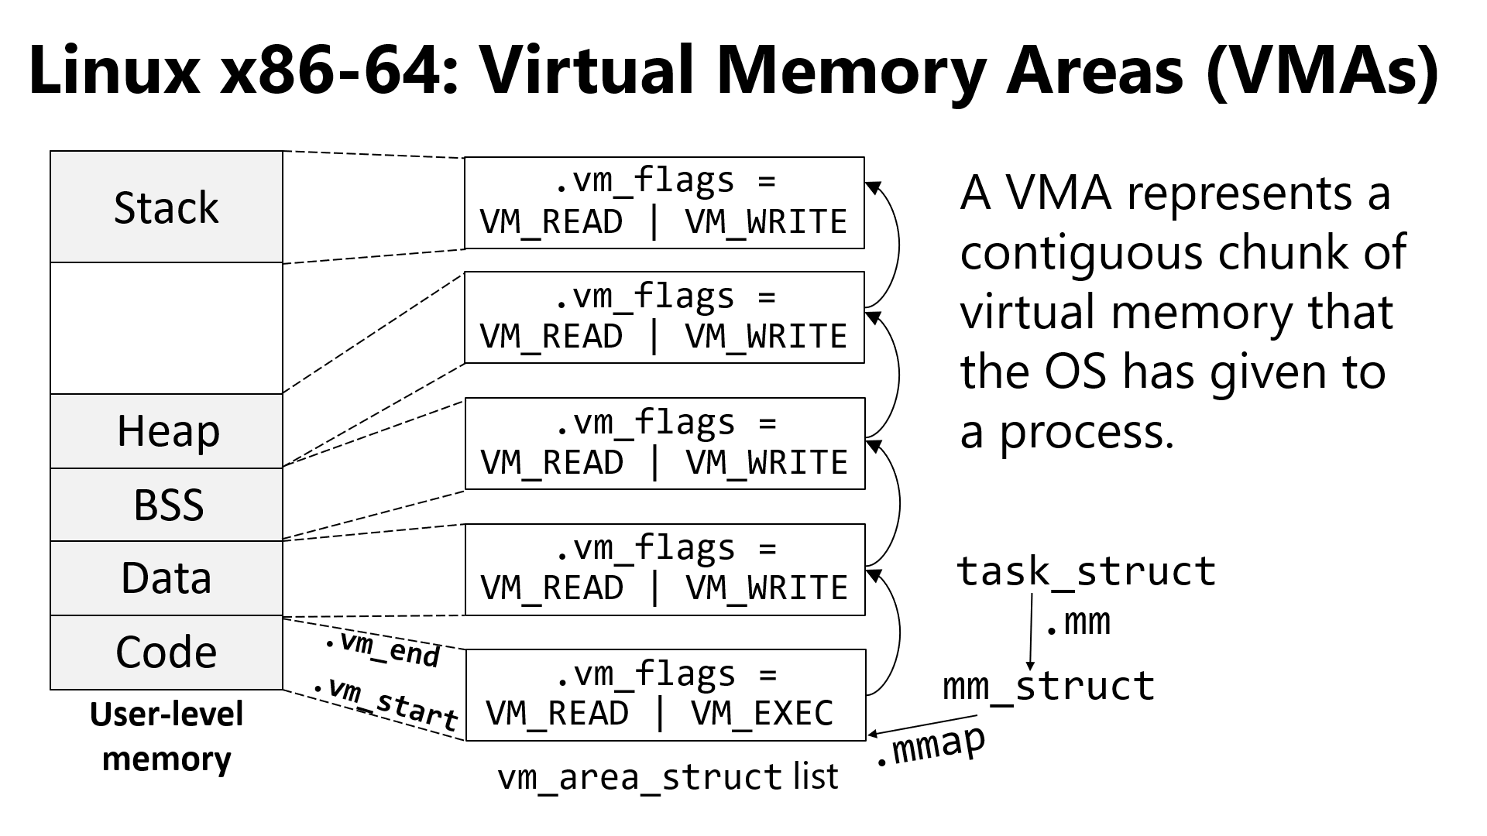
Linux x86-64: Virtual Memory Areas (VMAs)
.vm_flags =
A VMA represents a contiguous chunk of virtual memory that the OS has given to a process.
Stack
VM_READ | VM_WRITE
.vm_flags =
VM_READ | VM_WRITE
Heap
.vm_flags =
VM_READ | VM_WRITE
BSS
.vm_flags =
During a page fault, Linux consults the VMAs to see if a write fault is caused by a true protection violation or by the copy-on-write optimization!
Data
task_struct
VM_READ | VM_WRITE
.mm
Code
.vm_end
.vm_flags =
mm_struct
User-level memory
.vm_start
VM_READ | VM_EXEC
.mmap
vm_area_struct list
Notes:
In Linux, a task_struct is a per-kernel-thread data structure that contains bookkeeping information about the thread.
The data segment contains static variables that are explicitly initialized by a program. The BSS region holds static variables that weren’t given explicit initial values, and should be initialized to zero; remember that in C, static variables without an explicit initializer are set to all-zeroes. The name “BSS” is a historical artifact; you can read the Wikipedia article to learn its origins (which are not interesting). [Ref: https://en.wikipedia.org/wiki/.bss]
[Ref: https://elixir.bootlin.com/linux/latest/source/include/linux/mm_types.h#L292 //Kernel v5.5.4
https://elixir.bootlin.com/linux/latest/source/include/linux/mm.h#L249 //Ditto]

Slide 6
Our Strange Friend vfork()
Linux implements fork() using copy-on-write, but early Unix-style OSes implemented fork() using synchronous copying
If a program had many valid pages in its address space, synchronous copying would be slow
Regardless of how much copying was done, the copy work would be wasted if a process immediately followed fork() by exec()!
BSD (a Unix-derived OS) introduced vfork() to improve forking performance
Like fork(), vfork() creates a new process that inherits the parent’s environment (e.g., open file descriptors), memory pages, and register contents
However, vfork() forcibly suspends the parent until the child terminates (via _exit() or via a fatal signal) or executes execve()
Until the child does so, the child shares all its memory pages with the parent (including the stack!), since vfork() copied no pages!
So, the child cannot:
Return from the current function (because this may alter information on the stack, the heap, or global variables)
Call exit() (which would invoke exit handlers registered by the parent, e.g., to flush stdio buffers)
Touch memory state in any other way LOL
The child can touch data in registers, since each process has its own private registers
However, high-level languages (e.g., C/C++/Java/Go/Python/etc.) don’t reveal whether data is stored in a register or memory
So, if the child wants to touch register state, the process will have to use inline assembly LOLOL
Notes:
Note that a vfork() child can call the system call _exit(), because this system call won’t tamper with user-mode memory.
Also note that BSD did eventually implement copy-on-write for fork() :-D. [Aside: That being said, correctly implementing copy-on-write is difficult in any operating system, not just BSD. For more details about some of the challenges, see the paper "Copy-on-Pin: The Missing Piece for Correct Copy-on-Write“ by Hildenbrand et al. (https://nadav.amit.zone/publications/hildenbrand2023cow.pdf).]

Slide 7
Why Do Enlightened People Still Tolerate vfork()?
One reason is that performance-critical applications might benefit from the small performance advantage provided by vfork() (versus fork())
A copy-on-write fork() has to modify the page tables of the parent and the child to mark readable+writeable pages as read-only; this modification takes a small but nonzero amount of time
vfork() doesn’t have to do these modifications!
Another reason is that, because vfork() doesn’t leverage copy-on-write, Linux can provide vfork() on computers that don’t have MMUs (and thus cannot use page table protections to implement copy-on-write)!
On computers without MMUs, machine instructions always manipulate physical addresses directly
On such a machine, vfork() essentially just induces the kernel to create a new struct proc, with the exec() forcing the kernel to allocate new memory pages for the new process and load a binary into that memory
Notes:
[See the `man 2 fork` for a discussion of these issues: https://man7.org/linux/man-pages/man2/vfork.2.html]
[If you’re interested in the discussion of how an MMU-less system would work, see μClinux, a Linux variant designed for MMU-less computers! For example, check out https://elinux.org/images/3/35/Austin-uClinux_ELC_43_small.pdf and https://unix.stackexchange.com/questions/190350/mmu-less-kernel.]

Slide 8
posix_spawn()
As discussed in the last lecture, the environment for a Linux process has gotten more complicated over time
Ex: A process’s open file descriptors
Ex: A process’s explicit signal handlers and default signal actions
Ex: A process’s scheduling information (e.g., the priority of the process)
. . . and many more pieces of state!
Before posix_spawn(), a post-fork() child would have to invoke a lot of individual incantations to determine how to modify the child’s environment before the exec() occurred
int posix_spawn(pid_t* pid, const char* path, const posix_spawn_file_actions_t* file_actions, const posix_spawnattr_t* attrp, char* const argv, char* const envp) has such a complicated function signature because it allows the caller to be very specific about how the child’s environment should be changed before a new binary is loaded
In the forking step, posix_spawn() creates a new child process and places the child’s pid in *pid
In the pre-exec() stage, posix_spawn() changes the child’s environment as specified by the arguments to posix_spawn()
Ex: Doing open()s, close()s, and/or dup2()s of file descriptors as requested by the file_actions argument
Ex: Changing how signals are handled as indicated by the attrp argument
In the exec() stage, posix_spawn() actually invokes exec()

Slide 9
Race Conditions

Slide 10
Race Conditions
From the perspective of a user-level process or the OS, many kinds of events have unpredictable timings
Ex: A user deciding when to enter a keypress
Ex: A remote YouTube server deciding when to send the next part of cat video
An event-driven program will behave differently when presented with different sequences of events!
The kernel’s process scheduler also introduces unpredictability
Roughly speaking, the fraction of CPU time that a process P receives is proportional to how many other processes also want to run
The number of other processes will grow and shrink over time, in part due to nondeterministic events like the user deciding to launch a new application!
A system has a race condition if the system’s behavior is sensitive to the order in which various events occur
The race condition is a bug if a possible interleaving of events will cause undesirable system behavior
Buggy race conditions are often caused when multiple computations access the same resources but don’t coordinate their accesses!

Slide 11
Race Conditions via the Shell
Shells allow multiple processes to run serially via the ; operator
Ex: echo morning; echo afternoon; echo night
Shells provide several mechanisms for running processes in parallel
The & operator allows multiple processes to run in parallel, without any dependencies between each other
Ex: head –n 4 < log.txt & g++ test.cc
The | operator allows multiple processes to run in parallel, with the output of process i providing the input to process i+1
Ex: sort < in.txt | wc –c > out.txt
Seemingly innocent shell pipelines may generate race conditions if different processes manipulate shared resources!
Notes:
The `head –n N` command will print the first N lines of standard input.

Slide 12
Race Conditions via the Shell
/bin/echo handoff | cat
/bin/echo handoff > handoff.txt & cat handoff.txt
In the second example, the two processes run in parallel and try to synchronize via handoff.txt
However, echo can write the file at its own pace (subject to when the kernel schedules echo)
Similarly, cat can read the file at its own pace (subject to when the kernel schedules cat)
So, there’s no real coordination here!
In the first example, the two processes run in parallel but synchronize through the pipe!
cat will process the output of echo as that output is generated, blocking whenever no data is ready
Similarly, echo will eventually block if cat is not ready to receive new data
Notes:
The `cat [file1] [file2] …` program will read the specified files, concatenate their contents, and write the concatenated content to stdout. If no filenames are provided, `cat` just writes stdin to stdout.
[Note that some shells implement a “builtin” version of `echo`, such that running `echo` from the shell prompt will not actually cause a separate `echo` process to be created, but will instead just execute code within the shell process itself. This is (somewhat cryptically) mentioned by the man page for `echo` (https://linux.die.net/man/1/echo), which says that “NOTE: your shell may have its own version of echo, which usually supersedes the version described here.” In the examples above, the use of a full path for `echo` (i.e. `/bin/echo`) ensures that the shell uses the standalone executable version of `echo`.]

Slide 13
What Can A Signal Interrupt?
As we discussed in the last two lectures, a process might execute a signal handler between the execution of any two instructions in the process
If a process is blocked in certain system calls, the execution of a signal handler will “interrupt” the system call, forcing the system call to return early!
Consider a file descriptor fd that has at least 32 bytes ready for reading
read(fd, buf, 32) might be interrupted by a signal handler, returning a retval of:
Between 1 and 31 (indicating a “short count” read), or
-1: Indicating that no data has been read, with errno == EINTR
To prevent the execution of a signal handler from interrupting a system call, set struct sigaction::sa_flags to SA_RESTART
Also note that if a signal arrives that doesn’t kill the process and doesn’t trigger the execution of a signal handler, a system call will not be interrupted
Read man 7 signal (and the man pages of individual system calls) to understand the interruption semantics for system calls of interest!
Notes:
[Recall that `read()` returns zero if the file offset is already at the end of the file.]
[Aside: The slide says that “if a signal arrives that doesn’t kill the process and doesn’t trigger the execution of a signal handler, a system call will not be interrupted.” This is a bit of a lie. As described by `man 7 signal`, “On Linux, even in the absence of signal handlers, certain blocking interfaces can fail with the error EINTR after the process is stopped by one of the stop signals and then resumed via SIGCONT. This behavior is not sanctioned by POSIX.1, and doesn't occur on other systems.” Examples of such system calls are the socket calls `accept()`, `send()`, and `recv()`.]
[Ref: https://man7.org/linux/man-pages/man7/signal.7.html and the man pages of individual system calls like `read()`.]

Slide 14
Signal-based Race Conditions: Timed Wait
Suppose that a parent process creates a child and then wants to wait for the child to exit or 0.75 seconds to pass, whichever comes first
Can the parent do this in a way that is both efficient and free of race conditions?
//Attempt 1: Parent polls for the exit
//status of the child.
//Get the current time (internally calling
//the clock_gettime() libc call).
double start_time = timestamp();
//Create child via fork(), with the
//details hidden inside make_child()
//(whose code is elided).
pid_t child_pid = make_child();
//Wait for a timeout or child exit,
//whichever happens first!
int status;
pid_t exited_pid = 0;
while ((timestamp() - start_time < timeout) &&
(exited_pid == 0)) {
exited_pid = waitpid(child_pid, &status, WNOHANG);
assert(exited_pid == 0 || exited_pid == child_pid);
}
This works, but consumes a lot of CPU cycles as the parent busy-waits for the termination conditions to occur!

Slide 15
Signal-based Race Conditions: Timed Wait
This approach suffers from a race condition! If the child exits before the nanosleep() executes, the parent will wait the full 0.75 seconds because nanosleep() won’t be interrupted!
//Attempt 2: Parent uses a blocking, timed wait that can
//be interrupted by SIGCHLD (generated by the kernel
//upon a child’s transcendence, with a default behavior
//of "ignore").
void sig_handler(int sig) { (void) sig; }
struct sigaction sa;
sa.sa_handler = sig_handler;
sa.sa_flags = 0; //Don't specify SA_RESTART!
//Other sa initialization elided.
sigaction(SIGCHLD, &sa, nullptr);
double start_time = timestamp();
pid_t child_pid = make_child();
//nanosleep() can be interrupted by a signal handler and
//return early!
nanosleep(/* 0.75 seconds */);
//Print what happened!
pid_t exited_pid = waitpid(child_pid, nullptr, WNOHANG);
printf("%s\n", (child_pid == exited_pid) ?
"Child exited first" : “Timeout fired first");
Notes:
[Note that, technically speaking, Approach 1 also had a small race condition, since in this code . . .
pid_t child_pid = make_child();
int status;
pid_t exited_pid = 0;
while ((timestamp() - start_time < timeout) &&
(exited_pid == 0)) {
exited_pid = waitpid(child_pid, &status, WNOHANG);
assert(exited_pid == 0 || exited_pid == child_pid);
}
. . . the child could have exited before the parent’s while-loop started. However, in this case, the parent wouldn’t have to wait the full 0.75 seconds, but rather just the time needed to make one iteration through the loop.]

Slide 16
Signal-based Race Conditions: Timed Wait
//Approach #3: Use a timer and a pipe!
int sig_pipe[2];
void sig_handler(int sig) {
const char* msg = (signal == SIGCHLD)
? "C"
: "T";
write(sig_pipe[1], msg, 1); //write()
//is safe to call in a signal handler:
//see `man signal-safety(7)`.
}
//Create a pipe and register non-SA_RESTART
//handlers for SIGCHLD and SIGALRM.
pipe(sig_pipe);
set_signal_handler(SIGCHLD, sig_handler);
set_signal_handler(SIGALRM, sig_handler);
double start_time = timestamp();
pid_t child_pid = make_child(exit_delay);

Slide 17
Signal-based Race Conditions: Timed Wait
There’s no race condition! Or rather, there is a race between (1) the child exiting and (2) the parent registering the timer and then reading from the pipe. However, regardless of whether:
the child exits before the timer is registered,
the child exits after the timer is registered but before the pipe is read, or
the child exits during the pipe read,
. . . the parent will correctly either wait 0.75 seconds or wait less if the child exits before the timer fires!
//Approach #3: Use a timer and a pipe!
int sig_pipe[2];
void sig_handler(int sig) {
const char* msg = (signal == SIGCHLD)
? "C"
: "T";
write(sig_pipe[1], msg, 1); //write()
//is safe to call in a signal handler:
//see `man signal-safety(7)`.
}
//Create a pipe and register non-SA_RESTART
//handlers for SIGCHLD and SIGALRM.
pipe(sig_pipe);
set_signal_handler(SIGCHLD, sig_handler);
set_signal_handler(SIGALRM, sig_handler);
double start_time = timestamp();
pid_t child_pid = make_child();
//Set an alarm for 0.75 seconds, after which
//kernel delivers SIGALRM.
struct itimerval itimer;
itimer.it_value = /* 0.75 seconds */;
setitimer(ITIMER_REAL, &itimer, nullptr);
//read() will either succeed (because the
//child wrote to the pipe and exited before
//we got here) or be interrupted by a signal
//(either SIGCHLD or SIGALRM).
char c;
read(sig_pipe[0], &c, 1);
//Check if child exited.
pid_t exited_pid = waitpid(p1, &status, WNOHANG);
printf("%s\n", (child_pid == exited_pid) ?
"Child exited first" :
“Timeout fired first");

