Slide 1
Processes, Part III
CS 61: Lecture 18 11/13/2023

Slide 2
Linux Signals
import sys
import time
if __name__ == "__main__":
while True:
time.sleep(1)
sys.exit(0)
The kill(pid_t pid, int sig) system call will send a signal to another process
The sigaction(int sig, const struct sigaction *act, ...) system call allows a process to define a handler function for a particular signal
The kernel only delivers a signal during a context switch from the kernel to the receiving process
The kernel will push the handler’s stack frame atop the normal user-level stack
If a process receives a signal but defines no handler, Linux defines what the default outcome will be
Terminate: The process dies
Terminate with core dump: The process dies and the OS writes to disk a “core dump” (i.e., a snapshot of the process’s memory, register values, and call stack immediately before it died)
Stop the process: Halt but don’t kill the process (but resume the process later if it received SIGCONT)
Ignore: Process execution is unaffected
C:\Users\mickens\test-dev>python test.py
Traceback (most recent call last):
File "test.py", line 6, in <module>
time.sleep(1)
KeyboardInterrupt
^C
C:\Users\mickens\test-dev>
$ python test.py
^Z
[1]+ Stopped python test.py
$ fg
python test.py
A process cannot ignore or handle SIGSTOP! When a process receives SIGSTOP, the kernel automatically pauses the process.
The Python interpreter defines a handler for SIGINT! The interpreter notices that the Python script doesn’t register a Python-level interest in SIGINT, so the interpreter voluntarily terminates.

Slide 3
Signal Safety
char* first, second; //Invariant: Both names should
//belong to the same person!
void print_name(){
char buf[128];
snprintf(buf, sizeof(buf), “%s %s\n”, first,
second);
write(STDOUT_FILENO, buf, strlen(buf));
}
void handle_sigalarm(int sig) {
print_name();
}
int main() {
struct sigaction sa;
sa.sa_handler = handle_sigalarm;
//Other initialization of sa is elided.
sigaction(SIGALRM, &sa, nullptr);
alarm(1); //Request SIGALRM in 1 second.
std::map<char*, char*> names{{"alice", "wu"},
{"bob", "smith"},
{"charlie", “rios"}};
while (true) {
for (auto it = names.begin(); it != names.end();
++it) {
first = it->first;
second = it->second;
print_name();
}
}
return 0;
}
A signal handler can interrupt the execution of any user-level function, between any two instructions in that function
Thus, careless use of signals can lead to broken program invariants!
Ex: A signal handler may execute when the program is in the midst of updating an invariant like “when print_name() executes, first and second must belong to the same person”
Ex: Suppose that a program is executing fread() when a signal handler is triggered; if that handler also invokes fread(), stdio’s internal caching state may get changed . . .
Ex: The cached block is replaced
Ex: The seek offset is changed
. . . leading to confusion when the interrupted fread() resumes!
Broken invariant: print_name() should only print name pairs that belong to the same person!
Notes:
[Aside: In this example, we use a std::map<char*, char*>. However, in most situations, you probably want to use a std:string as the key instead of a char*. Using a char* will result in map lookups (e.g., via find()) looking for matches based on the value of (i.e., virtual address represented by) a char*; in reality, you probably wanted to do lookups based on matching of the string pointed to by the char*. To fix this, you could define a comparison function like this . . .
struct cmp_str {
bool operator()(char const *a, char const *b) const {
return std::strcmp(a, b) < 0;
}
};
std::map<char*, int, cmp_str> names;
. . . or just use std:string instead of char*; the latter approach works because, if an explicit comparator isn’t passed into the map<> constructor, the map<> will use the operator< defined for the key type, which for std::strings performs a lexicographic comparison of the strings themselves, not a comparison of the start addresses of the strings.]

Slide 4
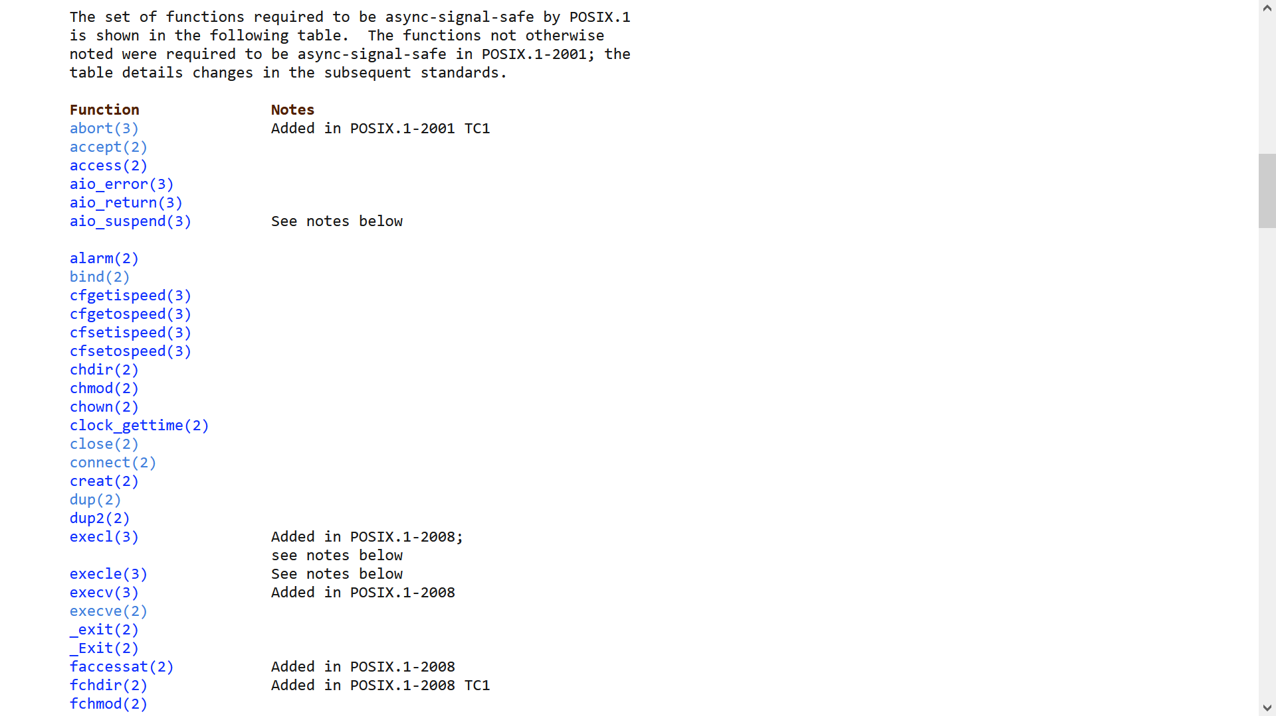
Signal Safety
char* first, second;
volatile sig_atomic_t flag = 0;
void print_name(){
char buf[128];
snprintf(buf, sizeof(buf), “%s %s\n”, first,
second);
write(STDOUT_FILENO, buf, strlen(buf));
}
void handle_sigalarm(int sig) {
flag = 1;
}
int main() {
struct sigaction sa;
sa.sa_handler = handle_sigalarm;
//Other initialization of sa is elided.
sigaction(SIGALRM, &sa, nullptr);
alarm(1); //Request SIGALRM in 1 second.
std::map<char*, char*> names{{"alice", "wu"},
{"bob", "smith"},
{"charlie", “rios"}};
while (true) {
if (flag == 1) {
printf(“Alarm received, exiting!\n”);
exit(1);
}
for (auto it = names.begin(); it != names.end();
++it) {
first = it->first;
second = it->second;
print_name();
}
}
return 0;
}
char* first, second;
void print_name(){
char buf[128];
snprintf(buf, sizeof(buf), “%s %s\n”, first,
second);
write(STDOUT_FILENO, buf, strlen(buf));
}
void handle_sigalarm(int sig) {
print_name();
}
int main() {
struct sigaction sa;
sa.sa_handler = handle_sigalarm;
//Other initialization of sa is elided.
sigaction(SIGALRM, &sa, nullptr);
alarm(1); //Request SIGALRM in 1 second.
std::map<char*, char*> names{{"alice", "wu"},
{"bob", "smith"},
{"charlie", “rios"}};
while (true) {
for (auto it = names.begin(); it != names.end();
++it) {
first = it->first;
second = it->second;
print_name();
}
}
return 0;
}
The best approach is usually for a signal handler to just set a flag that is periodically checked by the program
If a signal handler must call other functions, those functions must be reentrant, i.e., must behave correctly even if multiple copies of that function are executing simultaneously
A reentrant function can use local variables, but either:
Doesn’t use global variables, or
Protects accesses to global state using consistency mechanisms (e.g., locks) which ensure that only one function instance is using that state at any given time
See man signal-safety for a list of reentrant system calls and libc functions
Notes:
Note, for example, that fwrite() is *not* reentrant, but write() is! malloc() isn’t reentrant; the reason is that, just like fwrite(), and individual call to malloc() might update a variety of internal data structures, such that, if a second call to malloc() interrupted a first call, the second call might see metadata that exists in an inconsistent state.
[Ref: https://en.wikipedia.org/wiki/Reentrancy_(computing)
https://man7.org/linux/man-pages/man7/signal-safety.7.html]

Slide 5
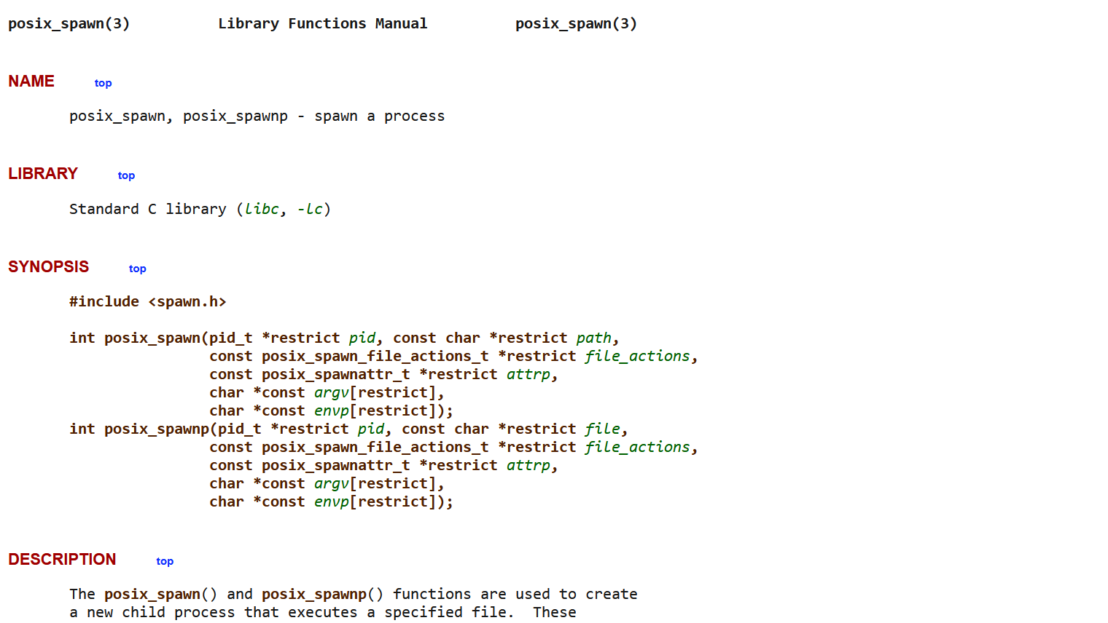
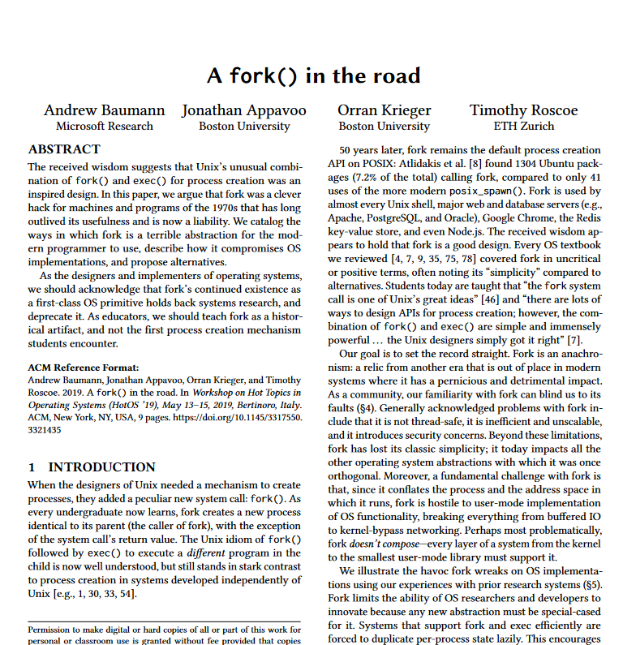
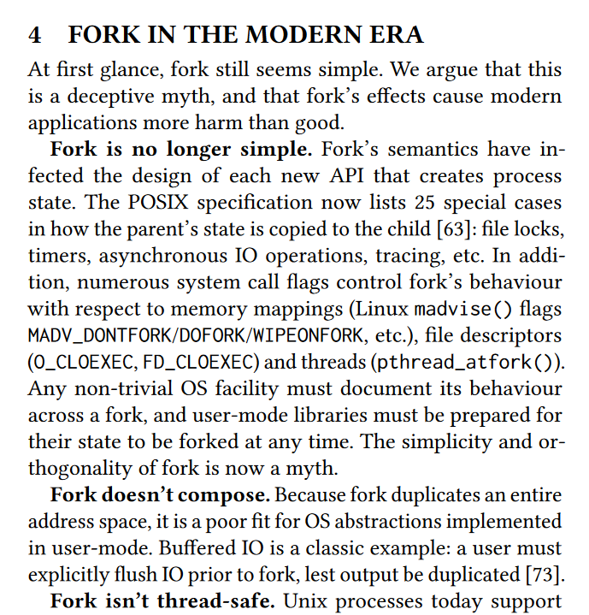
The posix_spawn() library call
fork() copies the address space and the environment of a parent process to a newly-created child process
Pro: The API is simple in theory
Con: The API is complex in practice because, as OSes have added more features, a process’s environment has gotten more complicated!
Con: Copying page tables, the referenced memory pages, and environmental state like file descriptor tables can be slow
Con: If fork() is often followed by exec(), why have two separate system calls?
At a high level, posix_spawn() is like a more efficient fork()+exec() that allows the caller to customize the environment of the child before creating the child
The details are . . . detailed
Internally, posix_spawn() is implemented via vfork() and/or clone() system calls which we’ll study in more detail later—these system calls only copy part of the parent’s state!
Notes:
[Ref: https://www.microsoft.com/en-us/research/uploads/prod/2019/04/fork-hotos19.pdf
https://www.bu.edu/rhcollab/2019/04/11/a-fork-in-the-road/
https://zatrazz.github.io/Launching-Process/
https://man7.org/linux/man-pages/man3/posix_spawn.3.html
https://man7.org/linux/man-pages/man2/vfork.2.html
]

Slide 6
Collecting a Child’s Termination Notification
_exit(int status) is a system call which terminates a process
A status of 0 (i.e., EXIT_SUCCESS) means that the process ended normally
A status between 1-255 indicates that the process termination was abnormal
pid_t waitpid(pid_t pid, int* status, int options) is a system call that lets a parent detect a child’s death and collect the child’s exit status
The system call can be blocking (options == 0) or nonblocking (options == WNOHANG)
The most common values for the pid argument are:
-1: Wait for any child
> 0: Wait for child having the specified pid
The return value is:
The process id of the child that has terminated
0 if the pid argument refers to a valid child but that child hasn’t exited and WNOHANG was specified
-1 on error (e.g., the pid argument refers to an invalid child)
On success, the system call sets *status to the child’s exit status
WFEXITED(status) != 0 if the child terminated via _exit() (directly or via exit() or returning from main())
If WFEXITED(status), then WEXITSTATUS(status) contains the least significant 8 bits of the status that was passed to _exit()
WIFSIGNALED(status) != 0 if the child was terminated via a signal; if so, WTERMSIG(status) extracts the signal number which caused termination
Notes:
[Ref: https://linux.die.net/man/2/waitpid]

Slide 7
Zombies
When a process dies for any reason, the kernel does not immediately remove the process from the system!
Instead, the kernel waits for the process to be reaped by its parent via a system call like waitpid()
A dead process that has not been reaped yet is a zombie
A process (alive or dead) whose real parent is dead is an orphan
The kernel reparents orphaned processes to init so that init can eventually reap those children (and thereby deallocate their resources via a system call like waitpid())
Good style requires a program to reap its own children to prevent those children from consuming resources unnecessarily!
Notes:
Examples of resources that may be held by dead children are:
-The physical memory pages that back the process’s virtual memory
-The physical memory pages that hold the process’s page table
-The physical memory pages that hold the process’s `struct proc`

Slide 8
ON THE TOPIC OF SHELLS

Slide 9
Shells
A shell provides a text-based interface that allows a user to manage processes
Redirection allows a user to control a process’s inputs and outputs
Connecting a process’s stdin to a file, e.g., sort < in.txt
Connecting a process’s stdout to a file, e.g., sort > out.txt
Connecting a process’s stderr to a file, e.g., sort 2> out.txt
Connecting a process’s stdout and stderr to a file, e.g., sort &> out.txt
Pipelines allow a user to stitch together multiple processes
Consider the shell command sort < in.txt | wc -c > out.txt
The semantics of this command are “run the sort program, redirecting stdin to in.txt, and feed the output to wc –c, redirecting wc’s output to the file out.txt”
If multiple processes in a pipeline are simultaneously writing to stdout and/or stderr, the terminal output may appear garbled!
The shell doesn’t wait for a background process (e.g., sort < in.txt &) to finish before the shell starts accepting new commands
Notes:
By default, a process’s `stdout` and `stderr` are both connected to the terminal output stream, meaning that both normal output and error output go to the same stream. However, `stdout` and `stderr` are indeed different file descriptors, so they can be redirected individually!
In the bash shell, “If [a] pipeline is not executed asynchronously [i.e., using the `&` operator], the shell waits for all commands in the pipeline to complete.” See https://www.gnu.org/software/bash/manual/html_node/Pipelines.html.
`wc –c` prints the number of bytes in the supplied `stdin` stream.
[Another trick that can be helpful is to redirect stderr to stdout using `2>&1`, e.g., `echo hiya > out.txt 2>&1`. In this example, `stdout` is redirected to the file `out.txt`, and `stderr` is made to point to whatever `stdout` points to.]

Slide 10
17756 execve("/usr/bin/sh", ["sh", "-c", "sort < in.txt | wc -c > out.txt"])= 0
17756 pipe([3, 4]) = 0
17756 clone(...) = 17757
17756 close(4) = 0
17756 clone(...) = 17758
17756 close(3) = 0
17757 close(3) = 0
17757 dup2(4, 1) = 1
17757 close(4) = 0
17757 openat(AT_FDCWD, "in.txt", O_RDONLY) = 3
17757 dup2(3, 0) = 0
17757 close(3) = 0
17757 execve("/usr/bin/sort", ["sort”]) <unfinished ...>
17758 dup2(3, 0) = 0
17758 close(3) = 0
17758 openat(AT_FDCWD, "out.txt", O_WRONLY|O_CREAT|O_TRUNC, 0666) = 3
17758 dup2(3, 1) = 1
17758 close(3) = 0
17758 execve("/usr/bin/wc", ["wc", "-c"]) <detached ...>
$ strace -f -b execve -o strace.out
-e trace=dup,dup2,fork,clone,execve,pipe,pipe2,openat
sh -c "sort < in.txt | wc -c > out.txt"
//-f: follow forks
//-b execve: detach when execve is encountered
//-e trace=s1,s2...: trace only the specified system calls
Notes:
For the purposes of this lecture, you can think of the `clone()` system call as being equivalent to the `fork()` system call. However, we’ll return to the topic of the `clone()` system call when we talk about multithreaded processes!
Note that /usr/bin/sh is the bash shell—see https://linux.die.net/man/1/sh.

Slide 11
sort < in.txt | wc -c > out.txt
17756 execve("/usr/bin/sh", ["sh", "-c", "sort < in.txt | wc -c > out.txt"]) = 0
17756 pipe([3, 4]) = 0
/usr/bin/sh:17756
Other fields
Eight-entry fd table
Metadata
Metadata
Metadata
Metadata
Metadata
Ref count
Ref count
Ref count
Ref count
Ref count
Ref count
Perms
Perms
Metadata
Perms
Offset
Perms
Perms
Offset
Perms
Offset
Offset
Offset
Offset
Six-entry open file table
1
1
r/w
0
3
r
0
w
0
…
…
…
Pipe buffer

Slide 12
sort < in.txt | wc -c > out.txt
17756 clone(...) = 17757
17756 close(4) = 0
17756 clone(...) = 17758
17756 close(3) = 0
/usr/bin/sh:17756
/usr/bin/sh:17757
/usr/bin/sh:17758
Other fields
Eight-entry fd table
Metadata
Metadata
Metadata
Metadata
Metadata
Ref count
Ref count
Ref count
Ref count
Ref count
Ref count
Perms
Perms
Metadata
Perms
Offset
Perms
Perms
Offset
Perms
Offset
Offset
Offset
Offset
Six-entry open file table
1
1
0
3
0
2
0
2
6
r/w
9
r
3
w
…
…
…
Pipe buffer

Slide 13
sort < in.txt | wc -c > out.txt
17757 close(3) = 0
17757 dup2(4, 1) = 1
17757 close(4) = 0
/usr/bin/sh:17756
/usr/bin/sh:17757
/usr/bin/sh:17758
Other fields
Eight-entry fd table
Metadata
Metadata
Metadata
Metadata
Metadata
Ref count
Ref count
Ref count
Ref count
Ref count
Ref count
Perms
Perms
Metadata
Perms
Offset
Perms
Perms
Offset
Perms
Offset
Offset
Offset
Offset
Six-entry open file table
2
1
0
9
0
1
0
r/w
8
r
w
2
…
…
…
Pipe buffer

Slide 14
sort < in.txt | wc -c > out.txt
17757 openat(AT_FDCWD, "in.txt", O_RDONLY) = 3
17757 dup2(3, 0) = 0
17757 close(3) = 0
17757 execve("/usr/bin/sort", ["sort”]) <unfinished ...>
/usr/bin/sh:17756
/usr/bin/sh:17757
/usr/bin/sh:17758
/usr/bin/sort:17757
Other fields
Eight-entry fd table
Metadata
Metadata
Metadata
Metadata
Metadata
Ref count
Ref count
Ref count
Ref count
Ref count
Ref count
Perms
Perms
Metadata
Perms
Offset
Perms
Perms
Offset
Perms
Offset
Offset
Offset
Offset
Six-entry open file table
2
1
0
9
0
1
0
2
7
r/w
8
r
w
r
0
1
…
…
…
…
Pipe buffer

Slide 15
sort < in.txt | wc -c > out.txt
17758 dup2(3, 0) = 0
17758 close(3) = 0
17758 openat(AT_FDCWD, "out.txt", O_WRONLY|O_CREAT|O_TRUNC, 0666) = 3
17758 dup2(3, 1) = 1
17758 close(3) = 0
17758 execve("/usr/bin/wc", ["wc", "-c"]) <detached ...>
/usr/bin/sh:17756
/usr/bin/wc:17758
/usr/bin/sort:17757
/usr/bin/sh:17758
Other fields
Eight-entry fd table
Metadata
Metadata
Metadata
Metadata
Metadata
Ref count
Ref count
Ref count
Ref count
Ref count
Ref count
Perms
Perms
Metadata
Perms
Offset
Perms
Perms
Offset
Perms
Offset
Offset
Offset
Offset
Six-entry open file table
2
1
0
9
0
0
5
2
2
6
1
0
1
r/w
7
r
w
r
0
1
w
…
…
…
…
…
Pipe buffer

Slide 16
SUMMARY

Slide 17
sort < in.txt | wc -c > out.txt
sort’s stdin is connected to in.txt, and sort’s stdout is connected to the write end of the pipe
wc’s stdin is connected to the read end of the pipe, and wc’s stdout is connected to out.txt
sh has the pids of the children and thus can wait on the entire pipeline to finish
/usr/bin/sh:17756
/usr/bin/sort:17757
/usr/bin/wc:17758
Other fields
Eight-entry fd table
Metadata
Metadata
Metadata
Metadata
Metadata
Ref count
Ref count
Ref count
Ref count
Ref count
Ref count
Perms
Perms
Metadata
Perms
Offset
Perms
Perms
Offset
Perms
Offset
Offset
Offset
Offset
Six-entry open file table
2
1
0
9
0
0
5
1
1
6
0
r/w
7
r
w
r
0
1
w
…
…
…
…
…
Pipe buffer

