Slide 1
Processes, Part I
CS 61: Lecture 16 11/6/2023

Slide 2
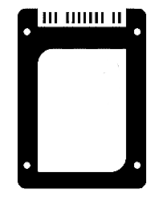
Process Management
OSes enforce process isolation: a process is restricted to performing computation that reads and writes the process’s own registers and memory
However, a process will often want to interact with the outside world
To interact with the external world, a user-level process invokes a system call
In the past three lectures, we focused on system calls involving file IO
Another important category of system calls involve process management!
User-level process X
User-level process Y
User-level process Z
Operating system
(Kernel-level code)
MMU
MMU
MMU
MMU
Hardware
RAM
SSD
UX devices
Network

Slide 3
Process Management
The most important system calls for process management are:
fork(): Create a new process, initializing it as a copy of the current process
execve(const char* exec_path,…): Restart the current process, having it load a new executable and run it
_exit(int status): Terminate the current process
kill(pid_t p, int sig_num): Send a signal to another process
waitpid(pid_t pid,…): Wait for another process to die or receive a signal
What a user may perceive as a single program may actually consist of multiple cooperating processes!
User-level process X
User-level process Y
User-level process Z
Operating system
(Kernel-level code)
MMU
MMU
MMU
MMU
Hardware
RAM
SSD
UX devices
Network

Slide 4
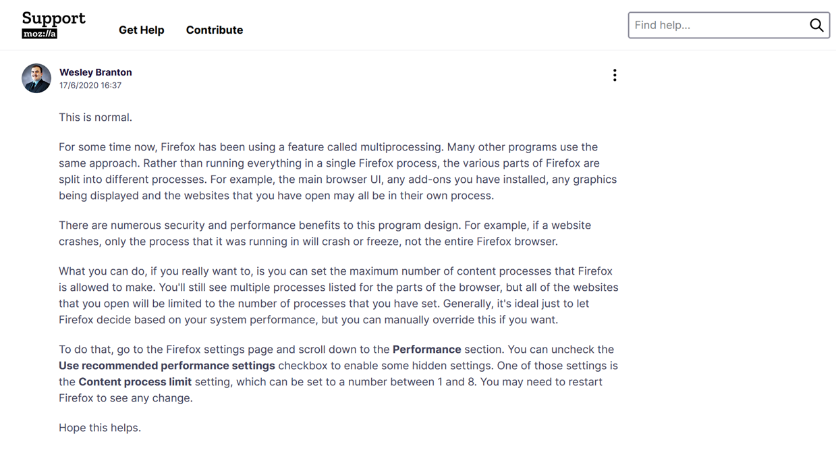
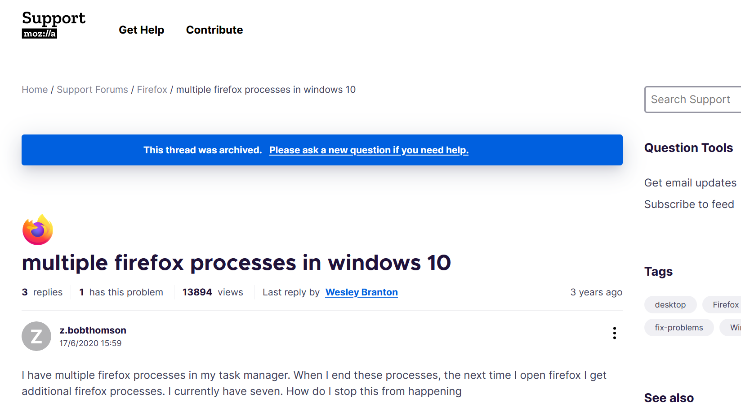
Of all the instructions being executed by my CPUs, what fraction belong to Firefox?
How much virtual memory is being consumed by Firefox?
How much disk throughput is being used by Firefox?
Notes:
[Ref: https://support.mozilla.org/bm/questions/1291626
https://superuser.com/questions/971967/why-is-my-committed-memory-so-much-higher-than-my-actual-ram-space]

Slide 5
main:
pushq %rbx
callq fork@PLT
testl %eax, %eax
leaq .L.str(%rip), %rax
leaq .L.str.1(%rip), %rbx
cmoveq %rax, %rbx
callq getpid@PLT
leaq .L.str.2(%rip), %rdi
movq %rbx, %rsi
movl %eax, %edx
xorl %eax, %eax
callq printf@PLT
xorl %eax, %eax
popq %rbx
retq
.L.str:
.asciz "child"
.L.str.1:
.asciz “parent"
.L.str.2:
.asciz "Hello from %s process,
pid %d\n"
int main() {
pid_t p = fork(); //Create a new process,
//initialized with a copy of the memory
//and register state of the source
//process. But!---note that fork()
//returns 0 to the child process, and
//the child’s pid to the parent.
const char* identity = (p == 0 ?
"child" :
“parent");
printf("Hello from %s process, pid %d\n",
identity, getpid());
return 0;
}
Console output:
Hello from parent process, pid 20273
Hello from child process, pid 20274
Notes:
[Why is `main()` pushing `%rbx` at the beginning of the code? The reason is that `%rbx` is a callee-saved register, and `main()` wants to modify that register! See Lecture 8.]
[Recall from pset3 that the child process’s registers are initialized as a copy of the parent process’s registers, except for `%rax`, because that’s where the return value for `fork()`---the child and the parent receive different return values for that system call.]

Slide 6
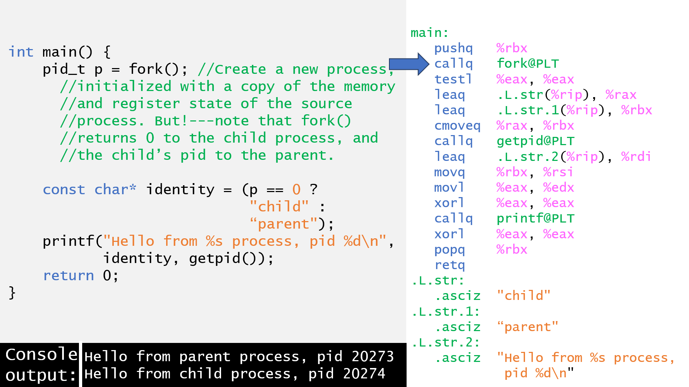
Parent
Child
main:
pushq %rbx
callq fork@PLT
testl %eax, %eax
leaq .L.str(%rip), %rax
leaq .L.str.1(%rip), %rbx
cmoveq %rax, %rbx
callq getpid@PLT
leaq .L.str.2(%rip), %rdi
movq %rbx, %rsi
movl %eax, %edx
xorl %eax, %eax
callq printf@PLT
xorl %eax, %eax
popq %rbx
retq
.L.str:
.asciz "child"
.L.str.1:
.asciz “parent"
.L.str.2:
.asciz "Hello from %s process,
pid %d\n"

Slide 7
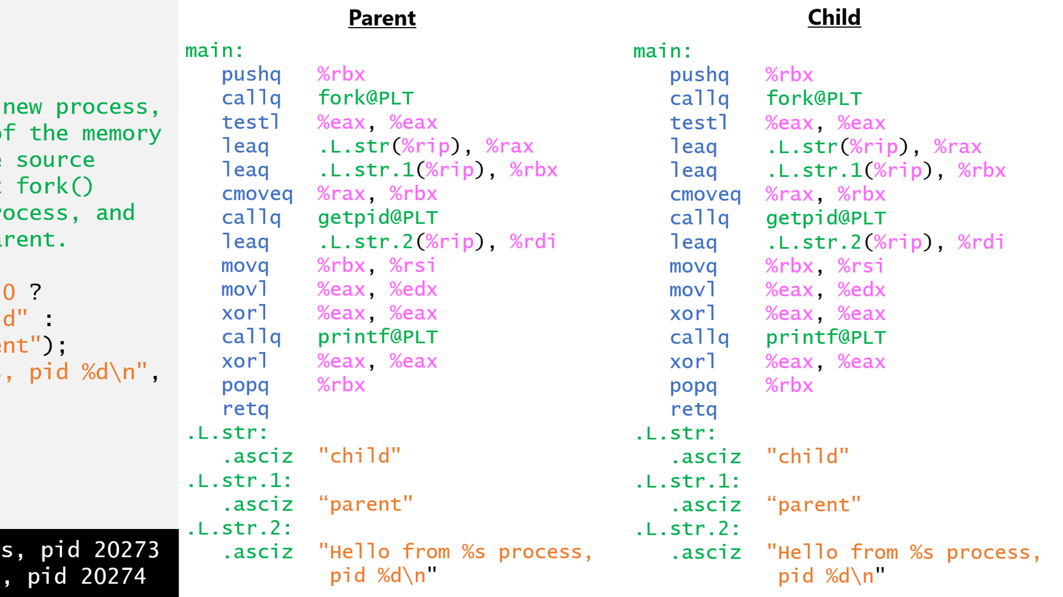
%eax contains pid of child!
%eax contains 0!
%rbx gets set to the address of the string “parent”
%rbx gets set to the address of the string “child”

Slide 8
Process Hierarchies
Shell: pid=432
pid=520
pid=521
pid=522
pid=523
Every process has a parent process
The getpid() system call returns the pid of the calling process
The getppid() system call returns the pid of the calling process’s parent
fork() create a new child process for the current process
In Linux-like systems, the root of the process hierarchy is the kernel-created init process
int main() {
printf(“Hi from initial process, pid %d\n",
getpid());
pid_t p1 = fork();
pid_t p2 = fork();
printf(“Bye from pid %d (parent pid %d)\n",
getpid(), getppid());
usleep(250000);
return 0;
}
Console output:
Hi from initial process, pid 520
Bye from pid 520 (parent pid 432)
Bye from pid 521 (parent pid 520)
Bye from pid 523 (parent pid 521)
Bye from pid 522 (parent pid 520)
Notes:
Note that pid=520 has two children because the process calls fork() twice, creating pid=521 and pid=522. The first child (pid=521) will call fork() once, creating pid=523. The second child (pid=522) starts executing after the fork() calls, and thus will create no children.
[Ref: https://linux.die.net/man/8/init]

Slide 9
Process State
A process’s image is its memory data and register values
Command line arguments (argc, argv) are part of the image!
Due to memory isolation and per-CPU register isolation, no other process can directly access a process’s image (absent page table tricks that enable cross-process shared memory pages)
The OS can see all memory (because the OS controls all page tables) and can examine a process’s register state when that process is not actively running (because those registers will be saved in memory!)
A process’s identity tracks relationships with users and other processes
Each process has a unique “process id” (pid)
A process also resides in a unique place in the process hierarchy tree
A process runs on behalf of an owning “user id” (uid) and “group id” (gid)
For example, a system might have uids for Alice, Bob, and the “superuser” root
gids belong to collections of users (e.g., devs, finance, lawyers)
A process’s environment captures the process’s relationship to other kernel state and hardware devices
Because Linux-like OSes use the file descriptor abstraction for so many resources, a process’s most important environmental values are its open file descriptors and the associated seek positions
Cloned during fork()
New state created during fork()
Cloned during fork()
Notes:
By “cloned during fork()”, we mean that the child process receives a copy of the relevant state belonging to the parent process. By “new”, we mean that the child receives distinct values for the relevant state.

Slide 10
Per-process File Metadata
Suppose that a process has two disk files open (one for reading, one for writing) . . .
Each process is associated with a file descriptor table
A file descriptor (e.g., that’s returned by open(“file.txt”, O_RDWR)) is an index into the local process’s table
A valid file descriptor points to an entry in the system-wide open file table
A valid open file descriptor points to kernel metadata for the associated open file—most importantly, pointers to functions that read/ write/etc. that kind of file descriptor (e.g., file vs. keyboard)
Terminal IO receives special treatment
By convention, file descriptor 0 (stdin) refers to the terminal’s keyboard input
By convention, file descriptors 1 (stdout), and 2 (stderr) refer to the terminal’s console output
struct proc
Other fields
Eight-entry fd table
Metadata
Metadata
Metadata
Ref count
Ref count
Ref count
Ref count
Perms
Perms
Metadata
Perms
Offset
Perms
Offset
Offset
Offset
Four-entry open file table
1
1
r/w
0
3
r
5
w
9
Kernel metadata for the terminal
Kernel metadata for the disk files
ssize_t read(…)
ssize_t write(…)
ssize_t write(…)
ssize_t read(…)
Code that implements
terminal-specific read/write/etc. kernel functionality
Code that implements disk-file-specific read/write/etc. kernel functionality
Notes:
In a real OS, the equivalent of `struct proc` would have an fd table that supports far more than eight file descriptor. For example, on Linux, the per-process fd table contains 1024 entries by default.
Note that each entry in the open file table has “ref count” (i.e., a reference count). This count tracks how many file descriptors point to the open file entry. When the ref count hits zero, the kernel can deallocate the metadata resources that are associated with that file!

Slide 11
The Mysteries of fork()
The high-level semantics of fork() are simple—”make a copy of the current process”
However, the details are quite subtle
Ex: Which pieces of the parent’s state are not copied? [We already know that the pid is one of them!]
Ex: What if the child process wants to execute an entirely different program than the one executed by the parent?

Slide 12
Handling File Descriptors in fork()
File descriptor inheritance is a useful way for a parent to pass information to a child
Ex: A parent makes a pipe (i.e., a pair of pipe file descriptors) and then forks a child, sending commands via the write end
Ex: A parent opens a network connection (i.e., a socket file descriptor) and forks a child to deal with the connection
Notes:
[Ref: https://man7.org/linux/man-pages/man2/fork.2.html]

Slide 13
Using Pipes with fork()
Suppose that a process has created a pipe . . .
struct proc
Other fields
The pipe(int pfd[2]) system call asks the kernel to create a high-throughput communication stream
The kernel places the file descriptor for the write end of the pipe in pfd[1]
The kernel places the file descriptor for the read end of the pipe in pfd[0]
Data sent via the write end of the pipe is buffered by the kernel until it is retrieved from the read end of the pipe
A process can send data to itself via a pipe, but the real use for a pipe is to allow a parent process and a child process to communicate
Eight-entry fd table
Metadata
Metadata
Metadata
Ref count
Ref count
Ref count
Ref count
Perms
Perms
Metadata
Perms
Offset
Perms
Offset
Offset
Offset
Four-entry open file table
1
1
r/w
0
3
r
0
w
0
Kernel metadata for the terminal
Kernel metadata for the pipe
ssize_t read(…)
ssize_t write(…)
ssize_t write(…)
ssize_t read(…)
Code that implements
terminal-specific read/write/etc. kernel functionality
Code that implements pipe-specific read/write/etc. kernel functionality
Notes:
Note that pipes are stream-oriented file descriptors, not random-access file descriptors, so seeking on them is disallowed!
[Ref: https://man7.org/linux/man-pages/man2/pipe.2.html]

Slide 14
. . . and then calls fork()!
struct proc
Other fields
Eight-entry fd table
Suppose that the child closes the write fd . . .
6
2
2
The parent and child now share the reading and writing ends of a pipe!
For the sake of simplicity, usually a single process is the sole writer of the pipe, and the other process is the sole reader
In other words, either the parent writes and the child reads, or the child writes and the parent reads
A process closes the pipe file descriptor that is unused in that process—note that the refcount in the open file table won’t drop to zero because the other process does care about that end of the pipe!

Slide 15
Network Sockets
Linux-like OSes use the file descriptor abstraction to allow two computers on the Internet to communicate
The int socket(AF_INET,...) system call returns a file descriptor suitable for IPv4 Internet communication
The server machine listens for connections on a particular IP address and port
The bind(int fd, const struct sockaddr *addr,...) system call tells the kernel to associate the given socket with a specific port
The listen(int fd,...) system call tells the kernel to start accepting connections, placing them in a queue
The int accept(int fd,...) system call returns a file descriptor that can be used to send and receive data to a connected client!
The client machine initiates the network connection
The connect(int fd, const struct sockaddr *addr, …) system call uses the given socket to connect to a server program with the given IP address and port
Once connected, the client and server can exchange data via the system calls send(int fd, const void* buf, size_t len,...) and recv(int fd, void* buf, size_t len)!
Server
Port: 80
IP address: 52.93.100.27
IP address: 140.247.201.3
Port: 9822
Client
Notes:
Server programs like a web server need to live at well-known ports so that clients know where to send the initial message in the communication exchange. So, when servers call `bind()`, they specify a particular port. A client program like a web browser typically doesn’t care what its local port is, so usually a client program will not call `bind()` before calling `connect()`; in these cases, the kernel will assign a random client-side port before trying to connect to the specified server IP address and port.
What happens if the server calls `accept()` but no client connection attempts are in the queue? By default, `accept()` will block, i.e., it will not return until a client has connected. However, the server can tell the kernel that the `accept()` call should be non-blocking, i.e., should return immediately, regardless of whether a client is in the queue. This allows a server to do something useful while waiting for clients to arrive.
[Nginx is a popular web server. See https://en.wikipedia.org/wiki/Nginx.]

Slide 16
Example: A fork()’ing Network Server
int listen_sock = socket(...);
bind(.../*Port 80: web server!*/);
listen(listen_sock, ...);
while(true){
int client_sock = accept(listen_sock, ...);
if(fork() == 0){ //Child
//Exchange data with client.
close(listen_sock);
handle_client(client_sock);
close(client_sock);
exit(0); //So child doesn’t continue
//the loop!
}else{ //Parent
close(client_sock);
}
}
struct proc:
parent
struct sock_metadata
(listen_sock)
struct sock_metadata
(client_sock)

Slide 17
Example: A fork()’ing Network Server
int listen_sock = socket(...);
bind(.../*Port 80: web server!*/);
listen(listen_sock, ...);
while(true){
int client_sock = accept(listen_sock, ...);
if(fork() == 0){ //Child
//Exchange data with client.
close(listen_sock);
handle_client(client_sock);
close(client_sock);
exit(0); //So child doesn’t continue
//the loop!
}else{ //Parent
close(client_sock);
}
}
struct proc:
parent
struct proc:
child
struct sock_metadata
(listen_sock)
struct sock_metadata
(client_sock)
Kernel can safely delete the metadata!

