Slide 1
Storage, Part III
CS 61: Lecture 15 11/1/2023

Slide 2
Review of the stdio Cache
The stdio library associates each FILE with a single 4 KB cache slot
During reading, when the file position moves outside of the currently cached block, stdio fetches the 4 KB-aligned 4 KB block that contains the new file position
During writing, when the file position moves outside of the currently cached block, stdio:
Flushes the currently cache write data (which may be less than a block in size!)
Starts issuing writes to a new cache block that starts at the current file position (and thus may not be 4 KB-aligned)
What is stdio wanted to associate each FILE with two cache slots instead of just one?
struct _IO_FILE {
int _fileno;//As returned
//by the open()
//syscall
int _flags; //E.g., read-only,
//read+write
char* _IO_buf_base;
//Other stuff . . .
};
stdio cache
Read target
4 KB file chunks
Last chunk (possibly less than 4 KB)

Slide 3
Review of the stdio Cache
The stdio library associates each FILE with a single 4 KB cache slot
During reading, when the file position moves outside of the currently cached block, stdio fetches the 4 KB-aligned 4 KB block that contains the new file position
During writing, when the file position moves outside of the currently cached block, stdio:
Flushes the currently cached write data (which may be less than a block in size!)
Starts issuing writes to a new cache block that starts at the current file position (and thus may not be 4 KB-aligned)
What if stdio wanted to associate each FILE with two cache slots instead of just one?
struct _IO_FILE {
int _fileno;//As returned
//by the open()
//syscall
int _flags; //E.g., read-only,
//read+write
char* _IO_buf_base;
//Other stuff . . .
};
stdio cache
Write target
4 KB file chunks
Last chunk (possibly less than 4 KB)

Slide 4
Two-slot stdio Cache: A Possible Design
Reading
Each buffer stores cached data for a different 4 KB-aligned, 4 KB-large file region
Once both slots are filled, a cached block is dropped and replaced if the new seek position isn’t contained within either cached block
Writing
Each buffer stores cached data for a different region (up to 4 KB) that is being written
A block is flushed when:
It fills up with 4 KB of write data
The seek position changes and is no longer the write offset in either cache block
This approach generalizes to N slots!
struct _IO_FILE {
int _fileno;//As returned
//by the open()
//syscall
int _flags; //E.g., read-only,
//read+write
char* _IO_buf_base1;
char* _IO_buf_base2;
//Other stuff . . .
};
A CACHE BLOCK MUST BE EVICTED
Read targets that stay within either of these blocks will not trigger block pulls from the underlying storage device!
stdio cache
Read target 2
Read target 1
Read target 3
4 KB file chunks
Last chunk (possibly less than 4 KB)
WHICH SHALL JOIN THE RACCOON?

Slide 5
Two-slot stdio Cache: A Possible Design
THE RACCOON AWAITS
Reading
Each buffer stores cached data for a different 4 KB-aligned, 4 KB-large file region
Once both slots are filled, a cached block is dropped and replaced if the new seek position isn’t contained within either cached block
Writing
Each buffer stores cached data for a different region (up to 4 KB) that is being written
A block is flushed to storage when:
It fills up with 4 KB of write data
The seek position changes and is no longer the write offset in either cache block
This approach generalizes to N slots!
struct _IO_FILE {
int _fileno;//As returned
//by the open()
//syscall
int _flags; //E.g., read-only,
//read+write
char* _IO_buf_base1;
char* _IO_buf_base2;
//Other stuff . . .
};
Write targets that use one of these write offsets will not trigger flushes to the underlying storage device!
CHOOSE WISELY
stdio cache
Write target 2
Write target 3
Write target 1
4 KB file chunks
Last chunk (possibly less than 4 KB)

Slide 6
Multi-slot Caches
A single-slot cache can be effective for many workloads (particularly sequential ones)
However, a multi-slot cache will often perform better
For example, at any given moment, a process will typically exhibit spatial and temporal locality for:
The stack page containing the current function’s stack frame
One or more code pages that store the code for the current function
Possibly one or more heap pages if the function manipulates heap objects
A TLB with multiple slots can hold mappings for more of these hot pages!
Multi-slot caches introduce some new questions
Associativity: Which cache slots can an incoming block map to?
Eviction: If the cache is full and needs to make space for a new block, which old block should be evicted?

Slide 7
Associativity in a Cache with S Slots
Cache
In a fully-associative cache, any block can be stored in any of the S slots
In a set-associative cache, a block with address A can reside in a specific subset of the slots
Ex: In a two-way set associative cache with S=4, a particular block can reside in one of two potential slots
In that example, the cache might partition the block address space of the underlying storage into two equally-sized regions, such that blocks from a particular region are mapped to the same set in the cache
In a direct-mapped cache, each block can only be stored by one slot
Ex: A block with address A might map to the slot A % S
The stdio cache for a particular file is single-slot, direct-mapped and fully-associative
Underlying storage
Cache
Underlying storage
Cache
Underlying storage

Slide 8
Slot Tags
Fully-associative two slot cache
Tag
Data
A cache associates each slot with a tag
If the slot is empty, the tag is meaningless
If the slot if filled, the tag allows the cache to determine if a particular read or write request will be a hit for that slot
For a cache that supports block-sized, block-aligned reads and writes, the slot tag is just the address of the block to read/write
For a cache that supports block-unaligned reads or writes, tagging is more complicated
Give example of a single-slot stdio cache in which the tag is the current write offset
Give example of a two-slot stdio cache in which the tag is the current write offset, but when a write comes in you have to make sure that it wouldn’t bleed into another cached block
read b₃
write b₂
write b₂
read b₁
3
2
Underlying storage
Cache miss— there’s no block with tag 2! The request is a write, so no need to pull from storage; also, the cache isn’t full yet, so no need to evict.
Cache miss— there’s no block with tag 3! The request is a read, so pull from the underlying storage.
👨🏿‍🌾
Cache miss—there’s no block with tag 1! The cache is full, so we must evict something.
Cache hit—there’s a block with tag 2!
b₂ is dirty, so evicting it would require writing to the underlying storage. b₃ is clean, so we could drop it for free!

Slide 9
Slot Tags
Reading a file
stdio cache
A cache associates each slot with a tag
If the slot is empty, the tag is meaningless
If the slot if filled, the tag allows the cache to determine if a particular read or write request will be a hit for that slot
For a cache that supports block-sized, block-aligned reads and writes, the slot tag is just the address of the block to read/write
For a cache that supports block-unaligned reads or writes, tagging is more complicated
Consider a single-slot stdio cache
In read mode, the tag is a 4 KB-aligned block address, even though the read address target may be non-4-KB-aligned
In write mode, the tag is the current, possibly unaligned write offset
Slot tag: 0x4000
Read target:
0x4000+0x800
4 KB file chunks
Last chunk (possibly less than 4 KB)
Writing a file
stdio cache
Slot tag: 0x4000+0x800
Write target:
0x4000+0x800
4 KB file chunks
Last chunk (possibly less than 4 KB)
Notes:
In the stdio case, when doing reads, the tag for the cache block is the 4 KB-aligned address of the block. Let that address be `b`. When a read at offset `o` arrives, stdio can satisfy the read from the cache if the offset is in `[b, b+4096)`.
In the stdio case, when doing writes, the tag for the cache block is the current file offset `off`. When a write arrives for target location `t`, stdio can direct the write to the cache if `off` == `t` (and there’s still space in the block for additional bytes).

Slide 10
Analyzing Caches using Reference Strings
Many aspects of multi-slot cache design are independent of block address semantics, the type of the underlying storage, etc.
We can abstract away those factors, analyzing cache behavior using a reference string of access patterns
ONE CHILD MUST GO
Reference string of accesses
 | 3 | 1 | 1 | 3 | 3 | 1 | 4
A | ③ | 3 | 3 | 3 | 3 | 3
B |  | ① | 1 | 1 | 1 | 1
Circled numbers indicate cache misses
Cache slots
WHO JOINS THE RACCOON?
Notes:
In the table above, circled numbers represent cache misses.

Slide 11
Analyzing Caches using Reference Strings
Many aspects of multi-slot cache design are independent of block address semantics, the type of the underlying storage, etc.
We can abstract away those factors, analyzing cache behavior using a reference string of access patterns
Eviction is the act of freeing a cache slot for use by a new block
Direct-mapped caches have a trivial eviction policy—just evict the old block in the slot which the new block maps too!
Non-direct-mapped caches can use a variety of eviction policies
For any reference string and cache of size S, the optimal eviction policy is one that always chooses to evict the block that won’t be needed again for the longest time
In practice, real access patterns are difficult/impossible to predict with complete accuracy
Real eviction policies have trade-offs with respect to accuracy and efficiency

Slide 12
Eviction Policies
Here are some common eviction policies for fully-associative caches:
FIFO (“first in, first out”)
Evict the block that was fetched the longest time ago
Possible implementation: In each tag, include the timestamp at which the block was fetched
LFU (“least frequently used”)
Evict the block that has been used the least often in recent history
Possible implementation: Keep a linked list of all blocks, sorted by the last access time for each block
LRU (“least recently used”)
Evict a block that hasn’t been accessed in the recent epoch
Possible implementation: In each tag, include an LRU bit; periodically reset all bits to 0 and then set a block’s bit to 1 when the block is accessed
For an N-way associative cache, each cache set is logically a fully-associative cache and can use a policy appropriate for such a cache
In practice, variants of LRU are very common

Slide 13
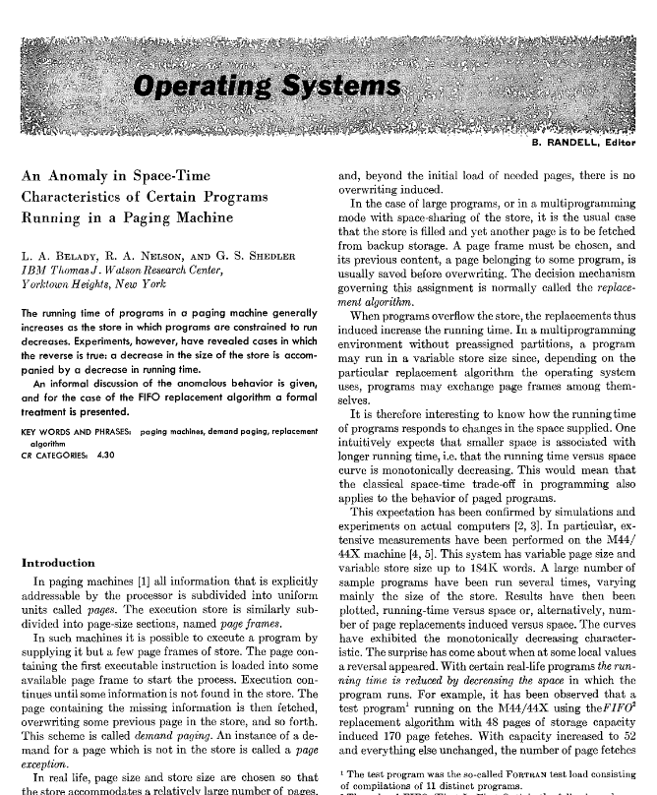
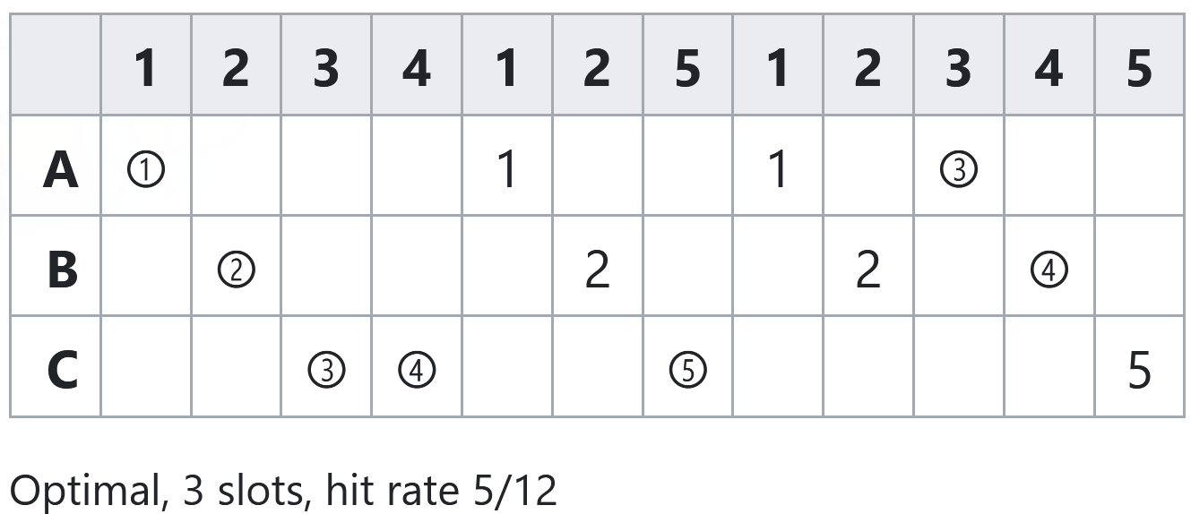
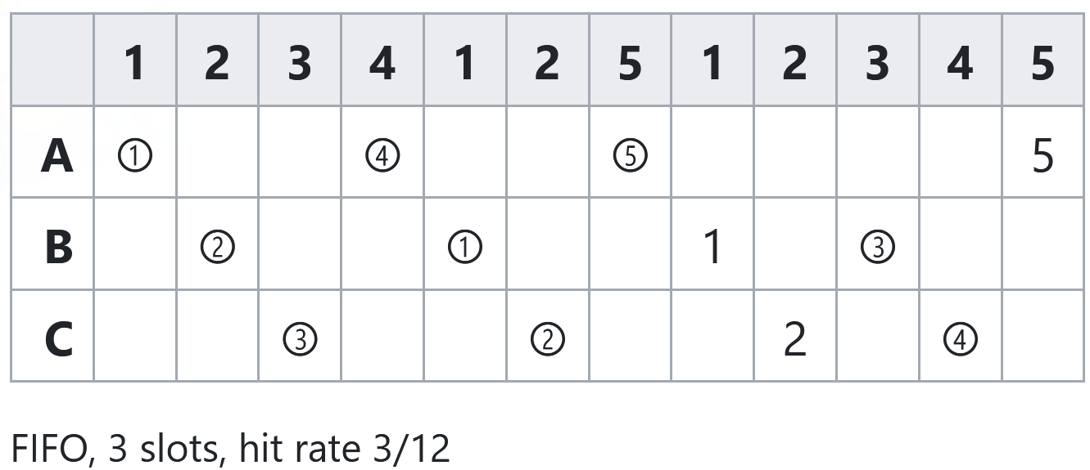
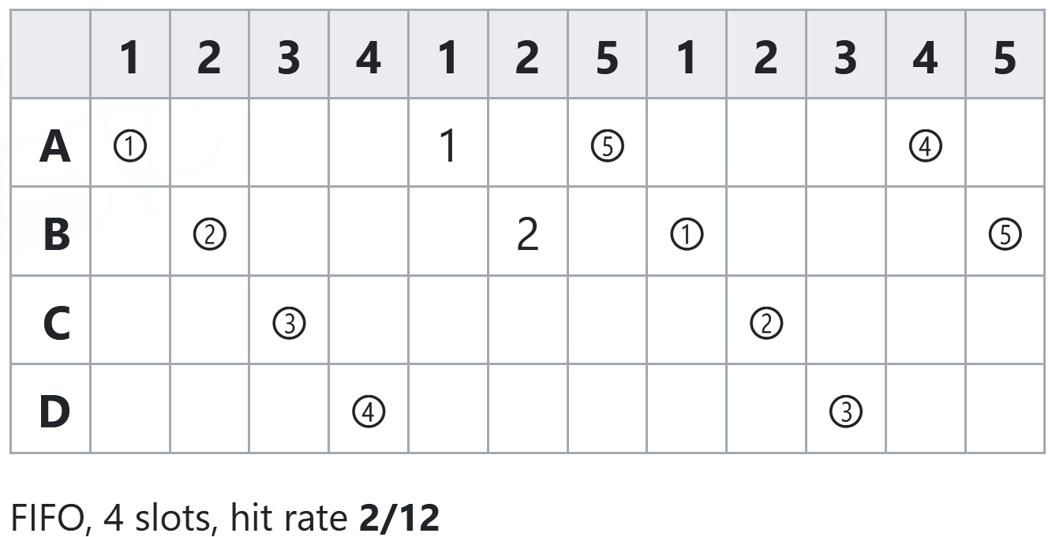
Hit Rates vs. The Number of Cache Slots
Bélády’s anomaly: Adding more slots does not always increase the hit rate!
Adding more slots to an LRU cache is guaranteed to improve the hit rate!
Notes:
[Ref: https://dl.acm.org/doi/pdf/10.1145/363011.363155]

Slide 14
Memory-mapped IO
Application code
With traditional file IO:
The kernel’s buffer cache stores file blocks in kernel memory
System calls like read() and write() transfer data between user-level buffers and the kernel-level buffer cache blocks
System calls incur context switch overheads!
With memory-mapped IO:
Process P selects a file f to be manipulated using memory-mapped IO
The OS reads f’s data into the buffer cache
The OS configures P’s page table to map f’s buffer cache blocks into P’s address space
P can then read or write the file data using normal memory writes, without using system calls (and thereby avoiding context switch overhead!)
stdio cache
fwrite()
stdio in libc++
User
write()
Kernel
Buffer cache
Device driver
Storage device

Slide 15
Memory-mapped IO
Static data
With traditional file IO:
The kernel’s buffer cache stores file blocks in kernel memory
System calls like read() and write() transfer data between user-level buffers and the kernel-level buffer cache blocks
System calls incur context switch overheads!
With memory-mapped IO:
Process P selects a file f to be manipulated using memory-mapped IO
The OS reads f’s data into the buffer cache
The OS configures P’s page table to map f’s buffer cache blocks into P’s address space
P can now read and write f’s data using normal memory operations, without using system calls (and thereby avoiding context switch overhead!)
Code
Buffer cache pages for f
Heap+stack
Other stuff
Kernel memory
User memory
Stack
Heap
Static data
Physical RAM
Code
Process X’s
virtual memory
Notes:
In the diagram of physical RAM, the black pages belong to the kernel, the pink pages belong to process X, and the blue pages belong to some other Process Y.

Slide 16
Memory-mapped IO
//Example: Reading a file using
//memory-mapped IO.
int fd = open(“file.txt”, O_RDONLY);
size_t size = filesize(fd);
char* file_data = (char*) mmap(size,
PROT_READ, fd, 0);
//The `size` bytes of virtual
//virtual memory starting at
//`file_data` are now mapped to
//the file’s buffer cache blocks!
size_t n = 0;
char buf[1];
while (n < size) {
memcpy(buf, &file_data[n], 1);
//Reads the file data:
//no system call needed!
n += 1;
}
munmap(file_data, size);
close(fd);
With traditional file IO:
The kernel’s buffer cache stores file blocks in kernel memory
System calls like read() and write() transfer data between user-level buffers and the kernel-level buffer cache blocks
System calls incur context switch overheads!
With memory-mapped IO:
Process P selects a file f to be manipulated using memory-mapped IO
The OS reads f’s data into the buffer cache
The OS configures the P’s page table to map f’s buffer cache blocks into P’s address space
P can now read and write f’s data using normal memory operations, without using system calls (and thereby avoiding context switch overhead!)

Slide 17
Files: Random Access vs. Stream
Linux-like kernels use the file descriptor abstraction to expose many resources (e.g., files, raw storage devices, keyboards)
However, a random access file has a file position, is seekable, has a finite size, and is typically mmap-able
In contrast, a stream file does not have a file position, is not seekable, is not mappable, and may be infinite in size
The most common example of a random access file is a file that resides on a persistent storage device like an SSD
Examples of stream files are keyboard streams and network streams that are connected to remote computers

Slide 18
Special Files on Linux
Linux defines a variety of “fake” files that are useful for testing/debugging programs (or providing dummy files to programs that insist on accepting files as inputs/outputs)
/dev/null contains nothing
Any read will return EOF
Any write will succeed (but have no real side effect)
Helpful if you want to run a program but discard the input: prog in.txt > /dev/null
/dev/urandom contains random data that the kernel generates on the fly
A read will return the next bytes of random data
A write will add the written bytes to the kernel’s entropy pool
/dev/zero contains zero bytes that the kernel generates on the fly
A read will return zero bytes
A write will succeed (but have no real side effect, similar to writing to /dev/null)

