Slide 1
Storage, Part II
CS 61: Lecture 14 10/30/2023

Slide 2
Linux: C++ File IO
Application code
Linux (like all commodity OSes) disallows a process from directly interacting with persistent storage devices
Instead, a process must use system calls to interact with files
Linux maintains a buffer cache in kernel memory
The cache stores recently-accessed file blocks
Linux does not synchronously flush dirty blocks to disk unless the application requests such behavior
The stdio library provides higher-level interfaces for file IO
Behind the scenes, the library invokes system calls
The library also implements its own caching layer for file data!
fwrite()
stdio cache
stdio in libc++
User
write()
Kernel
Buffer cache
Device driver
Storage device

Slide 3
Linux: C++ File IO
Application code
We looked at two programs that iteratively wrote 1 byte of data to a file: fputc() vs. write()
The fputc() version was orders of magnitude faster than a version that directly called the write() system call!
fputc() is a normal function call, not a system call
stdio only calls write() when the stdio-level 4 KB buffer is full, avoiding thousands of system calls (and the associated context-switching overhead)!
For both programs, the kernel asynchronously flushed dirty blocks to persistent storage
Asynchrony will cause data loss of non-flushed dirty blocks!
fwrite()
stdio cache
stdio in libc++
User
write()
Kernel
Buffer cache
Device driver
Storage device

Slide 4
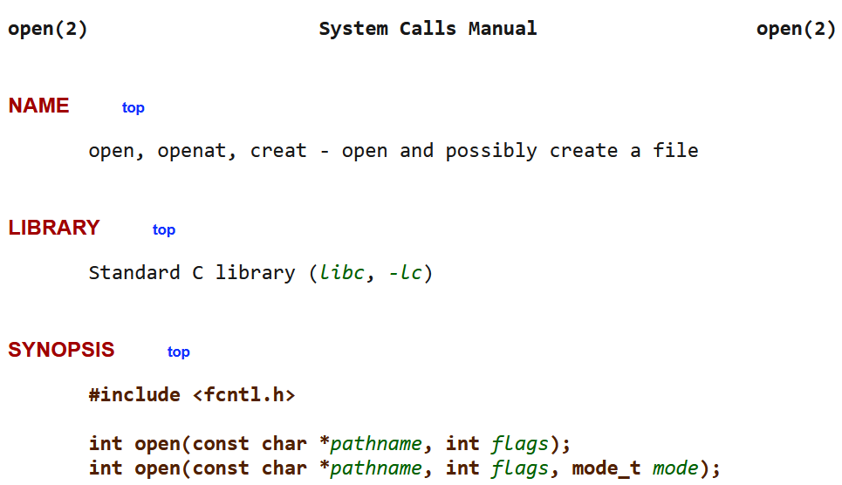
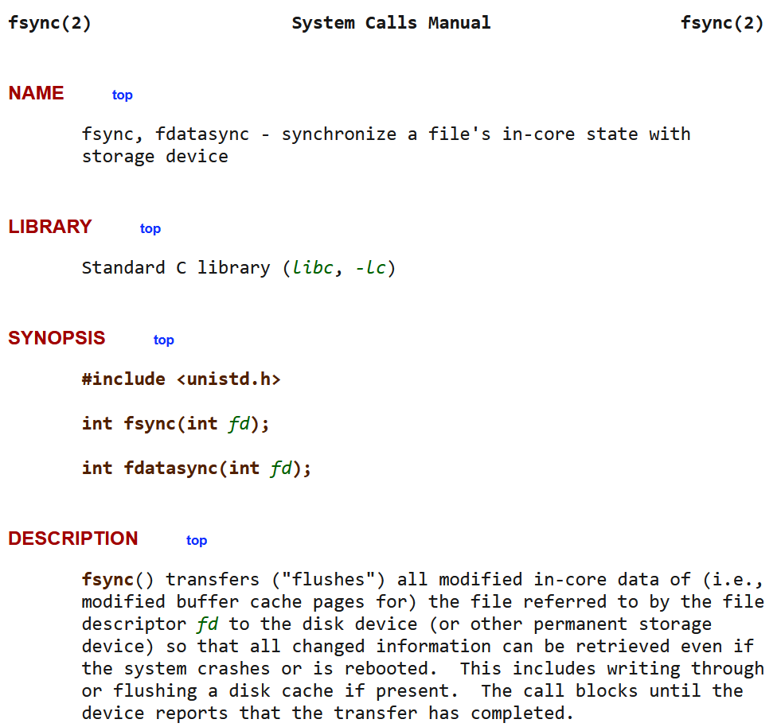
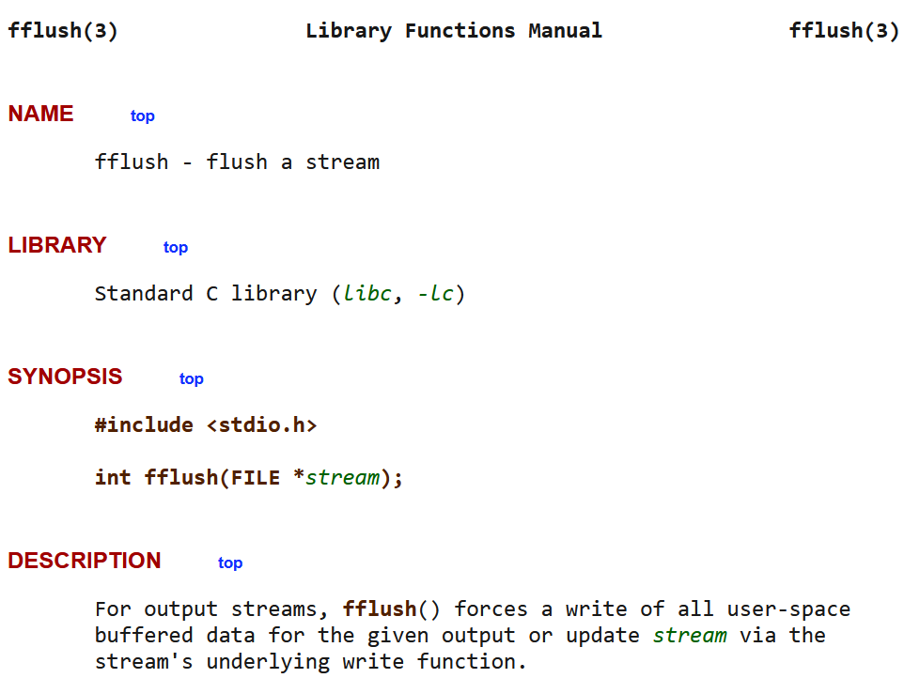
Linux: C++ File IO
Application code
Both the Linux kernel and the stdio library allow programs to explicitly flush buffered data
Flushing the stdio cache triggers a write() to the kernel’s buffer cache
Flushing the buffer cache forcibly sends blocks to the storage device
The OS also allows a process to open() a file for synchronous write()-ing (as opposed to the kernel’s default approach of asynchronous writes to the underlying storage device)
Synchronous writes (and flushing in general) make a program slower but result in less data loss after a crash
fwrite()
stdio cache
stdio in libc++
User
write()
Kernel
Buffer cache
Device driver
Storage device

Slide 5
Synchronous IO is Slower
//One byte per asynchronous write
int fd = open(“out.txt”, O_WRONLY |
O_CREAT | O_TRUNC);
size_t size = 51200;
size_t n = 0;
while (n < size) {
write(fd, buf, 1);
n += 1;
}
close(fd);
Synchronous writes: 51,200 bytes 78.665 sec 651 bytes/sec
Asynchronous writes: 51,200 bytes 0.076 sec 676,034 bytes/sec
You should think carefully about whether performance or crash tolerance is more important for your applications!
For example, in a database, the updates in a committed transaction (e.g., involving financial data) should be persistent before clients are notified of transaction completion
This ensures that the following sequence does not occur:
The client receives notification that their account has received $100
The banking server crashes
The banking server reboots but has no knowledge of the $100 update
The client tries to spend $100 dollars that the bank doesn’t think exists!
//One byte per synchronous write
int fd = open(“out.txt”, O_WRONLY |
O_CREAT | O_TRUNC |
O_SYNC);
size_t size = 51200;
size_t n = 0;
while (n < size) {
write(fd, buf, 1);
n += 1;
}
close(fd);
O_SYNC);

Slide 6
IO OPTIMIZATIONS

Slide 7
Cache Optimization: Read Prefetching
The basic idea is simple: proactively fetch data into the cache before it might be requested by the program
If later, the data is actually requested, you’ve hidden the cost of fetching the data from the slow underlying storage!
If the data is not actually needed later, you’ve:
Generated unnecessary IO traffic, possibly delaying the storage device from handling useful requests
Possibly kicked something useful out of the cache to make room for the useless data
The classic prefetching optimization is for programs that sequentially read a region of the underlying storage device
When the cache receives a read request for location x, the cache fetches the object at x, as well as the objects within the lookahead window
For example, with a lookahead window of 3, the cache will fetch the objects at location x+1, x+2, and x+3
Linux uses prefetching in its buffer cache
The kernel tries to automatically detect file access patterns which indicate that sequential prefetching would be helpful
The posix_fadvise() system call also allows a process to provide the kernel with prefetching/caching hints!

Slide 8
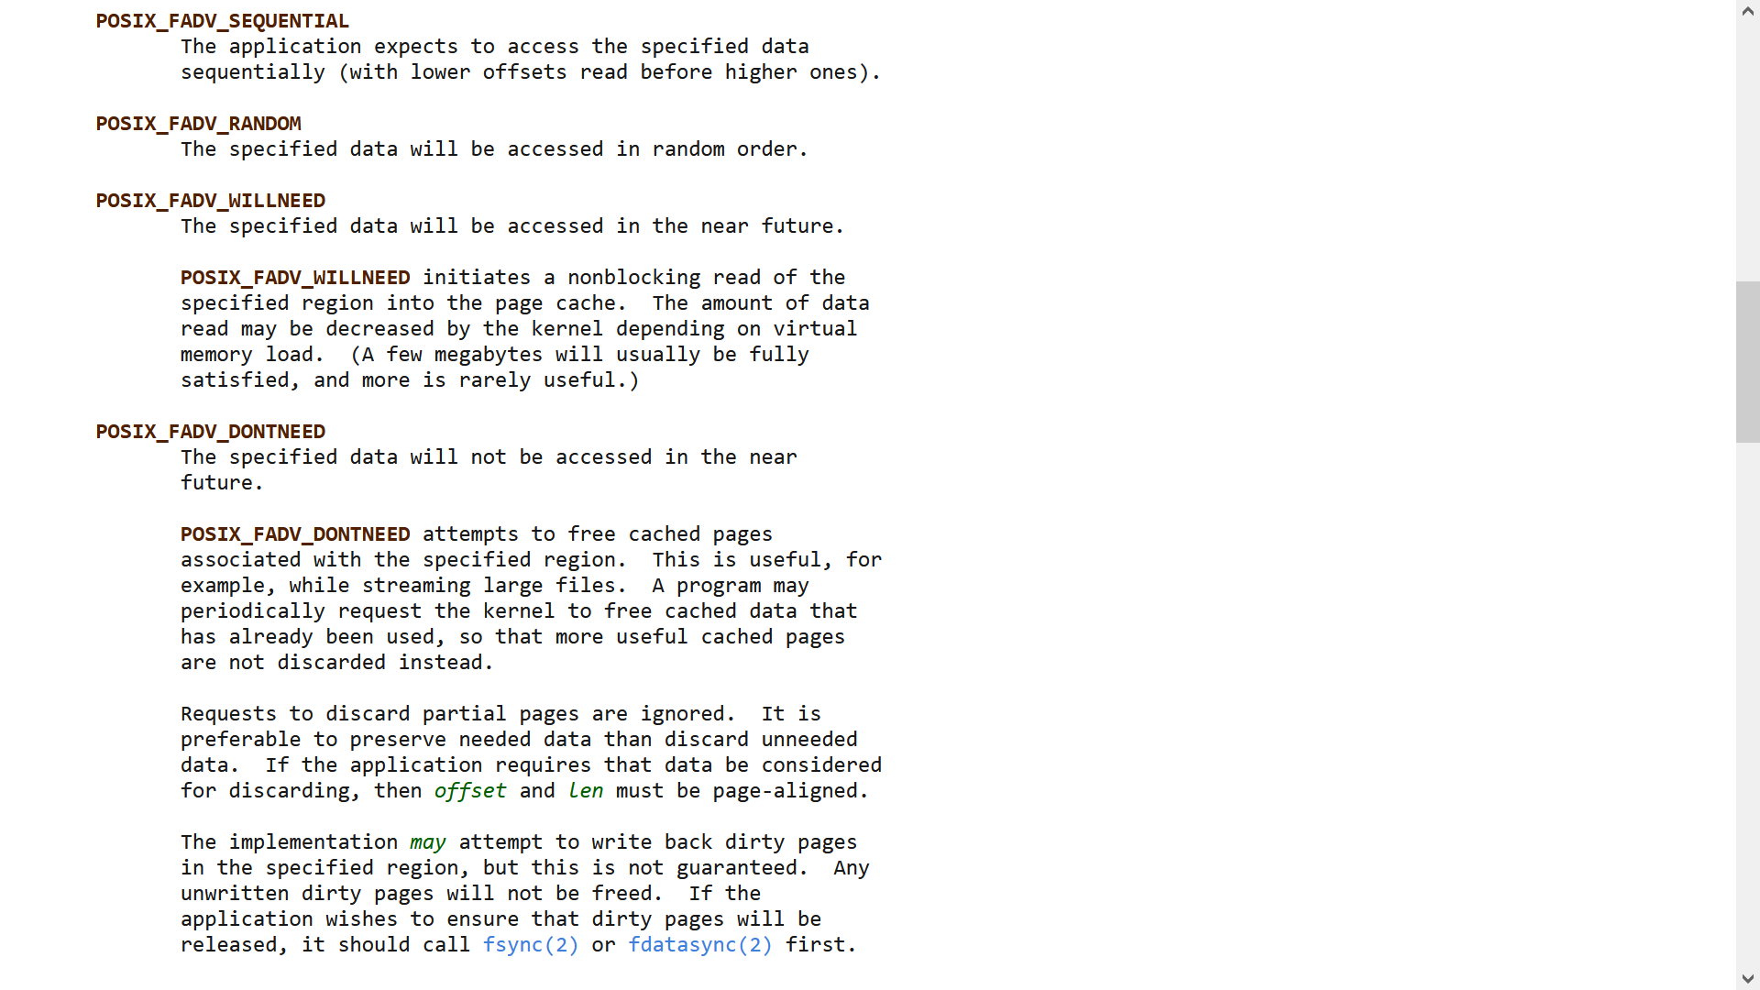
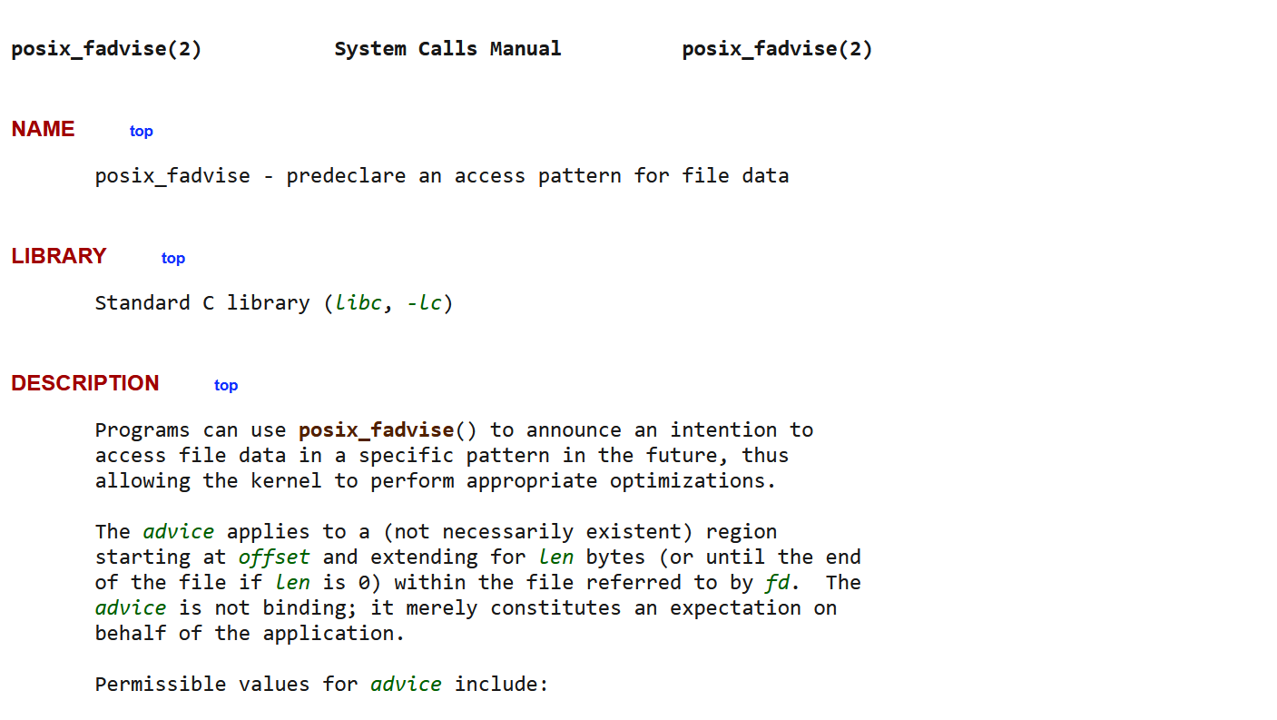
Kernel will likely perform sequential prefetch for the buffer cache!
Kernel will not perform sequential prefetch
Kernel will perform (possibly non-sequential) prefetch for the buffer cache!
Notes:
POSIX_FADV_WILLNEED may perform non-sequential prefetching because the file region delimited by <fd, offset, len> may not be the region that starts at the current position of the file descriptor!
[Ref: https://man7.org/linux/man-pages/man2/posix_fadvise.2.html
https://lwn.net/Articles/888715/
]

Slide 9
Cache Optimization: Write Coalescing
read b₃
write b₂
write b₂
//Cache flush
A particular cache block might be updated several times in short succession
In these scenarios, the cache decreases write traffic to the underlying storage device by not immediately synching a dirty block to the underlying storage
Decreasing the write traffic makes the device more available for other IO requests
However, delaying the write-back of dirty data will increase the amount of data lost after a crash or power outage!
Cache
We only issued one write instead of two!
Underlying storage

Slide 10
Cache Optimization: Write Coalescing
read b₃
write b₂
write b₂
A particular cache block might be updated several times in short succession
In these scenarios, the cache decreases write traffic to the underlying storage device by not immediately synching a dirty block to the underlying storage
Decreasing the write traffic makes the device more available for other IO requests
However, delaying the write-back of dirty data will increase the amount of data lost after a crash or power outage!
Crash!
Cache
Not even the first write made it to disk!
Underlying storage

Slide 11
The Design of stdio’s Cache
In stdio, a FILE is mostly a wrapper for a struct _IO_FILE
Each open file has a dedicated 4 KB buffer (._IO_buf_base)
When a program is reading from the file:
stdio uses the buffer to prefetch the 4 KB of data surrounding the target location of the read
stdio fetches data on a 4 KB-aligned boundary
If an fseek() takes the file position out of the current cache block, stdio does a 4 KB-aligned cache read for the new position
When a program is writing to the file:
stdio uses the buffer to accumulate 4 KB of data before invoking the write() system call
The cache block is not aligned—the 4 KB block starts at the file offset of the first write to the block
At program start, the file offset for the buffer is 0
If you do an fseek(), stdio flushes the current buffer to storage; the next write will determine the new file offset for the buffer
This approach:
Works well for sequential reads (both forward and backwards) and forward sequential writes
Works poorly for random reads and writes—no system calls are eliminated!
struct _IO_FILE {
int _fileno;//As returned
//by the open()
//syscall
int _flags; //E.g., read-only,
//read+write
char* _IO_buf_base;
//Other stuff . . .
};
stdio cache
Read target
4 KB file chunks
Last chunk (possibly less than 4 KB)
Notes:
[You can empirically observe the behavior of the stdio write buffer by explicitly inserting fseek()s into cs61-lectures/storage1/w-stdiobyte.cc and then running the program under strace!]
[Ref: https://github.com/bminor/glibc/blob/master/libio/bits/types/struct_FILE.h //See definition of `struct _IO_FILE`
http://www.r-5.org/files/books/computers/internals/ifs/Steve_Pate-UNIX_Filesystems-EN.pdf //Pages 79--82
https://www.slideshare.net/AngelBoy1/play-with-file-structure-yet-another-binary-exploit-technique
https://dangokyo.me/2018/01/01/advanced-heap-exploitation-file-stream-oriented-programming/
]

Slide 12
The Design of stdio’s Cache
In stdio, a FILE is mostly a wrapper for a struct _IO_FILE
Each open file has a dedicated 4 KB buffer (._IO_buf_base)
When a program is reading from the file:
stdio uses the buffer to prefetch the 4 KB of data surrounding the target location of the read
stdio fetches data on a 4 KB-aligned boundary
If an fseek() takes the file position out of the current cache block, stdio does a 4 KB-aligned cache read for the new position
When a program is writing to the file:
stdio uses the buffer to accumulate 4 KB of data before invoking the write() system call
The cache block is not aligned—the 4 KB block starts at the file offset of the first write to the block
At program start, the file offset for the buffer is 0
If you do an fseek(), stdio flushes the current buffer to storage; the next write will determine the new file offset for the buffer
This approach:
Works well for sequential reads (both forward and backwards) and forward sequential writes
Works poorly for random writes (and random reads outside a cached block)—no system calls are eliminated!
struct _IO_FILE {
int _fileno;//As returned
//by the open()
//syscall
int _flags; //E.g., read-only,
//read+write
char* _IO_buf_base;
//Other stuff . . .
};
stdio cache
Write target
4 KB file chunks
Last chunk (possibly less than 4 KB)

Slide 13
Cache Coherency
A cache usually tries to be transparent
For a read, the cache should return what a direct read from storage would return
For a write sent to the cache, the newly written block should be immediately visible via subsequent reads of that block
A fully transparent cache is called coherent
The buffer cache is coherent with respect to the persistent storage device
If a buffer cache block is clean, it represents the associated disk contents
If a buffer cache block is dirty, it would be returned by a cache read for that block, and will eventually be written to the storage device
What about the stdio cache? Is it coherent with the kernel’s buffer cache?
Notes:
Since the buffer cache is coherent, this means that a file update made by process X is visible to any other process Y immediately (i.e., once X’s system call is completed)!

Slide 14
The stdio cache is not coherent!
#define TESTFILE "consistency-test.txt"
//Overwrite the contents of `TESTFILE`
//with the string `contents`.
void overwrite(const char* contents) {
FILE* f = fopen(TESTFILE, "w");
fputs(contents, f);
fclose(f); //Flushes the written
//data to the kernel via
//`write()`!
}
int main() {
char f1_buf[32];
char f2_buf[32];
bzero(f1_buf, sizeof(f1_buf));
bzero(f2_buf, sizeof(f2_buf));
overwrite("CS 61 is awesome!\n");
FILE* f1 = fopen(TESTFILE, "r");
fread(f1_buf, 1, 1, f1); //Induces
//stdio to fetch the first 4 KB
//chunk of file data, which should
//start "CS 61 is awesome!\n".
overwrite("CS 61 sucks!\n"); //The
//on-disk version of the file
//is now "CS 61 sucks!\n".
//BUT!--the stdio-level cache
//associated with the file has
//not been changed!
FILE* f2 = fopen(TESTFILE, "r");
fread(f2_buf, 1, 18, f2); //Induces
//stdio to read the first 4 KB of
//the file into f2's cache.
fclose(f2);
fread(f1_buf + 1, 1, 17, f1); //Read
//the data in f1's (stale!) cache.
fclose(f1);
printf("%s\n%s\n", f1_buf, f2_buf);
//Prints:
// CS 61 is awesome!
// CS 61 sucks!
return 0;
}
]

Slide 15
#define TESTFILE "consistency-test.txt"
//Overwrite the contents of `TESTFILE`
//with the string `contents`.
void overwrite(const char* contents) {
FILE* f = fopen(TESTFILE, "w");
fputs(contents, f);
fclose(f); //Flushes the written
//data to the kernel via
//`write()`!
}
int main() {
char f1_buf[32];
char f2_buf[32];
bzero(f1_buf, sizeof(f1_buf));
bzero(f2_buf, sizeof(f2_buf));
overwrite("CS 61 is awesome!\n");
FILE* f1 = fopen(TESTFILE, "r");
fread(f1_buf, 1, 1, f1); //Induces
//stdio to fetch the first 4 KB
//chunk of file data, which should
//start "CS 61 is awesome!\n".
overwrite("CS 61 sucks!\n"); //The
//on-disk version of the file
//is now "CS 61 sucks!\n".
//BUT!--the stdio-level cache
//associated with f1 has not
//changed!
FILE* f2 = fopen(TESTFILE, "r");
fread(f2_buf, 1, 18, f2); //Induces
//stdio to read the first 4 KB of
//the file into f2's cache.
fclose(f2);
fread(f1_buf + 1, 1, 17, f1); //Read
//the data in f1's (stale!) cache.
fclose(f1);
printf("%s\n%s\n", f1_buf, f2_buf);
//Prints:
// CS 61 is awesome!
// CS 61 sucks!
return 0;
}
]
FILE IN-MEM STDIO CACHE
f1 “CS 61 is awesome!\n”
“CS 61 is awesome!\n”
“CS 61 sucks!\n”

Slide 16
#define TESTFILE "consistency-test.txt"
//Overwrite the contents of `TESTFILE`
//with the string `contents`.
void overwrite(const char* contents) {
FILE* f = fopen(TESTFILE, "w");
fputs(contents, f);
fclose(f); //Flushes the written
//data to the kernel via
//`write()`!
}
int main() {
char f1_buf[32];
char f2_buf[32];
bzero(f1_buf, sizeof(f1_buf));
bzero(f2_buf, sizeof(f2_buf));
overwrite("CS 61 is awesome!\n");
FILE* f1 = fopen(TESTFILE, "r");
fread(f1_buf, 1, 1, f1); //Induces
//stdio to fetch the first 4 KB
//chunk of file data, which should
//start "CS 61 is awesome!\n".
overwrite("CS 61 sucks!\n"); //The
//on-disk version of the file
//is now "CS 61 sucks!\n".
//BUT!--the stdio-level cache
//associated with f1 has not
//changed!
FILE* f2 = fopen(TESTFILE, "r");
fread(f2_buf, 1, 18, f2); //Induces
//stdio to read the first 4 KB of
//the file into f2's cache.
fread(f1_buf + 1, 1, 17, f1); //Read
//the data in f1's (stale!) cache.
fclose(f1);
fclose(f2);
printf("%s\n%s\n", f1_buf, f2_buf);
//Prints:
// CS 61 is awesome!
// CS 61 sucks!
return 0;
}
FILE IN-MEM STDIO CACHE
f1 “CS 61 is awesome!\n”
f2 “CS 61 sucks!\n”
“CS 61 sucks!\n”

Slide 17
Non-coherent Caches
Why do we tolerate this witchcraft?
Non-coherent caches exist because:
They are easier to design and implement than coherent caches
They are faster than coherent caches (because there is no need to track and invalidate stale data!)
However, for programs that do care about coherency, life becomes more difficult with non-coherent caches
Via setvbuf(…), stdio allows a process to disable stdio-level caching
Applications can also flush+empty the current stdio-level cache to the kernel using fflush(FILE* fp)

Slide 18
Linux: C++ File IO
Application code
Reading/writing at a larger granularity allows the same amount of data to be handled with fewer system calls
Reduces how many times you pay context-switch overhead between user code and kernel code
Avoids unnecessary per-request latencies associated with the storage hardware
The setvbuf() stdio call allows a process to supply a larger buffer for stdio to use for IO involving a particular file
A program which directly invokes system calls can also directly provide larger buffers!
fwrite()
stdio cache
stdio in libc++
User
write()
Kernel
Buffer cache
Device driver
Storage device
Notes:
[Ref: https://linux.die.net/man/3/setvbuf]

Slide 19
Larger IOs Are Your Friend
//One byte per write
size_t size = 5120000;
size_t n = 0;
while (n < size) {
write(fd, buf, 1);
n += 1;
}
The large-IO version is much faster . . .
Byte-per-write(): 5,120,000 bytes 6.591 sec 776,823 bytes/sec
512-bytes-per-write(): 51,200,000 bytes 0.769 sec 66,616,154 bytes/sec
The OS talks to the storage device at the granularity of the device’s block size
The device is literally only capable of exchanging data at that granularity!
For modern SSDs and hard disks, the block size is typically 512 B or 4 KB
Processes typically maximize IO efficiency by issuing an IO that is:
A multiple of the block size of the underlying storage device
Aligned with the device’s blocks size (so that handling the IO doesn’t induce any partial block reads/writes)
//512 bytes per write (and also
//write 10x the data!)
size_t size = 51200000;
size_t block_size = 512;
size_t n = 0;
while (n < size) {
size_t nw = min(block_size,
size - n);
ssize_t r = write(fd, buf, nw);
n += r;
}
Notes:
[Ref: https://wiki.archlinux.org/title/Advanced_Format]

