Slide 1
Storage, Part I
CS 61: Lecture 13 10/25/2023

Slide 2
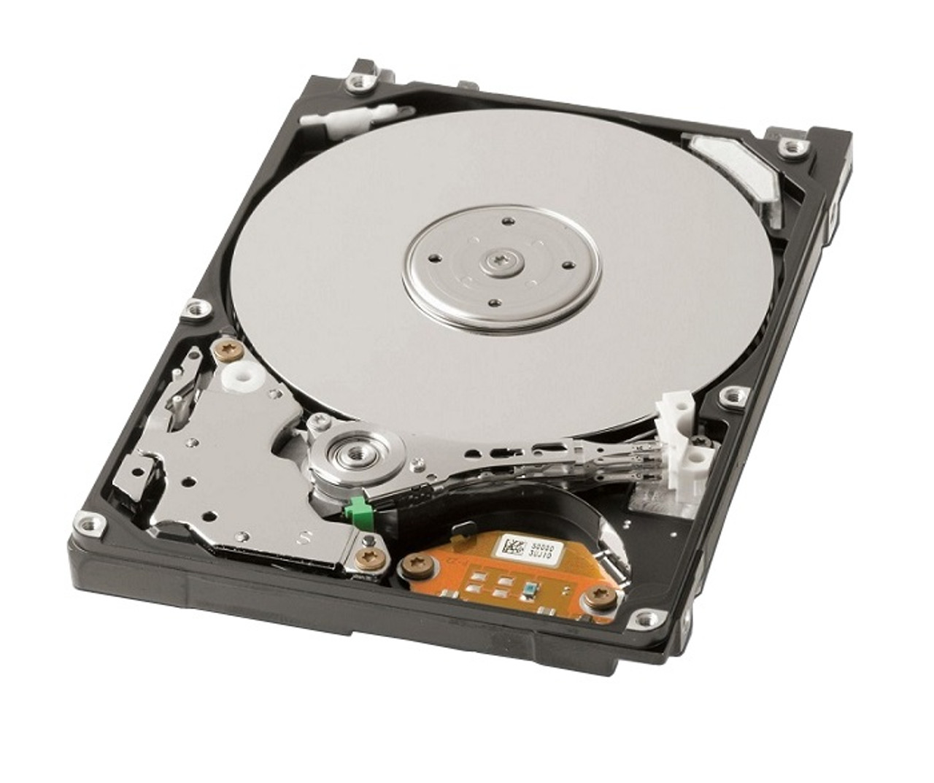
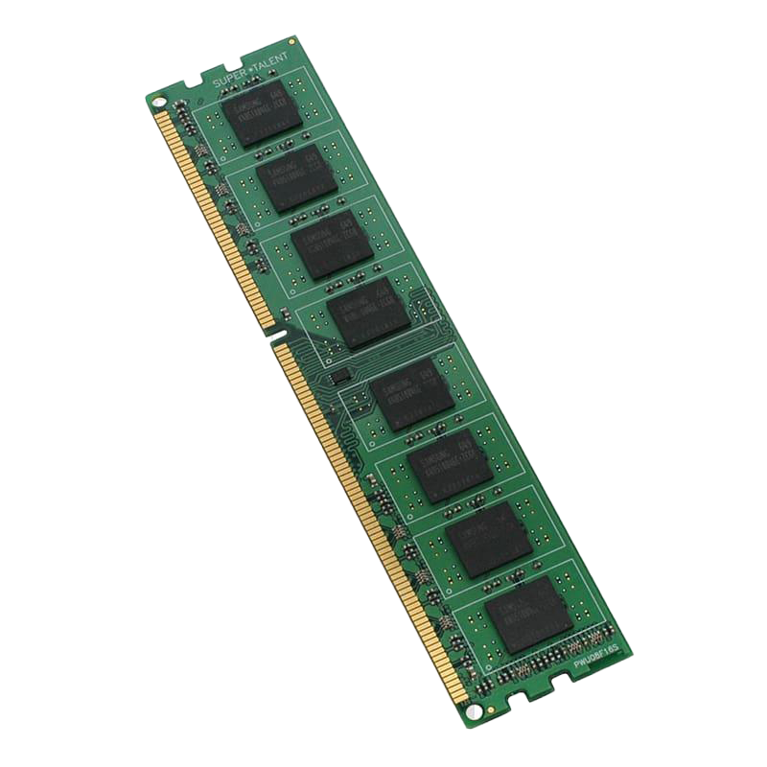
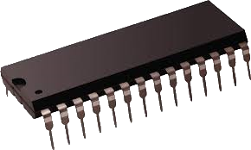
There are Many Different Kinds of Storage!
A storage device holds the bit-level representations of one or more object values
Persistent storage devices (e.g., SSDs, hard drives) remember values even when the devices are not electrically powered on
Ephemeral storage devices (e.g., registers, RAM) lose their values when powered down (either due to graceful shutdowns or unexpected power outages)
Most devices allow objects to be written as well as read, but some storage devices only allow reading once initial object values are set
Ex: Read-only memory (ROM) which holds low-level boot code
Ex: Glass-based archival storage
Hard disk
SSD
RAM
ROM

Slide 3
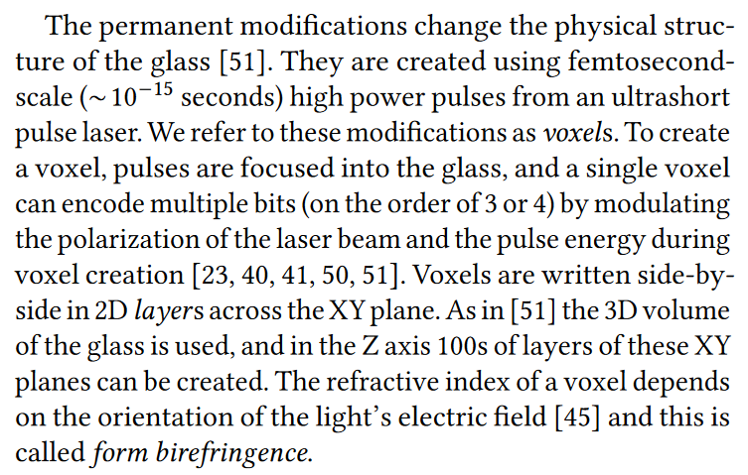
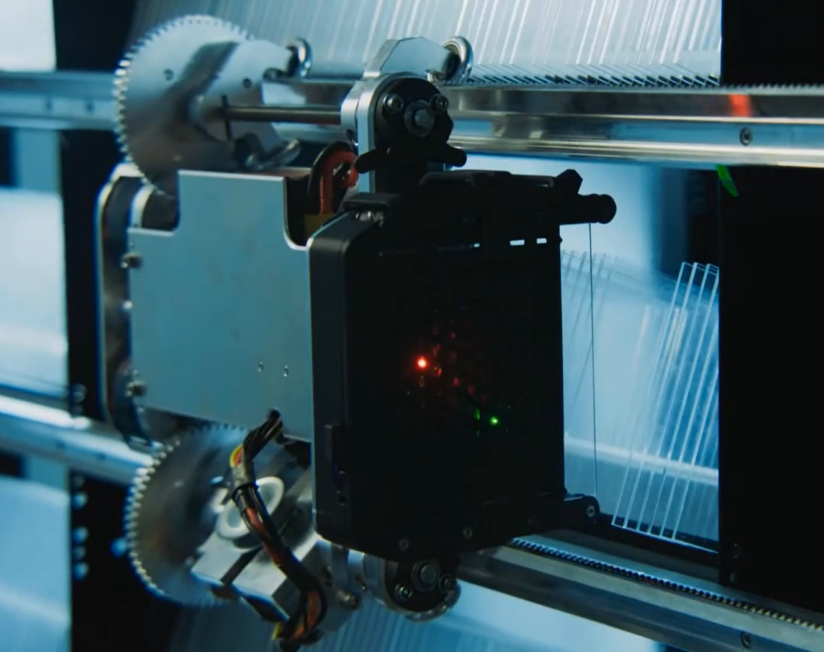
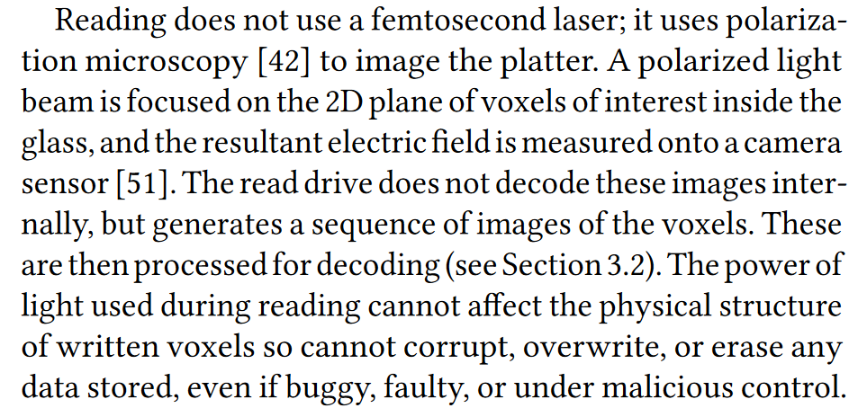
Notes:
[Ref: https://www.microsoft.com/en-us/research/project/project-silica/]

Slide 4
Storage Tradeoffs
Due to physics, there are intrinsic trade-offs between the capacity, performance, and financial cost of a storage device
Capacity: How many bytes can the device hold?
Performance: Roughly speaking, how quickly can bytes be read and written?
Financial cost: How expensive is it to build the device?
Increasing capacity and/or performance is expensive!
Example: Adding new storage to a MacBook Pro

Slide 5
Storage Devices: Latency and Throughput
Latency is the delay between the sending of a request and the storage device beginning to read/write the relevant object
For a read, latency corresponds to the time that code must wait to receive the first byte of requested data
For a write, latency corresponds to the wait time before the storage device begins to update the on-device object
Throughput is the rate at which data can be read or written once the device has begun to handle the request
An ideal storage device has both low latency and high throughput!
For storage devices that have low capacity and/or only store small objects (e.g., registers, TLBs), latency is usually the key metric because transfer costs are negligible
For storage devices like SSDs that are higher capacity and store larger objects, both throughput and latency are important

Slide 6
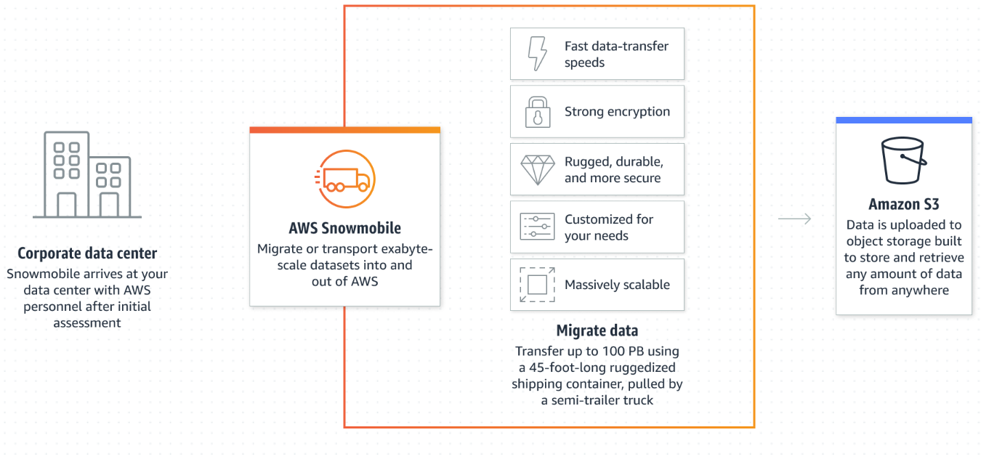
High latency, High throughput
Notes:
[Ref: https://aws.amazon.com/snowball/
https://aws.amazon.com/snowmobile/
]

Slide 7
What if I told you that you could build a cheap storage system that is high capacity and fast to access?
YOU CAN DO THIS
IF YOUR PROGRAMS EXHIBIT LOCALITY.

Slide 8
Access Locality
long f(int* v, int n) {
long sum = 0;
for (int i = 0; i < n; ++i) {
sum += v[i];
}
return sum;
}
A program’s access patterns to storage are often predictable!
Temporal locality: An object that has been accessed recently will likely be accessed in the near future
Spatial locality: If an object has been accessed recently, nearby objects are likely to be accessed in the near future
For such well-behaved programs, we can use a lot of cheap-but-slow storage and a little fast-but-expensive storage to give the illusion of a cheap, big, and fast storage device!
. . . unless your program has poor locality, in which case you will be sad
//Temporal locality: i and sum
//Spatial locality: Elements in
//v[]
//This program has worse locality!
bool g(int* v, int n) {
int tries = 0;
while (tries++ < 1000) {
if ((v[rand() % n] % 17) == 0) {
return true;
}
}
return false;
}
Notes:
In the sample code, the variables `i` and `sum` have good temporal locality because both variables are accessed during each loop iteration. The elements of the array `v[]` exhibit spatial locality, because when the i^{th} element is accessed, the i+1th element will soon be accessed.

Slide 9
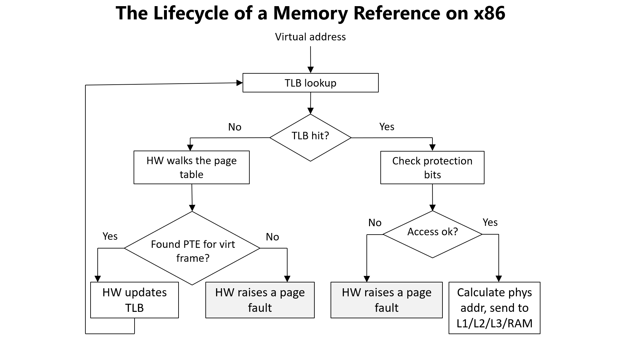
Caching: Exploiting Locality
A cache is a small amount of fast storage that is used to hide the access latencies of larger-but-slower storage
Temporal locality for object x: Once x has been fetched into the cache, subsequent reads and writes of the object can be satisfied by the cache
Spatial locality for object x: When a program accesses x, fetch x and nearby objects x+1, x+2, . . . into the cache as well, so that those objects will already be in fast storage when the program tries to access them!
Caches are a pervasive concept in computer science
Ex: Registers as a cache for RAM
Ex: TLBs as a cache for PTEs stored in RAM
Ex: Memory as a cache for SSDs/hard disks

Slide 10
Caching Terminology
A block is a unit of data storage: both the cache and the underlying storage contain blocks
Each block in the underlying storage has an address
We typically refer to blocks via an integer index, treating the underlying storage as an array of blocks
However, a block typically has a “real” address on the storage device (e.g., a memory address for RAM data, or a disk position for a file block)
A cache contains one or more slots (each the size of a block)
An empty slot contains no cached block
A filled slot contains a cached block
Cache
Underlying storage

Slide 11
Caching Terminology
When code tries to read block b, the cache checks whether b is already in the cache
If so, there was a cache hit: b is directly returned, avoiding a slow fetch from the underlying storage
If not, there was a cache miss: b must be pulled from the underlying storage before being returned to the program
A cache can absorb a write to b
The cache stores the new value for b, but does not synchronously (i.e., immediately) update the underlying storage
At some point later, the cache asynchronously flushes the new b to the underlying storage
A cached block is:
Dirty if it has absorbed a write that isn’t reflected on the underlying storage
Clean otherwise
Cache
Underlying storage
Notes:
Cache misses are bad because they incur both the cost of interacting with the cache *and* the cost of accessing slower storage! So, we want to design caches that have a high hit rate: in other words, we want to increase the fraction of all accesses that can be serviced by the cache.
Why might a cache decide to actually issue an asynchronous flush? One reason is that the cache might be full, so, to make room for a new item, the cache decides to flush an old dirty item. Another reason might be for crash resistance: if the cache does not reside in persistent storage, but the underlying storage *is* persistent, the cache might flush a dirty item to ensure that, if the machine does crash or unexpectedly lose power, the new value of the dirty object won’t be lost!

Slide 12
Caching Terminology
read b₃
write b₂
read b₃
read b₂
//Cache flush
When code tries to read block b, the cache checks whether b is already in the cache
If so, there was a cache hit: b is directly returned, avoiding a slow fetch from the underlying storage
If not, there was a cache miss: b must be pulled from the underlying storage before being returned to the program
A cache can absorb a write to b
The cache stores the new value for b, but does not synchronously (i.e., immediately) update the underlying storage
At some point later, the cache asynchronously flushes the new b to the underlying storage
A cached block is:
Dirty if it has absorbed a write that isn’t reflected on the underlying storage
Clean otherwise
The underlying storage is now synced with the cache! This is great if:
The underlying storage is persistent, and
The system unexpectedly crashes or loses power—there won’t be any data loss!
But how often should we flush the cache?
Too infrequently: We risk data loss
Too frequently: We generate unnecessary traffic for the IO device
Cache
Underlying storage
Notes:
We’ll return to the topic of cache flushing policies in an upcoming lecture!

Slide 13
Providing the Illusion of Fast, Big, and Cheap Storage
A modern computer has a storage hierarchy
Lower levels provide larger storage capacities
Higher levels provide lower latencies, and act as caches which hide the access costs of reading/writing the lower levels
The L1, L2, and L3 caches sit between a CPU and RAM
Data is transferred between RAM and the various cache levels in units of a cache line (e.g., 64 consecutive bytes on a modern x86 chip)
Notes:
[Aside: You might wonder whether, say, an L2 cache contains the data that resides in the associated L1 caches (in addition to the other L2 data). Such an L2 design would be called an inclusive cache. A design in which the L2 and L1 would hold a non-overlapping set of data would be called an exclusive cache design. An advantage of exclusive caches is that the total size of the L* caches would be the sum of each level’s size (instead of just the size of the L3). An advantage of inclusive caches is that, on a modern multicore machine, the L3 levels are often shared by multiple CPUs, even if the L1 and L2 are private (i.e., per-core). With an inclusive design, data pulled into the L3 by one core can be pulled into the private L1+L2 caches of that core and another core that shares the L3. For a more detailed discussion of these kinds of caching issues, see https://cs.brown.edu/courses/cs033/lecture/17cache.pdf.]
[For a nice discussion of L* caches, see https://meribold.org/2017/10/20/survey-of-cpu-caches/.]

Slide 14
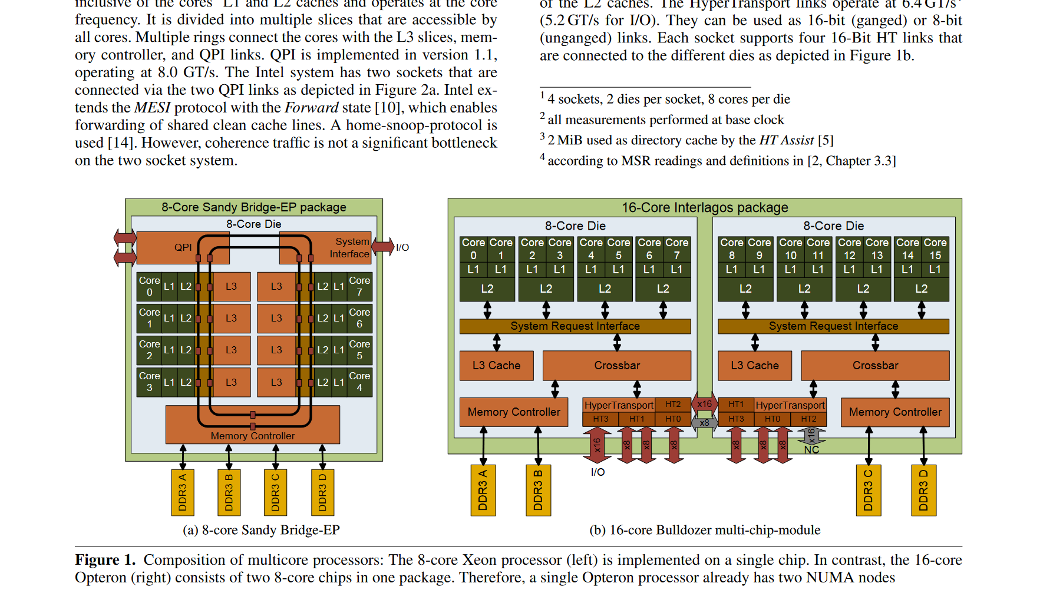
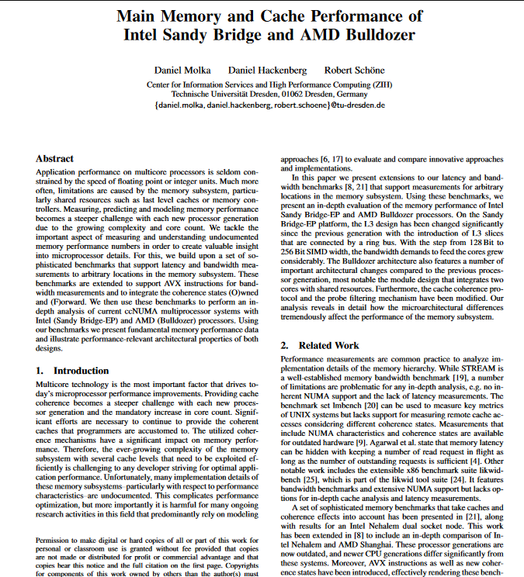
NUMA: “Non-uniform memory access”
On a NUMA machine, a CPU’s access latency to a physical RAM address depends on which RAM module the address resides in!
Notes:
[In the Bulldozer, imagine a core on the left want to access the rightmost RAM module. The core will have to send a request via the cross-die crossbars and the associated circuitry---a longer process than accessing memory that is directly connected to the core’s memory controller.]
[Ref: The paper "Main Memory and Cache Performance of Intel Sandy Bridge and AMD Bulldozer" by Molka et al. The paper can be downloaded at https://tu-dresden.de/zih/forschung/ressourcen/dateien/abgeschlossene-projekte/benchit/2014_MSPC_authors_version.pdf?lang=en]

Slide 15
SSDs versus Hard Drives (Throughput) [Source: “Flash-based SSDs” chapter of “Operating Systems: Three Easy Pieces” by the Arpaci-Dusseaus]
Random
Sequential
Reads
Writes
Reads
Writes
(MB/s)
(MB/s)
(MB/s)
(MB/s)
Device
Samsung 840 Pro SSD
103 287 421 384
Seagate 600 SSD
84 252 424 374
Intel 335 SSD
39 222 344 354
Seagate Savio 15K.3 HD
2 2 223 223
SSD random writes are faster than SSD random reads: the SSD can batch writes (acknowledging software quickly) and then issue the writes in one burst, but a read can’t complete until the data has actually been fetched.
Hard drives have terrible random IO performance! The disk head must incur a seek penalty and rotational delay for most IOs :-(.
Dollars per storage bit: Hard drives are an order-of-magnitude cheaper!
[SSD: ~$0.50/GB HD: ~$0.035/GB]
Sequential IO is faster than random IO on SSDs, even though SSDs have no mechanical latencies!
For sequential IOs, disks are more competitive.
Notes:
Hard drives have terrible performance for random reads and writes. The reason is that, for random workloads, the disk head is moving all around, incurring a bunch of seek latencies and rotational delays. In contrast, an SSD only has to pay electronic latencies. But, as we see from this chart, a file system for SSDs would also benefit from converting random IOs to sequential ones, because SSDs also have a performance disparity between random and sequential IO.
For SSDs, random writes are faster than random reads. This is because the SSD can batch a bunch of writes, and then write them in one burst to the end of the log. The SSD can’t play those kinds of tricks with reads. Also note that, like a hard disk, an SSD also has a “geometry.” Internally, the SSD groups a bunch of blocks together. Consecutively accessing pages in that group are faster than consecutively accessing pages across many different groups. [For a high-level overview of SSD geometries, see https://www.cactus-tech.com/resources/blog/details/solid-state-drive-primer-8-controller-architecture-channels-and-banks]
We see another interesting trend by looking at the sequential numbers. For sequential reads and writes, the performance difference between SSDs and hard drives is much smaller. So, if you’re designing a machine, and you know that the machine will only be running applications with sequential workloads, then maybe you should put a hard disk in the machine instead of an SSD. You’ll get a lot more storage capacity for the same amount of dollars, and your sequential performance will be pretty reasonable. In terms of dollar per storage bit, there’s a 10x differences between hard drives and SSDs. In other words, for a given amount of money, you can buy a hard disk that has ten times more storage than an SSD with the same dollar cost. So, SSDs have roughly twice as fast sequential throughput, but roughly a tenth of the storage capacity of a hard disk.

Slide 16
Storage: Isolation and Caching
Registers
A CPU’s local registers can only be accessed by the code that is currently running on that CPU—there is literally no hardware that allows cross-CPU register accesses
A program is responsible for moving its data between registers and RAM; in practice, the compiler (not a program developer) usually orchestrates this
Physical RAM
The OS uses virtual memory to determine which physical RAM can be accessed by which processes
The hardware in the L1/L2/L3 caching hierarchy automatically transfers data between RAM and the various caching layers
Developers who want the best performance for their programs will write cache-conscious code!
Persistent storage (e.g., SSDs and hard drives)
The OS provides a file system, using directory+file abstractions to layer a tree-like organizational structure upon raw storage blocks
The OS provides a software-implemented buffer cache for storage blocks
User-level libraries may implement additional software-level caches!
Unless you’re writing an OS, an in-memory database, or another high-performance, low-level program!

Slide 17
Linux: C++ File IO
Application code
Linux (like all commodity OSes) disallows a process from directly interacting with persistent storage devices
Instead, a process must use system calls to interact with files
Linux maintains a buffer cache in kernel memory
The cache stores recently-accessed file blocks
Linux does not synchronously flush dirty blocks to disk unless the application requests such behavior
The stdio library provides higher-level interfaces for file IO
Behind the scenes, the library invokes system calls
The library also implements its own caching layer for file data!
fwrite()
stdio cache
stdio in libc++
User
write()
Kernel
Buffer cache
Device driver
Storage device

Slide 18
Linux: C++ File IO
Application code
#include <fcntl.h>
#include <unistd.h>
void write_one_byte_syscall() {
int fd = open(“file.txt”,
O_WRONLY);
size_t size = 5120000;
const char* buf = "6";
size_t n = 0;
while (n < size) {
write(fd, buf, 1);
++n;
}
close(fd);
}
User
write()
Kernel
Buffer cache
A call to write() will synchronously update a buffer cache block, but Linux updates the actual storage device asynchronously!
Device driver
Storage device

Slide 19
Linux: C++ File IO
Application code
#include <stdio.h>
void write_one_byte_stdio() {
FILE* f = fopen("file.txt",
"w");
size_t size = 51200000;
const char* buf = "6";
size_t n = 0;
while (n < size) {
int ch = fputc(buf[0], f);
++n;
}
fclose(f);
}
stdio cache
fwrite()
stdio in libc++
User
write()
By default, stdio buffers file write data in a 4 KB buffer, only calling write() when the buffer is full! The write() synchronously updates a buffer cache block, but Linux updates the actual storage device asynchronously!
Kernel
Buffer cache
A normal function call returns faster than a system call—there’s no need to context switch into and out of the kernel! So, application code perceives that writes have gotten faster . . . but will we lose more data during a crash?
Device driver
Storage device
Notes:
We might lose more data during a crash because we’re delaying the time at which the kernel knows that there’s data available to flush to disk!
Note that the stdio library provides a `fflush(FILE* f)` method that allows an application to forcibly write the contents of the stdio cache to the buffer cache. However, as the man page says, “Note that fflush() flushes only the user-space buffers provided by the C library. To ensure that the data is physically stored on disk the kernel buffers must be flushed too, for example, with sync(2) or fsync(2).” [Ref: https://man7.org/linux/man-pages/man3/fflush.3.html.]
[You can find the two test programs in https://github.com/cs61/cs61-lectures/blob/main/storage1/w-osbyte.cc and https://github.com/cs61/cs61-lectures/blob/main/storage1/w-stdiobyte.cc.]

Slide 20
The Power of strace!
strace is a powerful analysis tool that eavesdrops on another program’s system calls
strace –o strace.out <program> <program arguments>
-f: follow forks (i.e., child processes)
-s N: For each string argument and return value, print up to N bytes
-e trace=open,close,read,write: Only track those system calls

Slide 21
(Very abridged) strace of the stdio program
openat(AT_FDCWD, "/lib64/libc.so.6", O_RDONLY|O_CLOEXEC) = 3
read(3, "\177ELF\2\1\1\3\0\0\0\0\0\0\0\0\3\0>\0\1\0\0\0P\22\2\0\0\0\0\0"..., 832) = 832
mmap(NULL, 3852960, PROT_READ|PROT_EXEC, MAP_PRIVATE|MAP_DENYWRITE, 3, 0) = 0x7fd13a2e2000
mprotect(0x7fd13a486000, 2093056, PROT_NONE) = 0
mmap(0x7fd13a685000, 24576, PROT_READ|PROT_WRITE, MAP_PRIVATE|MAP_FIXED|MAP_DENYWRITE, 3, 0x1a3000) = 0x7fd13a685000
mmap(0x7fd13a68b000, 15008, PROT_READ|PROT_WRITE, MAP_PRIVATE|MAP_FIXED|MAP_ANONYMOUS, -1, 0) = 0x7fd13a68b000
close(3) = 0
openat(AT_FDCWD, "data", O_WRONLY|O_CREAT|O_TRUNC, 0666) = 3
write(2, "\r 4,096 bytes 0.000"..., 68) = 68
write(3, "66666666666666666666666666666666"..., 4096) = 4096
write(2, "\r 8,192 bytes 0.000"..., 68) = 68
write(3, "66666666666666666666666666666666"..., 4096) = 4096
write(2, "\r 12,288 bytes 0.001"..., 68) = 68
write(3, "66666666666666666666666666666666"..., 4096) = 4096
write(2, "\r 16,384 bytes 0.001"..., 68) = 68
write(3, "66666666666666666666666666666666"..., 4096) = 4096
write(2, "\r 20,480 bytes 0.001"..., 68) = 68
write(3, "66666666666666666666666666666666"..., 4096) = 4096
Notes:
The first part of the strace log shows the program reading the libc library into memory, marking the code region as PROT_EXEC (i.e., executable) and other parts containing data as readable and writable. The second part of the strace log shows the write() system calls made by the stdio library.

Slide 22
Performance Comparison: Direct System Calls vs. stdio
The stdio version is much faster . . .
Direct system calls: 5,120,000 bytes 5.890 sec 869,230 bytes/sec
stdio: 51,200,000 bytes 0.844 sec 60,644,536 bytes/sec
The stdio version invokes many fewer system calls (12,500 vs. 5,120,000), and thus incurs much less context-switching overhead (e.g., restoring and saving registers)
However, the stdio version may be less safe!
RAM (which stores both the stdio cache and the kernel’s buffer cache) is not persistent
Data only becomes persistent when:
The data arrives in the kernel’s buffer cache, and
The kernel actually performs the asynchronous flush of the associated cache block to persistent storage
The stdio program delays Step 1, which might delay Step 2 for the associated data!
This delay is bad if you’re worried about your machine crashing or unexpectedly losing power: in those situations, the stdio approach may lead to more data loss!

