Slide 1
Embedded EthiCS: Character Encodings
I WAS A TABLET
CS 61: Lecture 12 10/23/2023
BEFORE TABLETS WERE COOL

Slide 2
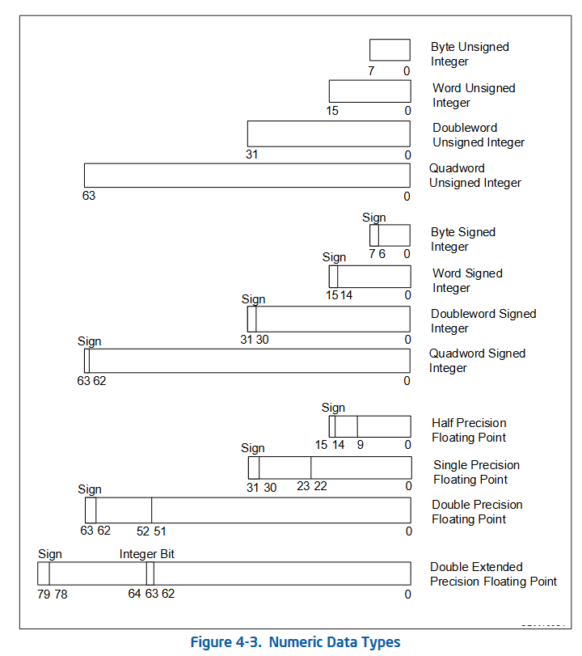
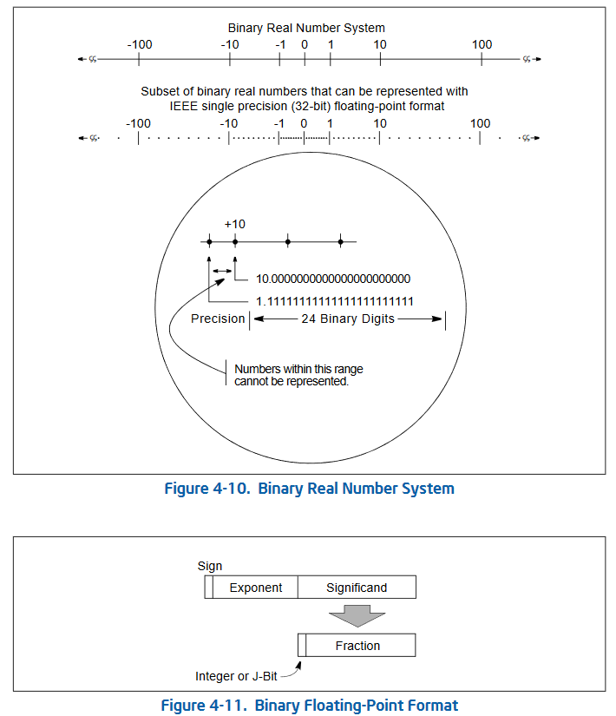
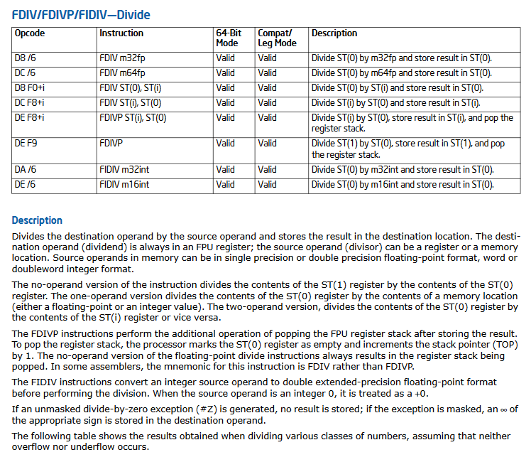
Data Encodings
CPU instructions manipulate bytes (i.e., sequences of binary digits)
A CPU defines:
A few low-level types (e.g., integers, floats, and pointers)
Semantics for how to interpret the bit patterns in those types
Instructions which directly manipulate those bit patterns (e.g., add, fdiv, call)
A higher-level programming language defines higher-level types whose bit-level semantics are not defined by the hardware
For example, there are multiple ways that a C++ library could represent a vector; internally, it could be represented as a growable array, or a growable tree, or something else!
Given such a representation, the library must cobble together low-level byte manipulation instructions to implement the vector interface
Notes:
[Ref for diagrams: “Intel® 64 and IA-32 Architectures Software Developer’s Manual, Volume 1: Basic Architecture”]

Slide 3
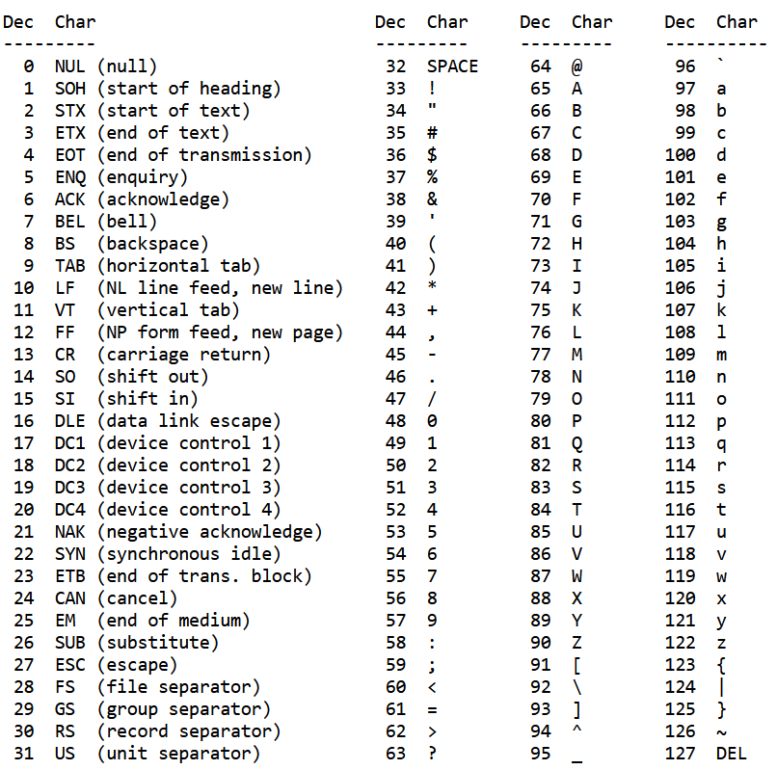
How Should Strings Be Represented?
Strings are a critical data type provided by higher-level languages
C and C++ historically used a very simple representation of strings
C: A string is a char array that is terminated by the special NUL character (‘\0’)
C++: A string is implemented via a string class which internally is similar to vector!
These representations assume one byte (i.e., one char) maps to a single character in the human-language string
The ASCII encoding defined the mapping from a human-language (Latin) character to a byte value
char* s = malloc(3);
s[0] = ‘C’;
s[1] = ‘S’;
s[2] = ‘\0’;
printf(“%s\n”, s);
‘C’
‘S’
‘\0’
s
string s = “CS”;
cout << s << endl;
s
size:2
cap:
4
data
‘C’
‘S’
‘\0’
Notes:
[Note that the size of the string does not include the NUL terminator, but the underlying array does require enough space to hold the string’s characters *and* the NUL terminator!]
[Ref: For gory details about how the `string` class is implemented, see https://joellaity.com/2020/01/31/string.html]

Slide 4
THE LATIN ALPHABET IS NOT UNIVERSAL

Slide 5
Overview of Unicode
As the Unicode consortium says, ““Unicode provides a unique number for every character, no matter what the platform, no matter what the program, no matter what the language”
A code point is the number for a particular character
Ex: The code point for the Latin character “M” is U+004D
Ex: The code point for the Japanese kanji “学” is U+5B66
The Unicode standards define several ways of encoding (i.e., translating) a code point into a bit-level representation
Notes:
[As Wikipedia says (https://en.wikipedia.org/wiki/Unicode), “The Unicode Standard defines a codespace: a sequence of integers called code points covering the interval [0 , 17×2¹⁶), notated according to the standard as U+0000–U+10FFFF.”]
[The Japanese kanji ideograph 学 has several meanings like “learning” and “knowledge.”]

Slide 6
Unicode Encoding Schemes: UTF-8
UTF-8 is a variable-length encoding: depending on the code point, the byte-level representation will be 1-4 bytes
UTF-8 is backwards-compatible with ASCII: Each valid one-byte ASCII character has the same UTF-8 byte-level value!
One-byte encodings start with a 0
Two-byte encodings start with 110
Three-byte encodings start with 1110
Four byte encodings start with 11110
These 61,440 code points cover most
Chinese, Japanese, and Korean characters
First code point | Last code point | Byte 1 | Byte 2 | Byte 3 | Byte 4
U+0000 | U+007F | 0xxxxxxx
U+0080 | U+07FF | 110xxxxx | 10xxxxxx
U+0800 | U+FFFF | 1110xxxx | 10xxxxxx | 10xxxxxx
U+10000 | U+10FFFF | 11110xxx | 10xxxxxx | 10xxxxxx | 10xxxxxx
These 127 code points handle the ASCII characters
These 1,048,576 code points cover various languages…
and emojis!
These 1,920 code points cover almost all remaining Latin-script alphabets, and some non-Latin alphabets (e.g., Greek, Arabic, Cyrillic)
Notes:
The nice thing about UTF-8 is that an ASCII file is automagically a valid UTF-8 file that contains the same characters!
[As described by https://docs.python.org/3/howto/unicode.html, “UTF-8 uses the following rules:
If the code point is < 128, it’s represented by the corresponding byte value.
If the code point is >= 128, it’s turned into a sequence of two, three, or four bytes, where each byte of the sequence is between 128 and 255.
UTF-8 has several convenient properties:
It can handle any Unicode code point.
A Unicode string is turned into a sequence of bytes that contains embedded zero bytes only where they represent the null character (U+0000). This means that UTF-8 strings can be processed by C functions such as strcpy() and sent through protocols that can’t handle zero bytes for anything other than end-of-string markers.
A string of ASCII text is also valid UTF-8 text.
UTF-8 is fairly compact; the majority of commonly used characters can be represented with one or two bytes.
If bytes are corrupted or lost, it’s possible to determine the start of the next UTF-8-encoded code point and resynchronize. It’s also unlikely that random 8-bit data will look like valid UTF-8.
UTF-8 is a byte oriented encoding. The encoding specifies that each character is represented by a specific sequence of one or more bytes. This avoids the byte-ordering issues that can occur with integer and word oriented encodings, like UTF-16 and UTF-32, where the sequence of bytes varies depending on the hardware on which the string was encoded.”
[Ref: https://en.wikipedia.org/wiki/UTF-8]

Slide 7
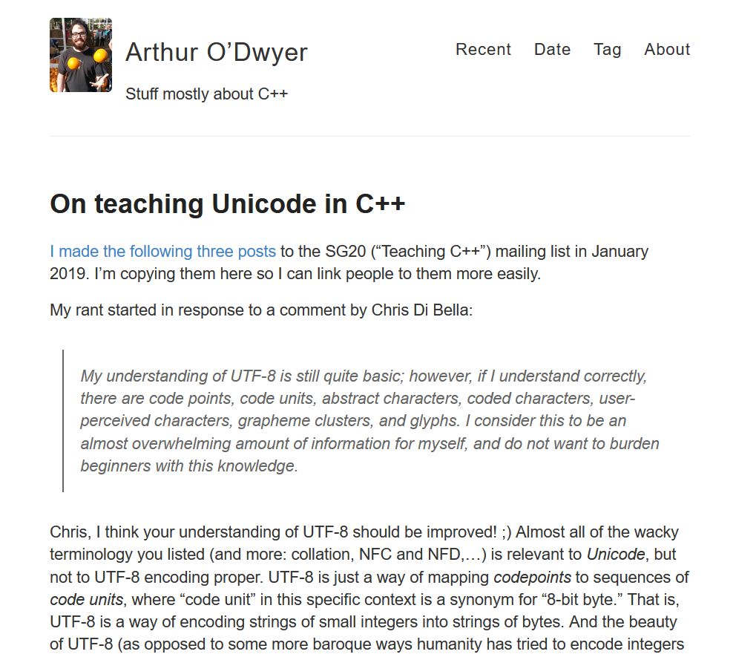
How (and when) do we teach internationalization to programmers?
Notes:
[Ref: https://quuxplusone.github.io/blog/2019/02/03/on-teaching-unicode/]

Slide 8
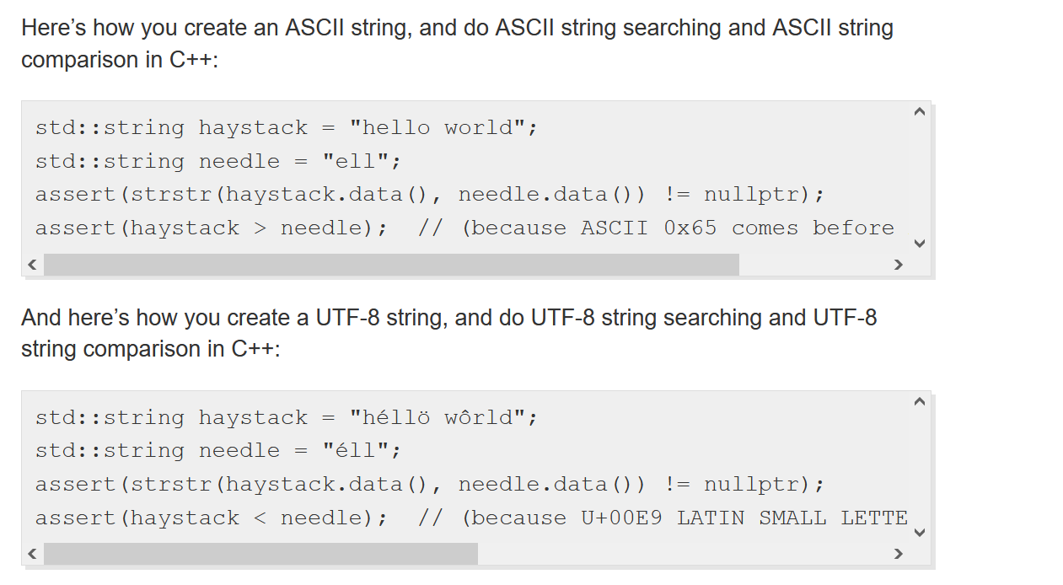
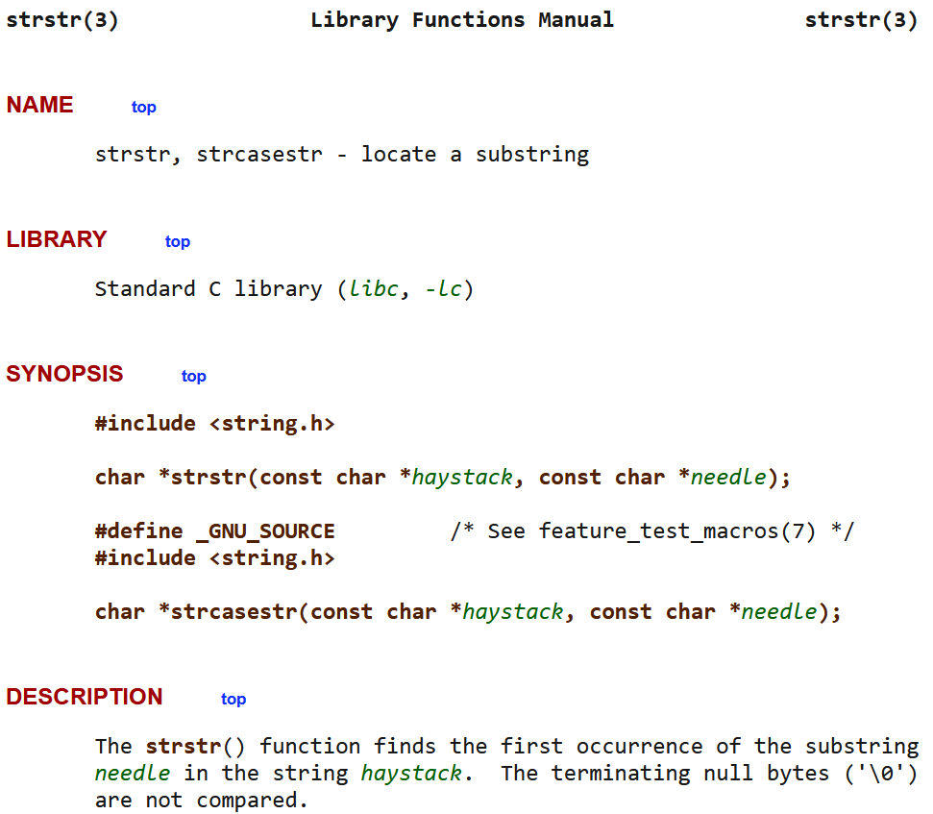
‘é’ is after 'h'
O RLY?
Notes:
“UTF-8 strings never contain '\0' (or indeed any ASCII character) unless it represents a real '\0' (or indeed the corresponding real ASCII character)” (Ref [1]). This is a very convenient property because it means that string manipulation functions that assume NUL-terminated strings will work as expected—a NUL character won’t show up in the middle of the string.
[Ref: [1] https://quuxplusone.github.io/blog/2019/02/03/on-teaching-unicode/]

Slide 9
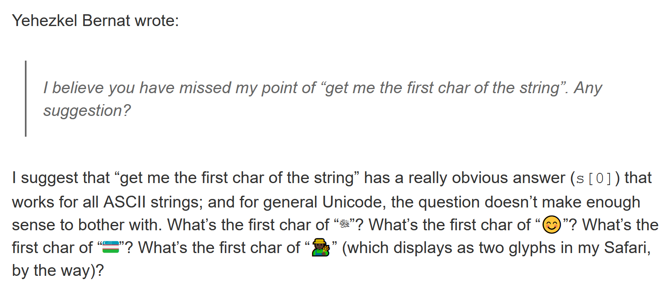
Notes:
[Ref: https://docs.python.org/3/howto/unicode.html]

Slide 10
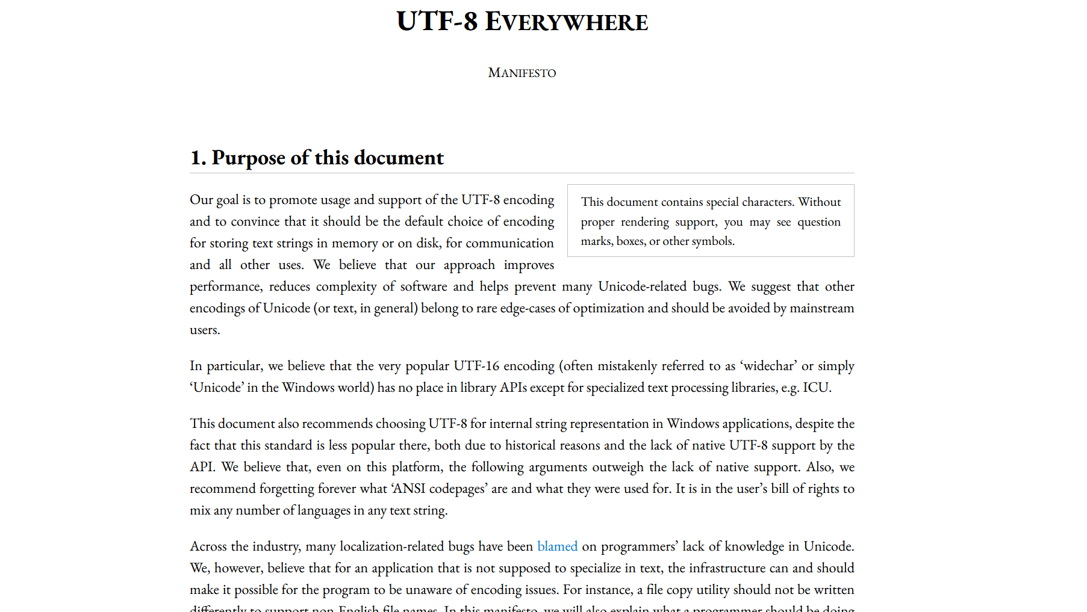
Notes:
[Ref: http://utf8everywhere.org/]

Slide 11
But is UTF-8 the Best Unicode Encoding?
UTF-32 is a fixed-sized encoding that represents each code point using 32 bits
Unlike a variable-length encoding, UTF-32 allows straightforward identification of the i^{th} code point in a string’s code point array
However, UTF-32 wastes space: there are only 2²¹ code points, so 11 bits in a UTF-32 code point are always zero
UTF-32 is not backwards-compatible with ASCII
UTF-16 is a variable-sized encoding that uses one or two 16-bit values to represent a code point
UTF-16 is not backwards compatible with ASCII
UTF-16 preferences certain character sets
Notes:
The primary advantage of UTF-32 is that it allows straightforward indexing into a string’s code point array: the i-th code point can be located by taking the base of the array and finding the 4 bytes at the offset i*4. But, as we discussed in a previous slide, perhaps being able to quickly identify a code point isn’t every helpful?
[Ref for the quote at the bottom of the slide: http://utf8everywhere.org/]

Slide 12
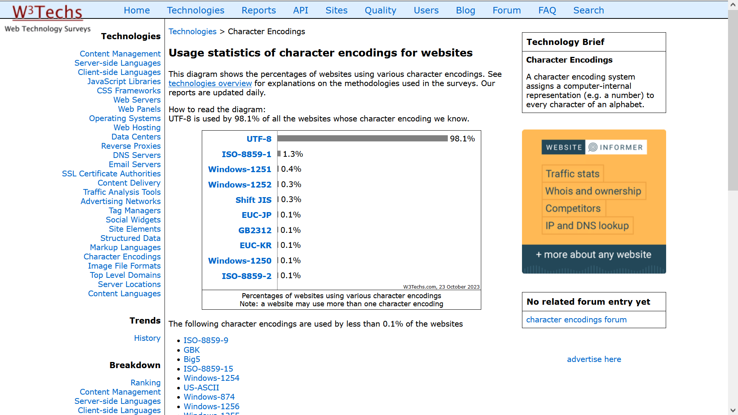
Notes:
[Ref: https://w3techs.com/technologies/overview/character_encoding]

Slide 13
The initial developers of a technology get an outsized say in how the technology works
Many foundational computer technologies were initially developed in English-speaking environments
Unix: An extremely influential OS whose abstractions (e.g., file descriptors) and system calls influenced many other OSes
C: The language designed to implement the UNIX kernel and whose syntax influenced many subsequent languages (e.g., C++, Java, Go, Python, JavaScript)
Internet protocol (IP), HTML, and HTTP: Foundational protocols for allowing computers to exchange data
Implicit cultural assumptions continue to resonate when technologies become international!

