Slide 1
Kernels: Part III
CS 61: Lecture 11 10/18/2023

Slide 2
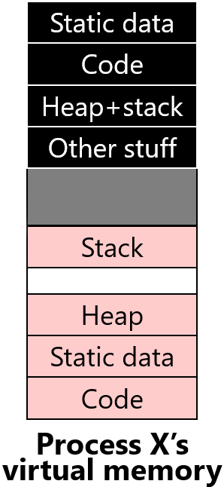
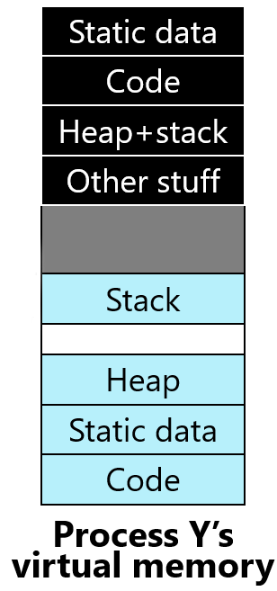
Virtual Memory: Basic Idea
(2^{V})-1
Static data
(2^{V})-1
Static data
Code
Code
//k-exception.S
_Z15exception_entryv:
push %gs
push %fs
pushq %r15
pushq %r14
pushq %r13
pushq %r12
pushq %r11
//...and the other registers,
//then do . . .
movq %rsp, %rdi
//Load the kernel’s page table.
movq $kernel_pagetable, %rax
movq %rax, %cr3
call _Z9exceptionP8regstate
//`exception` should never return!
Don’t let code (i.e., CPU instructions) access physical memory directly
Instead, use indirection!
CPU instructions manipulate virtual memory addresses in [0, (2^{V})-1]
The kernel defines the mapping between virtual addresses and physical memory addresses in [0, (2^{P})-1]
Kernel installs the appropriate virtual-to-physical mapping (the page table) when context-switching to a particular process
A CPU’s MMU hardware enforces the kernel-established mapping
Physical memory addresses are what the CPU actually sends to the DRAM hardware
Heap+stack
Heap+stack
Other stuff
Other stuff
Kernel memory
Kernel memory
User memory
Stack
User memory
Stack
Heap
Heap
_Z16exception_returnP4proc:
//Load the process's page table.
movq (%rdi), %rax
movq %rax, %cr3
//Restore user-mode registers.
leaq 16(%rdi), %rsp
popq %rax
popq %rcx
popq %rdx
//...pop other registers, then . . .
//Return to user mode!
iretq
Static data
Static data
0
Code
0
Code
Process X’s
virtual memory
Process Y’s
virtual memory
(2^{P})-1
0
Physical RAM
Notes:
[Remember that on, commodity OSes, the kernel lives at the top of the virtual address space, but in WeensyOS, the kernel lives at the bottom!]

Slide 3
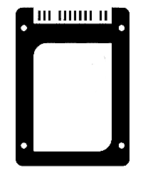
Virtual Memory: Basic Idea
User process X
User process Y
User process Z
Kernel
Don’t let code (i.e., CPU instructions) access physical memory directly
Instead, use indirection!
CPU instructions manipulate virtual memory addresses in [0, (2^{V})-1]
The kernel defines the mapping between virtual addresses and physical memory addresses in [0, (2^{P})-1]
Kernel installs the appropriate virtual-to-physical mapping (the page table) when context-switching to a particular process
A CPU’s MMU hardware enforces the kernel-established mapping
Physical memory addresses are what the CPU actually sends to the DRAM hardware
MMU
MMU
MMU
MMU
Hardware
RAM
SSD
UX devices
Network
Each CPU can potentially be using a different virtual-to-physical mapping!
Notes:
[Aside: An x86-64 CPU initially boots into a restricted mode with no virtual addresses: the initial part of the kernel must configure the CPU to use virtual addressing! If you’re interested in the low-level technical gore of how this is done, see WeensyOS’s bootentry.S. The incantations in bootentry.S won’t be on the midterm LOL.]

Slide 4
Memory Mapping via Pages
Virtual memory for process X
x86-64 CPUs (and other popular CPUs) map memory at a page-size granularity
Ex: On x86-64, the allowable page sizes are 4 KB, 2 MB, and 1 GB
Ex: On RISCV32, the allowable page sizes are 4 KB and 4 MB
Given a virtual page v_{x}, a page table maps v_{x} to some equally-sized physical page p_{y} (or none if v_{x} doesn’t reside in physical memory)
Any virtual page can map to any physical page!
All addresses within a particular virtual page map linearly, at the same offsets, to the associated physical page
Let b_{v} be the base virtual address of a virtual page, and b_{p} be the base physical address of the mapped physical page
For any offset o within the virtual page, the MMU maps the virtual address b_{v}+o to physical address b_{p}+o
v₁₅
Physical memory
o
MMU
b_{v}
v₉
Somewhere in physical memory . . .
Page table
v₀ -> p₀
v₁ -> p₆
v₇ -> p₁
v₈ -> p₃
v₉ -> p₇
v₁₅ -> p₅
Virtual page
v₁
o
v₉
v₁₅
b_{p}
v₈
Backing physical page
v₇
v₈
v₇
v₀
v₁
v₀

Slide 5
Memory Mapping via Pages
Virtual memory for process X
The largest possible virtual address space on a 64-bit chip contains 2⁶⁴ bytes (i.e., 17,179,869,184 GBs)!
In practice, modern x86-64 chips only support 256,000 GB of virtual memory, which is still huge
Physical RAM on a real computer is much smaller (e.g., 32 GB on a very nice laptop)
So, even a single process could not fit all of its virtual pages into physical RAM
Luckily, virtual address spaces are sparsely populated, i.e., most virtual pages aren’t actually used
A page table entry contains access permissions
Is the virtual page actually present in physical RAM?
Is the page’s data writable?
Is the page’s data execute-disabled?
Is the page accessible to user-privileged code?
v₁₅
Physical memory
MMU
Page table
v₀ -> p₀
v₁ -> p₆
v₇ -> p₁
v₈ -> p₃
v₉ -> p₇
v₁₅ -> p₅
v₉
v₁
v₉
v₁₅
v₈
v₇
v₈
v₇
v₀
The CPU generates a page fault if an instruction attempts to violate page permissions!
v₁
v₀
Notes:
If a page is execute-disabled, the CPU will generate a page fault if an instruction tries to jump to an address in the page!
Why might a virtual page be absent from physical RAM? A main reason is that the associated process hasn’t allocated that page. For example, the heap grows when a program calls `malloc()` or `new`. When a process initially starts, the process hasn’t allocated any heap memory, so the associated parts of the virtual address space are not associated with actual virtual pages (and thus there are no backing physical pages for those virtual pages).
[Aside: In commodity OSes, a virtual page might be valid (i.e., allocated) but placed by the OS on the disk instead of in physical RAM. Why would a virtual page be swapped to disk? Well, there may be a lot of processes that are running; if so, that means that a lot of processes will want to put their virtual pages in RAM. If all of the pages can’t fit at once, then some of those pages need to be stored on disk, where they can be retrieved later. The page table entry for a swapped-out page will not have the `present` bit set; when the process tries to access that page, the CPU will generate a page fault. The OS can then read the page from disk into somewhere in physical RAM, and then adjust the page’s page table entry to indicate where the page now lives.]
[Aside: The slide above says that modern x86-64 chips only support 256 TB of actual virtual address space. What’s interesting is that this allowable virtual address space isn’t contiguous—there’s a hole in the middle of it! The allowable virtual addresses lie in this range:
[0, 2^47) U [2^64 – 2^47, 2^64)
The weird reason is that modern x86-64 chips require that only the least-significant 48 bits of a virtual address be used for address translation, with all bits higher than the 48th bit needing to be a copy of the 48th bit. The net effect of all of this is that the allowable addresses are “low” addresses in the range 0---0000’7FFF'FFFF’FFFF, and “high” addresses in the range FFFF’8000'0000’0000—FFFF’FFFF'FFFF’FFFF. For more details, see https://en.wikipedia.org/wiki/X86-64#Virtual_address_space_details.]

Slide 6
Address Translation in More Detail
Virtual address
The virtual address is what is manipulated by software (i.e., by CPU instructions like mov 0x8(%rax), %rbx)
The MMU takes the virtual address (e.g., whatever 0x8(%rax) resolves to) and:
Extracts the v-bit virtual page number
Uses the page table to convert the virtual page number to a p-bit physical page number
Sends the physical address (of size p+o bits) to RAM
Suppose that on a 12-bit CPU, v=8, p=4, and o=4; a possible mapping is:
Virtual Page Number
Offset
v bits
o bits
MMU
p bits
Physical Page Number
Offset
8-bit virtual page number
12-bit Virtual address: 0xC98
4-bit offset
8-bit Physical address: 0xA8
Physical address
4-bit physical page number
Notes:
Note that, on modern hardware, v is larger than p because physical RAM is much smaller than a virtual address space!

Slide 7
Case study: x86-64
L4
L3
L2
L1
Offset
47
39
38
30
29
21
20
12
11
0
Holds the physical address of a 4 KB-aligned PML4
Highest-order bits not useful for address translations!
%cr3
Notes:
“PML4” stands for “Page Map Level 4.”
You might wonder why %cr3 stores a physical address even though every other register stores a virtual address. The reason is that page tables are used to convert virtual addresses to physical addresses, so the page table itself must be referenced using a physical address (i.e., one that doesn’t already presuppose a way to map virtual addresses to physical ones)!
[Reference: https://wiki.osdev.org/CPU_Registers_x86-64#CR3
Section 4.5 of “Intel® 64 and IA-32 Architectures Software Developer’s Manual
Volume 3 (3A, 3B, 3C & 3D): System Programming Guide” (there’s a
copy in the repo)
https://software.intel.com/sites/default/files/managed/2b/80/5-level_paging_white_paper.pdf
https://os.phil-opp.com/paging-introduction/
https://wiki.osdev.org/Page_Tables#Long_mode_.2864-bit.29_page_map]

Slide 8
Case study: x86-64
L4
L3
L2
L1
Offset
47
39
38
30
29
21
20
12
11
0
A 4 KB-aligned PDP has 512 8-byte entries
A 4 KB-aligned PML4 has 512 8-byte entries
%cr3
9 bits
Bookkeeping stuff
PDPTE
9 bits
Page directory pointer
PML4E
PML4E
4KB-aligned PDPTE physAddr
64 bits
Page map level 4
63
48
47
12
11
0

Slide 9
Case study: x86-64
L4
L3
L2
L1
Offset
47
39
38
30
29
21
20
12
11
0
A 4 KB-aligned PDP has 512 8-byte entries
9 bits
PDE
%cr3
9 bits
Page directory
Bookkeeping stuff
PDPTE
9 bits
Page directory pointer
A 4 KB-aligned PD has 512 8-byte entries
PML4E
PDPTE
4KB-aligned PDE physAddr
64 bits
Page map level 4
63
48
47
12
11
0

Slide 10
Case study: x86-64
L4
L3
L2
L1
Offset
47
39
38
30
29
21
20
12
11
0
9 bits
PDE
%cr3
9 bits
Page directory
Bookkeeping stuff
PDPTE
9 bits
Page directory pointer
A 4 KB-aligned PD has 512 8-byte entries
PML4E
PDE
4KB-aligned PTE physAddr
64 bits
Page map level 4
63
48
47
12
11
0

Slide 11
Case study: x86-64
L4
L3
L2
L1
Offset
47
39
38
30
29
21
20
12
11
0
PhysAddr
12 bits
4KB page
9 bits
PTE
9 bits
Page table
PDE
User-mode accessible?
%cr3
Writeable?
9 bits
Page directory
A 4 KB-aligned PT has 512 8-byte entries
PDPTE
Present?
9 bits
Page directory pointer
PML4E
PTE
4KB-aligned physPage addr
64 bits
Page map level 4
63
48
47
12
11
3
2
1
0

Slide 12
Why so many levels?
Virtual address spaces are sparse!
Ex: Most processes don’t have gigabytes of code
Ex: Most processes don’t have gigabytes of stack frames
Multi-level tables: only materialize entries for live parts of address space
Ex: A single PML4E covers 512 GB
If none of those addresses are in use, just set the PML4E.present bit to 0!
Don’t need to create PDP/PD/PT tables for the subtree
User-mode accessible?
Writeable?
Present?
Bookkeeping stuff
PML4E
4KB-aligned PDPTE physAddr
63
48
47
12
11
3
2
1
0

Slide 13
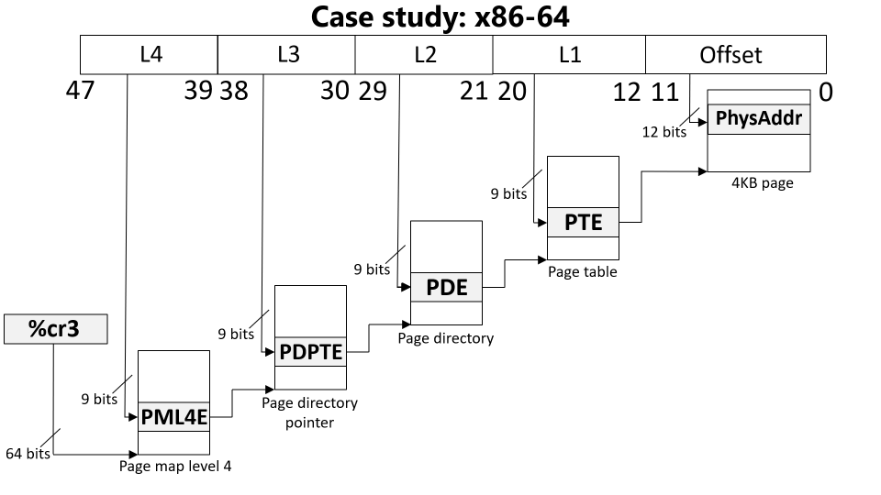
Paging: The Good and the Bad
Good: A virtual address space can be bigger/smaller than physical memory
Bad: A single virtual memory access now requires five physical memory accesses
x86-64 physical memory accesses
Load entry from page map level 4
Load entry from page directory pointer
Load entry from page directory
Load entry from page table
Generate the “real” memory access

Slide 14
Translation Lookaside Buffers (TLBs)
Idea: Cache some PTEs (i.e., virtual page to physical page translations) in a small hardware buffer
If a virtual address has an entry in TLB, the CPU doesn’t need to go to physical memory to fetch a PTE!
If a virtual address misses in TLB, the CPU must walk the page table to fetch a PTE
Key/value store: key is the virtual page number, and the value is the PTE
TLB
TLB
RAM

Slide 15
Translation Lookaside Buffers (TLBs)
Idea: Cache some PTEs (i.e., virtual page to physical page translations) in a small hardware buffer
If a virtual address has an entry in TLB, the CPU doesn’t need to go to physical memory to fetch a PTE!
If a virtual address misses in TLB, the CPU must walk the page table to fetch a PTE
TLBs are effective because programs exhibit locality
Temporal locality
When a process accesses virtual address x, it will likely access x again in the future
Ex: a function’s local variable that lives on the stack
Spatial locality
When the process accesses something at memory location x, the process will likely access other memory locations close to x
Ex: reading elements from an array on the heap
Notes:
Temporal locality means that a TLB entry that has recently been accessed will be accessed again in the near future.
Spatial locality means that, when we access a virtual address x, and we create a TLB entry for the associated page, the TLB entry will likely be useful for other virtual addresses that the program accesses. Remember that a TLB entry covers an entire page of spatially contiguous addresses! For machines that have a lot of physical RAM, you might want a single TLB entry to cover a much larger region than 4 KB. x64 supports this idea using “superpages.” When a process’s page table uses superpages, each PTE and TLB entry covers 2 MB or 1 GB instead of 4 KB. [Lecturer note: For reference on superpages, see Section 4.5 (“IA-32E Paging”) of “Intel® 64 and IA-32 Architectures Software Developer’s Manual Volume 3 (3A, 3B, 3C & 3D): System Programming Guide.”]

Slide 16
The Lifecycle of a Memory Reference on x86
Virtual address
TLB lookup
No
Yes
TLB hit?
HW walks the page table
Check protection bits
No
Yes
Yes
No
Access ok?
Found PTE for virt frame?
HW updates TLB
HW raises a page fault
HW raises a page fault
Calculate phys addr, send to L1/L2/L3/RAM
Notes:
Note that the protection bits state things like “is this page writable?” and “is this page accessible to user-mode processes?”
If there’s a TLB miss, the hardware walks the page table. If the hardware doesn’t find a valid PTE, i.e., if the PTE for the virtual address is not set to “present,” then the hardware raises a fault. Note that a fault could be raised for one of two reasons: the virtual address may reside in an unallocated part of the virtual address space (e.g., in the hole between the stack and the heap). Alternatively, the virtual address may reside in an allocated page of the address space, but that page is not in physical memory (e.g., because it has been swapped to disk).
[References: https://www.ece.umd.edu/~blj/papers/micro18-4.pdf
http://www.scs.stanford.edu/06au-cs240/notes/l7.pdf
http://wiki.osdev.org/Paging
https://en.wikipedia.org/wiki/Control_register#CR2
https://users.ece.cmu.edu/~jhoe/course/ece447/handouts/L21.pdf
https://users.ece.cmu.edu/~jhoe/course/ece447/handouts/L22.pdf]

Slide 17
The Lifecycle of a Memory Reference on x86
Virtual address
Before raising a page fault exception, the CPU sets %cr2 to faulting address, and pushes an error code onto stack
TLB lookup
-Ex: User process tried to read a nnon-present page
-Ex: User process tried to write aa present but read-only page
No
Yes
TLB hit?
HW walks the page table
Check protection bits
No
Yes
Yes
No
Access ok?
Found PTE for virt frame?
HW updates TLB
HW raises a page fault
HW raises a page fault
Calculate phys addr, send to L1/L2/L3/RAM

Slide 18
//WeensyOS's x86-64.h
//Paged memory constants
#define PAGEOFFBITS 12 //# bits in page offset
#define PAGEINDEXBITS 9 //# bits in a page index level
#define PAGESIZE (1UL << PAGEOFFBITS) //Page size
//in bytes
//Page table entry definitions
typedef struct __attribute__((aligned(PAGESIZE))) x86_64_page {
uint8_t x[PAGESIZE];
} x86_64_page;
typedef uint64_t x86_64_pageentry_t;
typedef struct __attribute__((aligned(PAGESIZE))) x86_64_pagetable {
x86_64_pageentry_t entry[1 << PAGEINDEXBITS];
} x86_64_pagetable;
//Permission flags: Define whether page is accessible
#define PTE_P 0x1UL //Entry is Present
#define PTE_W 0x2UL //Entry is Writeable
#define PTE_U 0x4UL //Entry is User-accessible
#define PTE_PWU 0x7UL //PTE_P | PTE_W | PTE_U
#define PTE_XD 0x8000000000000000UL //Entry is
//eXecute Disabled

Slide 19
//WeensyOS's x86-64.h
//Paged memory constants
#define PAGEOFFBITS 12 //# bits in page offset
#define PAGEINDEXBITS 9 //# bits in a page index level
#define PAGESIZE (1UL << PAGEOFFBITS) //Page size
//in bytes
//Page table entry definitions
typedef struct __attribute__((aligned(PAGESIZE))) x86_64_page {
uint8_t x[PAGESIZE];
} x86_64_page;
typedef uint64_t x86_64_pageentry_t;
typedef struct __attribute__((aligned(PAGESIZE))) x86_64_pagetable {
x86_64_pageentry_t entry[1 << PAGEINDEXBITS];
} x86_64_pagetable;
//Permission flags: Define whether page is accessible
#define PTE_P 0x1UL //Entry is Present
#define PTE_W 0x2UL //Entry is Writeable
#define PTE_U 0x4UL //Entry is User-accessible
#define PTE_PWU 0x7UL //PTE_P | PTE_W | PTE_U
#define PTE_XD 0x8000000000000000UL //Entry is
//eXecute Disabled

Slide 20
WeensyOS: Memory-related Constants
//WeensyOS does not support physical memory
//addressing beyond MEMSIZE_PHYSICAL, even
//if RAM is bigger than MEMSIZE_PHYSICAL.
#define MEMSIZE_PHYSICAL 0x200000 //2MB
//WeensyOS does not support virtual addresses
//above MEMSIZE_VIRTUAL, even if the CPU
//natively supports bigger address spaces.
#define MEMSIZE_VIRTUAL 0x300000 //3MB
//Kernel start address
#define KERNEL_START_ADDR 0x40000
//Top of the kernel stack
#define KERNEL_STACK_TOP 0x80000
//First application-accessible address
#define PROC_START_ADDR 0x100000
Stack
Heap
Static data
Code
PROC_START_ADDR
KERNEL_STACK_TOP
Stack
In pset3, you’ll write a kernel heap allocator which manages this memory!
Static data
Code
KERNEL_START_ADDR
Process X’s virtual memory in WeensyOS

Slide 21
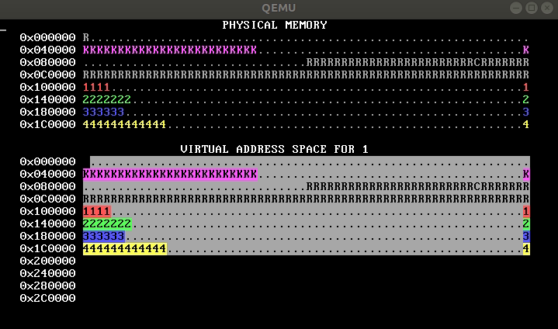
WeensyOS: Page Tables
The WeensyOS handout code uses a single page table (kernel_pagetable) for the kernel and all user-mode processes
The page table uses an identity mapping: each virtual address x maps to the physical address x
The kernel legitimately needs access to all physical memory, but user-mode processes do not!
Thus, in the handout kernel, there is no memory isolation—any process can tamper with any memory belonging to the kernel or another process
// WeensyOS’s kernel.cc
// INITIAL PHYSICAL MEMORY LAYOUT
//
// +-------------- Base Memory --------------+
// v v
// +-----+--------------------+----------------+--------------------+---------/
// | | Kernel Kernel | : I/O | App 1 App 1 | App 2
// | | Code + Data Stack | ... : Memory | Code + Data Stack | Code ...
// +-----+--------------------+----------------+--------------------+---------/
// 0 0x40000 0x80000 0xA0000 0x100000 0x140000
// ^
// | \___ PROC_SIZE ___/
// PROC_START_ADDR
You’ll add memory isolation in pset3!
Notes:
[In the memviewer, `K` represents a kernel page. `R` represents reserved memory that mustn’t be allocated for other uses. An integer like `1` corresponds to memory belonging to a particular user-mode process. A `.` indicates that a particular physical page or virtual page is unmapped. In the virtual memory portion of the memviewer, a reverse-video entry indicates that a process can access the associated page. In the handout code, all of the virtual memory entries in the memviewer are reverse-video because every process uses an identity mapping for address translation, and that mapping puts no restrictions on which of those mappings a process can use to access memory!]

