Slide 1
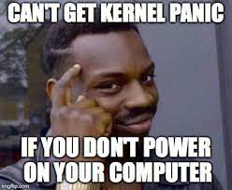
Kernels: Part II
CS 61: Lecture 10 10/16/2023

Slide 2
When Does WeensyOS Code Execute?
There are three ways that WeensyOS code executes
In response to a system call invoked by a user-mode process
In response to an interrupt raised by an external (w.r.t. the CPU) hardware device (e.g., the timer, the keyboard, the network card)
In response to an exception raised by the code (privileged or unprivileged) that is currently running on the CPU
Ex: Trying to access an inaccessible virtual address (e.g., mov $0x0, %rax; mov (%rax), %rbx)
Ex: Dividing by zero (e.g., mov $0x42, %rax; mov $0x0, %rcx; idiv %rcx)
System calls and exceptions are synchronous: they are directly and immediately triggered by something that an instruction did
Interrupts are asynchronous: they can arrive at any moment between the execution of two instructions!
Notes:
[Note that `idiv` is the integer division instruction, as opposed to `fdiv` which divides floating-point number.]
[Aside: In an industrial-strength OS like Windows or macOS, kernel code runs in response to system calls, interrupts, and exceptions. There’s also a fourth way that kernel code executes. An OS may create kernel processes that do not have a user-mode component---in other words, there is no user-mode code, static data, heap, or stack that is associated with the processes. However, such a process is associated with its own kernel-level stack (in addition to the kernel-level code, data, and heap that are shared with all kernel processes). Kernel processes allow an OS to accomplish work that needn’t be tied to any particular user-level process, and which should be restricted to only happening in response to a system call or exception generated by a user-level process. For example, to handle disk IOs, an OS might enqueue IO requests made by user-level processes, and leverage a separate kernel process to prioritize the requests and actually issue them to the storage device. In CS 161, we talk about kernel processes in more depth :-D.]

Slide 3
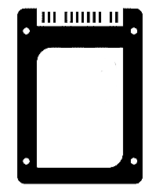
Exceptions and Interrupts: Example
//Code in user-mode process
mov $0x42, %rax
mov $0x0, %rcx
idiv %rcx //OH NO
add %r9, %r10
sub %rdi, %rsi
When the CPU detects an exception or an interrupt, the CPU:
Disables the IF flag in %rflags (preventing maskable interrupts from happening)
If the CPU mode isn’t already “privileged”:
Flips the CPU mode to “privileged”
Changes %rsp to point to the kernel stack
Pushes exception/interrupt-related state onto the stack
Exception: Division by zero!
jmp kernHandler
//Instrs
//in kernel
//exception/
//interrupt
//handler
mov $0x42,
%rax
mov $0x0,
%rcx
idiv %rcx
Flow of time from the perspective of the leftmost CPU
MMU
MMU
MMU
MMU
Hardware
RAM
SSD
UX devices
Network
Notes:
[Ref: Quoth Section 6.8.1 of Volume 3A of the Intel Developer’s Manual, “when an interrupt is handled through an interrupt gate, the IF flag [of %rflags] is cleared, which disables maskable hardware interrupts.” A maskable interrupt is simply one that can be deferred via the clearing of the IF flag. A non-maskable interrupt will fire even if the IF flag is clear.]

Slide 4
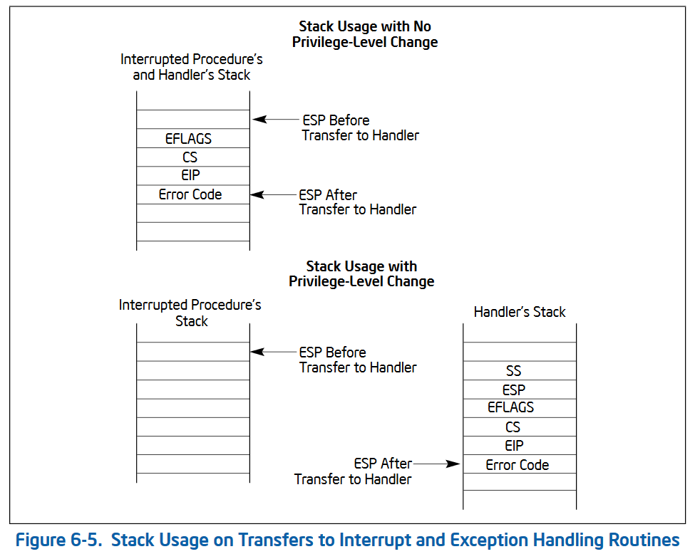
When the CPU detects an exception or an interrupt, the CPU:
Disables the IF flag in %rflags (preventing maskable interrupts from happening)
If the CPU mode isn’t already “privileged”:
Flips the CPU mode to “privileged”
Changes %rsp to point to the kernel stack
Pushes exception/interrupt-related state onto the stack
Jumps to the relevant kernel handler for the exception/interrupt
Non-maskable interrupts are urgent ones that cannot be disabled via the IF flag
Ex: “Machine check” interrupt caused by hardware failure
Ex: Watchdog timer that checks OS health
Not all interrupts and exceptions push an error code (in which case the stack pointer will point to the saved %rip value)
Notes:
For the purposes of this class, the most important things that the hardware pushes on the stack are:
-The %rip of the instruction which caused the exception/had just finished executing when the interrupt occurred, and
-The error code (if any) which provides additional information about the interrupt/exception. For example, a page fault exception pushes an error code which provides information about the problematic memory access (e.g., whether the privilege level was Ring 3 when the fault happened, and whether the page fault was caused by a read or a write attempt).
A “watchdog timer” is one that fires periodically to run code which ensures that the software/hardware state of a computer is still in reasonable shape. For example, mission-critical embedded healthcare devices like a pacemaker might have a watchdog timer which checks whether the device has been generating a pulse at a regular interval and, if not, the timer performs diagnostics or reboots the device.]
[Ref: https://wiki.osdev.org/Exceptions
https://wiki.osdev.org/Non_Maskable_Interrupt
Section 6.4.1 of “Intel 64 and IA-32 Architectures Software Developer’s Manual, Volume 1: Basic Architecture Manual” (https://www.intel.com/content/dam/www/public/us/en/documents/manuals/64-ia-32-architectures-software-developer-vol-1-manual.pdf)]
]

Slide 5
Q: How does the CPU know where the kernel stack is and where the kernel’s exception/
interrupt handler is?
A: The kernel must configure the CPU at boot time!

Slide 6
Exceptions and Interrupts: Set-up
At boot time, the kernel configures the CPU with the system call entry point
void init_cpu_hardware() { //In k-hardware.cc
//...Some stuff, then...
wrmsr(MSR_IA32_LSTAR, reinterpret_cast<uint64_t>(syscall_entry));
//syscall_entry refers to assembly code in weensyos64lab/k-exception.S
//that eventually calls syscall(regstate* reg).
wrmsr(MSR_IA32_FMASK, EFLAGS_IF | /*other flags*/); //Has the effect
//of forcing the syscall instruction to disable interrupts!

Slide 7
Exceptions and Interrupts: Set-up
At boot time, the kernel configures the CPU with the system call entry point
At boot time, the kernel also configures the CPU with the exception entry points and the interrupt entry points
//x86-64.h and kernel.hh: Exception and interrupt numbers
#define INT_DE 0 //Divide error (#DE)
#define INT_DB 1 //Debug (#DB)
#define INT_NM 2 //Non-maskable interrupt (#NM)
#define INT_BP 3 //Breakpoint (#BP)
#define INT_OF 4 //Overflow (#OF)
#define INT_UD 6 //Invalid opcode (#UD)
#define INT_DF 8 //Double fault (#DF)
#define INT_TS 10 //Invalid TSS (#TS)
#define INT_NP 11 //Segment not present (#NP)
#define INT_SS 12 //Stack fault (#SS)
#define INT_GP 13 //General protection (#GP)
#define INT_PF 14 //Page fault (#PF)
#define INT_AC 17 //Alignment check (#AC)
#define INT_MC 18 //Machine check (#MC)
#define INT_IRQ 32 //Base interrupt number
#define IRQ_TIMER 0 //When timer fires, the CPU raises
//interrupt number INT_IRQ + IRQ_TIMER
Triggered by an instruction that divides by zero
Triggered when the CPU jumps to a byte sequence which does not correspond to a valid instruction
Triggered by memory access errors (e.g., trying to write a read-only location, trying to access kernel memory while the CPU is in unprivileged mode)
Triggered when timer fires
Notes:
It’s a bit confusing that WeensyOS code uses the `INT_` prefix (e.g., `INT_DE`) to refer to *exception* types <shakes fist at sky>. However, WeensyOS is just following the terminology that Intel documentation uses—that documentation often refers to “interrupts” generically when, strictly speaking, the documentation is referring to “interrupts and exceptions.”
[To learn more details about what each of these exceptions mean, see https://wiki.osdev.org/Exceptions.]

Slide 8
Exceptions and Interrupts: Set-up
//k-exception.S
//The `exception_handler` macro creates one exception handler.
.altmacro
.macro exception_handler num
exception_entry_\num:
//Push zero error code, unless exception did so already.
.if \num != INT_DF && (\num < INT_TS || \num > INT_PF) && \num != INT_AC
pushq $0
.endif
//Push exception number.
pushq $\num
//Jump to the exception entry point!
jmp _Z15exception_entryv
//Add an entry to the `.interrupt_descriptors[]`
//array in the kernel's static data region.
.pushsection .interrupt_descriptors, "aw", @progbits
.quad exception_entry_\num //Address of handler
.quad 0
.popsection
.endm
//Now create all 256 exception handlers.
.set exception_number, 0
.rept 256
exception_handler %exception_number
.set exception_number, exception_number + 1
.endr
Notes:
[In the .pushsection region, the `@progbits` part means that the section being extended contains data that should go in the static data region of the executable . The `aw` part means that the section is “allocatable” (i.e., the section should be loaded into memory when the binary is launched) and “writable.” A non-allocatable, non-writable section might contain debugging information or other metadata that isn’t strictly needed for a program to execute.
Ref: http://sourceware.org/binutils/docs/as/Section.html
https://users.informatik.haw-hamburg.de/~krabat/FH-Labor/gnupro/5_GNUPro_Utilities/c_Using_LD/ldLinker_scripts.html
//In particular, the section “Basic linker script concepts.”
]

Slide 9
Interrupt number
Interrupt handler code: in virtual memory
16
x
Kernel handler code
Virtual address
+
Other stuff
Virtual address
How the CPU locates the appropriate kernel stack and kernel handler
Interrupt-Descriptor-Table Register (IDTR)
Interrupt Descriptor
Table (IDT): in virtual memory
Task state segment (TSS): in virtual memory
Index
TSS Descriptor
Virtual addr (base of TSS)
Task register (TR)
Other stuff
Other stuff
Virtual address
Interrupt-handler %rsp
Global-Descriptor-Table Register (GDTR)
Global Descriptor Table (GDT): in virtual memory
Notes:
At boot time, the kernel sets the values in the IDTR and the GDTR. Those registers can only be updated by privileged instructions. The kernel also places the IDT and the GDT in kernel memory, such that user-mode processes are unable to access the tables.

Slide 10
//k-exception.S
_Z15exception_entryv:
push %gs
push %fs
pushq %r15
pushq %r14
pushq %r13
pushq %r12
pushq %r11
//...and the other registers,
//then do . . .
movq %rsp, %rdi
//Load the kernel’s page table.
movq $kernel_pagetable, %rax
movq %rax, %cr3
call _Z9exceptionP8regstate
//`exception` should never return!
Notes:
[Note that the kernel has to save and restore all user-mode registers during exception/interrupt entry/return because there can be no calling convention in which user-mode code could save some (or any) registers! Exceptions and interrupts happen asynchronously, at times that the user-mode code cannot predict, so there’s no way that user-level code could save some registers “ahead of” the exception/interrupt.]

Slide 11
//kernel.cc::exception(regs): Simplified code
// Note that hardware interrupts are disabled when
// the kernel is running!
void exception(regstate* regs) {
//Copy the saved registers into the `current` process
//struct.
current->regs = *regs;
regs = &current->regs;
switch (regs->reg_intno) {
case INT_IRQ + IRQ_TIMER:
++ticks;
schedule(); //Pick another process to run.
break; //Will not be reached!
default:
proc_panic(current,
"Unhandled exception %d (rip=%p)!\n",
regs->reg_intno, regs->reg_rip);
}
}
struct proc {
x86_64_pagetable* pagetable; //Page table
pid_t pid; //Process ID
int state; //State
regstate regs; //User-mode registers
};
//Pick the next process to run and run it. If
//there are no runnable processes, spin forever.
void schedule() {
pid_t pid = current->pid;
for (unsigned spins = 1; true; ++spins) {
pid = (pid + 1) % PID_MAX;
if (ptable[pid].state == P_RUNNABLE) {
run(&ptable[pid]);
}
}
}

Slide 12
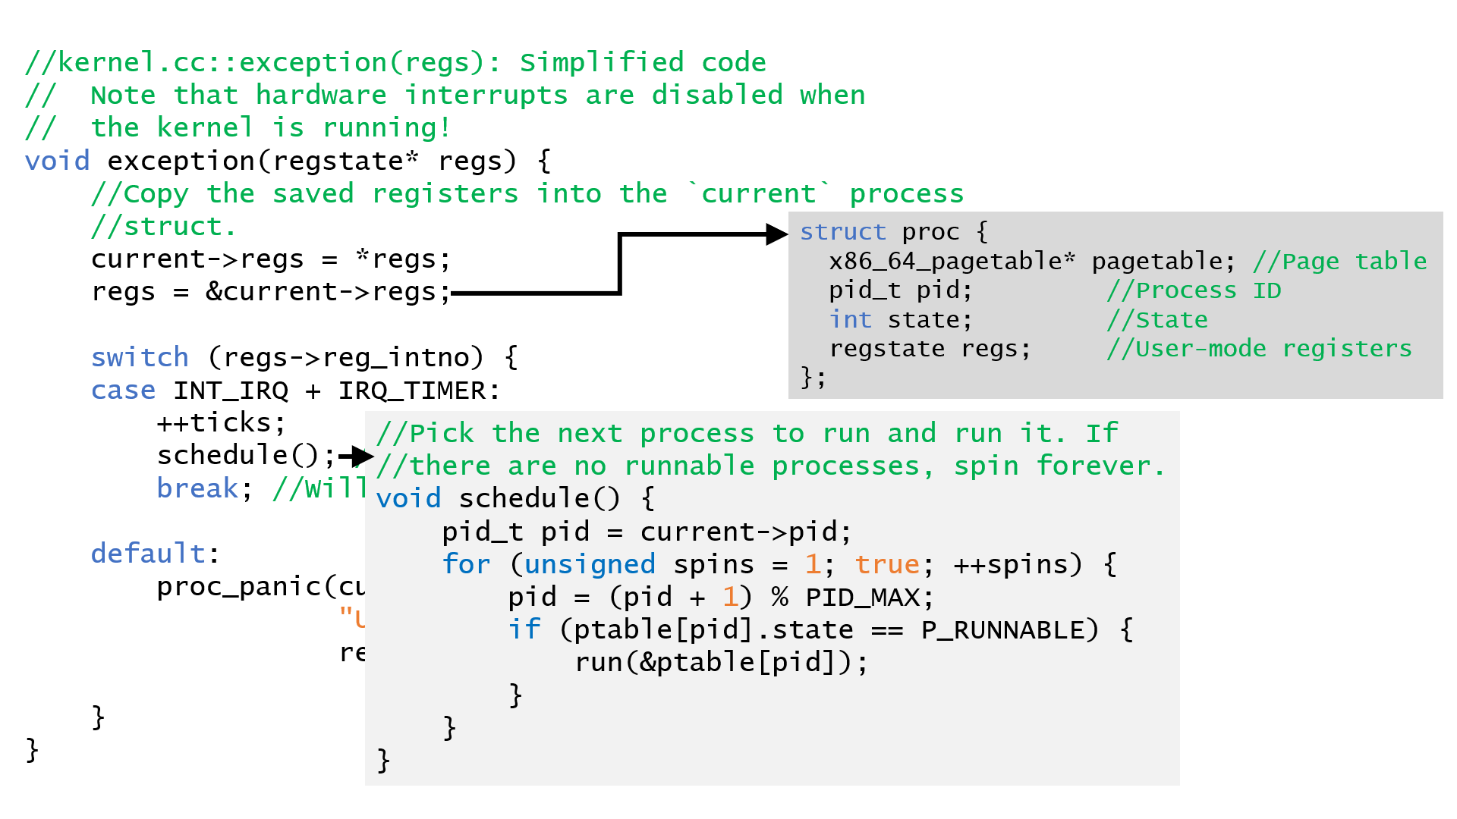
void run(proc* p) {
assert(p->state == P_RUNNABLE);
current = p;
//In k-exception.S, restore the
//process's registers then
//jump back to user mode!
exception_return(p);
//Should never get here!
while (true) {
}
}

Slide 13
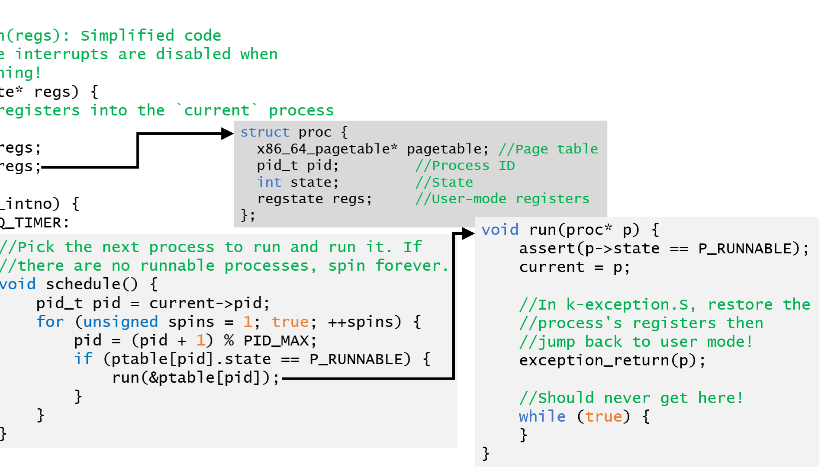
_Z16exception_returnP4proc:
//Load the process's page table.
movq (%rdi), %rax
movq %rax, %cr3
//Restore user-mode registers.
leaq 16(%rdi), %rsp
popq %rax
popq %rcx
popq %rdx
//...pop other registers, then . . .
//Return to user mode!
iretq
KERNEL_STACK_TOP
%ss
iretq pops these saved values into the relevant registers, jumping to the user-mode %rip and restoring the user-mode %rsp before flipping the privilege mode!
%rsp
%rflags
%cs
%rip
%rsp
Notes:
Note that restoring the old %rflags value will reenable interrupts!

Slide 14
WE’RE BACK IN USER-MODE YASSSS

Slide 15
Why Use a Kernel Stack?
In commodity OSes (and WeensyOS!), the kernel uses its own stack to respond to system calls, exceptions, and interrupts
In theory, the kernel could instead employ a user-mode stack, but this would be a bad idea in practice
The kernel must assume that user-level code mismanages registers or memory!
Ex: A bad libc++ might corrupt %rsp before invoking syscall, making %rsp point to nullptr
Ex: Buggy application code might have a buffer overwrite that would stomp over data in a user-mode kernel stack
Using the miracle of page tables and MMUs, kernel memory cannot be accessed by user-level code
Thus, the kernel places its stack, heap, code, and other data in memory that only privileged code can touch
The kernel also validates any arguments passed from user code via system calls (e.g., so the kernel won’t dereference a bad user-supplied pointer)!

Slide 16
Kernels
In general, kernels must assume that user-mode processes are buggy or malicious, such that:
A user-mode process may try to corrupt or abuse the kernel and the hardware
Different user-mode processes may try to corrupt each other
So, kernels must isolate processes from each other, from the kernel, and from hardware devices
User-level code cannot interact with hardware devices directly, but must instead use system calls to allow the kernel to mediate
User-level code must use system calls for process management (e.g., process creation, cross-process messaging)
A user-level process is restricted to accessing its own memory

Slide 17
Why is Memory Isolation Necessary?
The WeensyOS handout code does not isolate kernel memory from user-level code!
Wicked forms of user-level chicanery are therefore possible, e.g.,
The kernel will now loop forever!
0xeb 0xfe encodes the instruction jmp -2(%rip)
The instruction itself is 2 bytes long, so jumping to the location 2 bytes before %rip will be a jump to the jmp -2(%rip) itself!
This is a denial-of-service attack: the CPU can no longer run kernel code or code belonging to another user-mode process
uint8_t* ip = (uint8_t*) 0x40ec1; //Address of WeensyOS’s
//`syscall` handler---see `obj/kernel.sym`.
ip[0] = 0xeb;
ip[1] = 0xfe;
(void) sys_getpid();
Notes:
Recall that %rip refers to the instruction immediately *after* the currently-executing instruction!

Slide 18
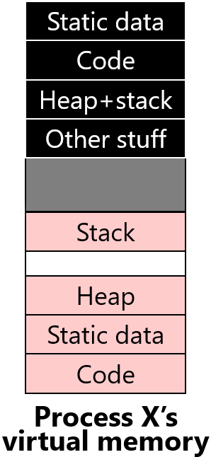
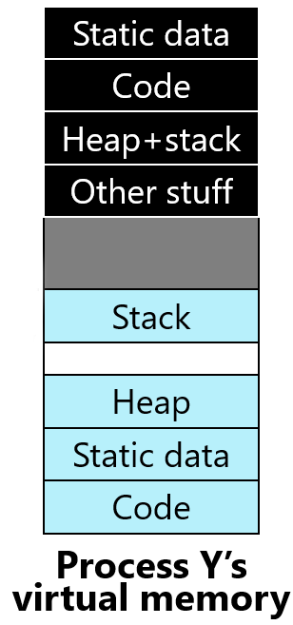
Virtual Memory: Basic Idea
(2^{V})-1
Static data
(2^{V})-1
Static data
Code
Code
Don’t let code (i.e., CPU instructions) access physical memory directly
Instead, use indirection!
CPU instructions manipulate virtual memory addresses in [0, (2^{V})-1]
The kernel defines the mapping between virtual addresses and physical memory addresses in [0, (2^{P})-1]
A CPU’s MMU hardware enforce the kernel-established mapping
Physical memory addresses are what the CPU actually sends to the DRAM hardware
Kernel installs the appropriate virtual-to-physical mapping when context-switching to a particular process
Heap+stack
Heap+stack
Other stuff
Other stuff
Kernel memory
Kernel memory
User memory
Stack
User memory
Stack
Heap
Heap
Static data
Static data
0
Code
0
Code
Process X’s
virtual memory
Process Y’s
virtual memory
(2^{P})-1
0
Physical RAM
Notes:
[Remember that on, commodity OSes, the kernel lives at the top of the virtual address space, but in WeensyOS, the kernel lives at the bottom!]

Slide 19
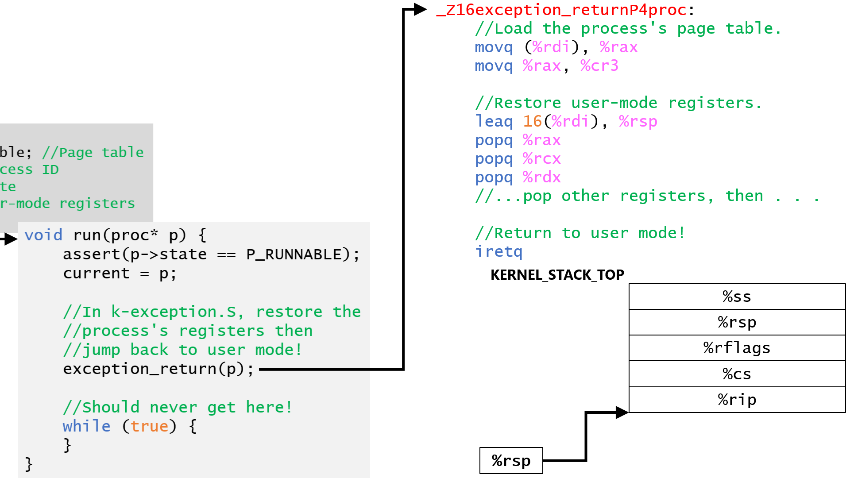
Virtual Memory: Basic Idea
User process X
User process Y
User process Z
Kernel
Don’t let code (i.e., CPU instructions) access physical memory directly
Instead, use indirection!
CPU instructions manipulate virtual memory addresses in [0, (2^{V})-1]
The kernel defines the mapping between virtual addresses and physical memory addresses in [0, (2^{P})-1]
Kernel installs the appropriate virtual-to-physical mapping (the page table) when context-switching to a particular process
A CPU’s MMU hardware enforces the kernel-established mapping
Physical memory addresses are what the CPU actually sends to the DRAM hardware
MMU
MMU
MMU
MMU
Hardware
RAM
SSD
UX devices
Network
Each CPU can potentially be using a different virtual-to-physical mapping!
Notes:
[Aside: An x86-64 CPU initially boots into a restricted mode with no virtual addresses: the initial part of the kernel must configure the CPU to use virtual addressing! If you’re interested in the low-level technical gore of how this is done, see WeensyOS’s bootentry.S. The incantations in bootentry.S won’t be on the midterm LOL.]

