Slide 1
Welcome! CS 61: Lecture 1 9/6/2023
Professor James Mickens
Certified Genius

Slide 2
What is CS 61?
You
Short answer: CS 61 is an experience of religious ecstasy in which you transform into a master software engineer
Longer answer: CS 61 is an introduction to computer systems programming
Ultimate goal: Learn how to build high-performance software that uses hardware efficiently
To achieve that goal, you must understand your tools!
How do CPUs work?
How do compilers work?
How do OSes allow multiple programs to run on the same machine safely and efficiently?
C++
OSes
psets
Not grade grubbing

Slide 3
Schedule
Weeks 1—4: A Glimpse of the Power
Overview: OSes, user-level programs, hardware
C++: Abstractions, toolchains, debugging
Week 5: CPUs
Architecture: CPU design
Programming: Assembly instructions
Weeks 6—7: Kernels
Abstractions: Processes, virtual memory, syscalls
Hardware support: MMUs, interrupts, exceptions
Weeks 8—9: Storage
OS abstractions: File descriptors, syscalls
Optimizations: Caching, prefetching
Weeks 10—11: Processes
Management: fork(), exec(), waitpid()
Communication: File descriptors, signals
Weeks 12—14: Synchronization
Performance: Parallelism
Correctness: Synchronization
User-level process X
User-level process Y
User-level process Z
Operating system
(Kernel-level code)
Hardware
RAM
SSD
UX devices
Network

Slide 4
Schedule
Weeks 1—4: A Glimpse of the Power
Overview: OSes, user-level programs, hardware
C++: Abstractions, toolchains, debugging
Week 5: CPUs
Architecture: CPU design
Programming: Assembly instructions
Weeks 6—7: Kernels
Abstractions: Processes, virtual memory, syscalls
Hardware support: MMUs, interrupts, exceptions
Weeks 8—9: Storage
OS abstractions: File descriptors, syscalls
Optimizations: Caching, prefetching
Weeks 10—11: Processes
Management: fork(), exec(), waitpid()
Communication: File descriptors, signals
Weeks 12—14: Synchronization
Performance: Parallelism
Correctness: Synchronization
The programs that users interact with directly
User-level process X
User-level process Y
User-level process Z
Manages all activity on the computer, e.g.,
Creating, destroying, and scheduling processes
Isolating processes from each other, the OS, and hardware
Sending data to hardware (e.g., updated file content) on behalf of user processes
Receiving data from hardware (e.g., keystrokes) on behalf of user processes
Operating system
(Kernel-level code)
Hardware
Electronic devices that allow programs to interact with the world
RAM
SSD
UX devices
Network

Slide 5
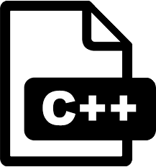
Schedule
Weeks 1—4: A Glimpse of the Power
Overview: OSes, user-level programs, hardware
C++: Abstractions, toolchains, debugging
Week 5: CPUs
Architecture: CPU design
Programming: Assembly instructions
Weeks 6—7: Kernels
Abstractions: Processes, virtual memory, syscalls
Hardware support: MMUs, interrupts, exceptions
Weeks 8—9: Storage
OS abstractions: File descriptors, syscalls
Optimizations: Caching, prefetching
Weeks 10—11: Processes
Management: fork(), exec(), waitpid()
Communication: File descriptors, signals
Weeks 12—14: Synchronization
Performance: Parallelism
Correctness: Synchronization
//Pseudocode to sort an array
//of length n.
bubblesort(arr, n):
for(i=0; i<(n-1); i++):
for(j=0; j<(n-i-1); j++):
if(arr[j] > arr[j+1]):
tmp = arr[j];
arr[j] = arr[j+1];
arr[j+1] = tmp;
User-level process X
User-level process Y
User-level process Z
User-level process Q
(4) Run the program!
> bsort in.txt
Operating system
(Kernel-level code)
(1) Design the program
.cc
Hardware
(2) Translate design to code
.hh
(3) Compile the program
RAM
SSD
UX devices
Network
Notes:
[Here’s an interesting article about abstract machines:
https://mortoray.com/abstract-machines-interpreters-and-compilers/
]

Slide 6
//.cc code for bubblesort
void bubblesort(int arr[], size_t n){
for(int i=0; i<(n-1); i++){
for(int j=0; j<(n-i-1); j++){
if(arr[j] > arr[j+1]){
int tmp = arr[j];
arr[j] = arr[j+1];
arr[j+1] = tmp;
}
}
}
}
How big is an int? And how is a value represented?
Where do bubblesort, arr, n, i, and j “live” in process Q?
What is the layout for arrays?
A single bit
?
01100011
?
0
User-level process Q
1
2
3
4
1
2
3
-2
-1
1
2
8 bits = 1 byte
?
arr
arr
arr
?

Slide 7
Logically speaking, a C++ program runs on an abstract machine that is defined by the C++ standard document
Defines a finite set of data types (e.g., signed char, unsigned int, bool, float) plus rules for aggregating those types (e.g., struct, union, class)
Provides operations for data manipulation (e.g., +,-,<<,[]) and control flow (e.g., if-else, for)
Defines a storage model for variables (e.g., stack variables vs. heap variables vs. global variables)
Practically speaking, a C++ program runs on real hardware (e.g., an x86 CPU or ARM CPU) with the compiler translating the program’s operations on the abstract machine to operations on a real CPU
The standard allows some aspects of the abstract machine to be implementation-defined, e.g., the number of bytes in an int can vary by CPU
The standard also explains that a non-well-formed program may issue operations to the abstract machine that cause undefined behavior, e.g., accessing the sixth element of a three-element array
; among other things, the abstract machine . . .
Notes:
[Ref: https://en.cppreference.com/w/cpp/language/ub
https://mortoray.com/abstract-machines-interpreters-and-compilers/
]

Slide 8
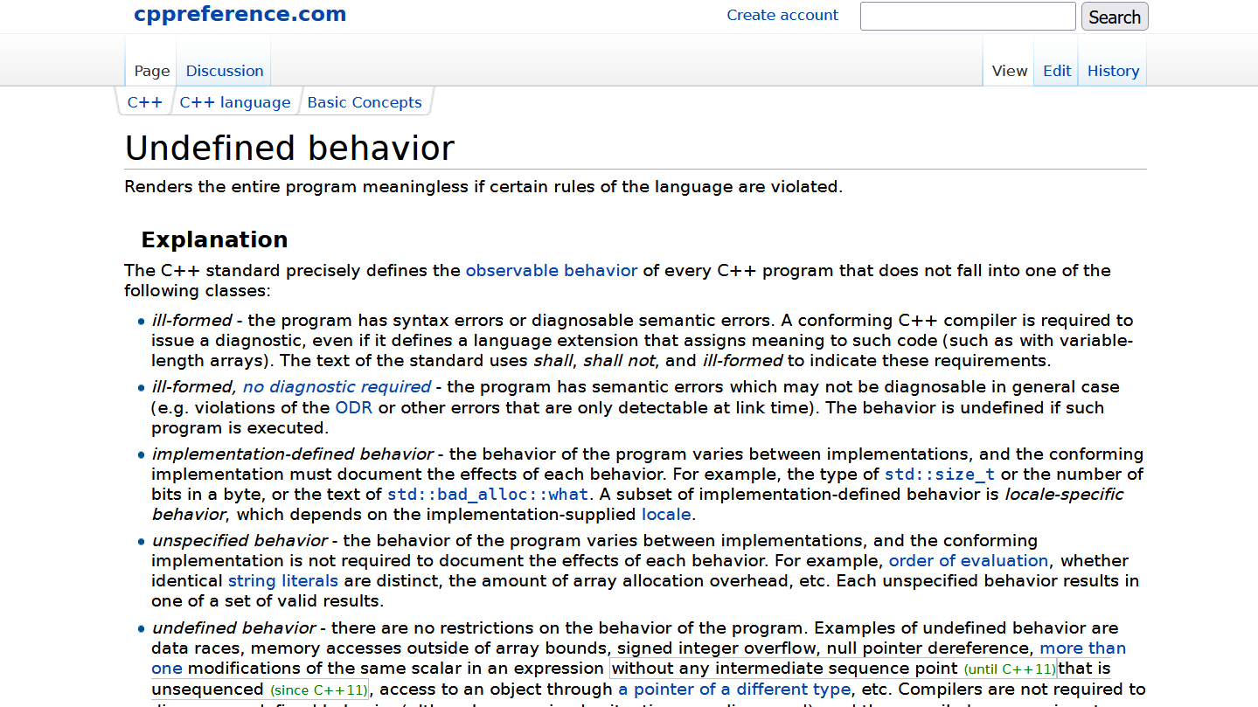
Notes:
THIS WILL HAPPEN TO YOU.

Slide 9
Schedule
Weeks 1—4: A Glimpse of the Power
Overview: OSes, user-level programs, hardware
C++: Abstractions, toolchains, debugging
Week 5: CPUs
Architecture: CPU design
Programming: Assembly instructions
Weeks 6—7: Kernels
Abstractions: Processes, virtual memory, syscalls
Hardware support: MMUs, interrupts, exceptions
Weeks 8—9: Storage
OS abstractions: File descriptors, syscalls
Optimizations: Caching, prefetching
Weeks 10—11: Processes
Management: fork(), exec(), waitpid()
Communication: File descriptors, signals
Weeks 12—14: Synchronization
Performance: Parallelism
Correctness: Synchronization
A (simplified!) view of an x86 CPU and RAM
Suppose that a program contains the instruction add %rax, %rbx
This is an arithmetic instruction—we’re performing math upon two values
The semantics are “sum the values in %rax and %rbx, storing the result in %rbx”
The instruction decode hardware sees that:
ALU op = “add”
ALU argument 1 = %rax
ALU argument 2 = %rbx
ALU output = %rbx
Registers
%rax
%rbx
%rcx
%rdx
CPU
ALU
Instruction
decode
ALU op
ALU output

Slide 10
Schedule
Weeks 1—4: A Glimpse of the Power
Overview: OSes, user-level programs, hardware
C++: Abstractions, toolchains, debugging
Week 5: CPUs
Architecture: CPU design
Programming: Assembly instructions
Weeks 6—7: Kernels
Abstractions: Processes, virtual memory, syscalls
Hardware support: MMUs, interrupts, exceptions
Weeks 8—9: Storage
OS abstractions: File descriptors, syscalls
Optimizations: Caching, prefetching
Weeks 10—11: Processes
Management: fork(), exec(), waitpid()
Communication: File descriptors, signals
Weeks 12—14: Synchronization
Performance: Parallelism
Correctness: Synchronization
A (simplified!) view of an x86 CPU and RAM
Suppose that a program contains the instruction mov %rax, %rcx
This is an data movement instruction—we’re copying a value from a source to a destination
The semantics are “copy the value in %rax to %rcx”
The instruction decode hardware sees that:
ALU op = “none”
ALU argument 1 = %rax
ALU argument 2 = N/A
ALU output = %rcx
Registers
%rax
%rbx
%rcx
%rdx
CPU
ALU
Instruction
decode
ALU op
ALU output

Slide 11
Schedule
Weeks 1—4: A Glimpse of the Power
Overview: OSes, user-level programs, hardware
C++: Abstractions, toolchains, debugging
Week 5: CPUs
Architecture: CPU design
Programming: Assembly instructions
Weeks 6—7: Kernels
Abstractions: Processes, virtual memory, syscalls
Hardware support: MMUs, interrupts, exceptions
Weeks 8—9: Storage
OS abstractions: File descriptors, syscalls
Optimizations: Caching, prefetching
Weeks 10—11: Processes
Management: fork(), exec(), waitpid()
Communication: File descriptors, signals
Weeks 12—14: Synchronization
Performance: Parallelism
Correctness: Synchronization
Registers cannot store a lot of data!
A CPU only has a handful (~8—32) registers
Each register is small (e.g., 8 bytes)
RAM can store gigabytes or even terabytes of data!
However, arithmetic instructions often require at least one operand to be a register
IO devices can only read and write memory, not registers
So, a program often needs to move values between registers and RAM
A (simplified!) view of an x86 CPU and RAM
RAM
Byte N-1
Registers
%rax
%rbx
. . .
%rcx
%rdx
CPU
RAM controller
ALU
Instruction
decode
ALU op
ALU output
Byte 0
RAM controller command
Notes:
[An x86-64 CPU has 16 general-purpose registers. A 64-bit ARM chip has 31 general-purpose registers. A RISC-V chip (32-bit, 64-bit, or 128-bit) has 32 general-purpose registers. Note that the “-bit” part refers to how big a register is. For example, in a 64-bit chip, each register is 64 bits wide.]

Slide 12
Schedule
Weeks 1—4: A Glimpse of the Power
Overview: OSes, user-level programs, hardware
C++: Abstractions, toolchains, debugging
Week 5: CPUs
Architecture: CPU design
Programming: Assembly instructions
Weeks 6—7: Kernels
Abstractions: Processes, virtual memory, syscalls
Hardware support: MMUs, interrupts, exceptions
Weeks 8—9: Storage
OS abstractions: File descriptors, syscalls
Optimizations: Caching, prefetching
Weeks 10—11: Processes
Management: fork(), exec(), waitpid()
Communication: File descriptors, signals
Weeks 12—14: Synchronization
Performance: Parallelism
Correctness: Synchronization
A (simplified!) view of an x86 CPU and RAM
RAM
Suppose that a program contains the instruction mov %rax, 0x2(%rbx)
This is an data movement instruction—we’re copying a value from a source to a destination
The (simplified) semantics are “copy the value in %rax to the RAM location 0x2 + %rbx”
The instruction decode hardware sees that:
ALU op = “add”
ALU argument 1 = 0x2
ALU argument 2 = %rbx
ALU output = RAM controller
The RAM controller also reads %rax (so that the value can be written to memory!)
Byte N-1
Registers
%rax
%rbx
. . .
%rcx
%rdx
CPU
RAM controller
ALU
Instruction
decode
ALU op
ALU output
Byte 0
RAM controller command
Notes:
[The semantics for the mov instruction have been simplified because we’re ignoring the distinction between virtual and physical memory! This distinction will be explained in future lectures :-D. Another simplification is that the diagram implies that %rax is a single byte large, and the memory location that is written is a single byte large. In practice, x86-64 registers are 8 bytes large, although instructions can access a register using smaller “prefixes.” For example %eax represents the first 4 bytes of %rax; %ax represents the first 2 bytes, and %al represents the first byte; see the “Register” section of https://web.stanford.edu/class/cs107/guide/x86-64.html.]

Slide 14
Each process has its own private memory state (e.g., to hold C++ variables and code)
User-level process X
User-level process Y
User-level process Z
Q: Why can’t Process X steal data from Process Y’s variables, or overwrite variables in Process Y?
A: The kernel implements virtual memory protection for each process!
Operating system
(Kernel-level code)
MMU
MMU
MMU
MMU
Hardware
Hardware that is configured by the kernel and automatically checks whether a process’s memory accesses are valid!
RAM
SSD
UX devices
Network

Slide 15
User-level process X
User-level process Y
User-level process Z
Q: Why can’t Process X directly interact with IO devices and do naughty things like fill up the storage device with junk?
A: The kernel forces a process to interact with IO devices via the kernel itself, using system calls!
Operating system
(Kernel-level code)
MMU
MMU
MMU
MMU
Hardware
RAM
SSD
UX devices
Network

Slide 16
User-level process X
User-level process Y
User-level process Z
System calls are the way that user-level processes interact with the kernel (and thus the outside world!)
Modern kernels define hundreds of system calls
IO: open(), read(), write()
Process management: fork(), exec(), waitpid()
. . . and many more!
Operating system
(Kernel-level code)
MMU
MMU
MMU
MMU
Hardware
RAM
SSD
UX devices
Network

Slide 17
User-level process X
User-level process Y
User-level process Z
Q: Why can’t Process X just run forever and prevent other processes from using a CPU?
A: The CPU periodically generates a timer interrupt that vectors control back to the kernel!
Operating system
(Kernel-level code)
MMU
MMU
MMU
MMU
Hardware
RAM
SSD
UX devices
Network

Slide 18
At any given time, only one thing (the kernel or a user-level process) executes on a CPU!
(1) A user-level process executes and then invokes a system call, giving up the CPU so that the kernel can run.
(1)
syscall
Flow of time from the perspective of the leftmost CPU
Q: Why can’t Process X just run forever and prevent other processes from using a CPU?
A: The CPU periodically generates a timer interrupt that vectors control back to the kernel!
MMU
MMU
MMU
MMU
Hardware
RAM
SSD
UX devices
Network

Slide 19
At any given time, only one thing (the kernel or a user-level process) executes on a CPU!
(2) The kernel does some work to handle the system call, and decides to run a different user-level process on the CPU.
(1)
(2)
syscall
schedule
Flow of time from the perspective of the leftmost CPU
Q: Why can’t Process X just run forever and prevent other processes from using a CPU?
A: The CPU periodically generates a timer interrupt that vectors control back to the kernel!
MMU
MMU
MMU
MMU
Hardware
RAM
SSD
UX devices
Network

Slide 20
At any given time, only one thing (the kernel or a user-level process) executes on a CPU!
(3) The user-level process has an infinite loop! The hardware timer eventually fires and puts the kernel on the CPU.
(1)
timer interrupt
(2)
(3)
syscall
schedule
Flow of time from the perspective of the leftmost CPU
Q: Why can’t Process X just run forever and prevent other processes from using a CPU?
A: The CPU periodically generates a timer interrupt that vectors control back to the kernel!
MMU
MMU
MMU
MMU
Hardware
RAM
SSD
UX devices
Network

Slide 21
At any given time, only one thing (the kernel or a user-level process) executes on a CPU!
(4) The kernel makes a scheduling decision to run another user-level process.
(1)
timer interrupt
(2)
(3)
(4)
syscall
schedule
schedule
Flow of time from the perspective of the leftmost CPU
Q: Why can’t Process X just run forever and prevent other processes from using a CPU?
A: The CPU periodically generates a timer interrupt that vectors control back to the kernel!
MMU
MMU
MMU
MMU
Hardware
RAM
SSD
UX devices
Network

Slide 22
Schedule
Weeks 1—4: A Glimpse of the Power
Overview: OSes, user-level programs, hardware
C++: Abstractions, toolchains, debugging
Week 5: CPUs
Architecture: CPU design
Programming: Assembly instructions
Weeks 6—7: Kernels
Abstractions: Processes, virtual memory, syscalls
Hardware support: MMUs, interrupts, exceptions
Weeks 8—9: Storage
OS abstractions: File descriptors, syscalls
Optimizations: Caching, prefetching
Weeks 10—11: Processes
Management: fork(), exec(), waitpid()
Communication: File descriptors, signals
Weeks 12—14: Synchronization
Performance: Parallelism
Correctness: Synchronization
User-level process X
User-level process Y
User-level process Z
Operating system
(Kernel-level code)
MMU
MMU
MMU
MMU
Hardware
RAM
SSD
UX devices
Network

Slide 23
Schedule
Weeks 1—4: A Glimpse of the Power
Overview: OSes, user-level programs, hardware
C++: Abstractions, toolchains, debugging
Week 5: CPUs
Architecture: CPU design
Programming: Assembly instructions
Weeks 6—7: Kernels
Abstractions: Processes, virtual memory, syscalls
Hardware support: MMUs, interrupts, exceptions
Weeks 8—9: Storage
OS abstractions: File descriptors, syscalls
Optimizations: Caching, prefetching
Weeks 10—11: Processes
Management: fork(), exec(), waitpid()
Communication: File descriptors, signals
Weeks 12—14: Synchronization
Performance: Parallelism
Correctness: Synchronization
Q: Why is this relevant if I don’t want to be systems hacker when I grow up?
A: LIFE WILL OFTEN FORCE YOU TO BE A SYSTEMS HACKER.
BE PREPARED
Notes:
[Nobody ever thinks that zombies will show up, but when the zombies show up, you’ll wish that you had a plan.]

Slide 24
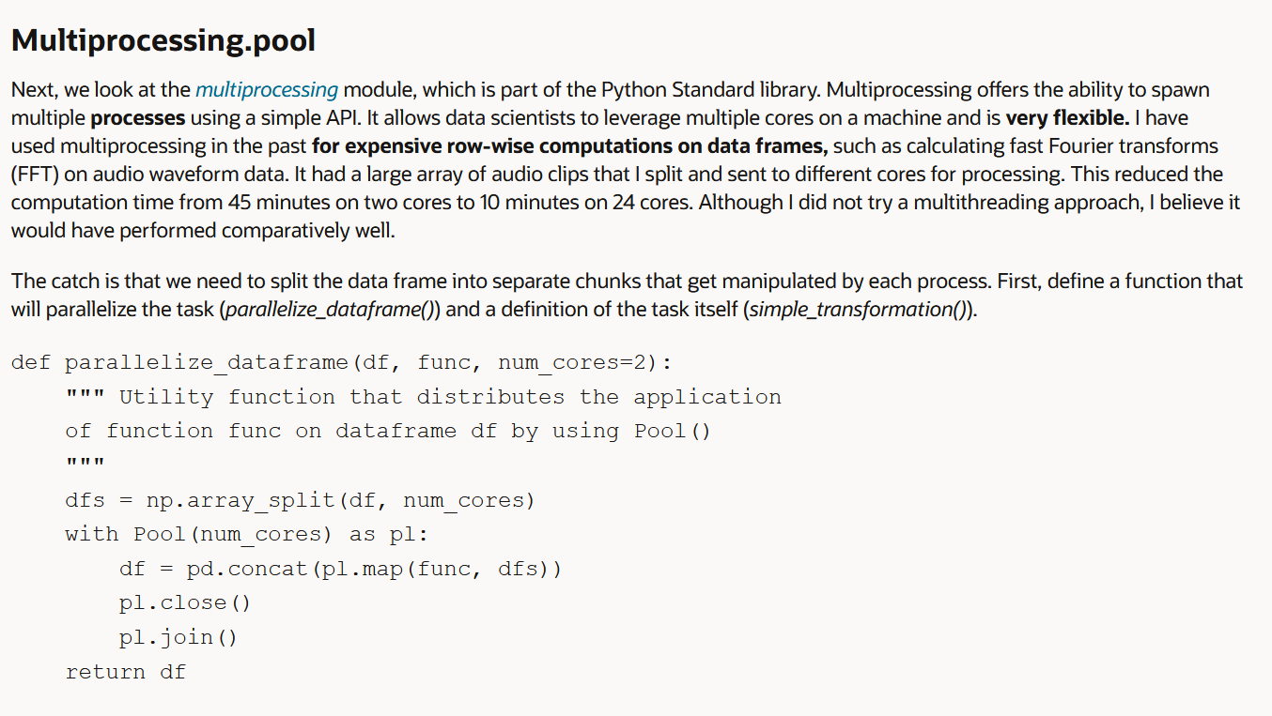
Notes:
[Ref: https://blogs.oracle.com/ai-and-datascience/post/a-simple-guide-to-leveraging-parallelization-for-machine-learning-tasks]

Slide 25
Notes:
[Quoth the Wikipedia, “Logic Pro is a proprietary digital audio workstation and MIDI sequencer software application for the macOS platform developed by Apple Inc.” See https://en.wikipedia.org/wiki/Logic_Pro. The documentation in the screenshot above is taken from https://support.apple.com/en-us/HT203930.]

Slide 26
Grades
Final numerical grades are assigned using the following breakdown:
50%: Psets
15%: Midterm
20%: Final
15%: Participation (lecture, section, office hours, Ed)
Final letter grades use letter bands
Each band is at least 10 points wide and will be defined by gaps in the distribution of numerical grades
CS 61 uses the mastery criterion to determine where letter bands start and end
A, A-: Work of superior quality and demonstrating a full mastery of the subject
B+, B, B-: Work of strong comprehension and full student engagement
C+, C, C-: Work indicating an adequate comprehension and basic student engagement
What is the best way to do well in the class?
Attend lectures and sections
Read posts and write posts on Ed
Do not fall behind on psets or conceptual material from lectures!
A/A- cutoff
Cannot be the A-/B+ cutoff: each band must be at least 10 points wide!
A-/B+ cutoff
Notes:
[Reference for mastery standards: https://extension.harvard.edu/registration-admissions/for-students/student-policies-conduct/grades/]

Slide 27
Attendance
Attending lecture and section is mandatory
IT IS IN YOUR BEST INTEREST TO ATTEND LECTURE AND SECTION
Important concepts are taught at lecture and section
I know this because I teach the lectures and supervise the TFs and create the exams and psets

Slide 28
Policy for Questions During Lecture
In general, my lectures are perfectly clear and delivered in a way that transfers my genius directly into your brain
However, if you have a question, raise your hand!
I will answer as many questions as possible during lecture itself
However, for time reasons, I may postpone some questions until after class
Ed and office hours are valuable resources too!
Deep insights
Professor Mickens
You

Slide 29
DO NOT MANSPLAIN

Slide 30
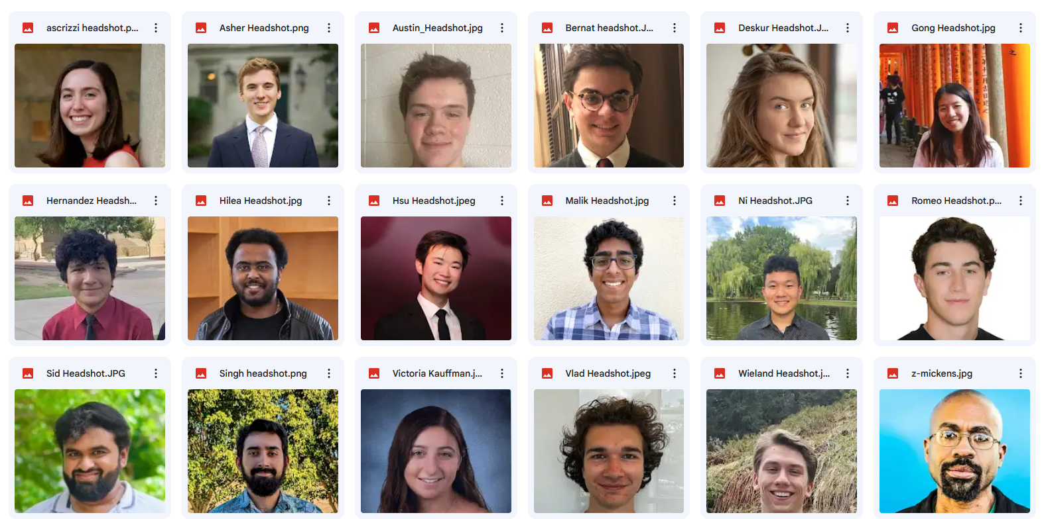
Course Staff

